Slide 1
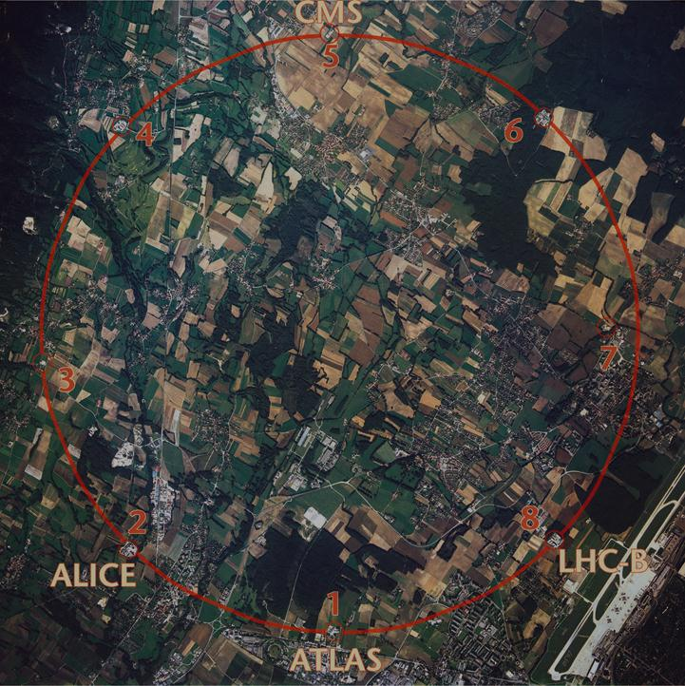
The Future of Highest-Energy Accelerators
Frank Zimmermann
CERN, Geneva, Switzerland
thanks to Y. Cai, A. Bogacz, O. Brüning,
D. Douglas, W. Fischer, M. Furman, Z. Huang, T. Roser, W. Scandale, V. Shiltsev, R. Tomas
Work supported by the European Commission under the FP7 Research Infrastructures project EuCARD, grant agreement no.~227579

Slide 2
Higgs boson
spin=0
The most important tool in this story was the particle accelerator!
A. Caldwell, March 2012

Slide 3
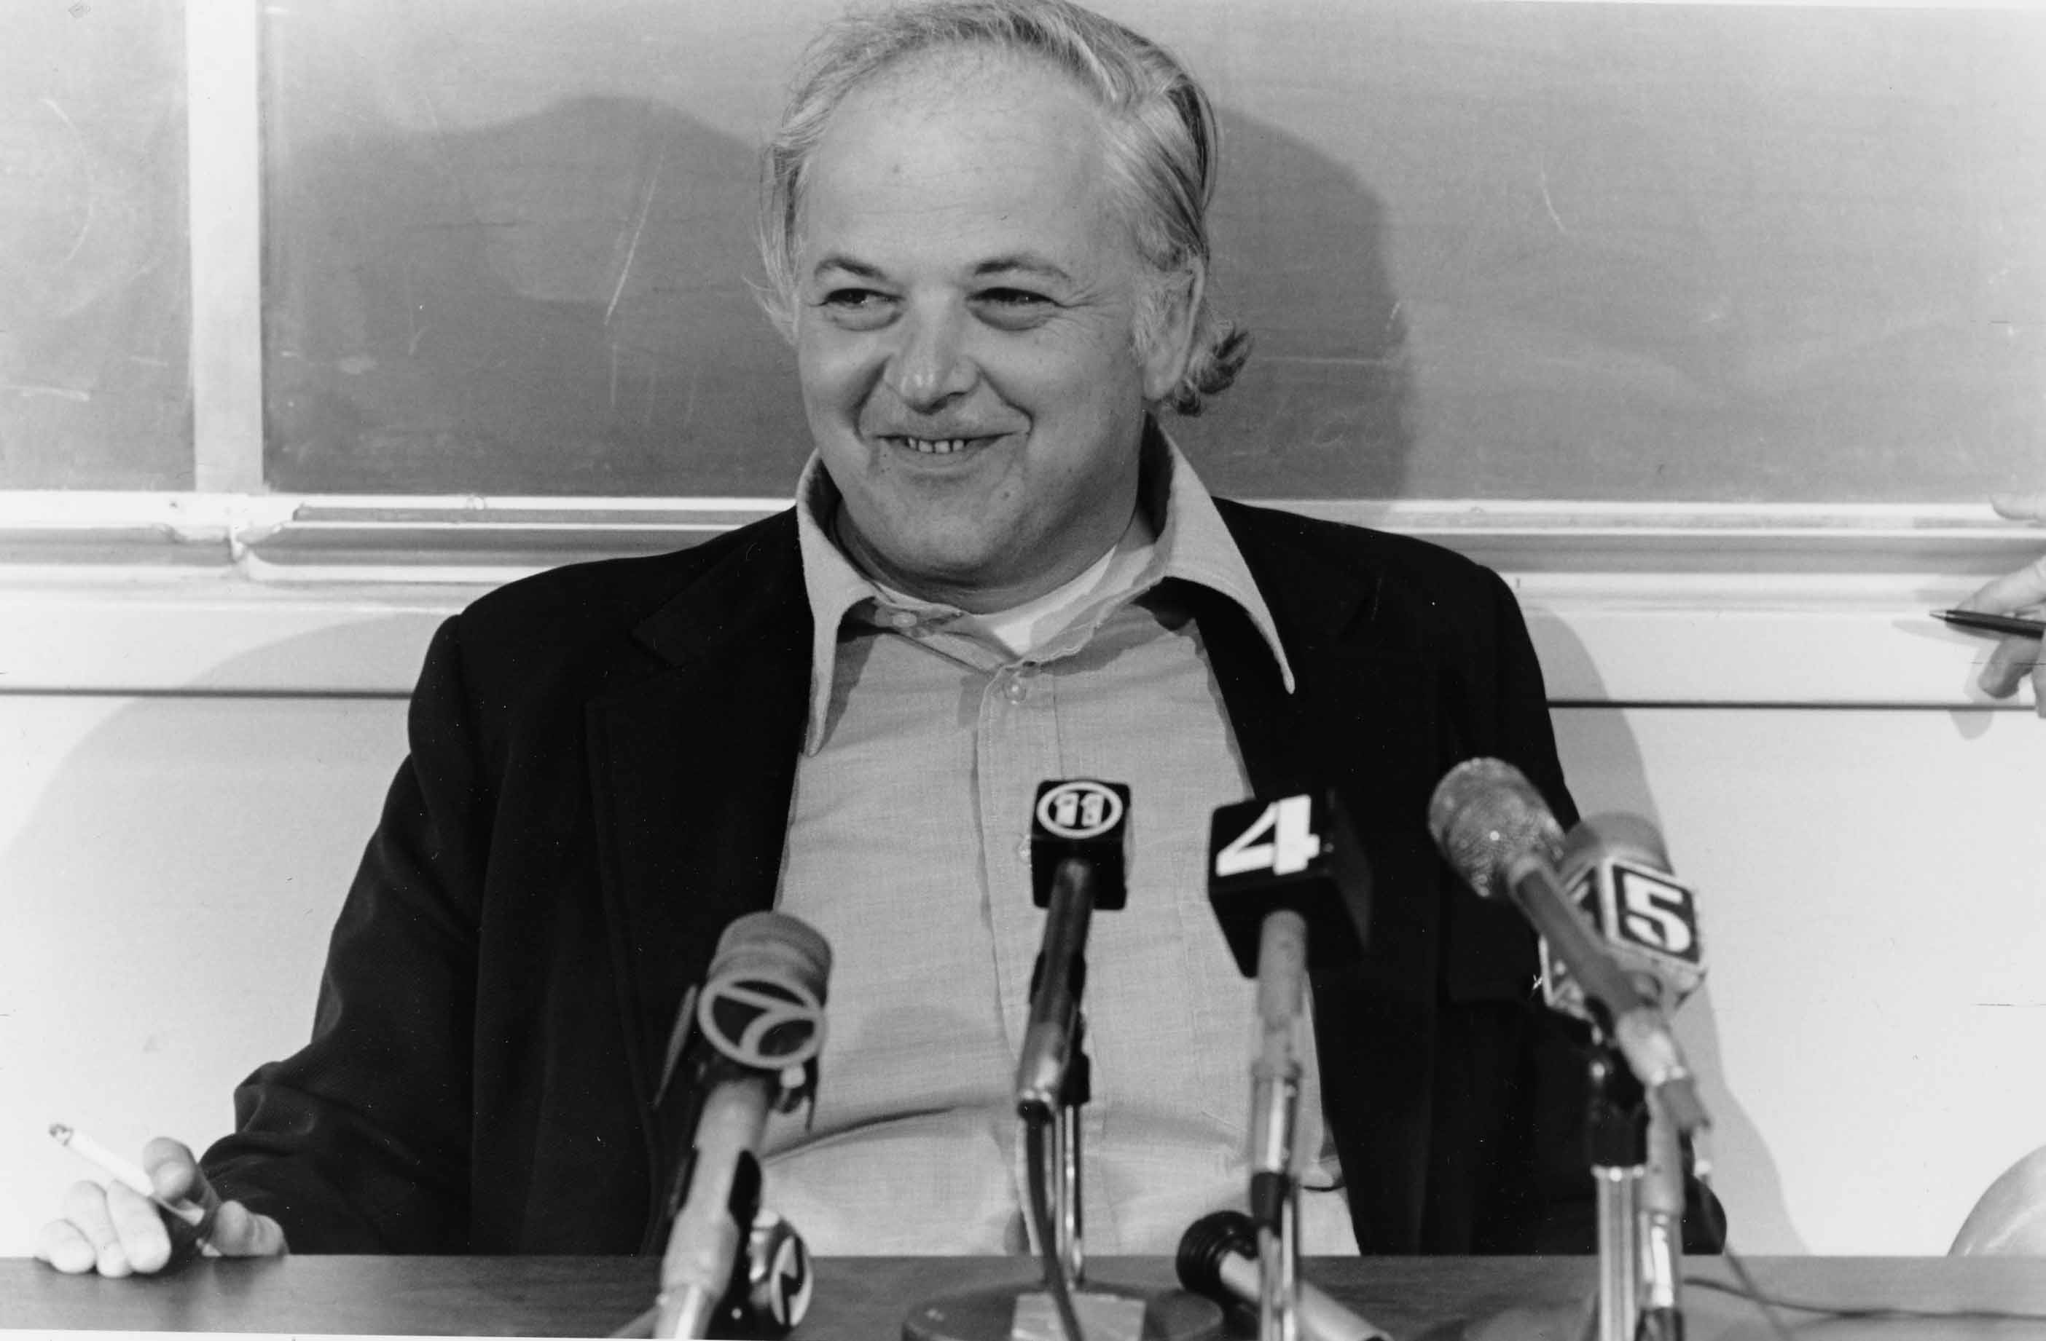
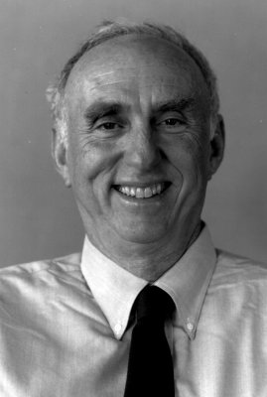
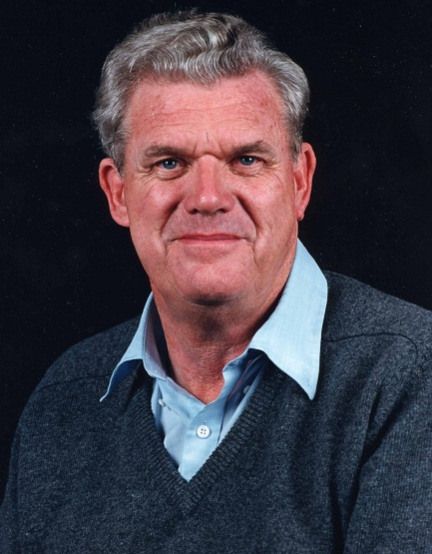
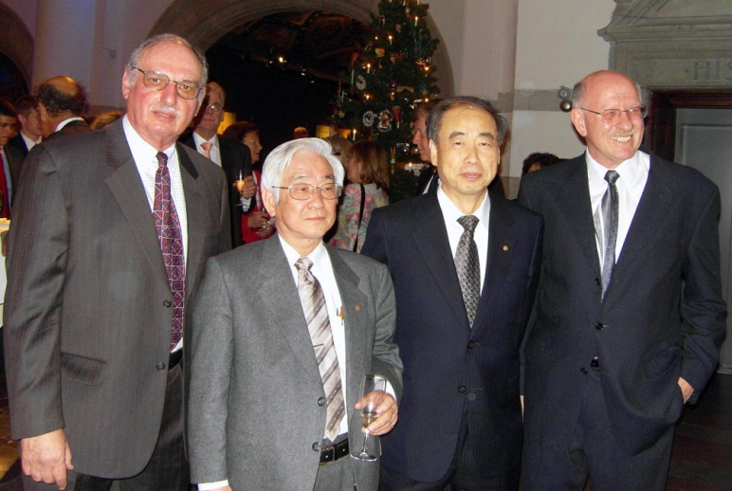
28 Nobel Prizes for particle physics
include several for accelerator-
based experiments performed at SLAC

Slide 4
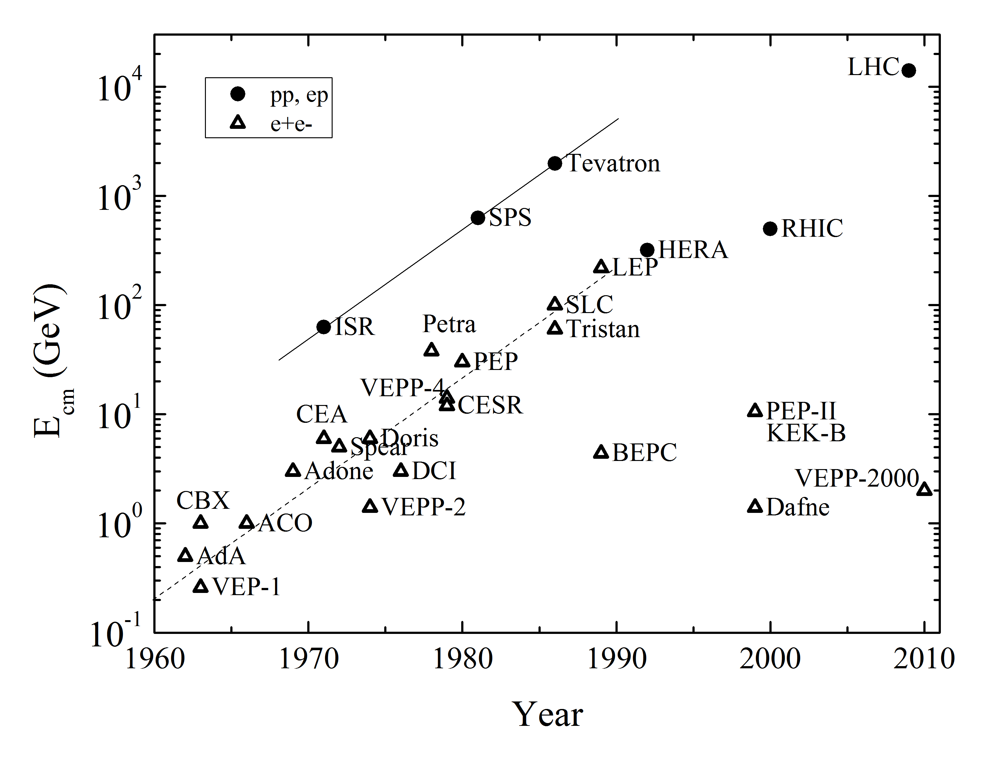
particle colliders over the decades
V. Shiltsev,
Physics-Uspekhi, 2012

Slide 5
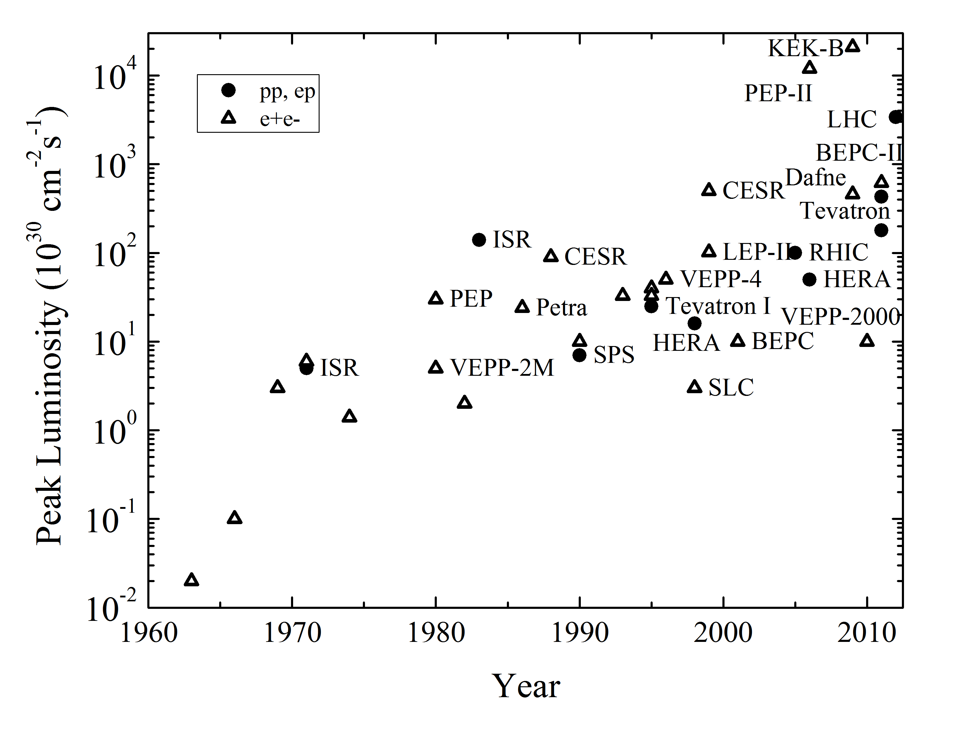
peak luminosities of particle colliders
L= (event rate) / (cross section)
V. Shiltsev,
Physics-Uspekhi, 2012

Slide 6
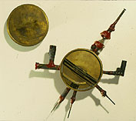
1st cyclotron by
Ernest O. Lawrence
& Stanley Livingston
~1930
diameter 4.5 inches
(~11 cm)
final proton energy
1.1 MeV
Table-top cyclotron.
“Dr Livingston has asked me to advise you that he has obtained 1,100,000 volt protons. He also suggested that I add ‘Whoopee’!”
—Telegram to Lawrence, 3 August 1931

Slide 7
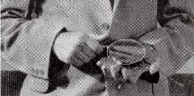
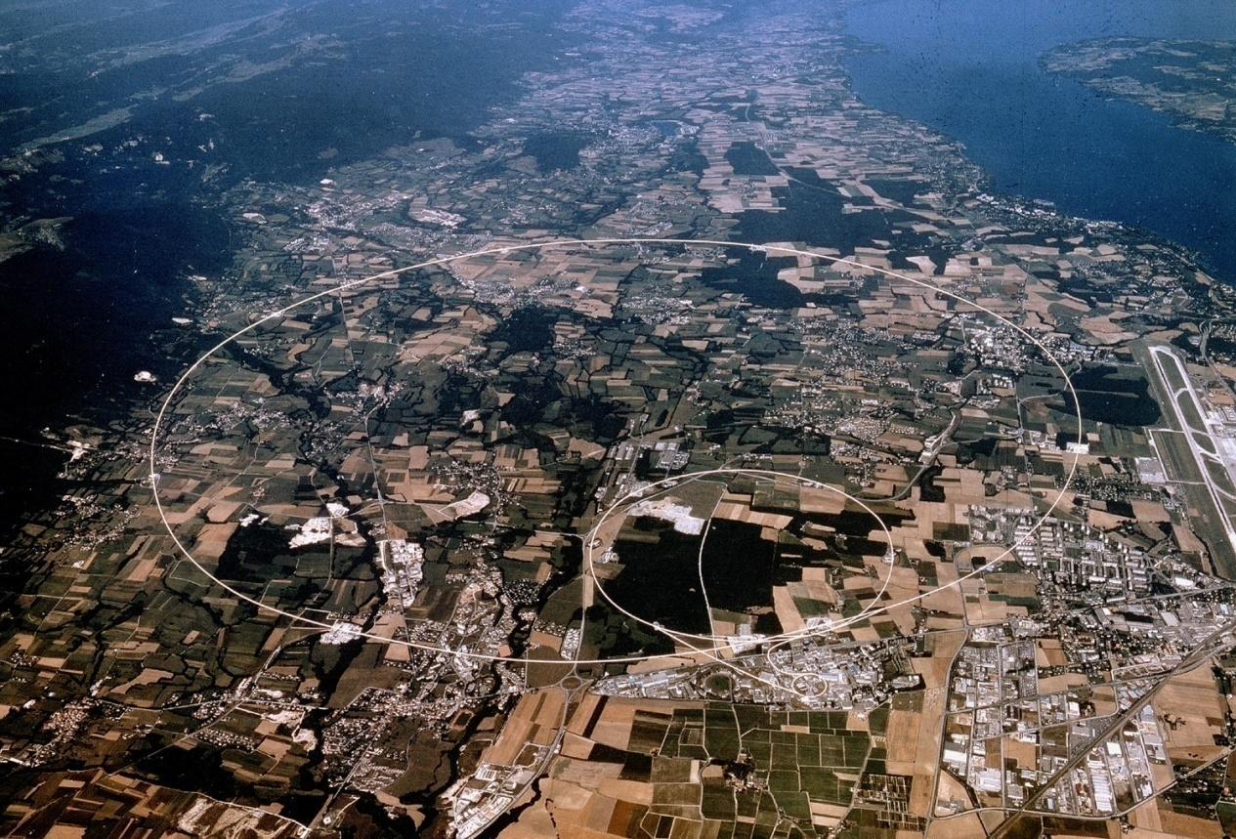
1st cyclotron, ~1930
E.O. Lawrence
11-cm diameter
1.1 MeV protons
Large Hadron
Collider (LHC), 2008,
9-km diameter
7 TeV protons
after ~80 years
~10⁷ x more energy
~10⁵ x larger

Slide 8
hadron colliders
“discovery machines” (hadrons: composite particles)
W and Z bosons, top quark, Higgs boson
next: supersymmetry, dark matter, extra dimensions, dark energy,…?
maximum energy
E_{max}≈ e c B ρ
bending radius
LHC: ρ≈3 km
magnetic field
LHC: superconduncting magnets (Nb-Ti) with B≈8.33 T

Slide 9
higher-energy hadron colliders
stronger magnetic fields:
Nb-Ti (~8 T) → Nb₃Sn (~15 T) → HTS (~20 T)
factor 2.5 in beam energy (“HE-LHC”)
larger circumference:
27 km (LHC) → 80 km (“VHE-LHC”?)
another factor 3 in beam energy
combined: an order of magnitude in energy

Slide 10
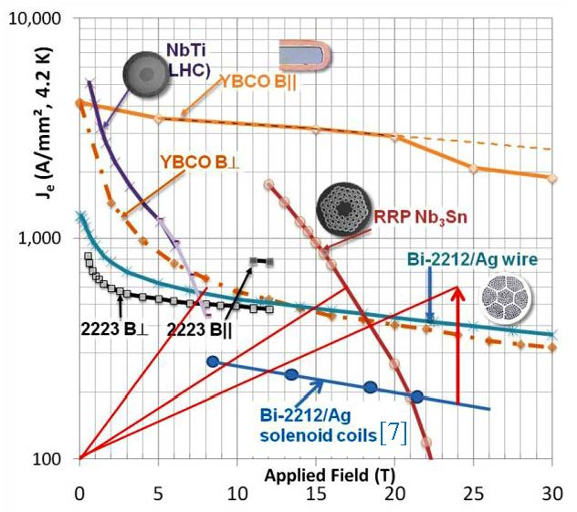
pushing SC magnet technology
Nb-Ti ~8 T
(LHC, 2005)
→
Nb₃Sn ~15-17 T
(HL-LHC, 2022)
→
Bi-2212 ~20-24 T?
(HE-LHC, 2030)
Bi-2212: only round-wire superconductor at fields > 18 T
P. McIntyre et al, Proc. EuCARD-AccNet workshop HE-LHC10, Malta, Oct. 2010, Yellow Report CERN-2011-003
P. Lee, Compilation of current je data, http://www.magnet.fsu.edu/magnettechnology/research/asc/plots.html

Slide 11
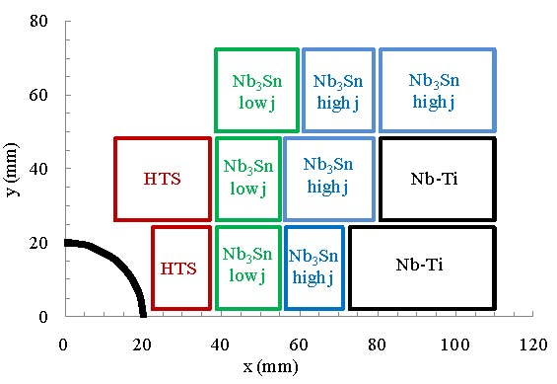
HE-LHC 20-T hybrid magnet
E. Todesco,
L. Rossi,
P. McIntyre
Block layout of Nb-Ti & Nb₃Sn & HTS (Bi-2212) 20-T dipole-magnet coil. Only one quarter of one aperture is shown.
A lot of stored energy in both magnets and beams!

Slide 12
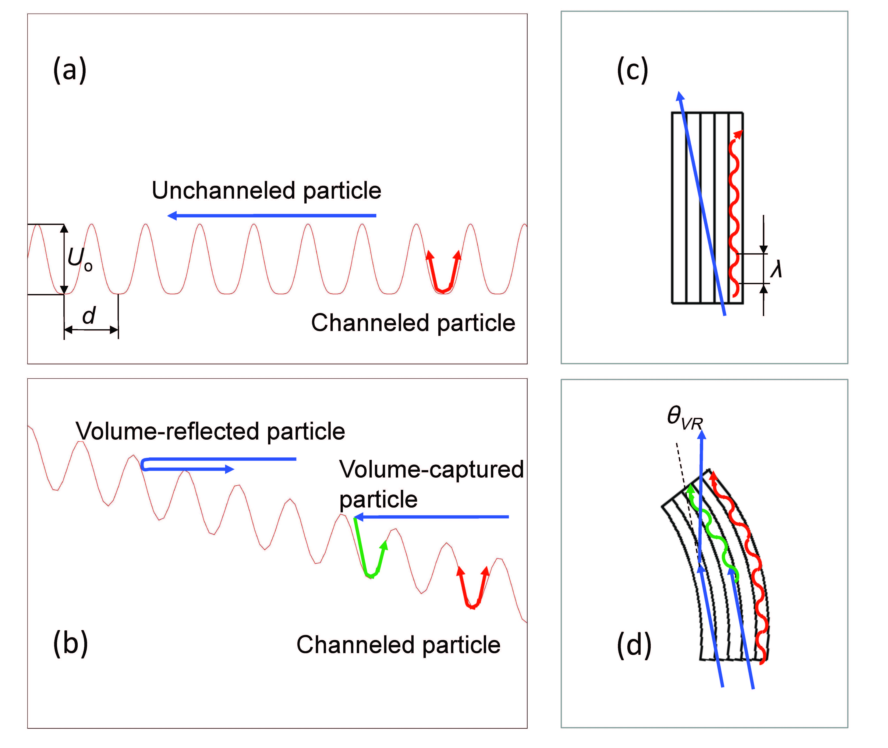
even stronger “magnets”? - crystals
straight crystal
crystal focusing strength
φ~20-60 eV/Å²
B_{max}≈2000 T !
λ=2πβ=2π (E/φ)^{1/2}
bent crystal
W. Scandale, MPL A (2012)
S.A. Bogacz, D. Cline, 1997
since 1978 crystals are used for extracting high-energy protons or ions from storage rings; can they by used for a circular collider? possible problems: “dechanneling” due to interactions w. crystal nuclei & e⁻; heating; staging – atomic-scale positioning?; synchrotron radiation

Slide 13
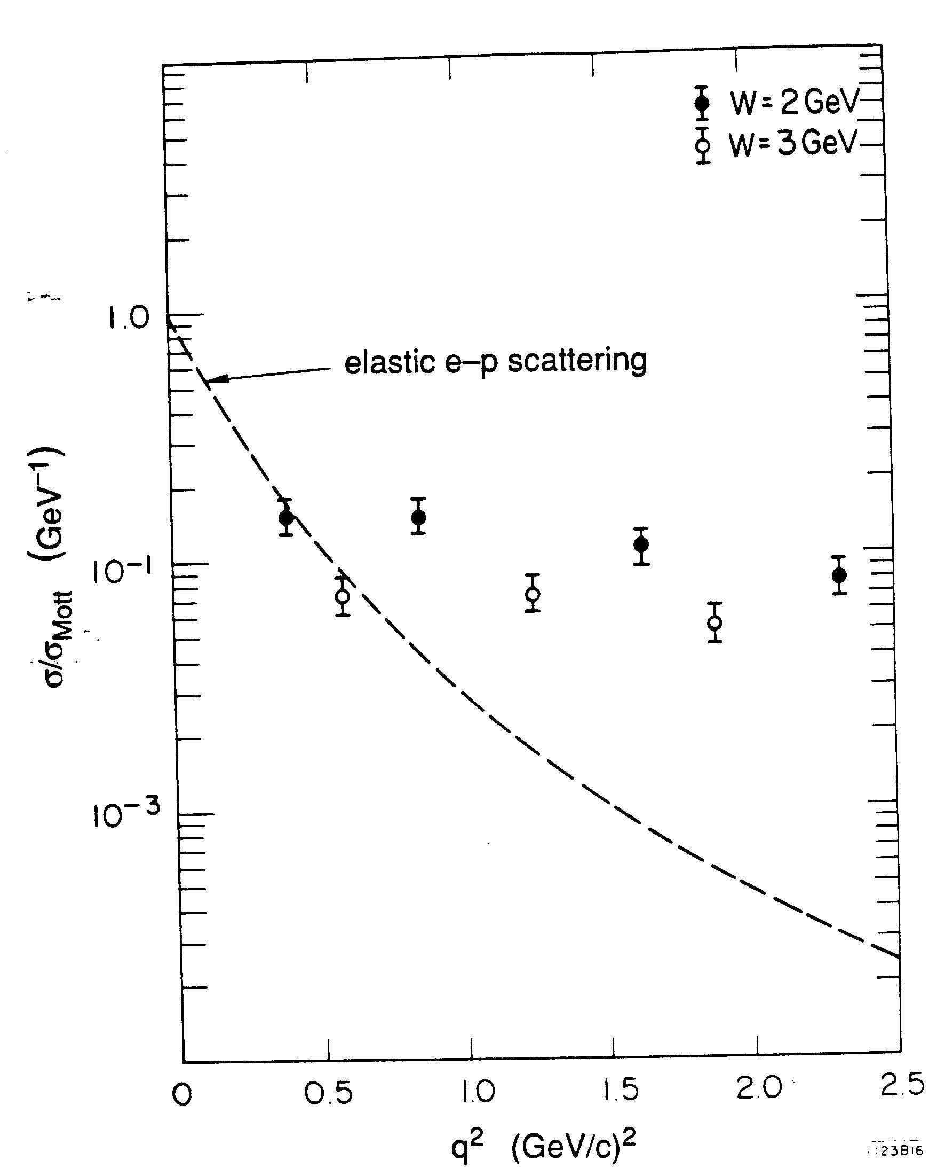
p: not fundamental, made of partons
discovered in inelastic electron-nucleon scattering experiments at SLAC ESA,
1967-1973

Slide 14
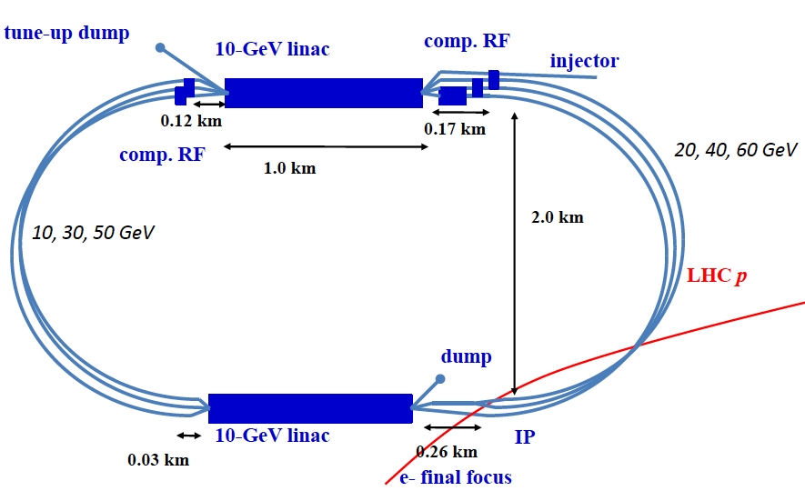
next step in ep scattering?
MIT-SLAC (1967-73)→ HERA (1990-2007) → LHeC (2025-32?)
6-pass 2x10-GeV recirculating linac with energy recovery

Slide 15
lepton colliders
“precision instruments” (fundamental particles)
circular colliders
- e⁺e⁻
- μ⁻μ⁺
linear e⁺e⁻ colliders
- normal or superconducting μ-wave linac
- dielectric or plasma-based linac
- crystal accelerator

Slide 16
circular e⁺e⁻ colliders
largest circular colliders:
highest energy: LEP (27 km), 104.5 GeV/beam
→ 80 km (“TLEP”?)
another factor 2 in beam energy, 200 GeV
max. beam energy limited by synchr. radiation
E_{max}[100 GeV]≈(P_{SR}[70MW] ρ²[km]/N_{e}[10¹²])^{1/4}
SR power
~1/2 wall plug power
with 50% RF efficiency
bending radius
LHC: ρ≈3 km
#e±
(for luminosity)

Slide 17
possible master plan
not yet endorsed by CERN management!
TLEP (80 km,
e⁺e⁻, up to
400 GeV c.m.)
L(350GeV)≈7x10³³cm⁻²s⁻¹
L(240GeV)≈10³⁵cm⁻²s⁻¹
L(160GeV)≈4x10³⁵cm⁻²s⁻¹
L(91GeV)≈3x10³⁶cm⁻²s⁻¹
PSB
PS (0.6 km)
SPS (6.9 km)
LHC (26.7 km)
VHE-LHC
(pp, up to
100 TeV c.m.)
Also: e± (200 GeV) – p (7 & 50 TeV) collisions

Slide 18
circular μ⁺μ⁻ colliders
synchrotron radiation smaller than for e± by factor (m_{e}/m_{μ})⁴≈6x10⁻¹⁰
maximum beam energy limited by ν radiation
E_{max}[TeV]≈(D[mSv/y]L²[km]/(dN_{μ}/dt[10¹³/s])^{1/3}
B. King, 1999
radiation dose / year
at distance L
distance
#μ into collider / s
other issues:
μ production, μ cooling,
μ acceleration, …
energy limited to a few TeV

Slide 19
linear e⁺e⁻ colliders
max. beam energy limited by accel. gradient
E_{max} ≈ 1/3 G L
other issues:
luminosity, power, e⁺ production, spot sizes,
beamstrahlung (synchrotron radiation in collision),…
accelerating
gradient
total length
for example: L=30 km ; max G from surface breakdown
G=30 MV/m→ E_{max}≈ 300 GeV (SC RF)
G=100 MV/m (breakdown)→ E_{max}≈ 1 TeV (NC RF)
higher linear-collider energy needs higher gradients!
(dielectric, plasma, crystals … see later)

Slide 20
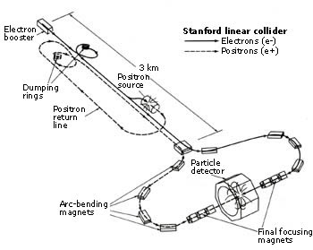
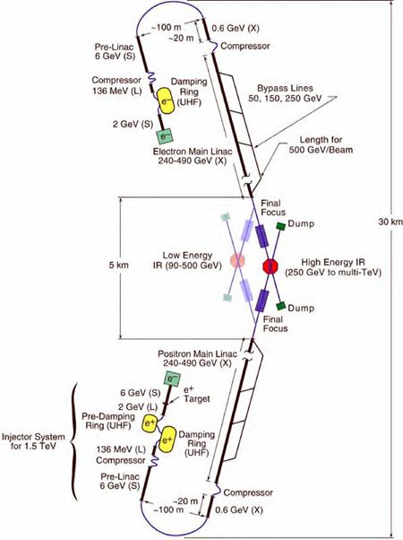
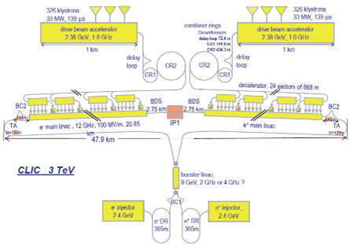
example linear e⁺e⁻ colliders
SLAC Linear Collider
(SLC) 1990-1998
the only linear collider
so far
proposed
future
linear
colliders
CLIC
(NC),
48 km
3 TeV
c.m.
ILC (SC)
31 km
500 GeV c.m.

Slide 21
dielectric & plasma accelerators
dielectric materials (quartz, diamond, garnets,….)
higher breakdown limits than metals;
dielectric structures driven in THz,
optical or near-IR regime
G=1-3 GV/m
driven by e⁻ beam or by laser (external fiber laser or
integrated semiconductor laser)
plasma acceleration
G≈ 100 GV/m (n₀ [10¹⁸ cm⁻³])^{1/2} ; n₀ ≈10¹⁷-10¹⁸ cm⁻³
driven by laser, e⁻ beam, or p beam
unlimited acceleration is predicted to be possible ?!
Kostyukov, Nerush, Litvak, 2012

Slide 22
crystal accelerators
acceleration in crystal channels
G≈ 10 TV/m (n₀ [10²² cm⁻³])^{1/2} ; n₀ ≈10²²-10²³ cm⁻³
driven by x-ray laser
max. energy set by radiation emission due to betatron oscillations between crystal planes
E_{max} ≈300 GeV for e⁺, 10⁶ TeV for p ? Chen & Noble 1997; Dodin & Fisch 2008
[is there no similar limit for plasmas?]
10 TV/m – disposable crystal accelerator
or 0.1 TV/m – reusable crystal accelerator
side injection of x-ray pulses using long fibers

Slide 23
far-reach future colliders
inspired by
V. Shiltsev, 2012,
Physics-Uspekhi
 | dielectric | plasma | crystal
accelerating media | micro-structures | ionized plasma | solid crystals
energy source option 1 option 2 option 3 | opt. laser e⁻ bunch p bunch | e- bunch p bunch opt. laser | x-ray laser
preferred particles | any stable | e⁻, μ- | p⁺, μ⁺
max. accel. gradient | 1-3 GV/m | 30-100 GV/m | 0.1-10 TV/m
c.m. energy in 10 km | 3-10 TeV | 3-50 TeV | 10³-10⁵ TeV
#stages/10 km option 1 option 2 option 3 | 10⁵-10⁶ 10⁴-10⁵ 2-10 | ~100 10³-10⁴ 2-10² | ~2

Slide 24
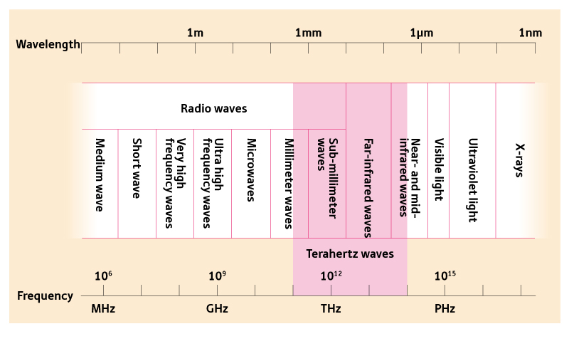
towards shorter wavelengths
dielectric & plasma
based accelerators
crystal accelerators
conventional
accelerators
accelerator
type
accelerator
power source
tetrodes, IOTs,
klystrons,
solid-state
amplifiers,…
e- (p) beam
or laser
intense X-ray
laser

Slide 25
highest-energy particles
4 July 2012 CERN, Geneva, Switzerland
Higgs boson – “God particle”? – mass 1.25x10¹¹ eV, neither matter nor force!
15 October 1991 Dugway Proving Ground, Utah, U.S.A.
“Oh-my-God-particle”!
(kinetic) energy 3x10²⁰ eV
(=3x10¹¹ GeV = 300 EeV)!

Slide 26
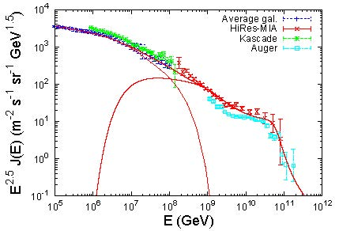
cosmic-ray energy spectrum
10⁴⁵ m⁻²s⁻¹sr⁻¹GeV^{1.5}!
P. Blasi, UHECR2012
crystal accelerator driven by X-ray laser
GZK limit
dielectric & plasmas
LHC p energy
x10⁸

Slide 27
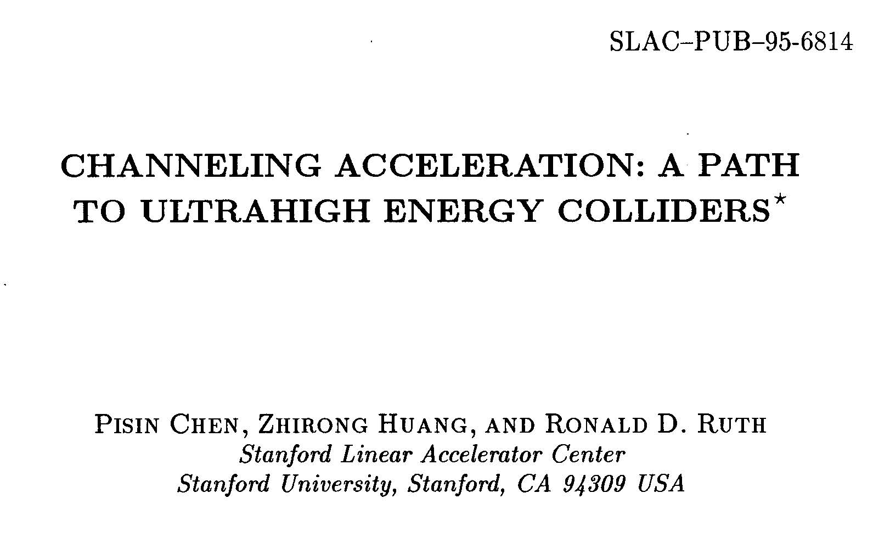
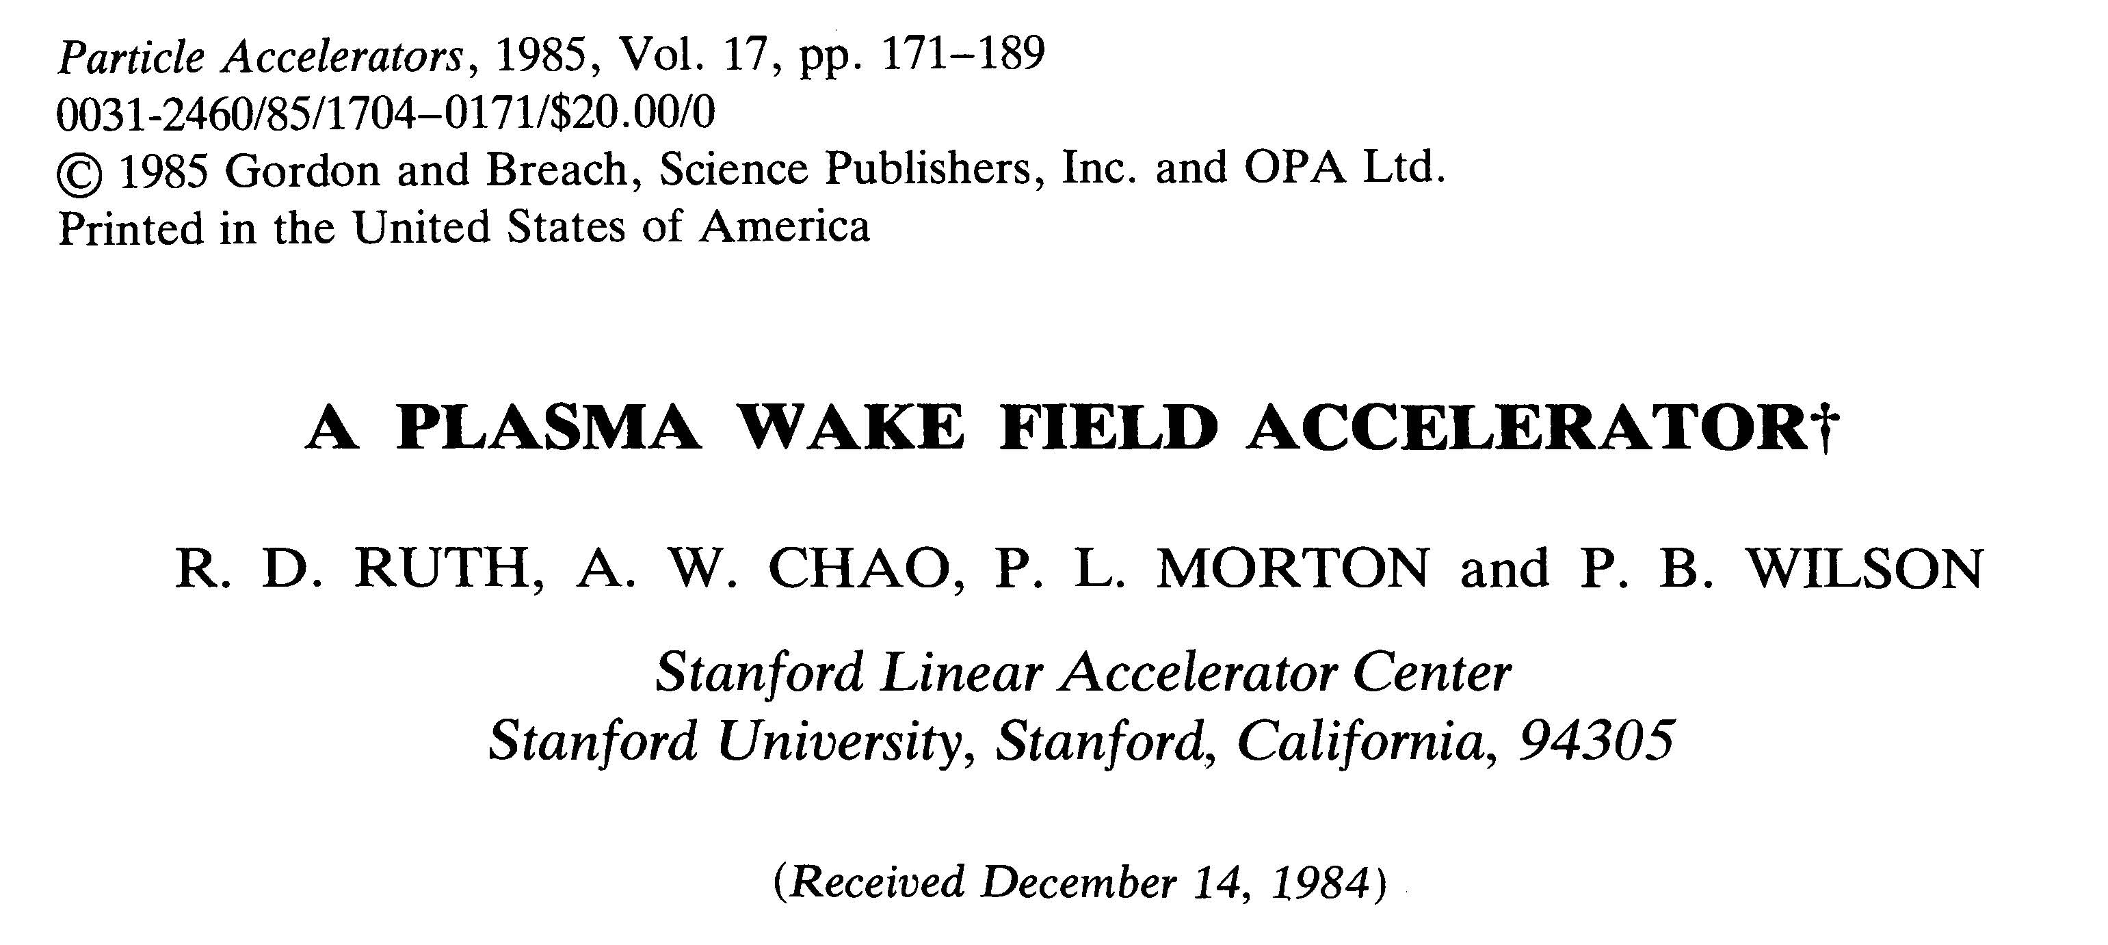
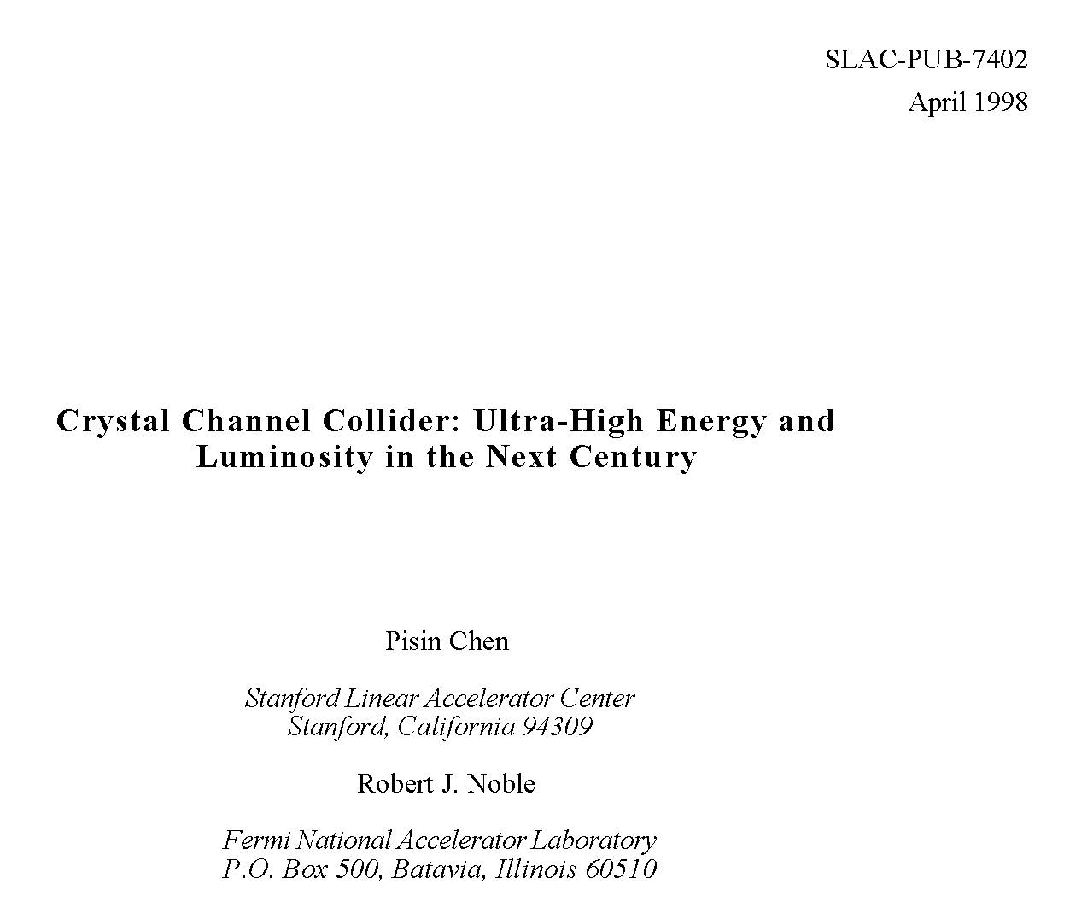
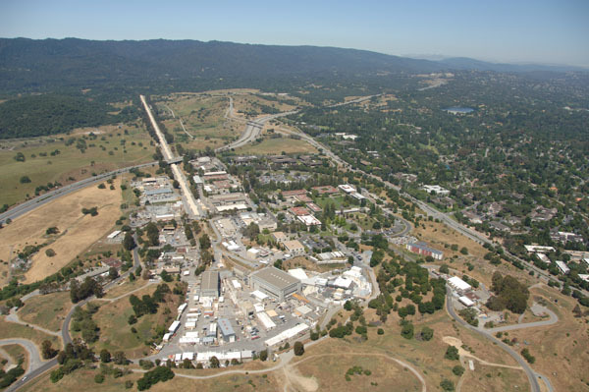
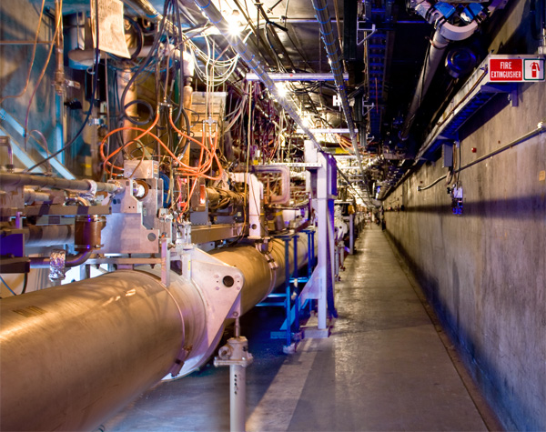
SLAC is well positioned for the next 50 years!
many pioneering papers across the field
exceptional forward-looking facilities

Slide 28
ultimate limit of electromagnetic acceleration
E_{cr} ≈10¹⁸ V/m critical field for e⁺e⁻
pair creation - ħ/(m_{e}c) e E_{cr} ~ m_{e}c²
reaching Planck scale of 10²⁸ eV
would need 10¹⁰ m long accelerator
[10¹⁰ m= 1/10th of distance earth-sun]
“not an inconceivable task for an
advanced technological society”
P. Chen, R, Noble, SLAC-PUB-7402, April 1998

Slide 29
step back to 2015-20

Slide 30
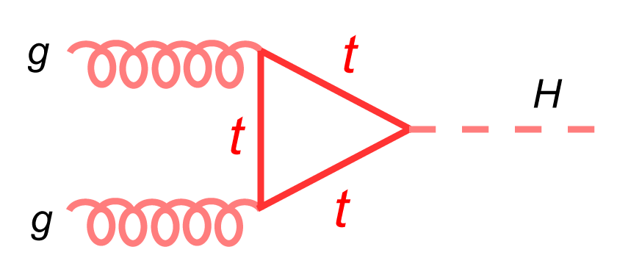
Higgs production at hadron & lepton colliders
LHC
e⁺e⁻ collider
Higgs-strahlung, dominant for E_{CoM}<500 GeV

Slide 31
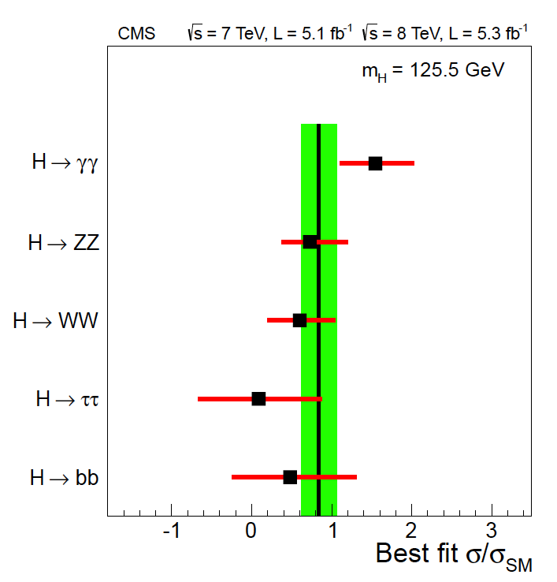
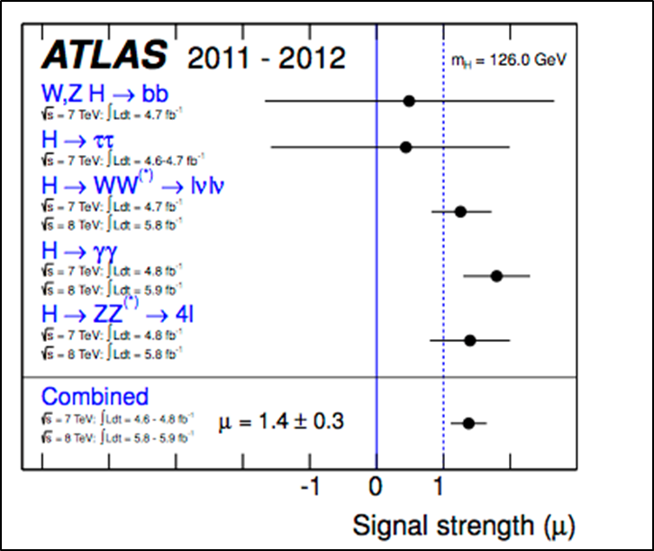
“Higgs” strongly couples to γγ
LHC CMS result
LHC ATLAS result

Slide 32
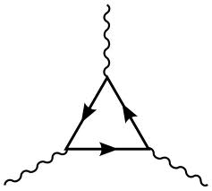
a new type of collider?
γ
t, W, …
H
another advantage:
no beamstrahlung
→ higher energy reach
than e⁺e⁻ colliders
γ
γγ collider Higgs factory

Slide 33
combining photon science & particle physics!
γγ collider
K.-J. Kim, A. Sessler
Beam Line
Spring/Summer 1996
few J pulse
energy with
λ~350 nm

Slide 34
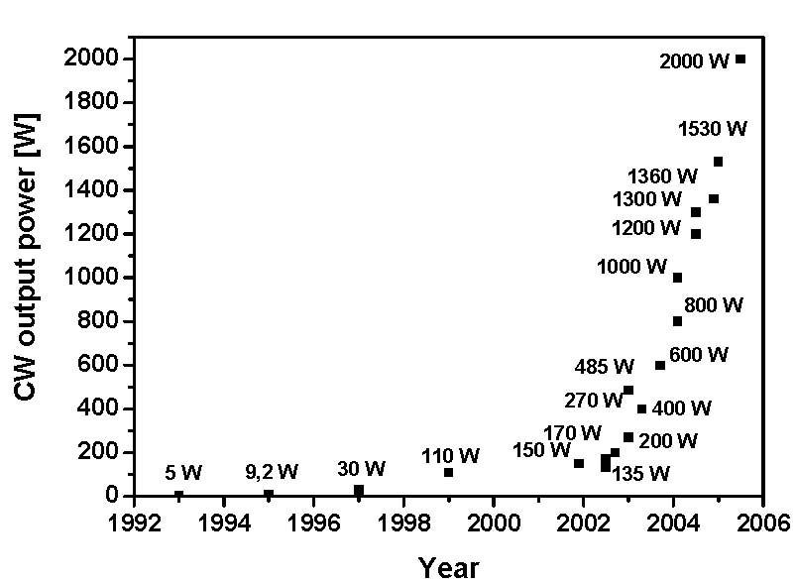
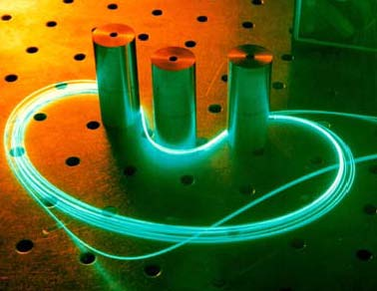
laser progress: example fiber lasers
power evolution of cw double-clad
fiber lasers with diffraction limited
beam quality over one decade:
factor 400 increase!
Source: Fiber Based High Power Laser Systems,
Jens Limpert, Thomas Schreiber, and Andreas Tünnermann

Slide 35
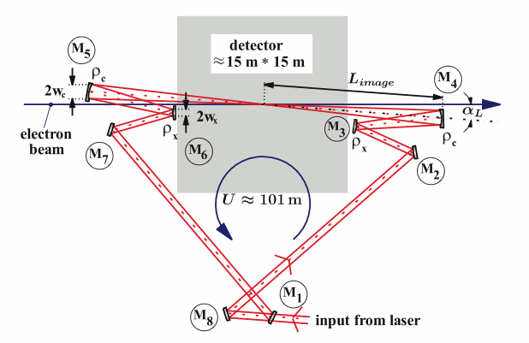
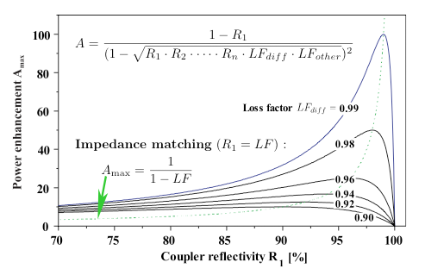
passive optical cavity
→
relaxed
laser
parameters
K. Moenig et al, DESY Zeuthen

Slide 36
self-generated FEL γ beams
(instead of laser)?
e⁻
(80 GeV)
wiggler
converting some
e⁻ energy into
photons (λ≈350 nm)
e⁻
(80 GeV)
e⁻ bend
optical
cavity
mirrors
Compton
conversion
point
e⁻ bend
γγ IP
“intracavity powers at MW levels are perfectly reasonable” – D. Douglas, 23 August 2012
example: λ_{u}=50 cm, B=5 T, L_{u}=50 m, 0.1%P_{beam}≈25 kW

Slide 37
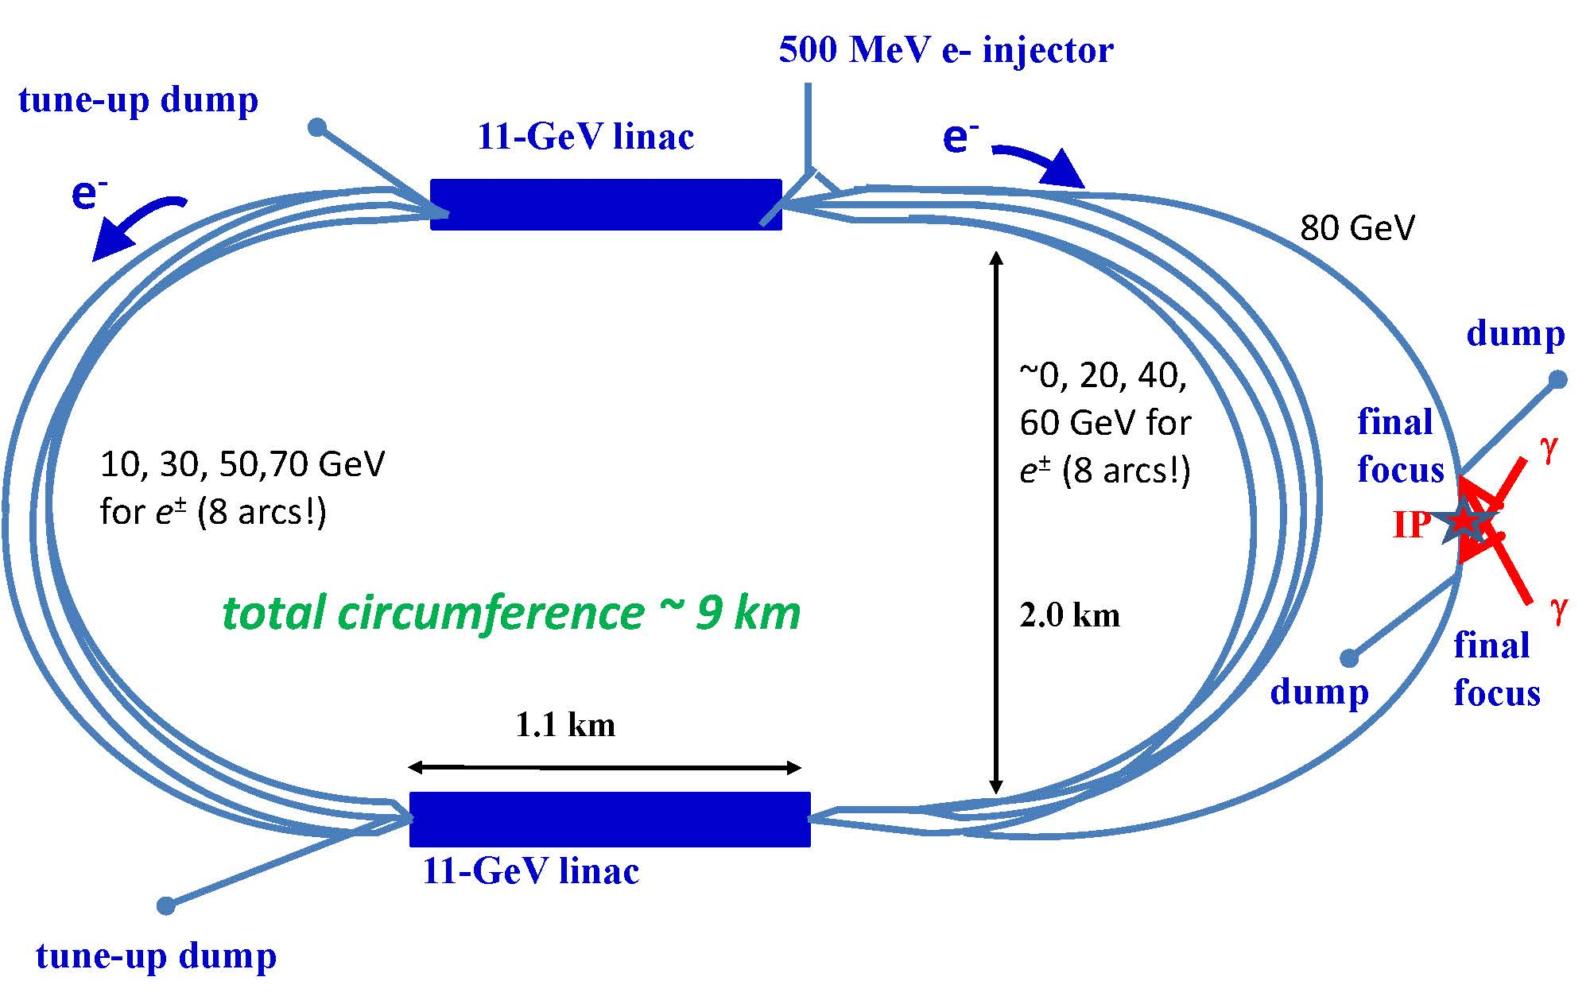
SAPPHiRE: a Small γγ Higgs Factory
scale ~ European XFEL,
about 10k Higgs per year
SAPPHiRE: Small Accelerator for Photon-Photon Higgs production using Recirculating Electrons

Slide 38
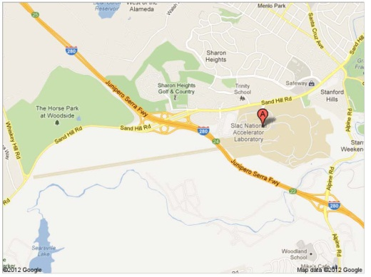
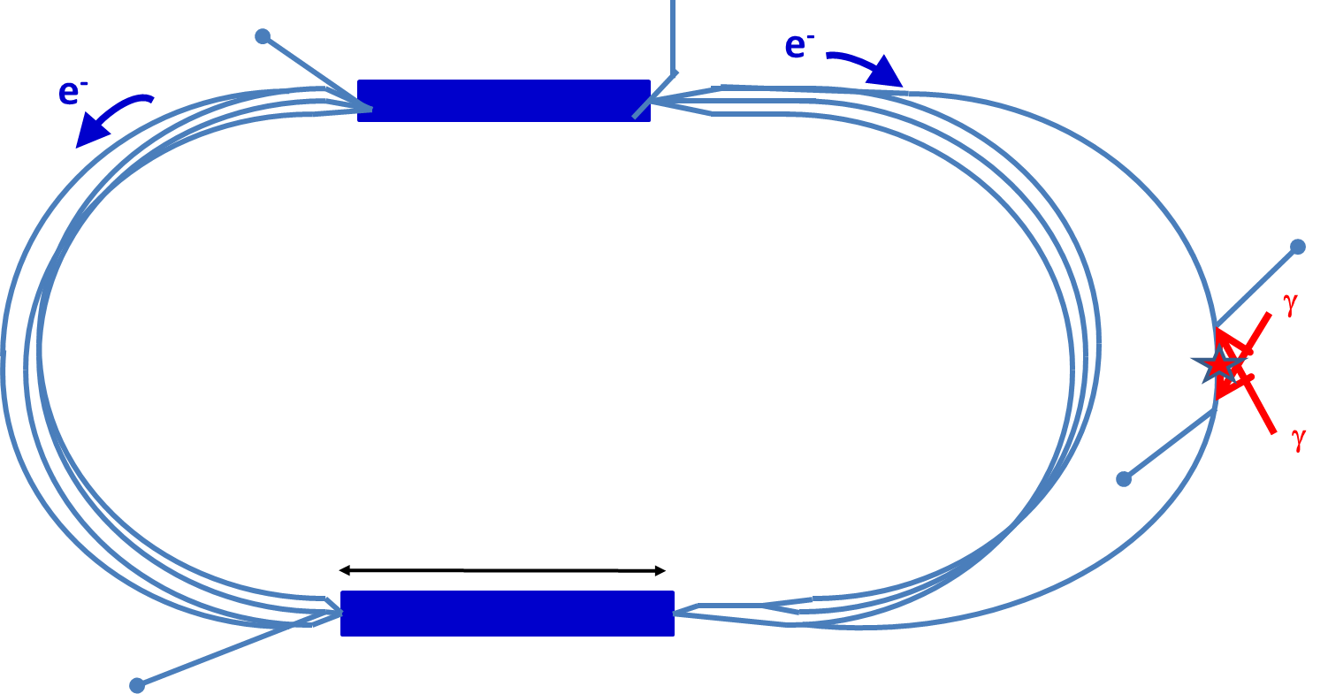
would it fit on SLAC site?

Slide 39
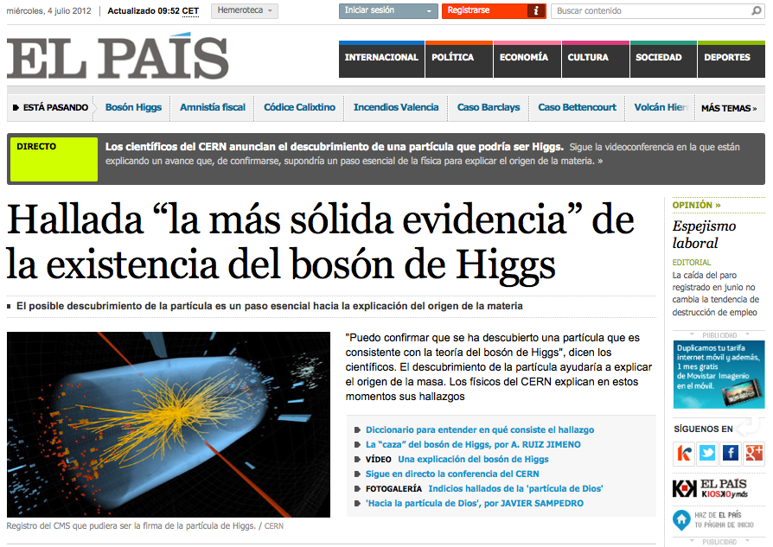
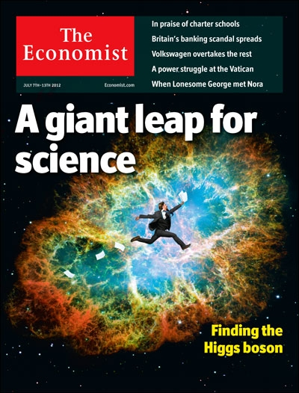
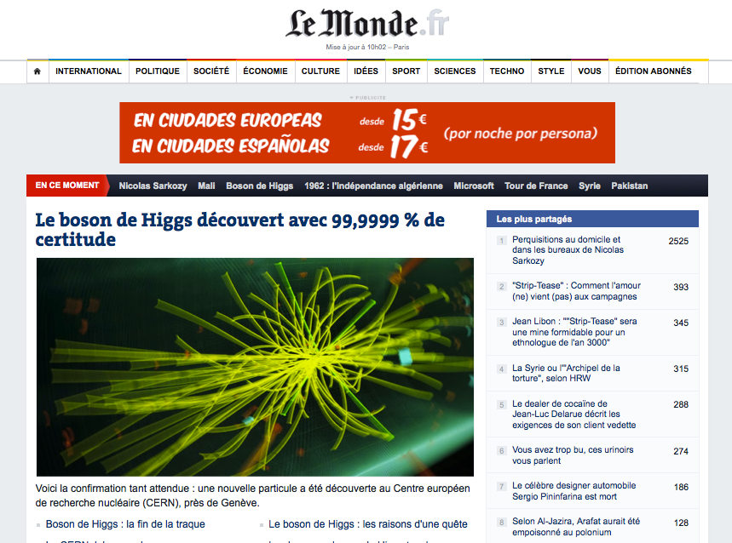
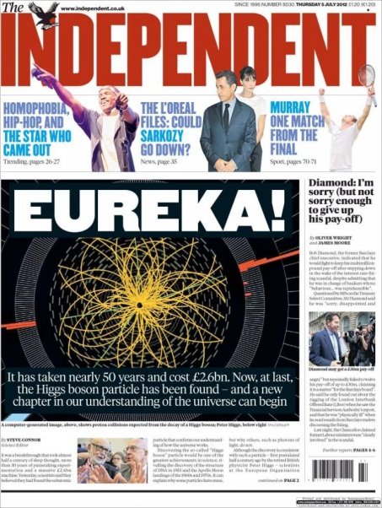
now is the time!

Slide 40
SLAC’s particle accelerators have been at forefront of discoveries for 50 years
SLAC will be a strong player in the accelerator revolution of next 50 years;
no other lab can better push dielectric, plasma & x-ray crystal acceleration!
next SLAC machine - a Higgs factory?
HAPPY BIRTHDAY – SLAC !

Slide 41
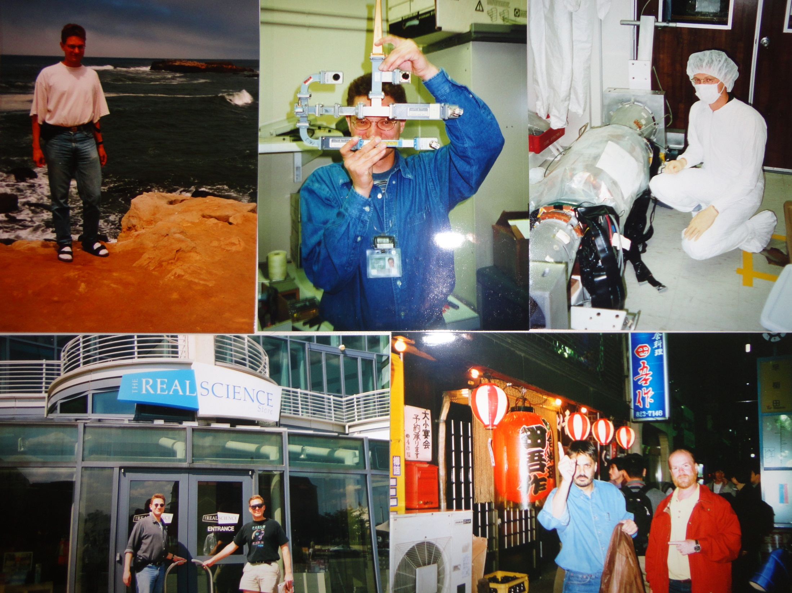

Slide 43
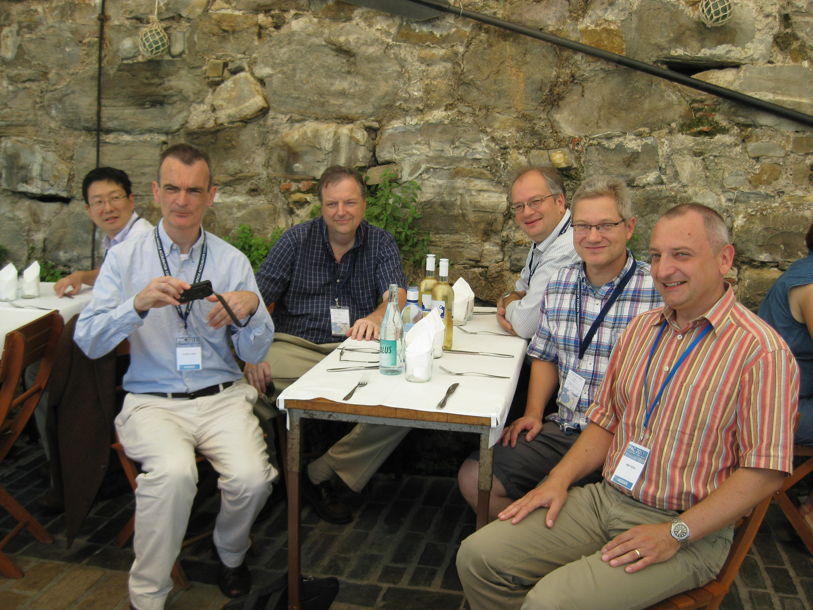
“SLAC reunion” at the harbour of San Sebastian on 6 September 2011

