Slide 1
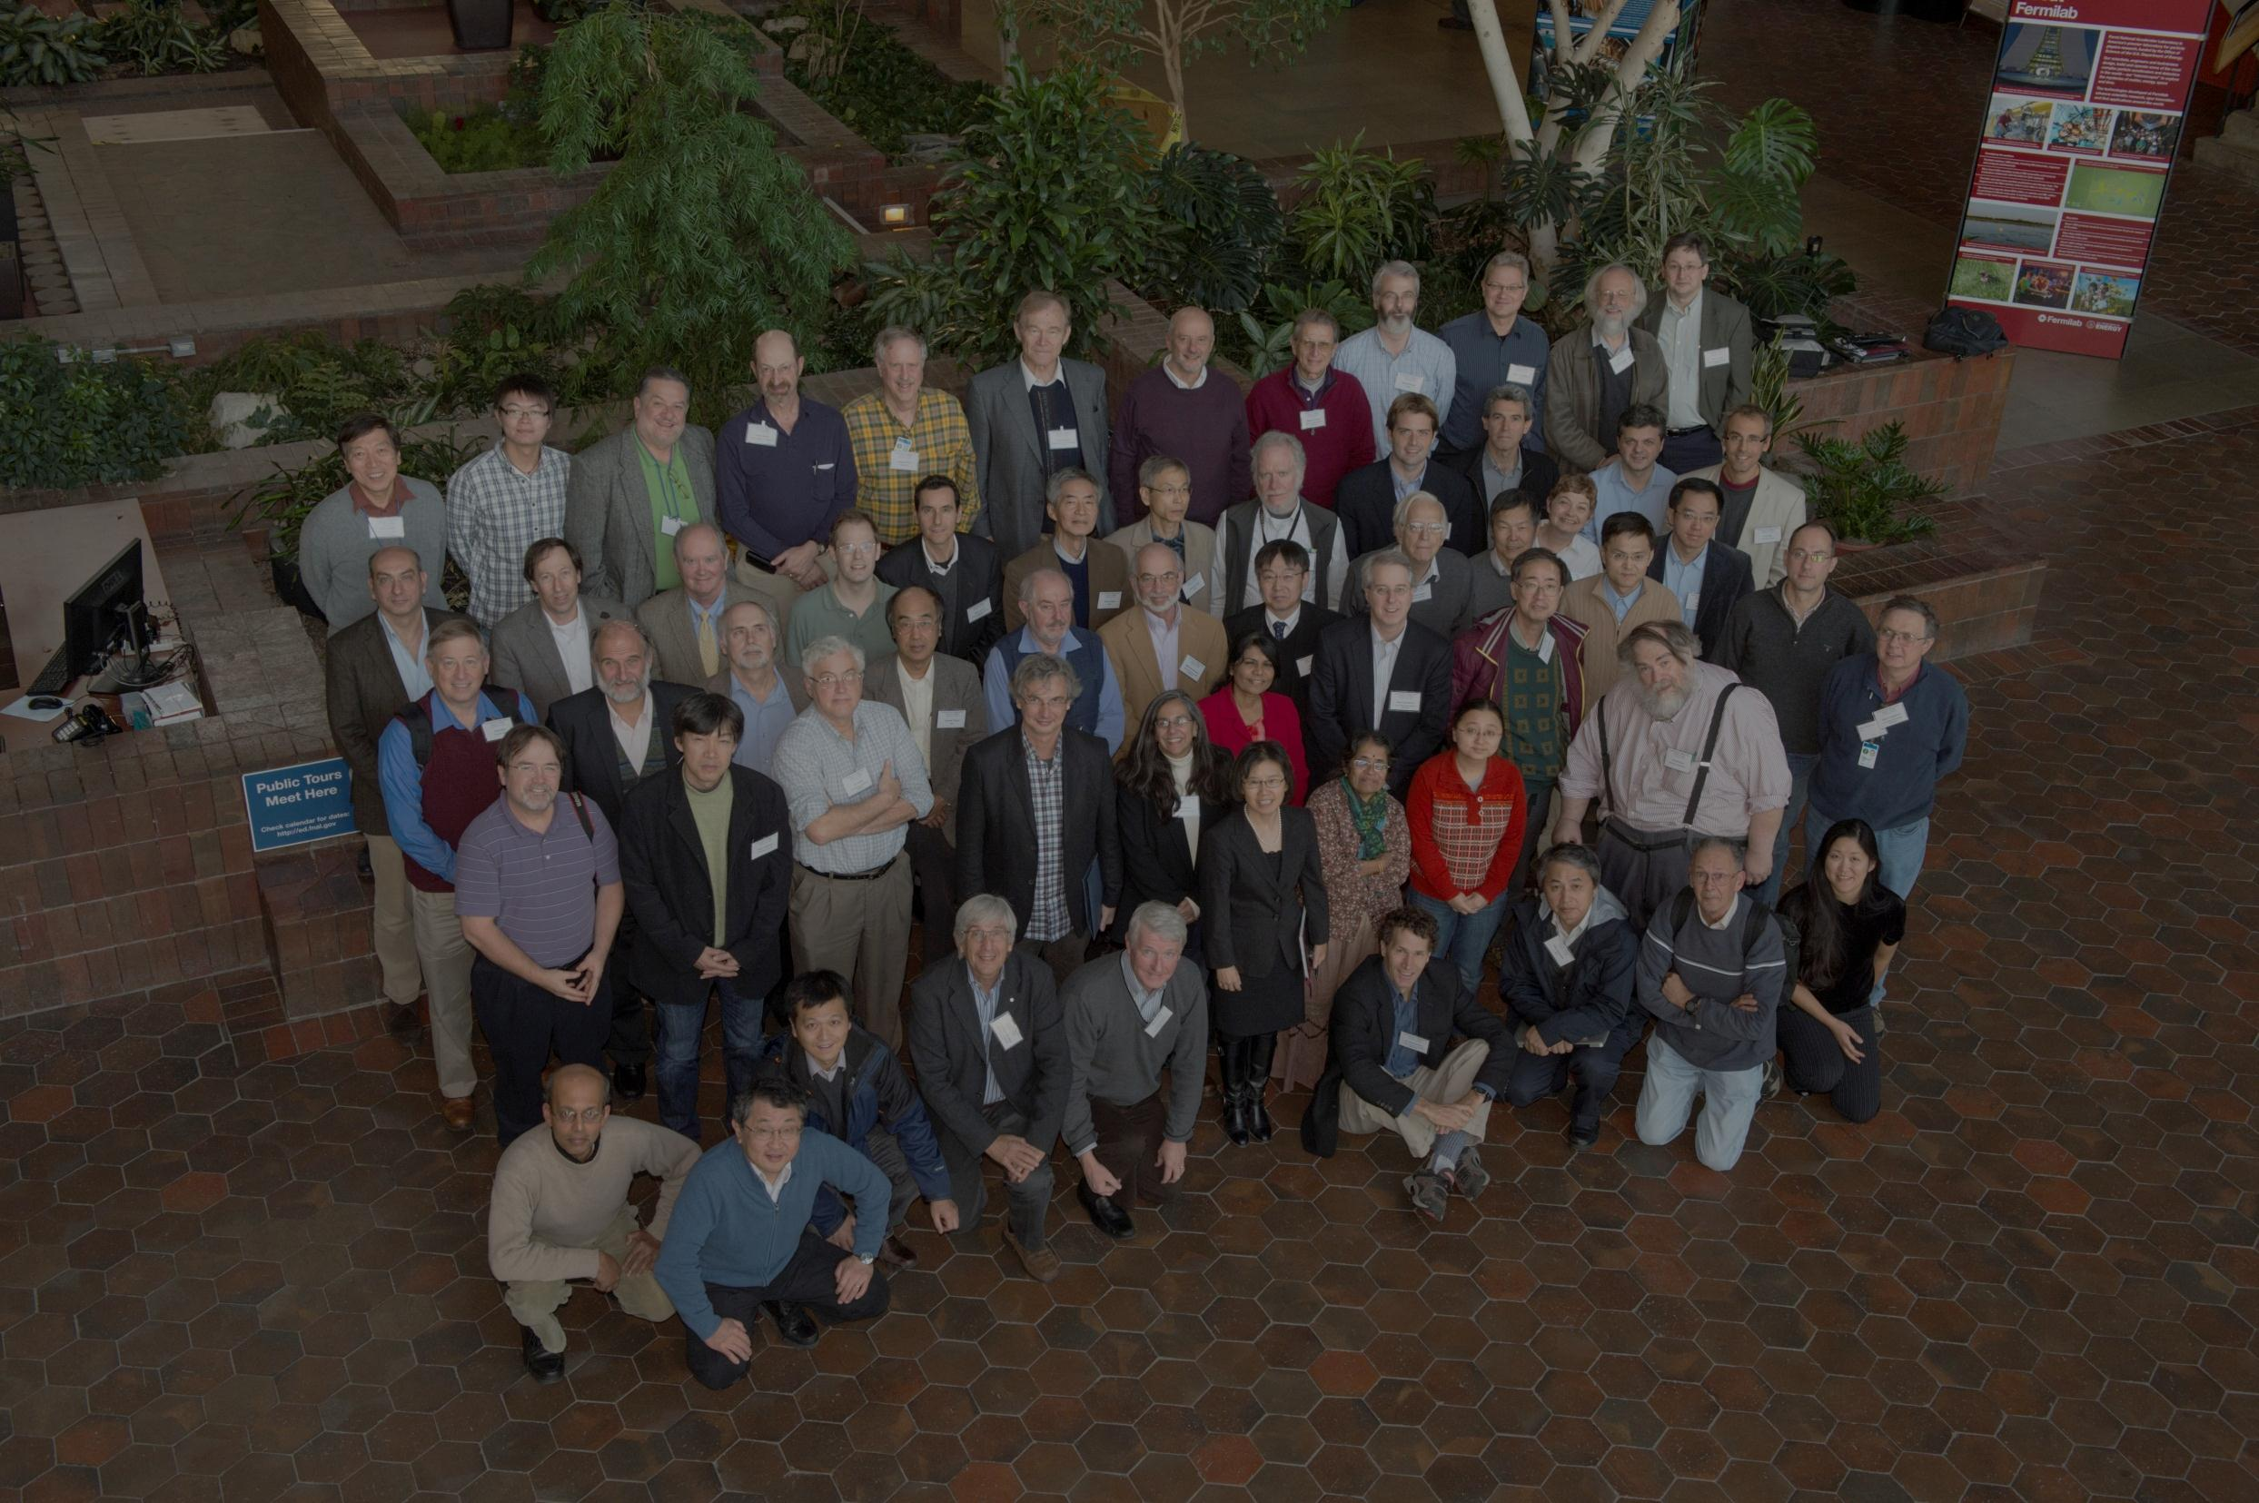
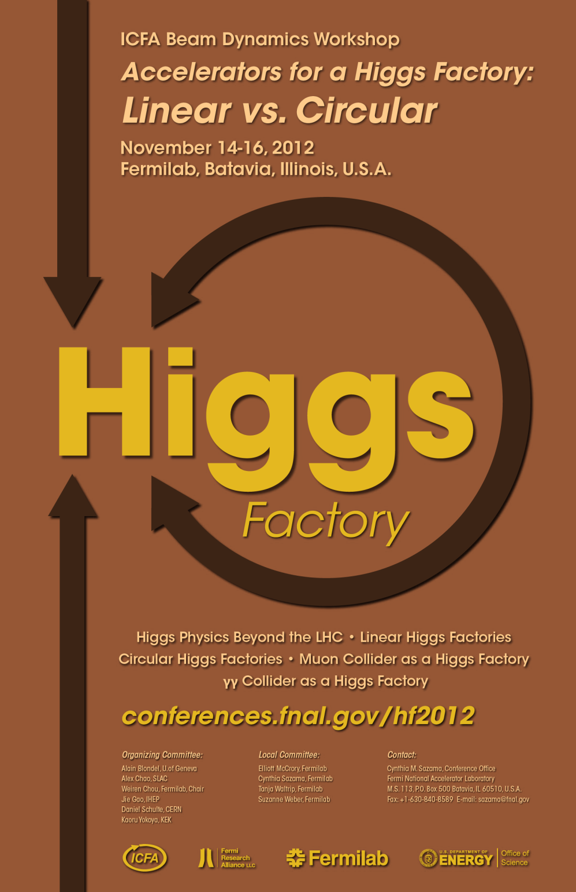
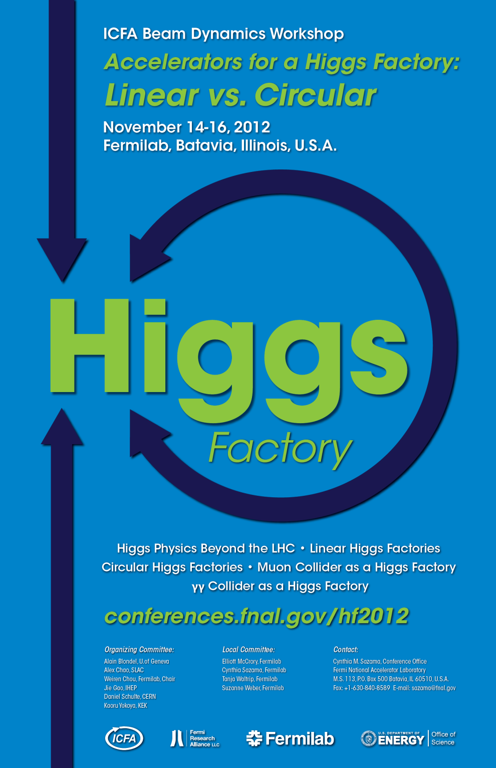
Future Possibilities for Precise Studies of the X(125) Higgs Candidate – Higgs Factories
Frank Zimmermann
CERN Colloquium
22 November 2012
work supported by the European Commission under the FP7 Research Infrastructures project EuCARD, grant agreement no. 227579

Slide 2
Higgs Factory (HF) candidates
LHC & upgrades
linear colliders
circular e⁺e⁻ colliders
lepton-hadron collider
gamma-gamma colliders
muon collider

Slide 3
HF quality indicators
readiness / maturity
cost , electrical power
peak luminosity , #IPs
integrated luminosity
Hübner (H) factor = integrated lumi/(peak lumi x calendar time for physics)
H_{LEP} ≈0.2, H_{LHC} ≈0.2, H_{KEKB}≈0.7
commissioning time
expandability

Slide 4
LHC Higgs Factory & LHC upgrades

Slide 5
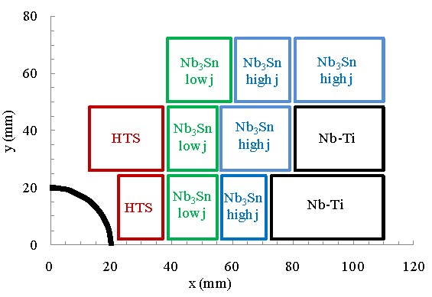
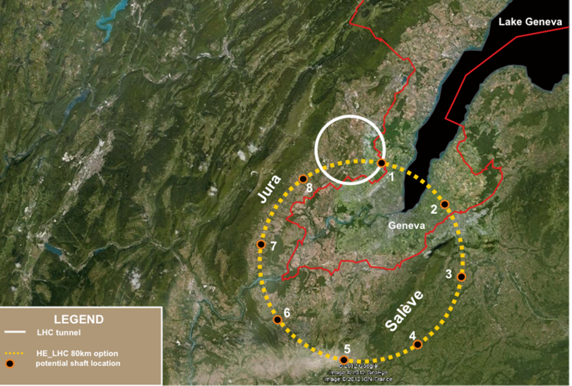
LHC Higgs factory & upgrades
LHC is the 1st Higgs factory!
E_{CoM}=8-14 TeV,$\hat{ L}\sim$10³⁴cm⁻²s⁻¹
total cross section at 8 TeV: 22 pb
1 M Higgs produced so far – more to come
15 H bosons / min – and more to come
HL-LHC (~2022-2030)
will deliver ~9x more H bosons!
E_{CoM}=14 TeV,$\hat{ L}\sim$5x10³⁴cm⁻²s⁻¹
with luminosity leveling
8 → 14 TeV: ggH x1.5
F. Cerutti, P. Janot
SHE-LHC: new 80 km tunnel
E_{CoM}=84-104 TeV,$\hat{ L}=$2x10³⁴cm⁻²s⁻¹
HE-LHC: in LHC tunnel (2035-)
E_{CoM}=33 TeV,$\hat{ L}=$2x10³⁴cm⁻²s⁻¹
20-T dipole magnet
80 km tunnel
16 T magnets over 80 km (Ex6)
cheaper than 20 T magnets
over 27 km (Ex2.5)!?
14 → 33 TeV:
ggH→ HH x6
E. Todesco, L. Rossi, P.. McIntyre
J. Osborne, C. Waaijer, S. Myers

Slide 6
Linear Collider Higgs Factories

Slide 7
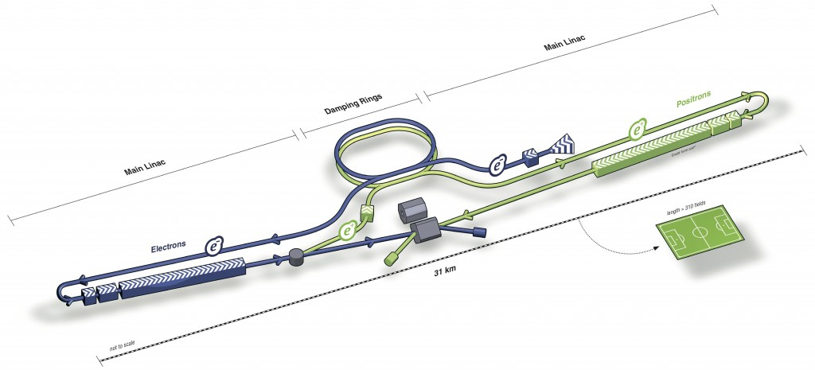
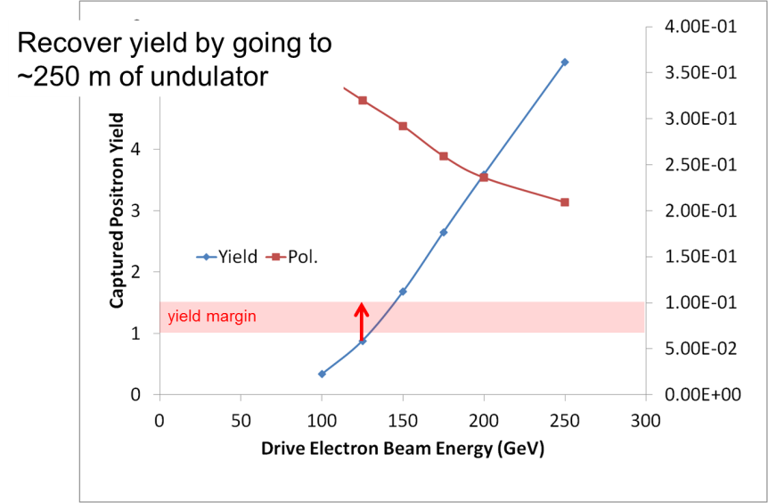
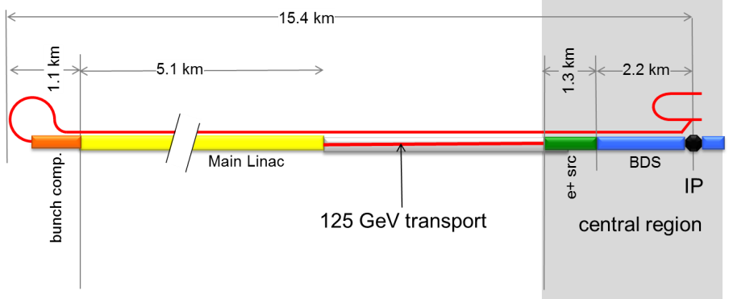
ILC as Higgs factory
31 km
e⁺ source
250 GeV staged scenario
ILC Summary (Nick Walker, DESY)
ILC (500 GeV) “contains” light Higgs factor; luminosity 7.5×10³³ cm⁻² s⁻¹ (possible upgrade x2) ; Standalone machine for LHF: reduced cost by ~35% (P_{AC} ~ 100 MW). Only makes sense as part of 1st-stage machine; scope still ~500 GeV, TeV optional

Slide 8
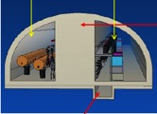
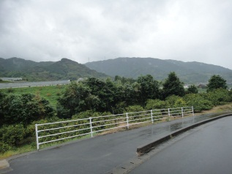
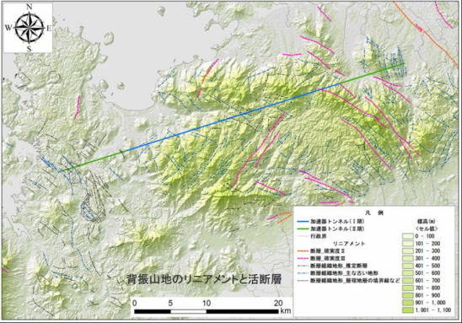
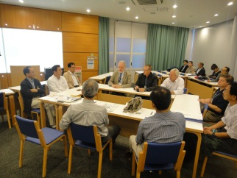
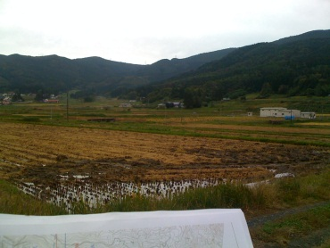
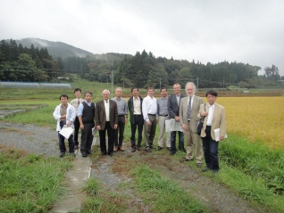
Two ILC Candidate Sites in Japanese mountainous locations
5 m
SEFURI
- GDE-CFS group visited two candidates sites,
Oct. 14 and 15, 2011

Slide 9
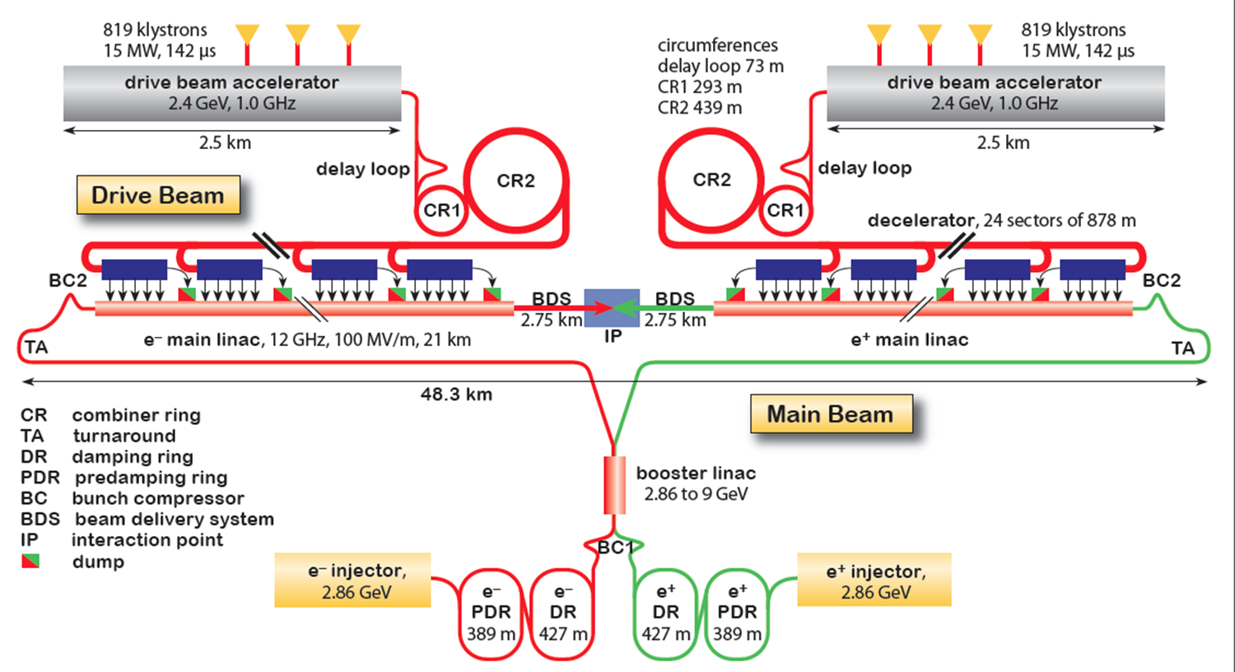
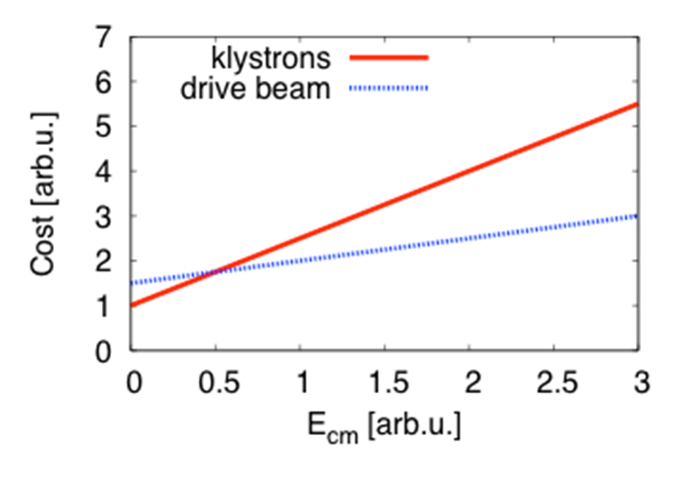
CLIC as Higgs factory
13 - 48 km
CLIC Summary (Daniel Schulte, CERN)
The feasibility of the CLIC scheme has been established.
CLIC proposes a staged approach to reach 3 TeV: Stages with 500fb⁻¹ at 375-500GeV, 1500fb⁻¹ at 1-2TeV, 2000fb⁻¹ at 3 TeV; 2.3×10³⁴ cm⁻² s⁻¹ at 500 GeV. First stage with klystrons is being explored - promising alternative; Construction could start in 2022; commissioning in 2030.

Slide 10
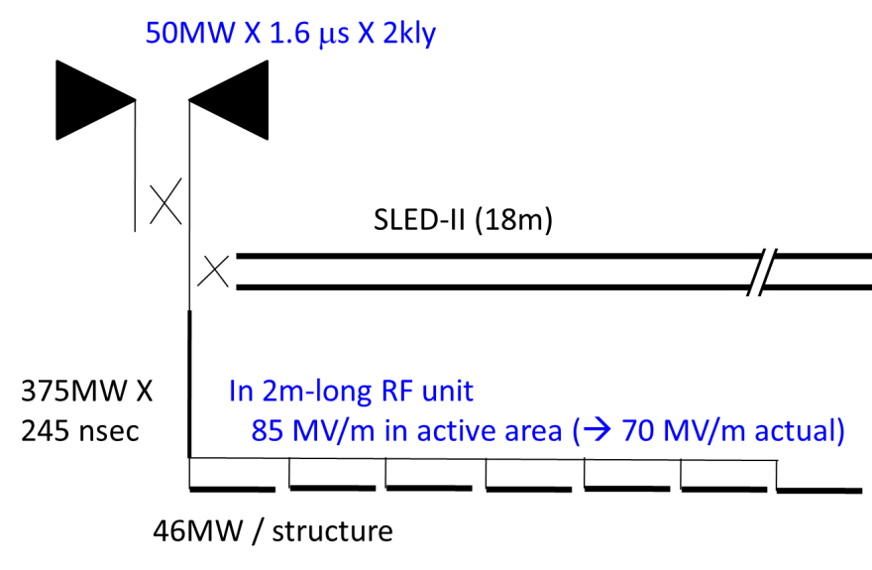
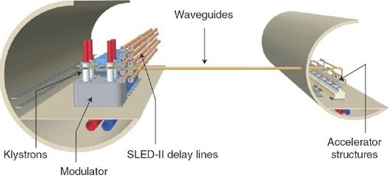
X-band Higgs factory
3.6 km
170-350 GeV CoM
highly versatile Higgs factory
first stage of operation (γγ → Η) fits on KEK site
genuine test facility for CLIC
R. Belusevic & T. Higo, KEK

Slide 11
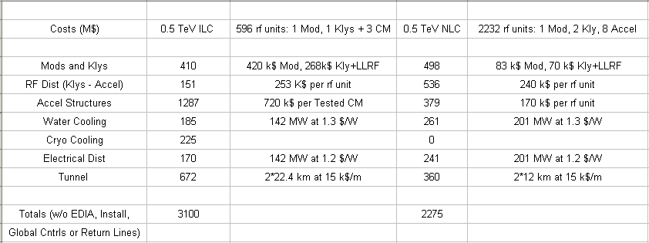
NCRF vs SCRF (Tor Raubenheimer, SLAC)
NCRF may be more cost effective than SCRF for a low energy (Higgs Factory) LC
Topic may be re-examined if a project is formed but hard to make progress at this time

Slide 12
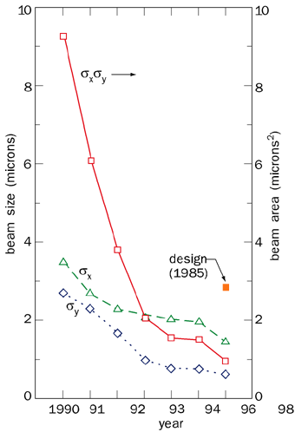
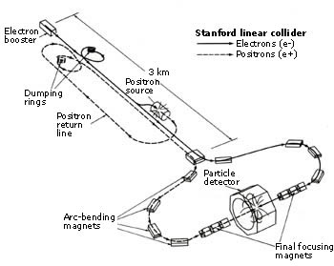
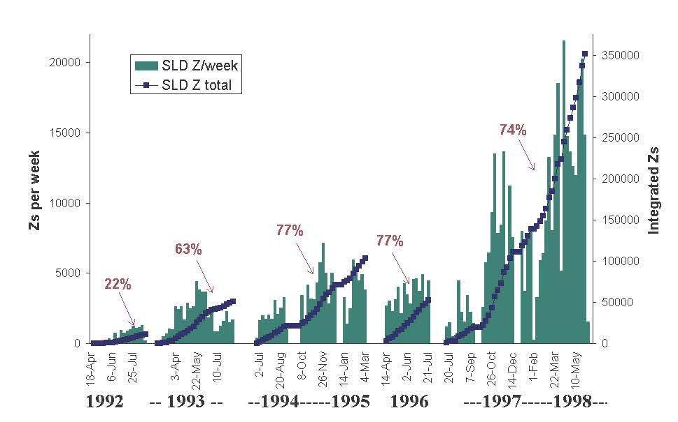
LC experience: SLAC Linear Collider (SLC) 1989-1998
minimum IP beam size
at low intensity
up to 77%
e⁻
polarization
after 10 years of operation:
$\hat{L}$=3x10³⁰ cm⁻²s⁻¹ ~ ½ L_{design}
& <L> ~0.04 x$\hat{ L}$
average IP
beam size
1998
<σ_{x}*>~1.8 μm
<σ_{y}*>~1 μm
10 years

Slide 13
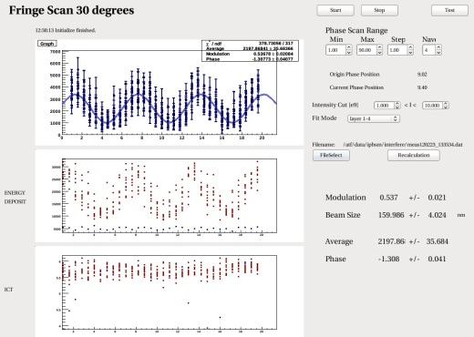
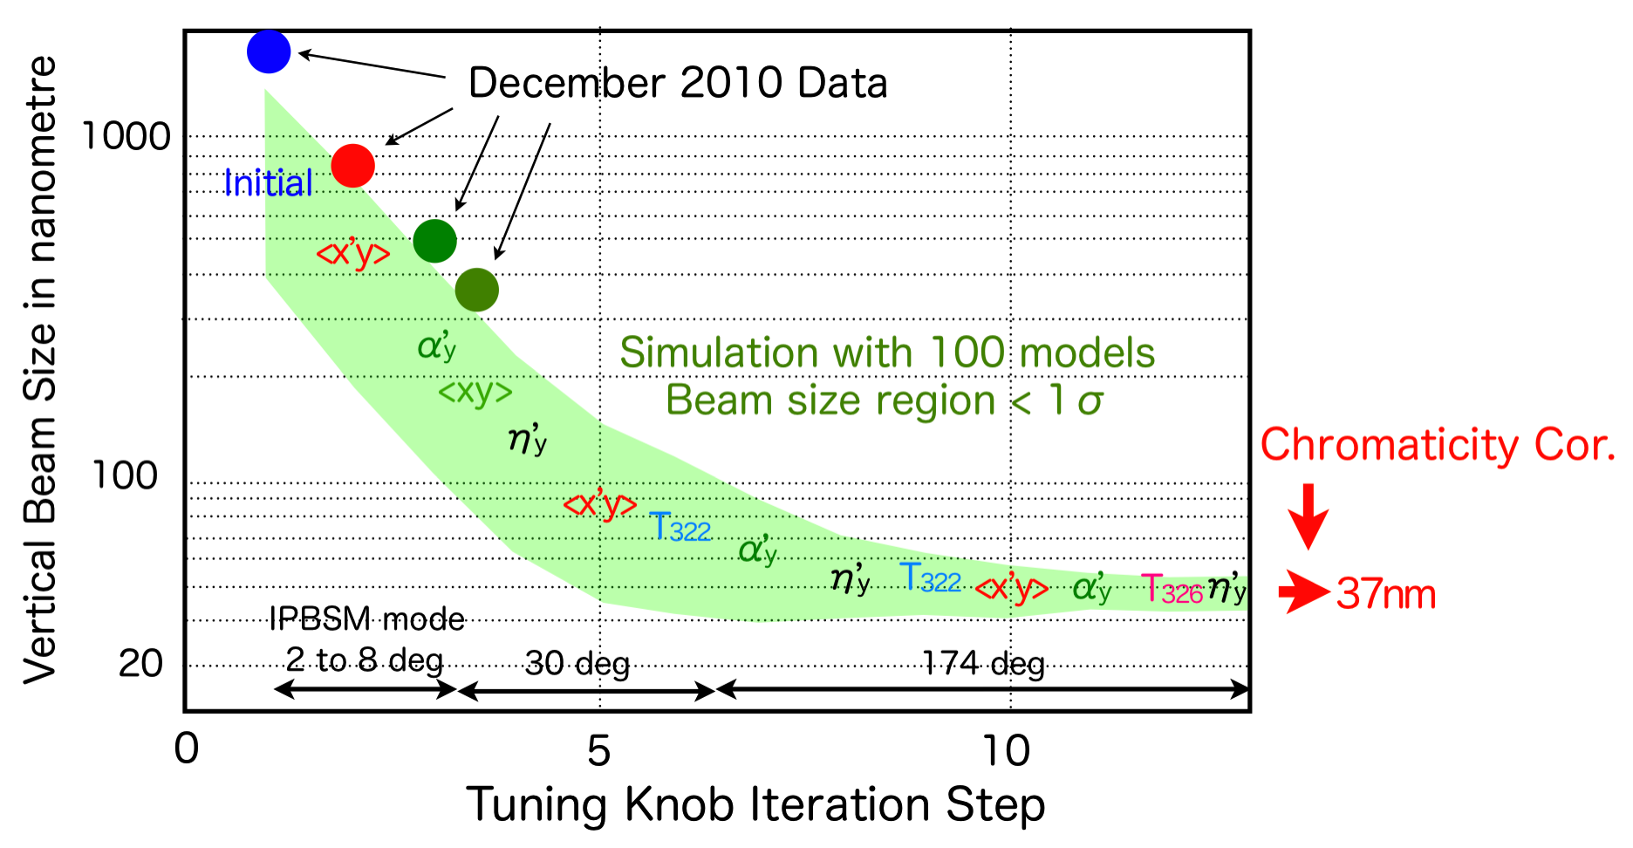
LC experience: final-focus test facility KEK-ATF2 in operation since early 2009 - IP spot size tuning
“…ATF2 will enable us to … test the very demanding beam delivery requirements for the ILC.” Barry Barish, 2005
goal:
design
value
σ_{y}=
37 nm
February 2012 σ_{y}=166±7 nm
P. Bambade, LAL

Slide 14
Circular Higgs Factories

Slide 15
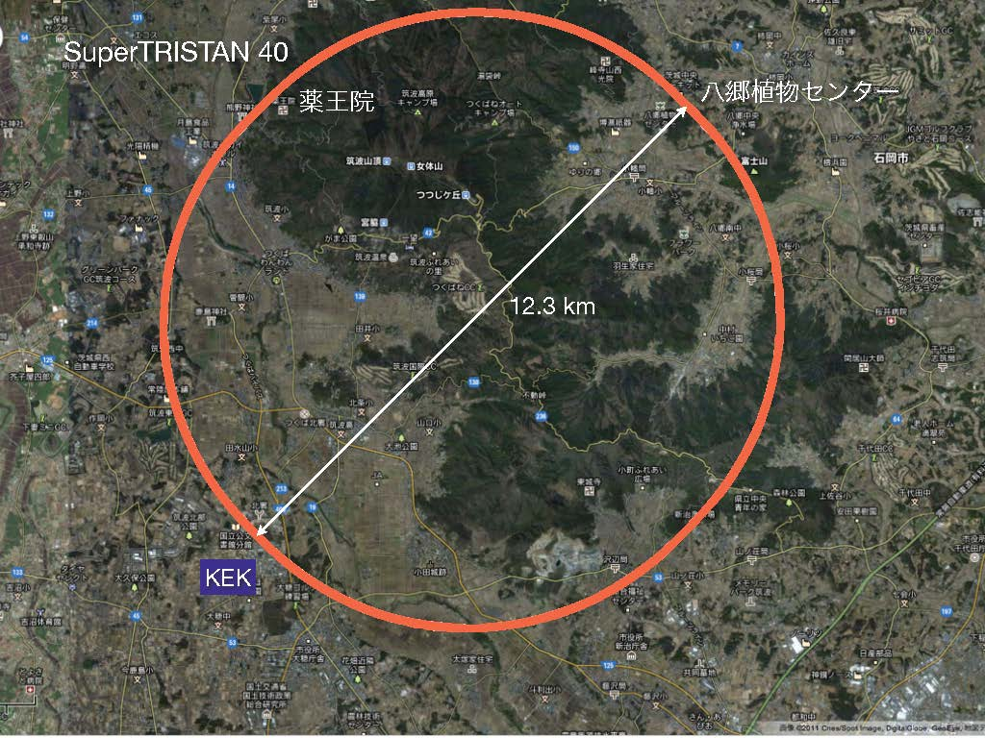
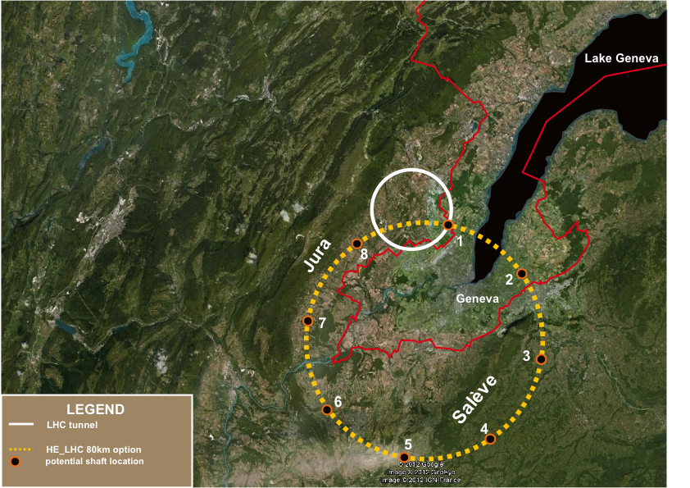
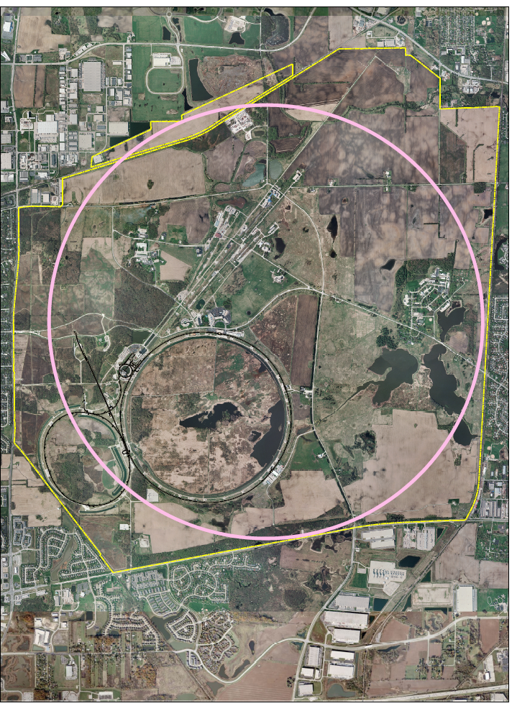
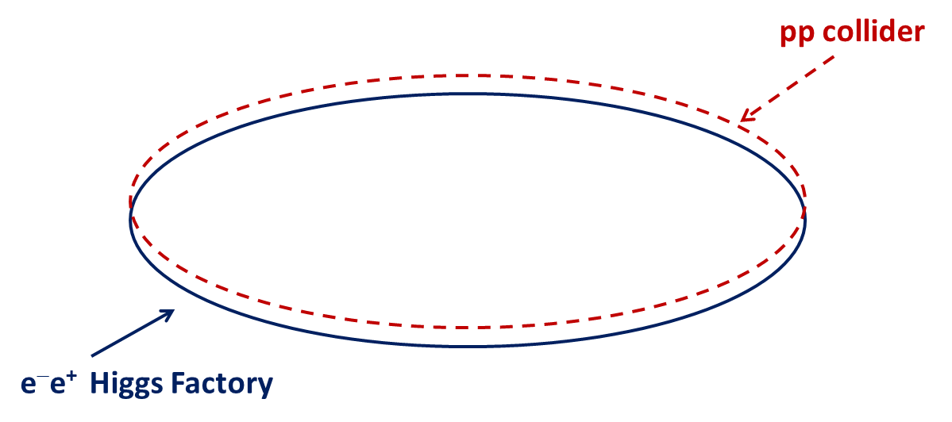
circular HFs – a few examples
SLAC/LBNL
design:
27 km
LEP3: 27 km
TLEP (LEP4): 80 km
near Geneva
SuperTRISTAN in Tsukuba: 40 km
Y. Cai, SLAC
A. Blondel, J. Osborne, F. Zimmermann
FNAL site filler, 16 km
& FNAL VLLC 233 km ring
K. Oide, KEK
IHEP Chinese HF
+ Super pp Collider
50 or 70 km
Q. Qin, IHEP
T. Sen, E. Gianfelice-Wendt, Y. Alexahin, FNAL

Slide 16
LEP3, TLEP (LEP4) (e⁺e⁻ -> ZH, e⁺e⁻ → W⁺W⁻, e⁺e⁻ → Z,[e⁺e⁻→ t$\overline{t}]$ )
key parameters
 | LEP3 | TLEP (LEP4)
circumference | 26.7 km | 80 km
max beam energy | 120 GeV | 175 GeV
max no. of IPs | 4 | 4
luminosity at 350 GeV c.m. | - | 0.7x10³⁴ cm⁻²s⁻¹
luminosity at 240 GeV c.m. | 10³⁴ cm⁻²s⁻¹ | 5x10³⁴ cm⁻²s⁻¹
luminosity at 160 GeV c.m. | 5x10³⁴ cm⁻²s⁻¹ | 2.5x10³⁵ cm⁻²s⁻¹
luminosity at 90 GeV c.m. | 2x10³⁵ cm⁻²s⁻¹ | 10³⁶ cm⁻²s⁻¹
at the Z pole repeating LEP physics programme in a few minutes…

Slide 17
circular HFs – beam lifetime
LEP2:
beam lifetime ~ 6 h
dominated by radiative Bhahba scattering with cross section σ~0.215 barn
LEP3:
with L~10³⁴ cm⁻²s⁻¹ at each of several IPs:
τ_{beam,LEP3}~18 minutes from rad. Bhabha scattering
→ solution: top-up injection
additional beam lifetime limit due to beamstrahlung:
(1) large momentum acceptance (η ≥ 3%), and/or
(2) flat(ter) beams and/or
(3) fast replenishing
(H. Burkhardt)
(A. Blondel)
(V. Telnov, K. Yokoya, M. Zanetti)

Slide 18
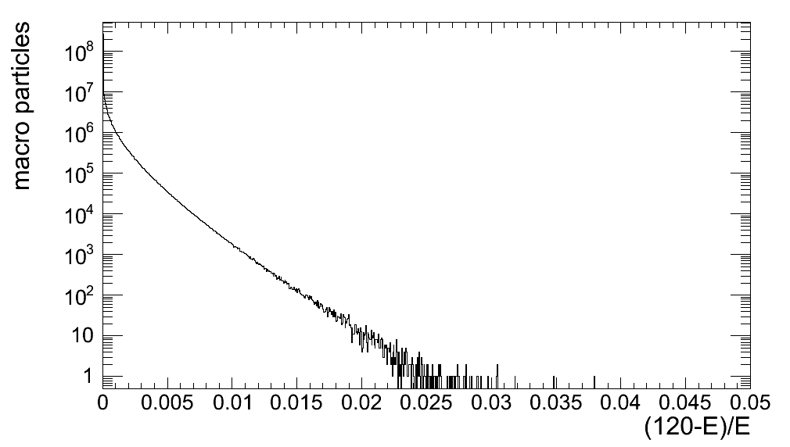
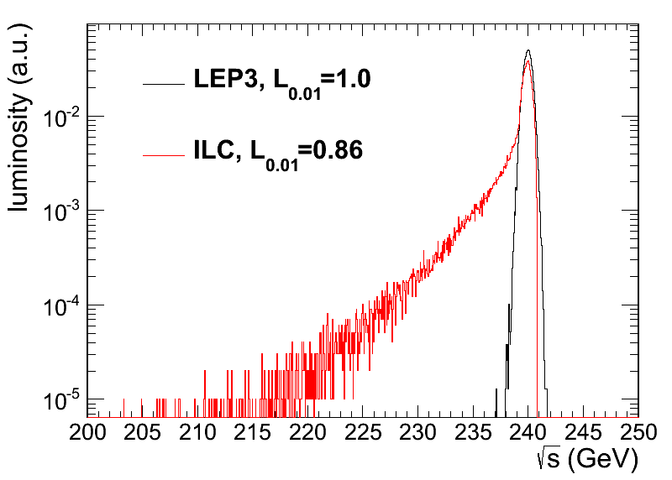
circular HFs – beamstrahlung
simulation w 360M macroparticles
τ varies exponentially w energy acceptance η
TLEP at 240 GeV:
post-collision E tail → lifetime τ
LEP3 & ILC:
luminosity E spectrum
τ>20 s at η=1.0%
τ>3 min at η=1.5%
τ>20 min at η=2.0%
τ>4h at η=3%
LEP3 beamstrahlung more benign than for linear collider
M. Zanetti (MIT)

Slide 19
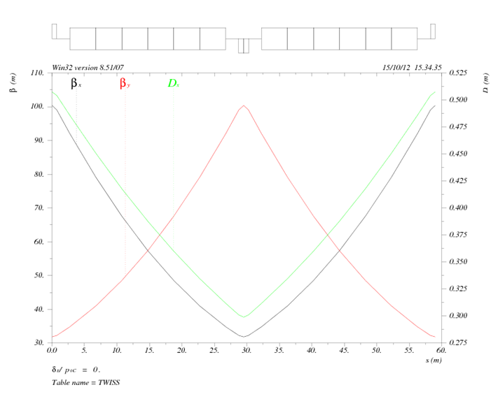
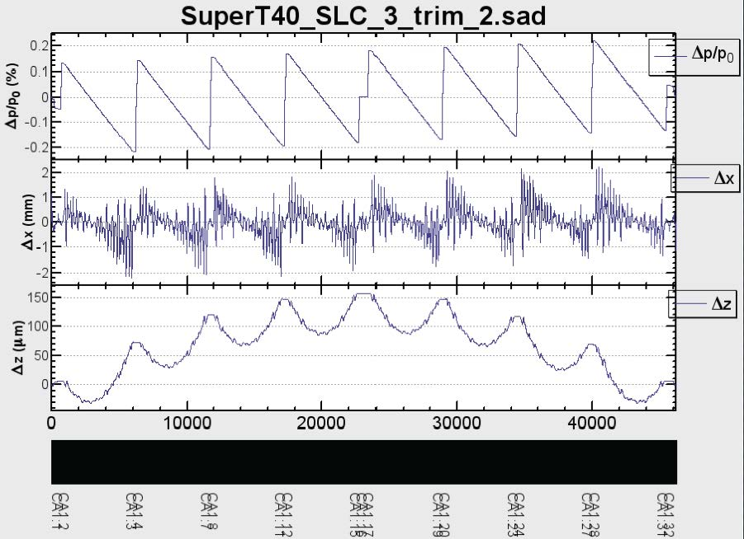
circular HFs – arc lattice
KEK design
IHEP design
Q. Qin
K. Oide
FNAL site filler
SLAC/LBNL design
Y. Cai
T. Sen, E. Gianfelice-Wendt, Y. Alexahin

Slide 20
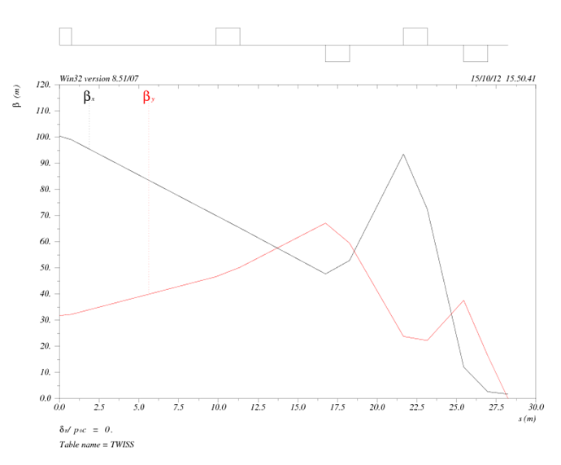
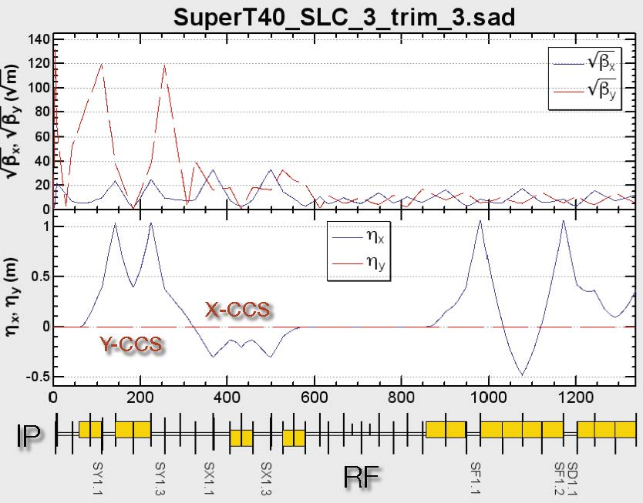
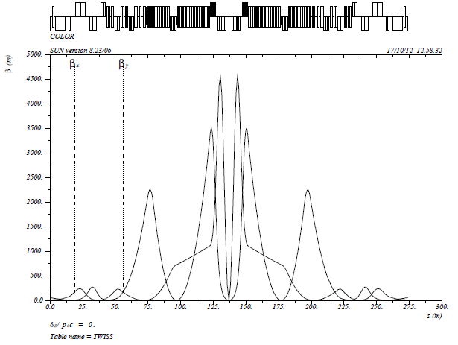
circular HFs – final-focus design
KEK design
IHEP design
K. Oide
Q. Qin
βx*=20cm,
βy*=0.5cm
FNAL site filler
SLAC/LBNL design
Y. Cai
T. Sen, E. Gianfelice-Wendt, Y. Alexahin

Slide 21
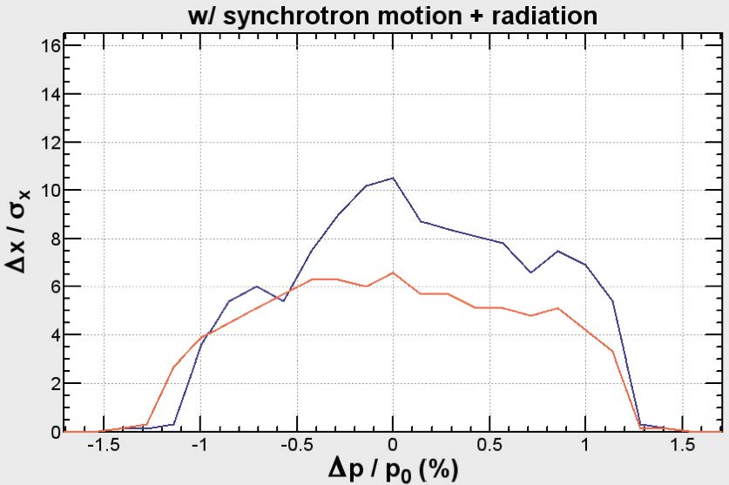
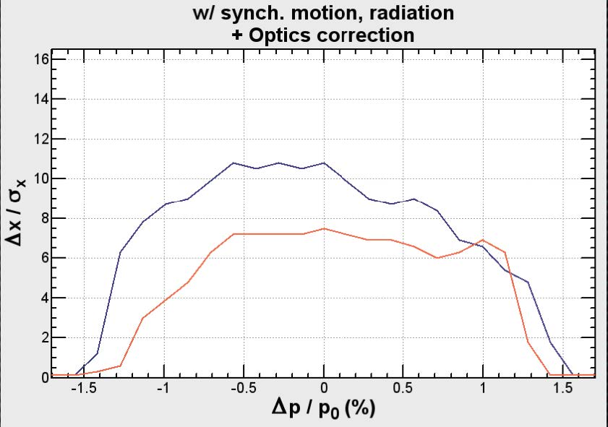
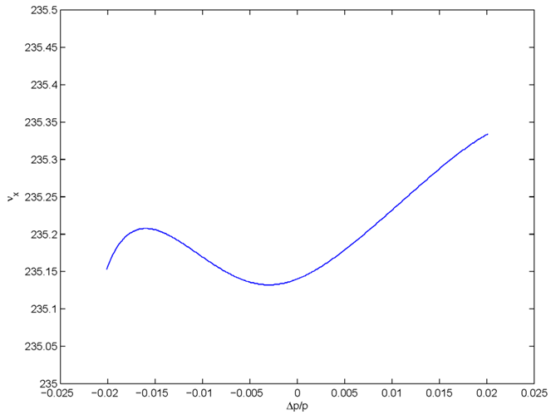
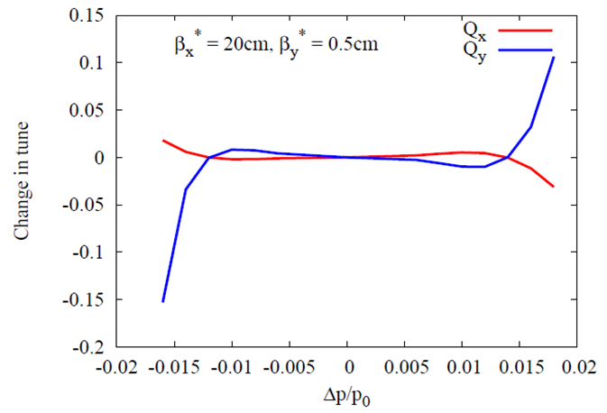
circular HFs - momentum acceptance
with synchrotron motion &
radiation
(sawtooth)
KEK design
before optics
correction
KEK design
after optics
correction
±1.1%
±1.3%
K. Oide
±2.0%
±1.6%
FNAL site filler
SLAC/LBNL design
Y. Cai
T. Sen, E. Gianfelice-Wendt, Y. Alexahin

Slide 22
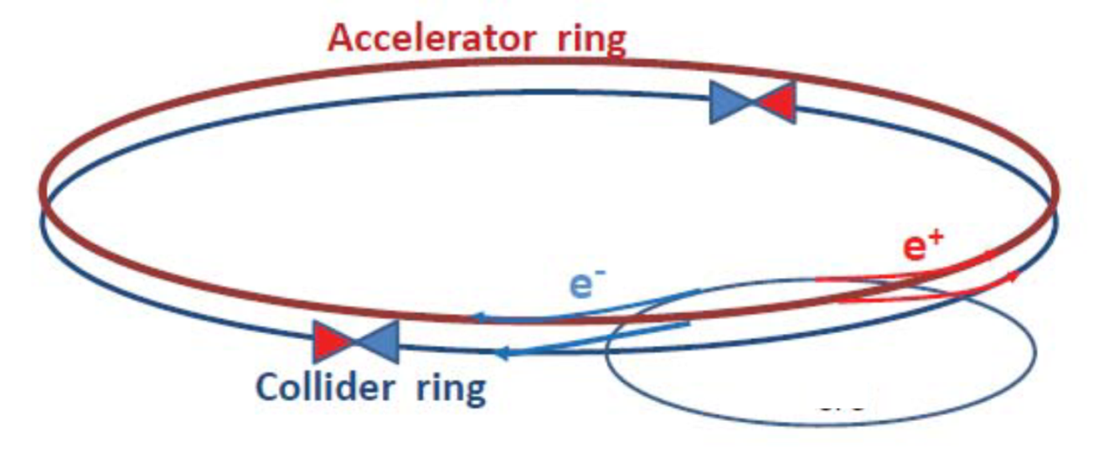
circular HFs – top-up injection
double ring with top-up injection supports short lifetime & high luminosity
A. Blondel
top-up experience: PEP-II, KEKB, light sources

Slide 23
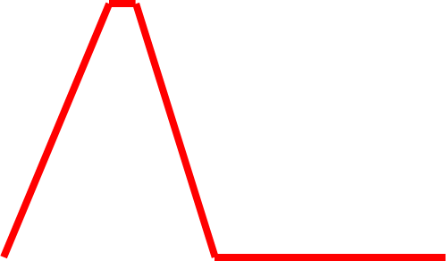
top-up injection: schematic cycle
beam current in collider (15 min. beam lifetime)
100%
99%
almost constant current
energy of accelerator ring
120 GeV
injection into collider
injection into
accelerator
20 GeV
10 s

Slide 24
top-up injection at PEP-II/BaBar
Before Top-Up Injection
After Top-Up Injection
average ≈ peak
luminosity (H≈1)!
J. Seeman

Slide 25
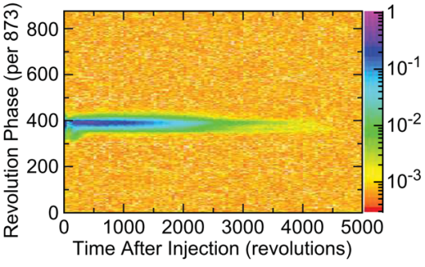
top-up injection: feasibility
HF 2012 conclusions (John Seeman, SLAC):
Top-up injection will work for a Circular Higgs Factory.
A full energy injector is needed.
A synchrotron injector will work the best, but is more than is needed (60 Hz!).
A rapidly ramped storage ring is likely adequate (4 sec).
The detectors will need to mask out the buckets with damping injected bunches during data taking as had been done for PEP-II/BaBar:
BaBar trigger masking:
Mask all of ring a few tens of turns.
Mask injected bunch area for 1250
turns or about 0.9 msec.

Slide 26
Circular Collider & SR Experience
…
CESR
BEPC
LEP
Tevatron
LEP2
HERA
DAFNE
PEP-II
KEKB
BEPC-II
LHC
SuperKEKB (soon)
3rd generation light sources
1992 ESRF, France (EU) 6 GeV
ALS, US 1.5-1.9 GeV
1993 TLS, Taiwan 1.5 GeV
1994 ELETTRA, Italy 2.4 GeV
PLS, Korea 2 GeV
MAX II, Sweden 1.5 GeV
1996 APS, US 7 GeV
LNLS, Brazil 1.35 GeV
1997 Spring-8, Japan 8 GeV
1998 BESSY II, Germany 1.9 GeV
2000 ANKA, Germany 2.5 GeV
SLS, Switzerland 2.4 GeV
2004 SPEAR3, US 3 GeV
CLS, Canada 2.9 GeV
2006: SOLEIL, France 2.8 GeV
DIAMOND, UK 3 GeV
ASP, Australia 3 GeV
MAX III, Sweden 700 MeV
Indus-II, India 2.5 GeV
2008 SSRF, China 3.4 GeV
2009 PETRA-III, Germany 6 GeV
2011 ALBA, Spain 3 GeV
well understood technology &
typically exceeding design performance
within a few years

Slide 27
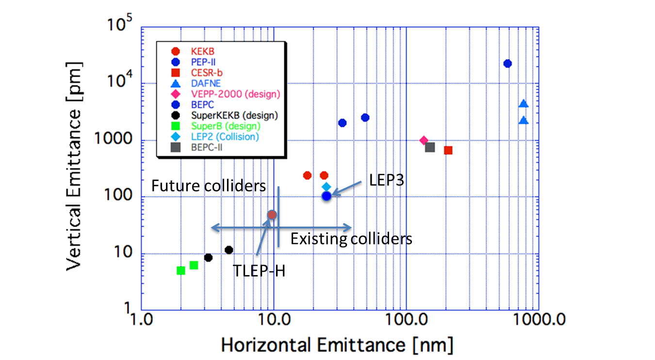
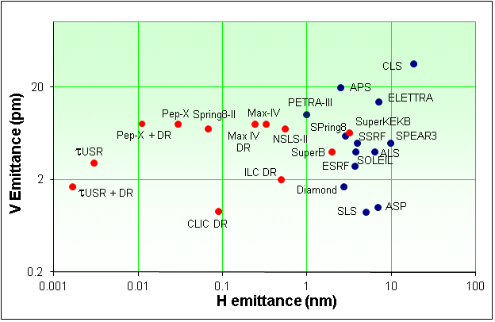
Emittances in Circular Colliders &
Modern Light Sources
Y. Funakoshi, KEK
LEP3
Top up injection essential for achieving small vertical emittance
Lenny Rivkin, 2nd LEP3 Day
TLEP (240)
R. Bartolini,
DIAMOND

Slide 28
circular HFs: synchroton-radiation heat load
LEP3 and TLEP have 3-10 times less SR heat load per meter than PEP-II or SPEAR! (though higher photon energy)
N. Kurita, U. Wienands, SLAC

Slide 29
circular Higgs Factories - R&D items
choice of RF frequency: 1.3 GHz (ILC)
or 700 MHz (ESS)? & RF coupler
SR handling and radiation shielding
(LEP experience)
beam-beam interaction for large Q_{s}
and significant hourglass effect
IR design with even larger momentum
acceptance
integration in LHC tunnel (LEP3)
Pretzel scheme for TERA-Z operation

Slide 30
LHeC Higgs Factory

Slide 31
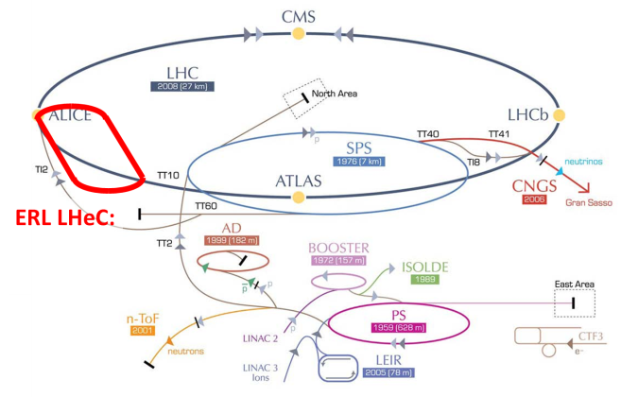
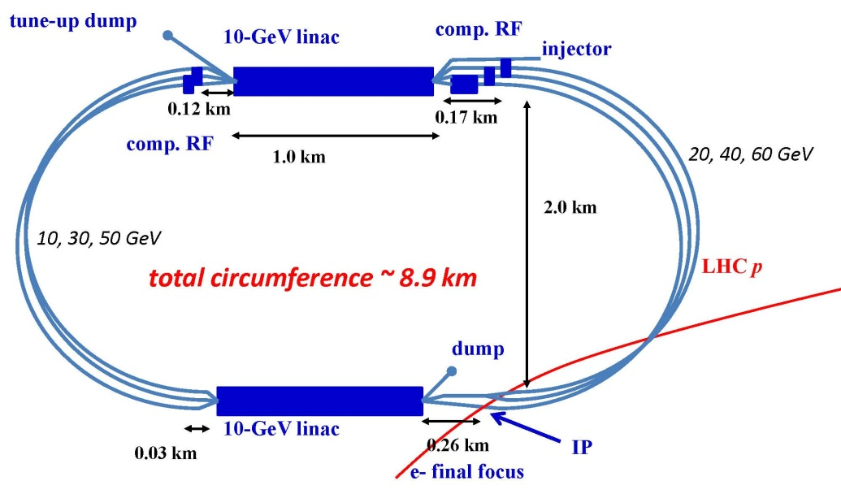
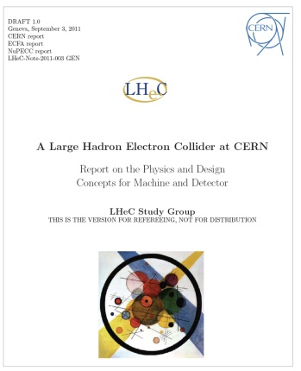
Large Hadron electron Collider (LHeC) HF
two 10-GeV SC linacs, ERL with 3 passes up, 3 passes down; 6.4 mA e⁻ current, 60 GeV e⁻’s collide w. LHC protons/ions,
L~10³³-10³⁴ cm⁻²s⁻¹
precision coupling measurements (Hb$\overline{b}$, Hγγ, H4l,…)
reduction of theoretical QCD-related uncertainties in pp Higgs physics
potential to find new physics at the cleanly accessible WWH (and ZZH)
LHeC CDR published in
J. Phys. G: Nucl. Part. Phys. 39
075001 (2012)
A. Bogacz, O. Brüning,
M. Klein, D. Schulte,
F. Zimmermann, et al

Slide 32
γγ Higgs Factories

Slide 33
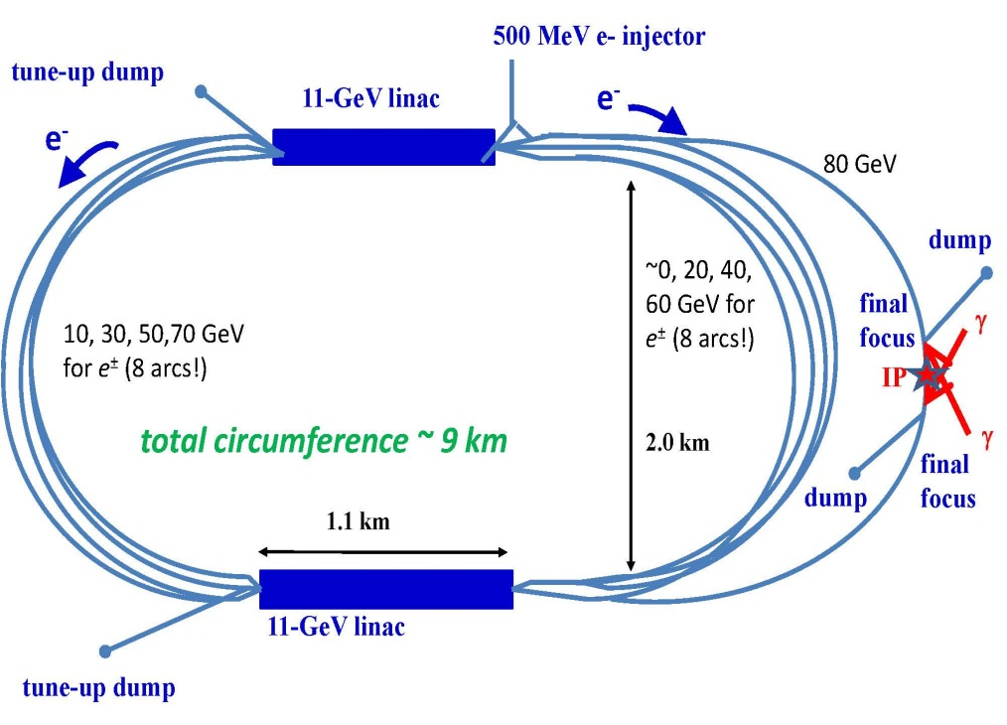
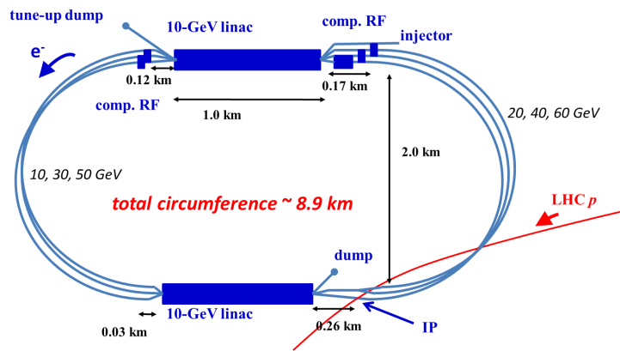
Reconfiguring LHeC → SAPPHiRE
SAPPHiRE*
γγ Higgs factory
LHeC-ERL
*Small Accelerator for Photon-Photon Higgs production using Recirculating Electrons

Slide 34
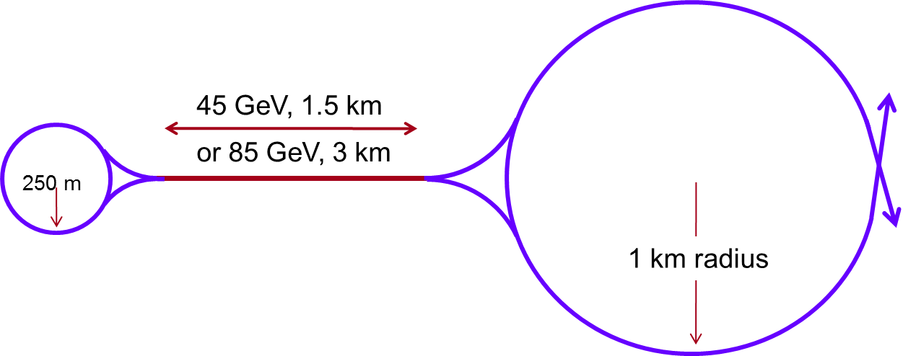
γγ HFs – additional examples
LHeC type (SAPPHiRE)
SLAC-ILC type (SILC)
upgrade with
plasma afterburners
T. Raubenheimer, SLAC
F. Zimmermann
Tevatron tunnel filler
HERA tunnel filler
F. Zimmermann
JLAB γγ
141 GeV CoM
E. Nissen
E. Nissen, JLAB

Slide 35
γγ Higgs Factories - R&D items
γγ interaction region
large high-finesse optical cavity
high repetition rate laser
and/or FEL in unusual regime
separation scheme for beams
circulating in opposite directions
polarized low-emittance e⁻ gun
detector

Slide 36
μ Collider Higgs Factory

Slide 37
μ collider HF
D. Neuffer, FNAL
8 GeV, 4MW p source (Project-X upgrade)
15 Hz, 4 bunches 5×10¹³/bunch
π→μ collection, bunching, cooling
ε_{⊥,N} =400 π mm-mrad, ε_{‖,N}= 2 π mm, 10¹² μ/ bunch
Accelerate, Collider ring
δE = 4 MeV, C=300m
for energy measurement, δE_{error} → 0.1 MeV
one challenge: rms momentum spread of 0.004%!

Slide 38
Comparison, Conclusions, & Outlook

Slide 39
Circular & Linear HF:
peak luminosity vs energy
LEP3 , TLEP
x 4 IPs
LEP3/TLEP would be THE choice for e⁺e⁻ collision energies up to ~370 GeV
K. Yokoya, KEK

Slide 40
vertical rms IP spot sizes in nm
in regular
font:
achieved
in italics:
design
values
LEP2 | 3500
KEKB | 940
SLC | 500
LEP3 | 320
TLEP-H | 220
ATF2, FFTB | 150? (35), 65
SuperKEKB | 50
SAPPHiRE | 18
ILC | 5 – 8
CLIC | 1 – 2
β_{y}*:
5 cm→
1 mm
LEP3/TLEP
will learn
from ATF2 &
SuperKEKB

Slide 41
HF Accelerator Quality (My Opinion)
 | Linear C. | Circular C. | LHeC | Muon C. | γ−γ C.
maturity | ☺ | ☺ ☺ | ☺ ☺ | ☹ | ☹
size | ☹ | ☹ | ☺ | ☺☺ | ☺
cost | ☹ | ☺ - 😐 | ☺ | ☹ | ☺
power | 😐 | 😐 | 😐 | 😐 | 😐
#IPs | 1 | 4 | 1 | 1 | 1
com. time | 10 yr | 2 yr | 2 yr | 10 yr | 5 yr
H factor | 0.15 (4xSLC) | 0.5 (1/2 PEP-II) | 0.2? | 0.1? | 0.1?
Higgs/IP/yr | 5 k [10 k] | 20-100 k | 5 k | 5 k | 10 k
expanda-bility | 1-3TeV e⁺e⁻, γγ C. | 100 TeV pp | γγ C. | 10 TeV μμ | LC later
inspired by S. Henderson, FNAL

Slide 42
possible long-term strategy
TLEP (80 km,
e⁺e⁻, up to
~350 GeV c.m.)
PSB
PS (0.6 km)
SPS (6.9 km)
LHC (26.7 km)
LEP3
(e⁺e⁻, 240 GeV c.m.)
SHE-LHC
(pp, up to
100 TeV c.m.)
also: e± (200 GeV) – p (7 & 50 TeV) collisions
≥50 years of e⁺e⁻, pp, ep/A physics at highest energies

Slide 43
quoting Nick Walker, ILC-GDE,
having the tunnel is everything!

Slide 44
near-term outlook
ICFA HF2012 Organizing Committee (OC) will write workshop report including comparison tables & Executive Summary
Target readers:
Joint ICFA – Lab Directors meeting (February 21-22, 2013 at TRIUMF)
US Snowmass 2013 conference
European Strategy Updates meeting (January 21-22, 2013)
HEP roadmap study in Asia (Japan and China)
World HEP and accelerator communities
HF2012 OC recommends these studies should continue!
HF accelerator R&D at CERN?

Slide 45
Mikhail S. Gorbachev
If what you have done yesterday
still looks big to you,
you haven’t done much today.

Slide 46
back-up slides

Slide 47
luminosity formulae & constraints
$$L=\frac{f_{rev}n_{b}N_{b}^{2}}{4πσ_{x}σ_{y}}=\left(f_{rev}n_{b}N_{b}\right)\left(\frac{N_{b}}{ε_{x}}\right)\frac{1}{4π}\frac{1}{\sqrt{β_{x}β_{y}}}\frac{1}{\sqrt{{ε_{y}}/{ε_{x}}}}$$
$$\left(f_{rev}n_{b}N_{b}\right)=\frac{P_{SR }ρ}{8.8575×{10}^{−5}\frac{\text{m}}{{\text{GeV}}^{−3}}E^{4}}$$
SR radiation
power limit
$$\frac{N_{b}}{ε_{x}}=\frac{ξ_{x}2πγ\left(1+κ_{σ}\right)}{r_{e}}$$
beam-beam limit
$$\frac{N_{b}}{σ_{x}σ_{z}}\frac{30 γr_{e}^{2}}{ δ_{acc} α}<1$$
>30 min beamstrahlung lifetime (Telnov) → N_{b},β_{x}
→minimize κ_{ε}=ε_{y}/ε_{x,} β_{y}~β_{x}(ε_{y}/ε_{x}) and respect β_{y}≥σ_{z}

Slide 48
LEP3/TLEP parameters -1
soon at SuperKEKB:
β_{x}*=0.03 m, β_{Y}*=0.03 cm
 | LEP2 | LHeC | LEP3 | TLEP-Z | TLEP-H | TLEP-t
beam energy Eb [GeV] circumference [km] beam current [mA] #bunches/beam #e−/beam [10¹²] horizontal emittance [nm] vertical emittance [nm] bending radius [km] partition number J_{ε} momentum comp. α_{c} [10⁻⁵] SR power/beam [MW] β∗_{x} [m] β∗_{y} [cm] σ∗_{x} [μm] σ∗_{y} [μm] hourglass F_{hg} ΔE^{SR}_{loss}/turn [GeV] | 104.5 26.7 4 4 2.3 48 0.25 3.1 1.1 18.5 11 1.5 5 270 3.5 0.98 3.41 | 60 26.7 100 2808 56 5 2.5 2.6 1.5 8.1 44 0.18 10 30 16 0.99 0.44 | 120 26.7 7.2 4 4.0 25 0.10 2.6 1.5 8.1 50 0.2 0.1 71 0.32 0.59 6.99 | 45.5 80 1180 2625 2000 30.8 0.15 9.0 1.0 9.0 50 0.2 0.1 78 0.39 0.71 0.04 | 120 80 24.3 80 40.5 9.4 0.05 9.0 1.0 1.0 50 0.2 0.1 43 0.22 0.75 2.1 | 175 80 5.4 12 9.0 20 0.1 9.0 1.0 1.0 50 0.2 0.1 63 0.32 0.65 9.3
SuperKEKB:ε_{y}/ε_{x}=0.25%

Slide 49
LEP3/TLEP parameters -2
LEP2 was not beam-beam limited
 | LEP2 | LHeC | LEP3 | TLEP-Z | TLEP-H | TLEP-t
V_{RF,tot} [GV] δ_{max,RF} [%] ξ_{x}/IP ξ_{y}/IP f_{s} [kHz] E_{acc} [MV/m] eff. RF length [m] f_{RF} [MHz] δ^{SR}_{rms} [%] σ^{SR}_{z,rms} [cm] L/IP[10³²cm⁻²s⁻¹] number of IPs Rad.Bhabha b.lifetime [min] ϒ_{BS} [10⁻⁴] n_{γ}/collision Δδ^{BS}/collision [MeV] Δδ^{BS}_{rms}/collision [MeV] | 3.64 0.77 0.025 0.065 1.6 7.5 485 352 0.22 1.61 1.25 4 360 0.2 0.08 0.1 0.3 | 0.5 0.66 N/A N/A 0.65 11.9 42 721 0.12 0.69 N/A 1 N/A 0.05 0.16 0.02 0.07 | 12.0 5.7 0.09 0.08 2.19 20 600 700 0.23 0.31 94 2 18 9 0.60 31 44 | 2.0 4.0 0.12 0.12 1.29 20 100 700 0.06 0.19 10335 2 74 4 0.41 3.6 6.2 | 6.0 9.4 0.10 0.10 0.44 20 300 700 0.15 0.17 490 2 32 15 0.50 42 65 | 12.0 4.9 0.05 0.05 0.43 20 600 700 0.22 0.25 65 2 54 15 0.51 61 95
LEP data for 94.5 - 101 GeV consistently suggest a beam-beam limit of ~0.115 (R.Assmann, K. C.)

Slide 50
S. Henderson’s Livingston Chart: Luminosity
TLEP-Z
TLEP-W
adding TLEP to the chart!
TLEP-H
TLEP-t

Slide 51
Circular HF HiTech option
H. Piekarz,
1st EuCARD LEP3 Day
transmission-line
HTS/LTS magnets
schematic HTS/LTS LEP3 magnet
SC magnets require typically 10 x less space than NC magnet of the same field and gap; the magnet weight is very significantly reduced.
HTS prototype dipole at FNAL
Test: B _{max} = 0.5 T, I_{max} = 27 kA, dB/dt _{max} = 10 T/s , T _{max} ~ 25 K
acceleration time ~0.1 s,
total cycle ~1 s; fast SC
magnets might support
1 minute lifetime
in collider ring!

