Slide 1
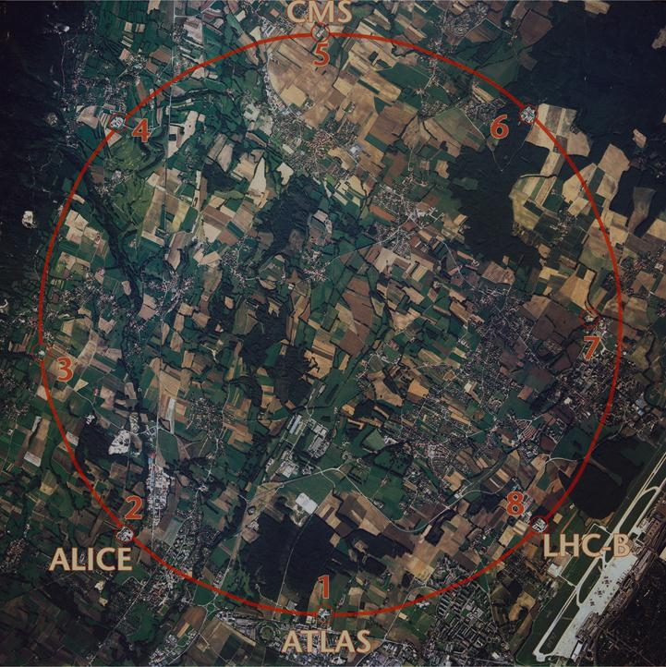



Circular Higgs Factories:
LEP3, TLEP and SAPPHiRE
cern.ch/accnet
Frank Zimmermann
KEK, 6 November 2012
work supported by the European Commission under the FP7 Research Infrastructures project EuCARD, grant agreement no. 227579

Slide 2
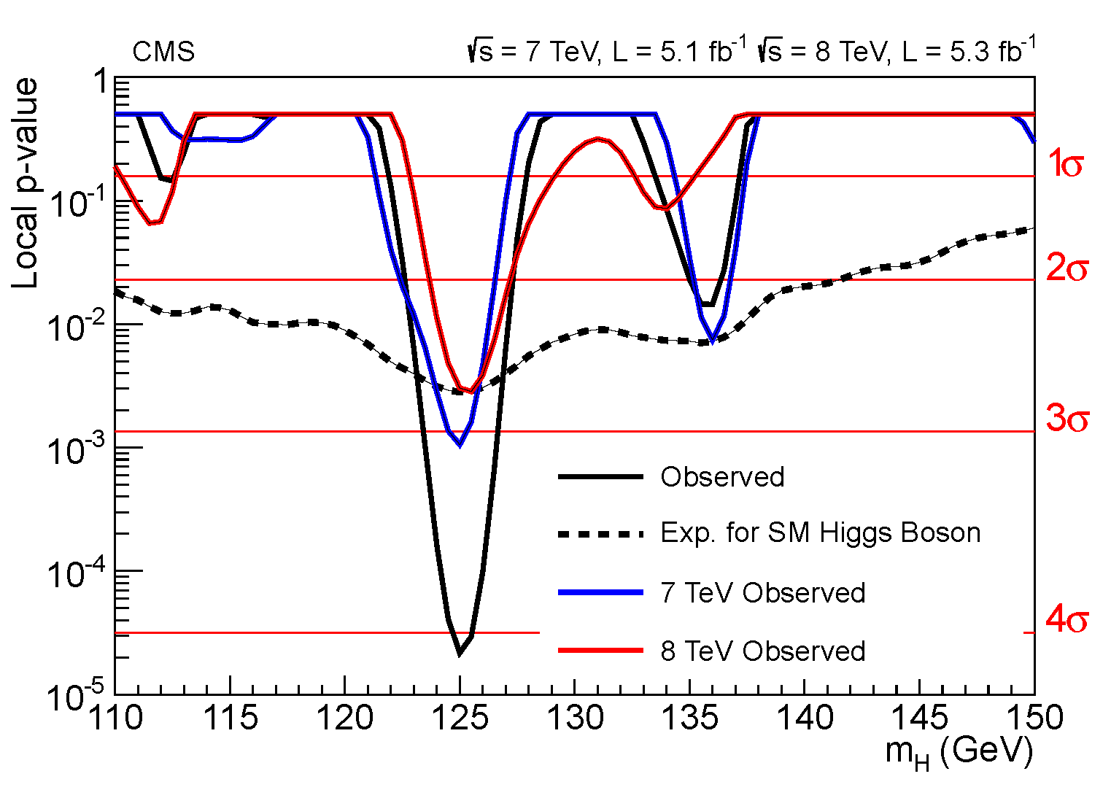
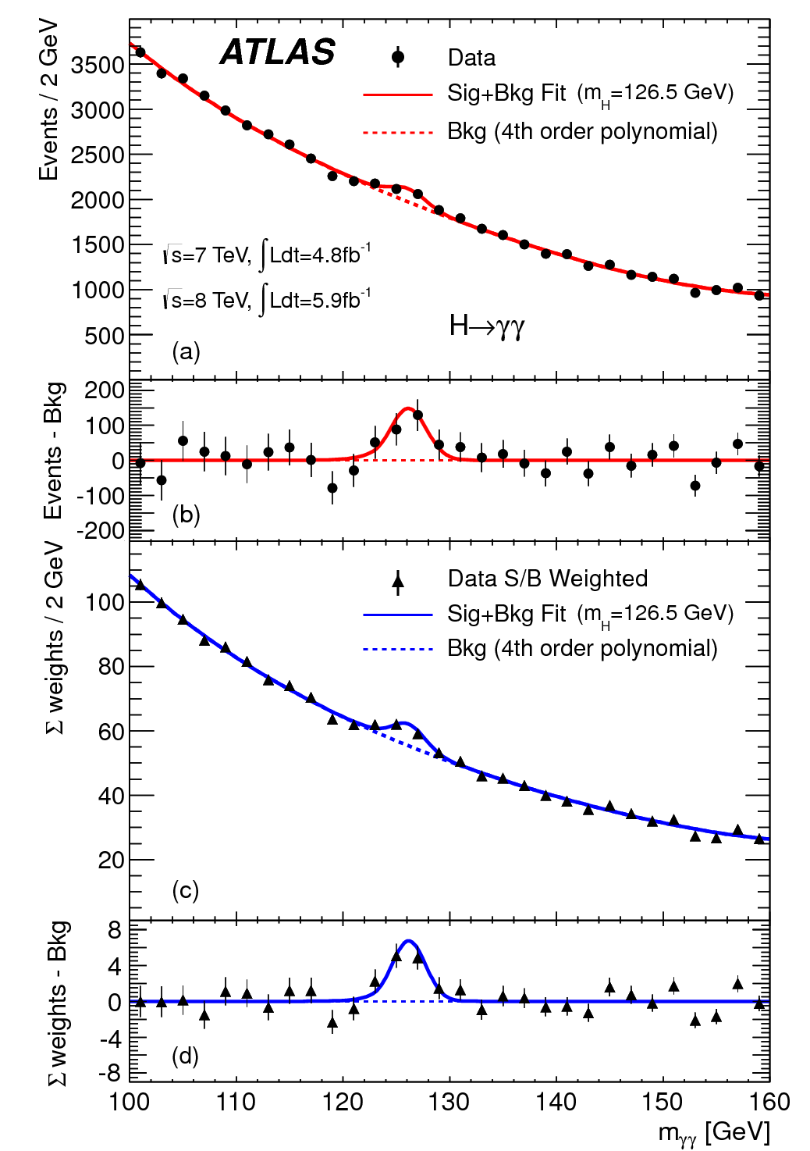

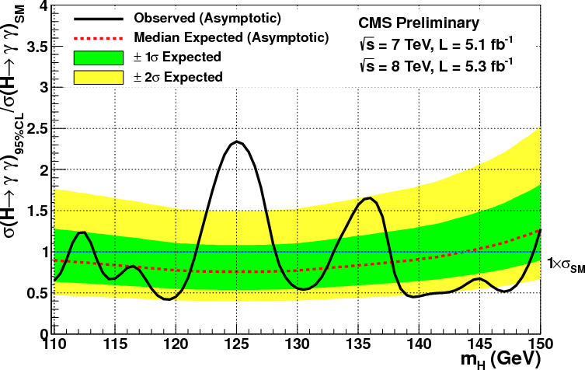
4 July 2012 - X(125) “Higgs” discovery

Slide 3

Part 1 – LEP3 / TLEP

Slide 4
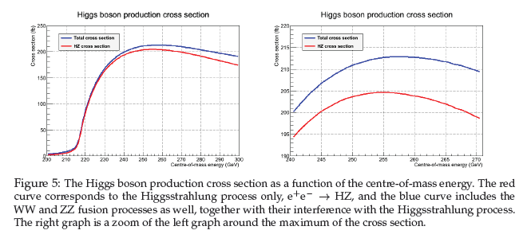
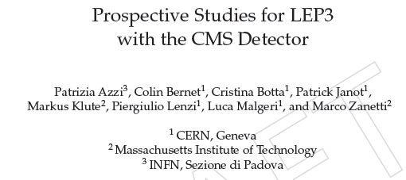
Higgs e⁺e⁻ production cross section
best for tagged ZH physics:
Ecm= m_{H}+111±10
W. Lohmann et al LCWS/ILC2007
take 240 GeV
A. Blondel

Slide 5
Higgs production mechanism
in e⁺e– collisions a light Higgs is produced by the “Higgstrahlung” process close to threshold ; production section has a maximum at near threshold ~200 fb
10³⁴/cm²/s ➔ 20’000 H-Z events per year.
e⁻
H
Z – tagging
& missing mass
Z*
e⁺
Z
For a Higgs of 125GeV, a centre of mass energy of 240GeV is sufficient ➔ kinematical constraint near threshold for high precision in mass, width, selection purity
A. Blondel

Slide 6
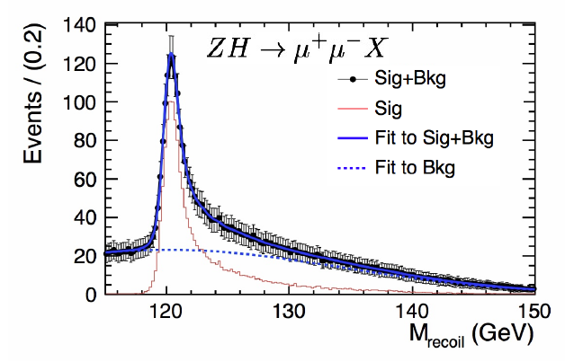
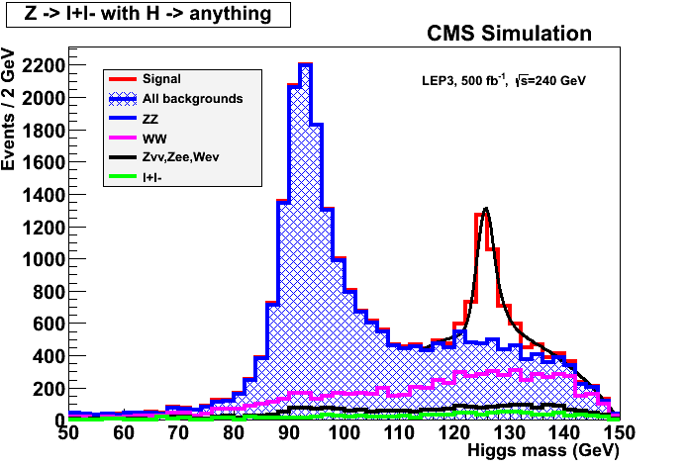
ILC
A. Blondel
Z – tagging
& missing mass
e⁻
H
Z*
e⁺
Z
total rate ∝ g_{HZZ}²
ZZZ final state ∝ g_{HZZ}⁴/ Γ_{H}
➔ measure total width Γ_{H}

Slide 7
a long-term strategy for HEP
TLEP (80 km,
e⁺e⁻, up to
~350 GeV c.m.)
PSB
PS (0.6 km)
SPS (6.9 km)
LHC (26.7 km)
LEP3
(240 GeV c.m.)
VHE-LHC
(pp, up to
100 TeV c.m.)
also: e± (200 GeV) – p (7 & 50 TeV) collisions

Slide 8
two options
installation in the LHC tunnel “LEP3”
  + inexpensive (<0.1xLC)
  + tunnel exists
  + reusing ATLAS and CMS detectors
  + reusing LHC cryoplants
  - interference with LHC and HL-LHC
new larger tunnel “TLEP”
  + higher energy reach, 5-10x higher luminosity
  + decoupled from LHC/HL-LHC operation & construction
  + tunnel can later serve for HE-LHC (factor 3 in energy from tunnel alone) with LHC remaining as injector
  - 4-5x more expensive (new tunnel, cryoplants, detectors)

Slide 9
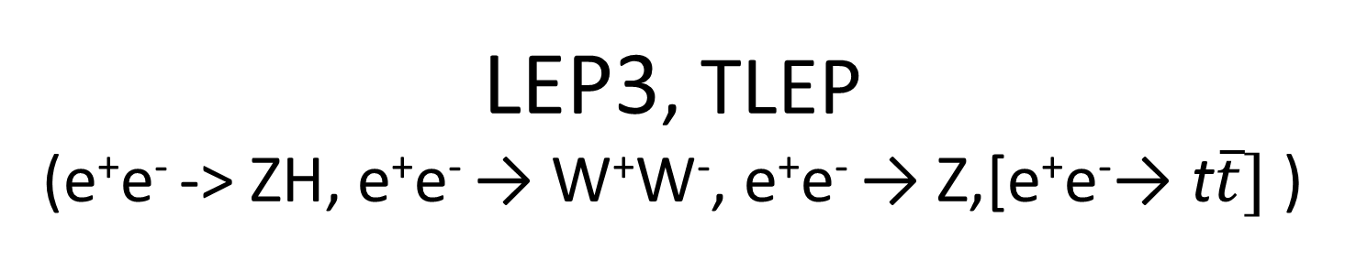
LEP3, TLEP
(e⁺e⁻ -> ZH, e⁺e⁻ → W⁺W⁻, e⁺e⁻ → Z,[e⁺e⁻→ t$\overline{t}]$ )
key parameters
 | LEP3 | TLEP
circumference | 26.7 km | 81 km
max beam energy | 120 GeV | 175 GeV
max no. of IPs | 4 | 4
luminosity at 350 GeV c.m. | - | 0.7x10³⁴ cm⁻²s⁻¹
luminosity at 240 GeV c.m. | 10³⁴ cm⁻²s⁻¹ | 5x10³⁴ cm⁻²s⁻¹
luminosity at 160 GeV c.m. | 5x10³⁴ cm⁻²s⁻¹ | 2.5x10³⁵ cm⁻²s⁻¹
luminosity at 90 GeV c.m. | 2x10³⁵ cm⁻²s⁻¹ | 10³⁶ cm⁻²s⁻¹

Slide 10
other LEP3 parameters
arc optics
same as for LHeC: ε_{x,LHeC}<1/3 ε_{x,LEP1.5} at equal beam energy,
optical structure compatible with present LHC machine
small momentum compaction (short bunch length)
assume ε_{y}/ε_{x} ~5x10⁻³ similar to LEP (ultimate limit ε_{y} ~ 1 fm from opening angle)
RF
RF frequency 1.3 GHz or 700 MHz
ILC/ESS-type RF cavities high gradient (20 MV/m assumed, 2.5 times LEP gradient)
total RF length for LEP3 at 120 GeV similar to LEP at 104.5 GeV
short bunch length (small β*_{y})
cryo power <1/2 LHC
synchrotron radiation
energy loss / turn: E_{loss}[GeV]=88.5×10⁻⁶ (E_{b}[GeV])⁴ /ρ[m].
higher energy loss than necessary
arc dipole field = 0.153 T
compact magnet
critical photon energy = 1.4 MeV
50 MW per beam (total wall plug power ~200 MW ~ LHC complex)→4x10¹² e±/beam

Slide 11
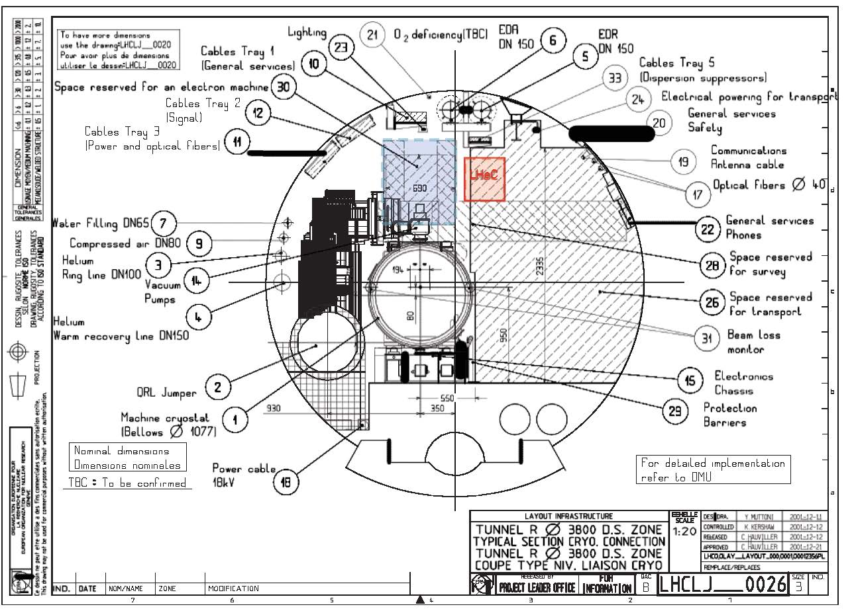
putting LEP3 into the LHC tunnel?
LHC tunnel cross section with space reserved for a future lepton machine like LEP3 [blue box above the LHC magnet] and with the presently proposed location of the LHeC ring [red]

Slide 12
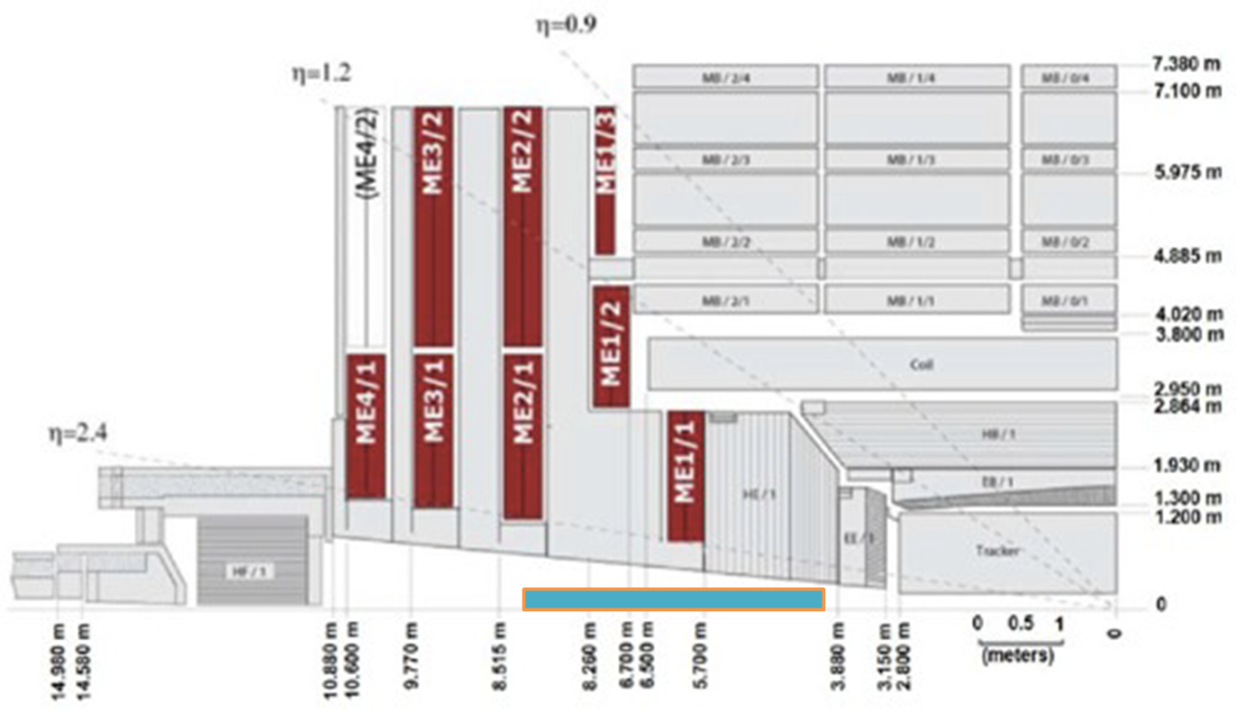
integrating LEP3 IR in CMS detector?
Azzi, et al..
QUADS insertions in the CMS detector
A. Blondel, ATLAS Meeting 4 Oct. 2012

Slide 13
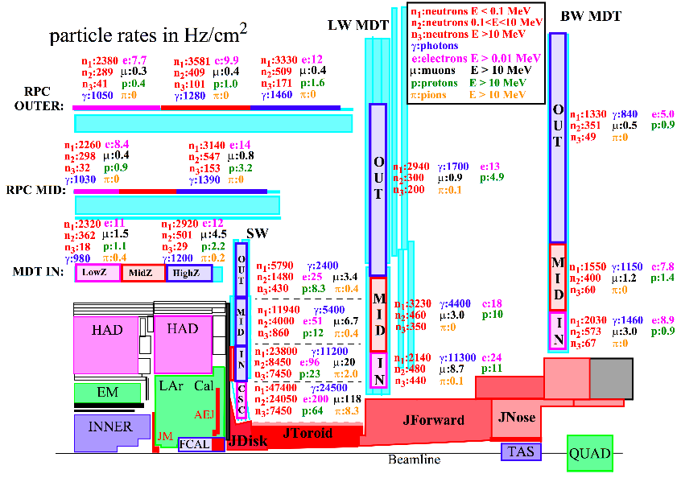
integrating LEP3 IR in ATLAS detector?
based on
M. Nessi
CARE-HHH
IR’07
z=3.49-4.58 m
r_{max}=18 cm
z=6.8-8.66 m
r_{max}=43 cm
z=8.69-12.870 m
r_{max}=87 cm
z=12.95-18.60 m
r_{max}=150 cm

Slide 14
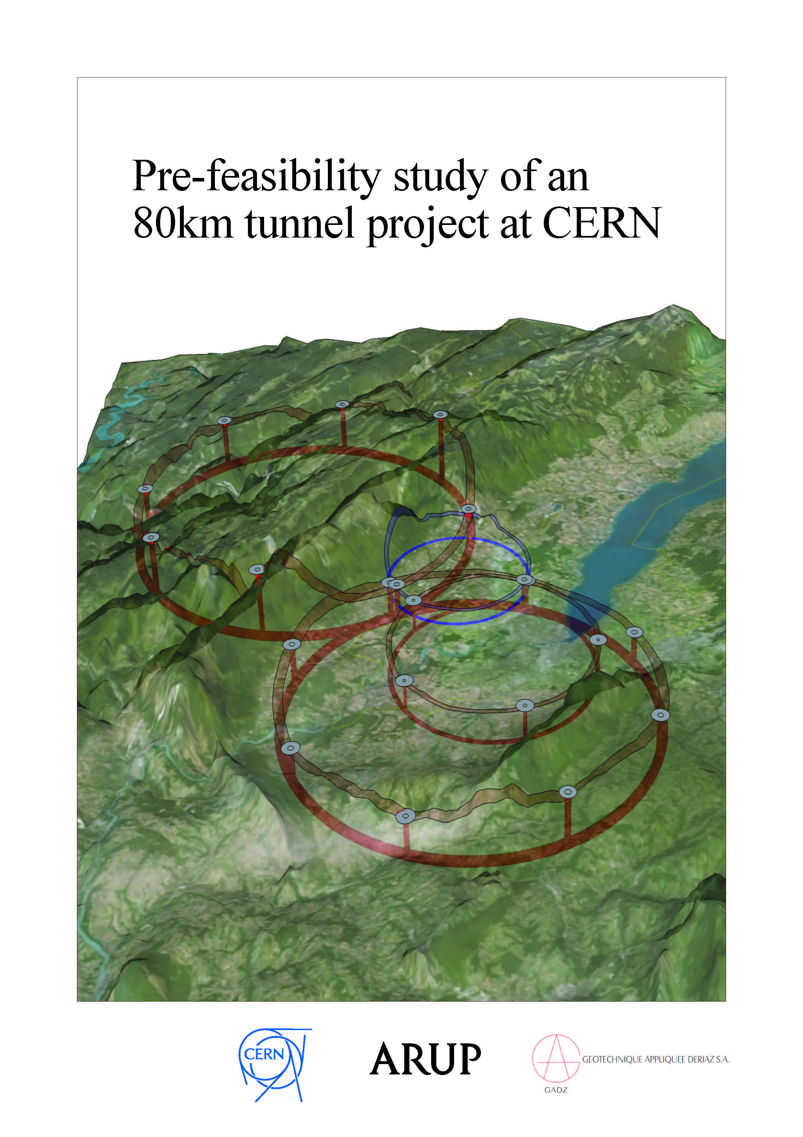
a new tunnel for TLEP in the Geneva area?

Slide 15
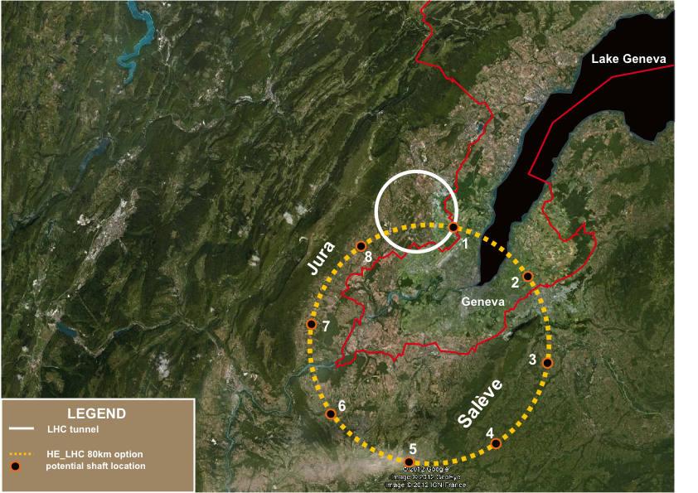
TLEP tunnel in the Geneva area – “best” option
«Pre-Feasibility Study for an 80-km tunnel at CERN»
John Osborne and Caroline Waaijer,
CERN, ARUP & GADZ, submitted to ESPG

Slide 16
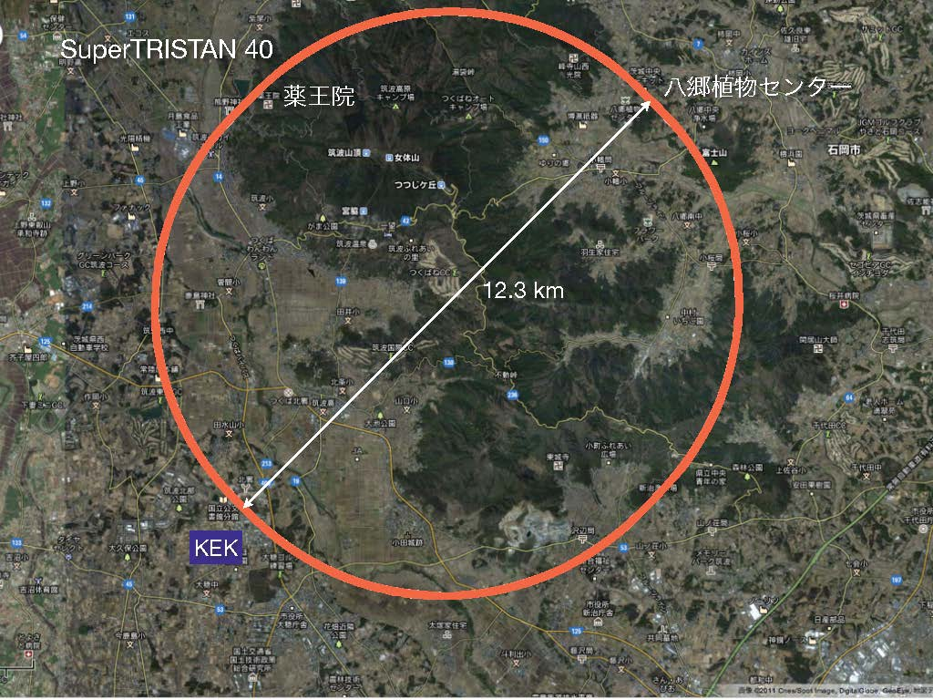
TLEP tunnel in the KEK area?
my wife’s home about here
SuperTRISTAN in Tsukuba: 40-80 km ring
Proposal by K. Oide, 13 February 2012

Slide 17
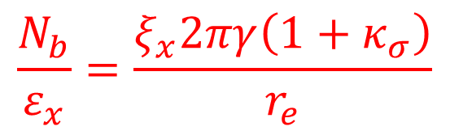
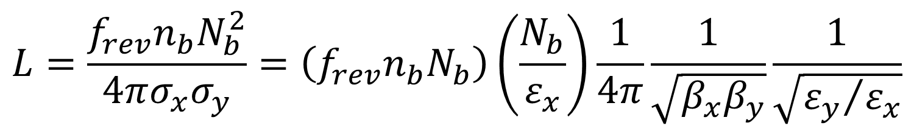
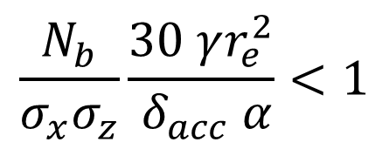
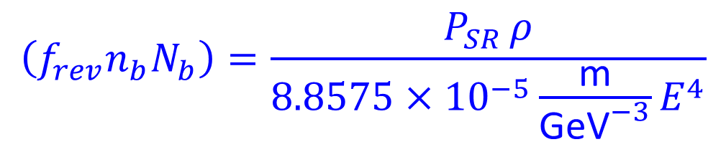
luminosity formulae & constraints
$$L=\frac{f_{rev}n_{b}N_{b}^{2}}{4πσ_{x}σ_{y}}=\left(f_{rev}n_{b}N_{b}\right)\left(\frac{N_{b}}{ε_{x}}\right)\frac{1}{4π}\frac{1}{\sqrt{β_{x}β_{y}}}\frac{1}{\sqrt{{ε_{y}}/{ε_{x}}}}$$
$$\left(f_{rev}n_{b}N_{b}\right)=\frac{P_{SR }ρ}{8.8575×{10}^{−5}\frac{\text{m}}{{\text{GeV}}^{−3}}E^{4}}$$
SR radiation
power limit
$$\frac{N_{b}}{ε_{x}}=\frac{ξ_{x}2πγ\left(1+κ_{σ}\right)}{r_{e}}$$
beam-beam limit
$$\frac{N_{b}}{σ_{x}σ_{z}}\frac{30 γr_{e}^{2}}{ δ_{acc} α}<1$$
>30 min beamstrahlung lifetime (Telnov) → N_{b},β_{x}
→minimize κ_{ε}=ε_{y}/ε_{x,} β_{y}~β_{x}(ε_{y}/ε_{x}) and respect β_{y}≥σ_{z}

Slide 18
LEP3/TLEP parameters -1
 | LEP2 | LHeC | LEP3 | TLEP-Z | TLEP-H | TLEP-t
beam energy Eb [GeV] circumference [km] beam current [mA] #bunches/beam #e−/beam [10¹²] horizontal emittance [nm] vertical emittance [nm] bending radius [km] partition number J_{ε} momentum comp. α_{c} [10⁻⁵] SR power/beam [MW] β∗_{x} [m] β∗_{y} [cm] σ∗_{x} [μm] σ∗_{y} [μm] hourglass F_{hg} ΔE^{SR}_{loss}/turn [GeV] | 104.5 26.7 4 4 2.3 48 0.25 3.1 1.1 18.5 11 1.5 5 270 3.5 0.98 3.41 | 60 26.7 100 2808 56 5 2.5 2.6 1.5 8.1 44 0.18 10 30 16 0.99 0.44 | 120 26.7 7.2 4 4.0 25 0.10 2.6 1.5 8.1 50 0.2 0.1 71 0.32 0.59 6.99 | 45.5 80 1180 2625 2000 30.8 0.15 9.0 1.0 9.0 50 0.2 0.1 78 0.39 0.71 0.04 | 120 80 24.3 80 40.5 9.4 0.05 9.0 1.0 1.0 50 0.2 0.1 43 0.22 0.75 2.1 | 175 80 5.4 12 9.0 20 0.1 9.0 1.0 1.0 50 0.2 0.1 63 0.32 0.65 9.3

Slide 19
LEP3/TLEP parameters -2
LEP2 was not beam-beam limited
 | LEP2 | LHeC | LEP3 | TLEP-Z | TLEP-H | TLEP-t
V_{RF,tot} [GV] δ_{max,RF} [%] ξ_{x}/IP ξ_{y}/IP f_{s} [kHz] E_{acc} [MV/m] eff. RF length [m] f_{RF} [MHz] δ^{SR}_{rms} [%] σ^{SR}_{z,rms} [cm] L/IP[10³²cm⁻²s⁻¹] number of IPs Rad.Bhabha b.lifetime [min] ϒ_{BS} [10⁻⁴] n_{γ}/collision Δδ^{BS}/collision [MeV] Δδ^{BS}_{rms}/collision [MeV] | 3.64 0.77 0.025 0.065 1.6 7.5 485 352 0.22 1.61 1.25 4 360 0.2 0.08 0.1 0.3 | 0.5 0.66 N/A N/A 0.65 11.9 42 721 0.12 0.69 N/A 1 N/A 0.05 0.16 0.02 0.07 | 12.0 5.7 0.09 0.08 2.19 20 600 700 0.23 0.31 94 2 18 9 0.60 31 44 | 2.0 4.0 0.12 0.12 1.29 20 100 700 0.06 0.19 10335 2 74 4 0.41 3.6 6.2 | 6.0 9.4 0.10 0.10 0.44 20 300 700 0.15 0.17 490 2 32 15 0.50 42 65 | 12.0 4.9 0.05 0.05 0.43 20 600 700 0.22 0.25 65 2 54 15 0.51 61 95
LEP data for 94.5 - 101 GeV consistently suggest a beam-beam limit of ~0.115 (R.Assmann, K. C.)

Slide 20
beam lifetime
LEP2:
beam lifetime ~ 6 h
dominated by radiative Bhahba scattering with cross section σ~0.215 barn
LEP3:
with L~10³⁴ cm⁻²s⁻¹ at each of two IPs:
τ_{beam,LEP3}~18 minutes from rad. Bhabha
additional beam lifetime limit due to beamstrahlung requires: (1) large momentum acceptance (δ_{max,RF} ≥ 3%), and/or (2) flat(ter) beams and/or (3) fast replenishing
(Valery Telnov, Kaoru Yokoya, Marco Zanetti)

Slide 21
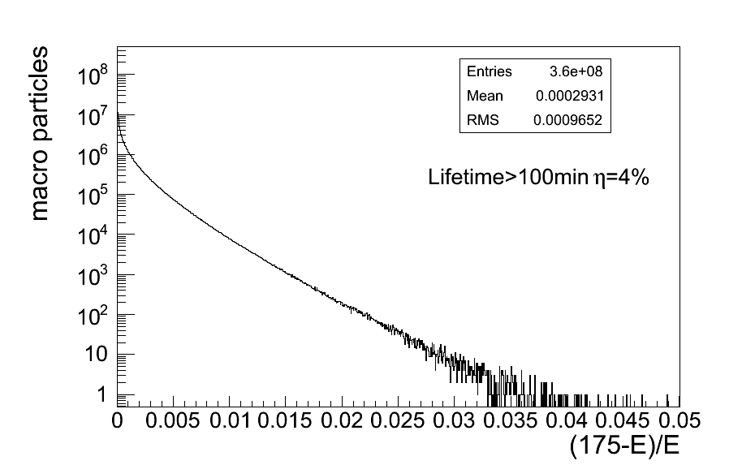
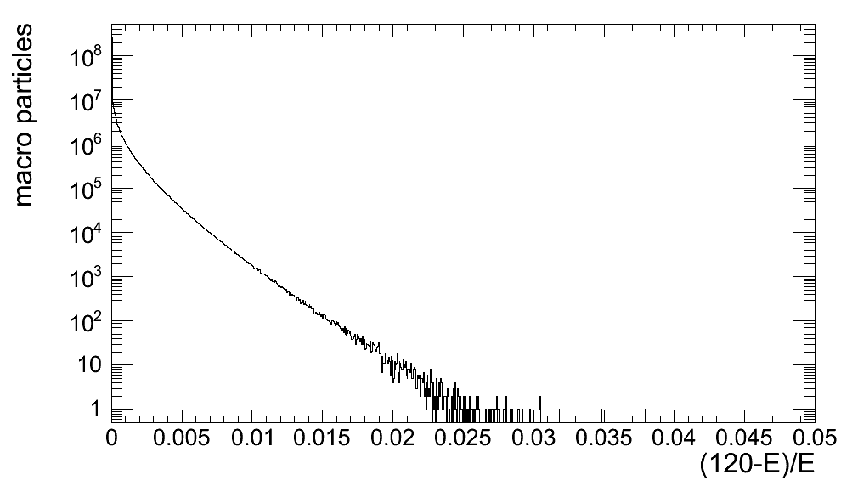
energy spectrum after 1 collision
GUINEA-PIG simulation with 360M macroparticles
lifetime depends exponentially on energy acceptance η
M. Zanetti, MIT
2nd LEP3 Day
TLEP-H
TLEP-t
BS lifetime >100 min at η=4%
BS lifetime>4h at η=3%
as for LEP3, TLEP BS lifetime well above required threshold
in particular there is some margin for TLEP-H

Slide 22
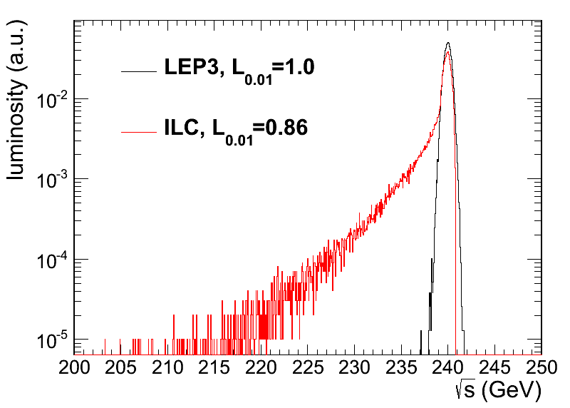
note: beamstrahlung effect at LEP3 much smaller than for ILC, ~monochromatic luminosity profile
M. Zanetti, MIT
2nd LEP3 Day
beamstrahlung much more benign than for linear collider;
LEP3/TLEP are clean machines

Slide 23
LEP3/TLEP: double ring w. top-up injection supports short lifetime & high luminosity
A. Blondel
a first ring accelerates electrons and positrons up to operating energy (120 GeV) and injects them at a few minutes interval into the low-emittance collider ring, which includes high luminosity ≥10³⁴ cm⁻² s⁻¹ interaction points

Slide 24
top-up injection: e⁺ production
top-up interval << beam lifetime
→ average luminosity ≈ peak luminosity!
LEP3 needs about 4×10¹² e⁺ every few minutes, or of order 2×10¹⁰ e⁺ per second
for comparison:
LEP injector complex delivered ~10¹¹ e⁺ per second (5x more than needed for LEP3!)

Slide 25
top-up injection: magnet ramp
SPS as LEP injector accelerated e± from 3.5 to 20 GeV (later 22 GeV) on a very short cycle:
acceleration time = 265 ms or about 62.26 GeV/s
Ref. K. Cornelis, W. Herr, R. Schmidt, “Multicycling of the CERN SPS: Supercycle Generation & First Experience with this mode of Operation,” Proc. EPAC 1988
LEP3/TLEP: with injection from SPS into top-up accelerator at 20 GeV and final energy of 120 GeV → acceleration time = 1.6 seconds
total cycle time = 10 s looks conservative (→ refilling ~1% of the LEP3 beam, for τ_{beam}~18 min)
Ghislain Roy & Paul Collier

Slide 26
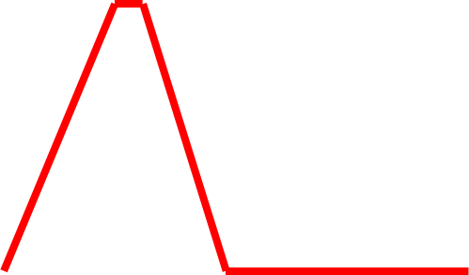
top-up injection: schematic cycle
beam current in collider (15 min. beam lifetime)
100%
99%
almost constant current
energy of accelerator ring
120 GeV
injection into collider
injection into
accelerator
20 GeV
10 s

Slide 27
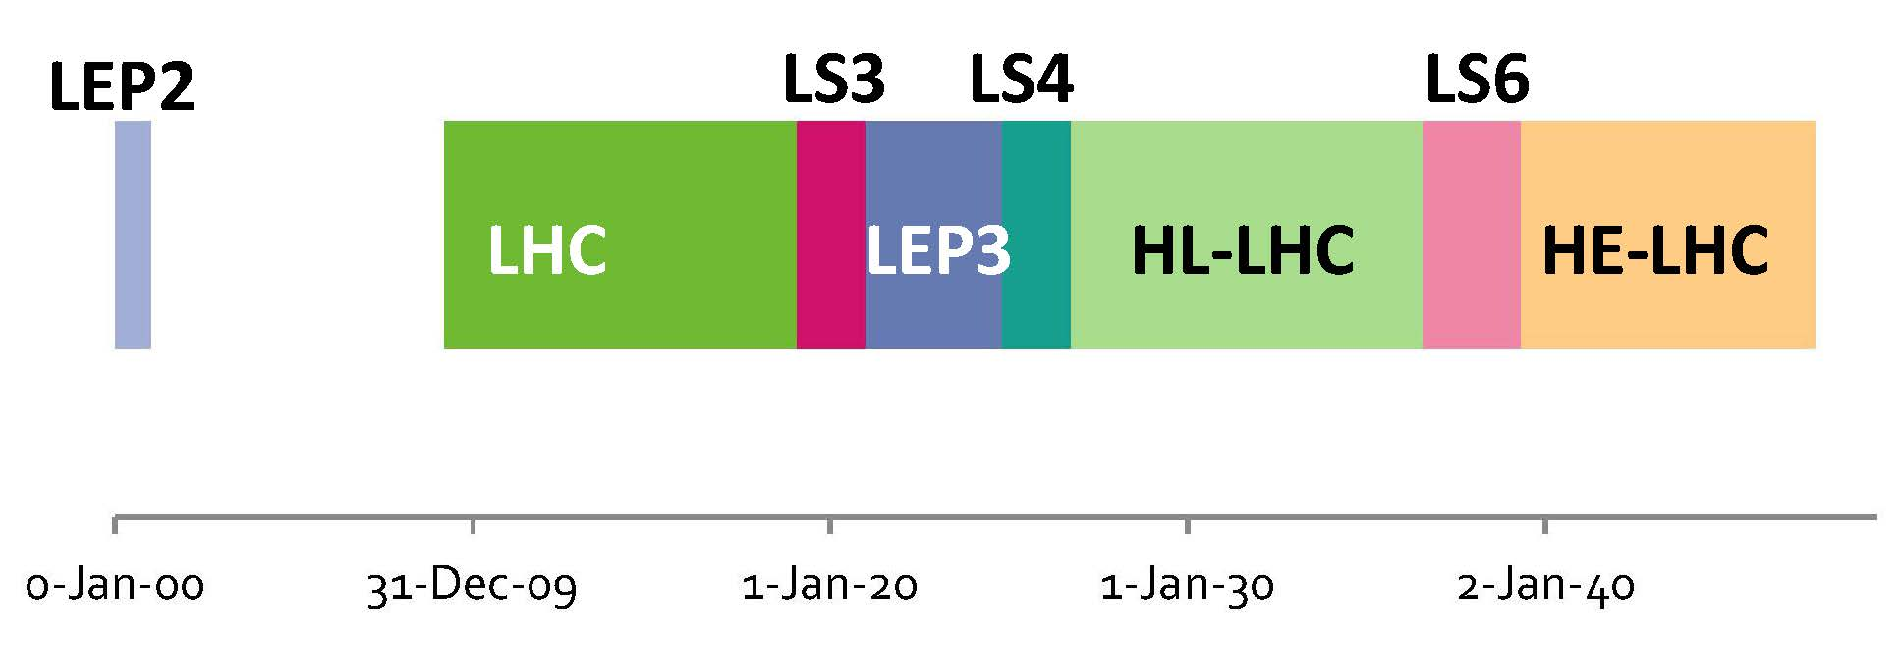
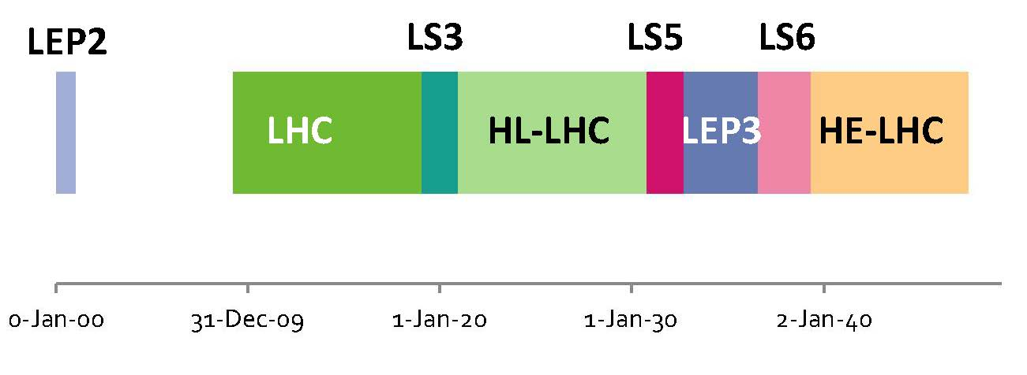
two schematic time schedules for LEP3
(LEP3 run time likely to be longer than shown)
of course TLEP would be constructed independently and could pave a direct path to VHE-LHC

Slide 28
LEP3/TLEP R&D items
choice of RF frequency: 1.3 GHz (ILC)
  or 700 MHz (ESS)? & RF coupler
SR handling and radiation shielding
  (LEP experience)
beam-beam interaction for large Q_{s}
and significant hourglass effect
IR design with large momentum
acceptance
integration in LHC tunnel (LEP3)

Slide 29
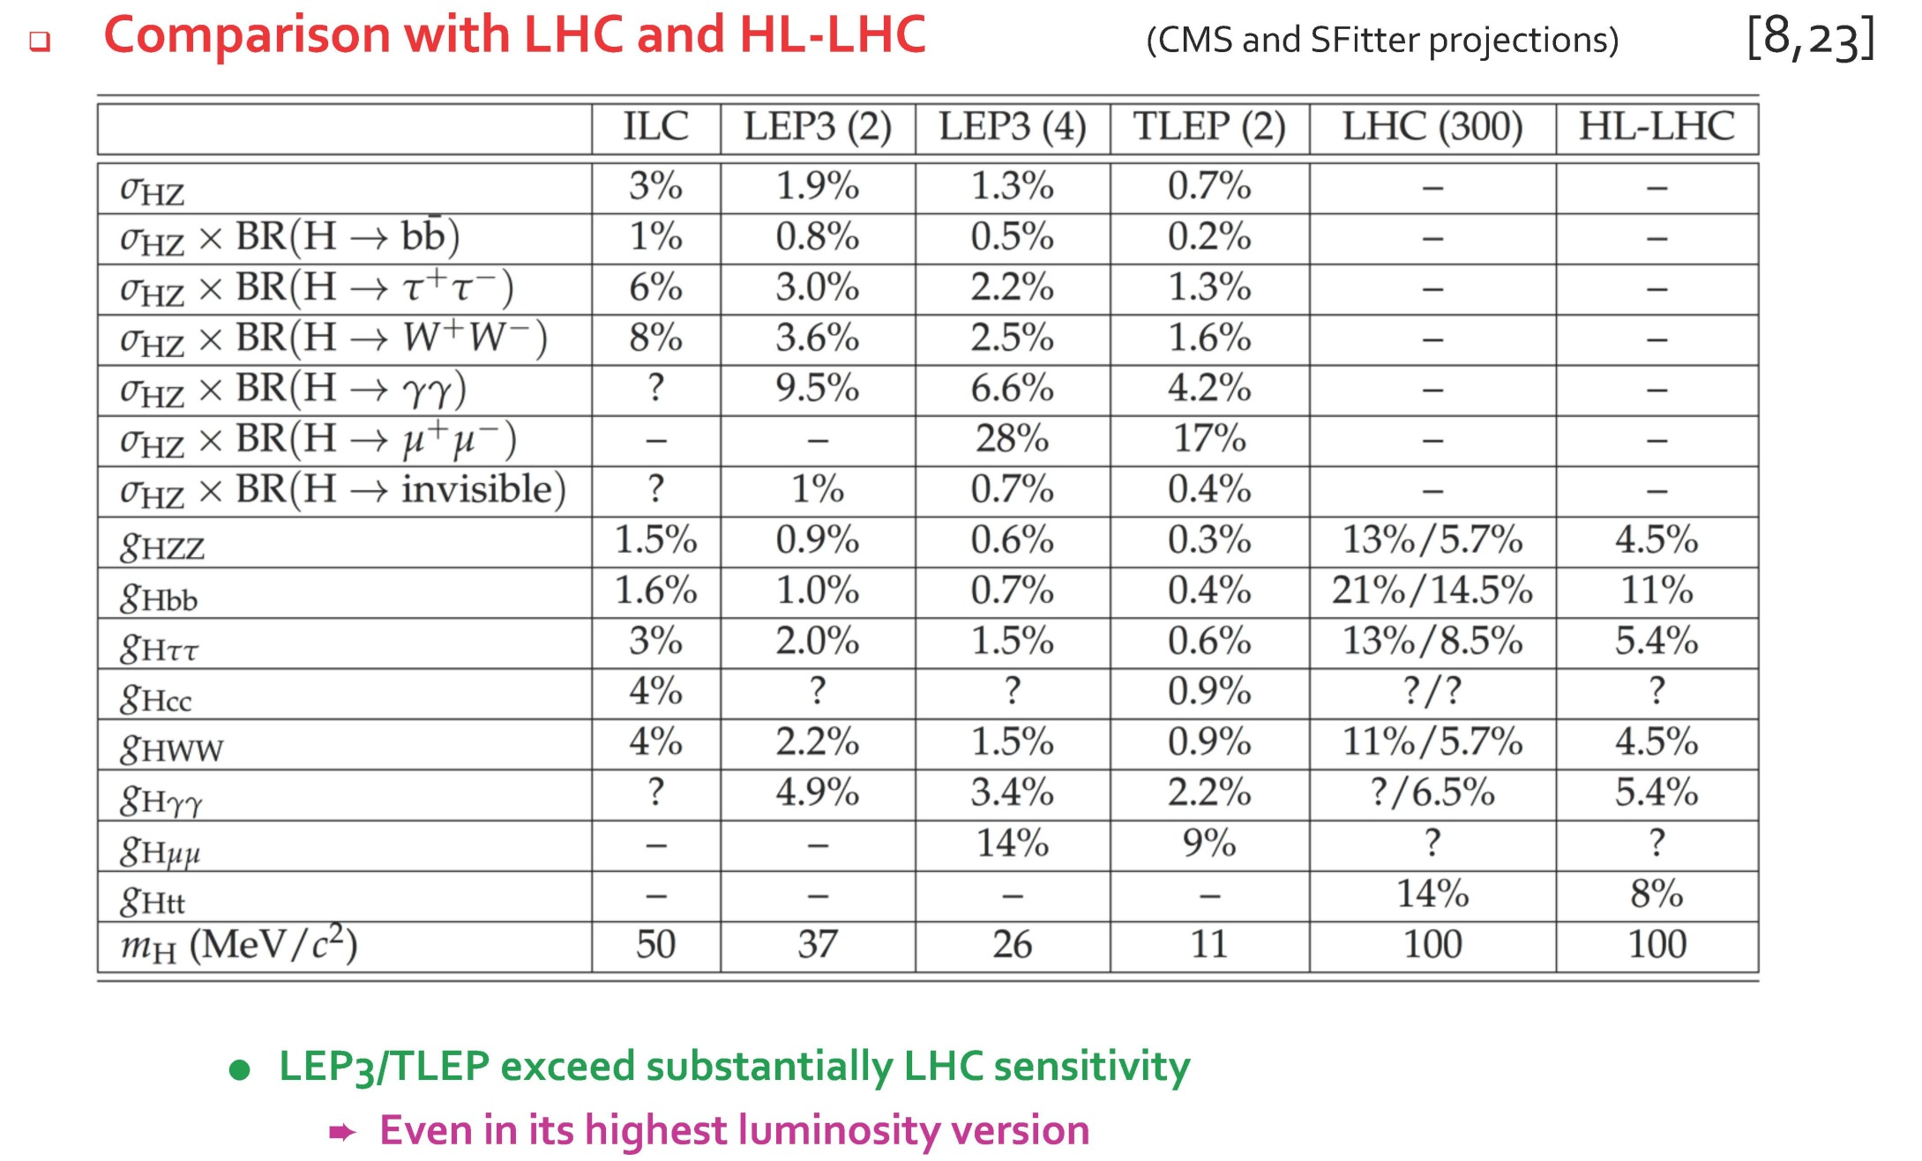
summary of LEP3/TLEP physics measurements
P. Janot, CERN PH seminar 30 October, attended and watched by >400 physicists

Slide 30
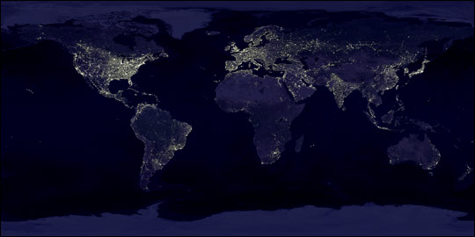
UNK Higgs
Factory, 2012
FNAL site filler, 2012
LEP3 2011
West Coast
design, 2012
LEP3 on LI, 2012
LEP3 in Texas, 2012
Chinese Higgs
Factory, 2012
SuperTristan 2012
circular e⁺e⁻ Higgs factories become
popular around the world

Slide 31
LEP3/TLEP baseline w established technology
I had thought (and still think) that the possible use of cheap, robust, established technology is a great asset for LEP3/TLEP
However, in Cracow the argument has been put forward that any future collider should be a Hi-Tech facility (i.e. ~18 GV SRF not enough, 350 GeV SRF being much better! - In other words a reasoning that we should fill a large tunnel with expensive objects instead of with cheap “concrete” magnets like LEP/LEP2)

Slide 32
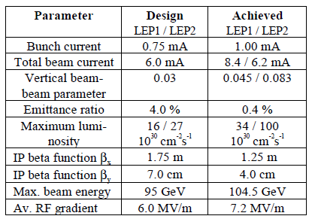
by the way, LEP2 technology worked well
A. Blondel, P, Janot

Slide 33
LEP3/TLEP(/VHE-LHC) “Hi-Tech options”
examples-
novel SC cavities for LEP3/TLEP collider
fast ramping HTS magnets
for LEP3/TLEP double ring
VHE-LHC 20-T high-field magnets

Slide 34
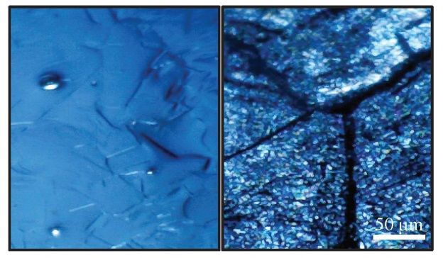
SC cavities based on material other than bulk niobium e.g. thin films or Nb₃Sn
  extensive studies at CERN (T. Junginger) and JLAB
  CERN/Legnaro/Sheffield cavities - first prototypes tested at Legnaro in 2012! HiPIMS technique; SIS concept,…
  sputtered Nb will reduce cost & and may show better performance; even more HTS SIS cavities
  Nb₃Sn could be studied at CERN (quad resonator) in collaboration with other labs
E. Jensen,
LHeC 2012;
JLAB, IPAC12
Hi-Tech cavities!
micrographs of sample surface of a micrometer thin niobium film sputtered on top of a copper substrate
(left) and a bulk niobium (right) sample
grain boundaries
& 3-5x rougher
T. Junginger et al,
IPAC2011

Slide 35
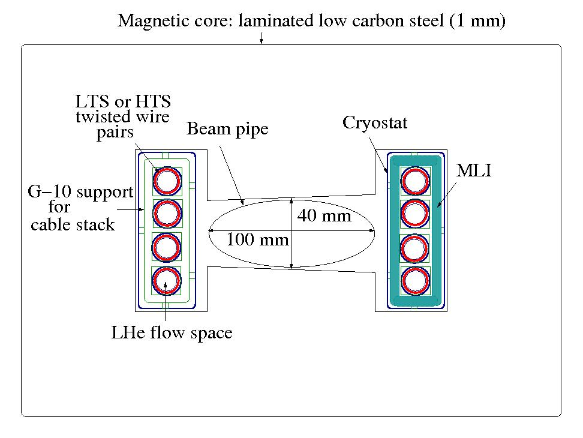
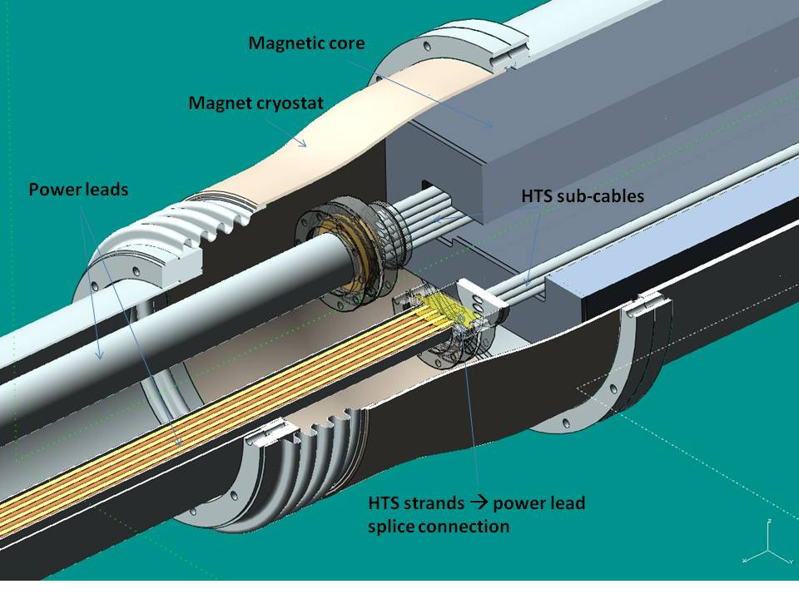
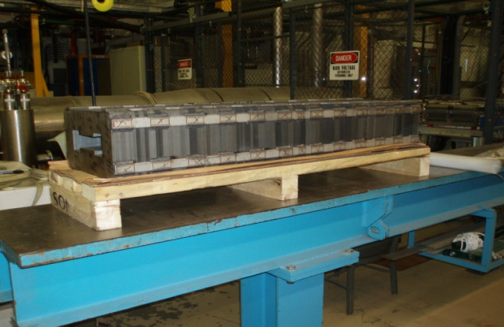
fast ramping HTS/LTS magnets
H. Piekarz,
1st EuCARD LEP3 Day
schematic HTS/LTS LEP3 magnet
SC magnets require typically 10 x less space than NC magnet of the same field and gap; the magnet weight is very significantly reduced.
Hi-Tech magnet!
HTS prototype dipole at FNAL
Test: B _{max} = 0.5 T, I_{max} = 27 kA, dB/dt _{max} = 10 T/s , T _{max} ~ 25 K
acceleration time ~0.1 s,
total cycle ~1 s; fast SC
magnets might support
1 minute lifetime
in collider ring!

Slide 36
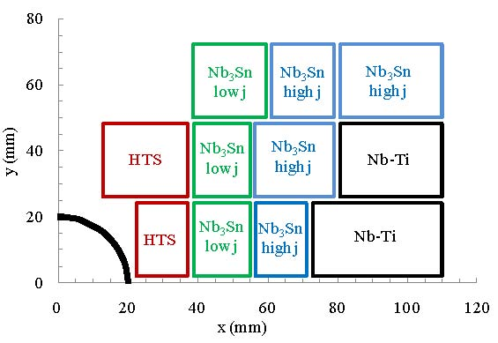
(V)HE-LHC 20-T hybrid magnet
E. Todesco,
L. Rossi,
P. McIntyre
Hi-Tech magnet!
block layout of Nb-Ti & Nb₃Sn & HTS (Bi-2212) 20-T dipole-magnet coil. Only one quarter of one aperture is shown.

Slide 37
LEP3/TLEP punchline
a ring e⁺e⁻ collider LEP3 or TLEP can provide an economical & robust solution with very high statistics at several IPs for studying the X(125) with excellent precision & for performing many high-resolution measurements on H, W, Z (+top quark)
LEP3/TLEP would be THE choice for e⁺e⁻ collision energies up to 400 GeV ;
TLEP would be part of a long-term HEP strategy aiming for 100 TeV pp CoM energy
within our lifetimes ;

Slide 38
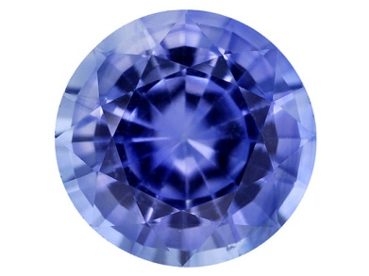
Part 2 - SAPPHiRE

Slide 39
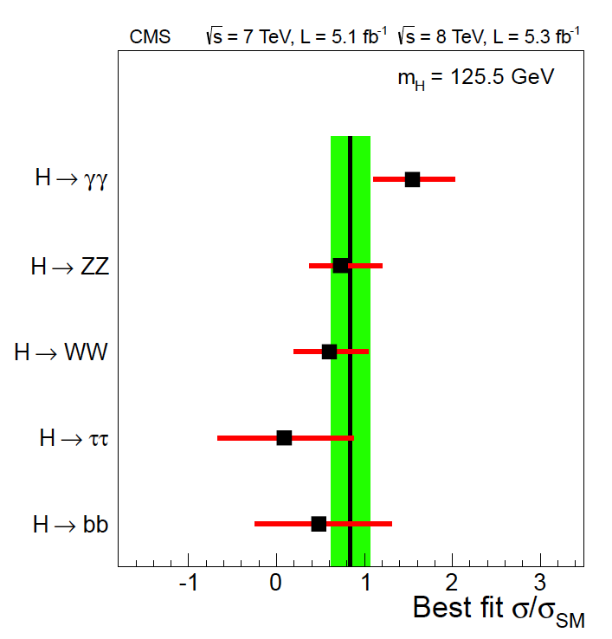
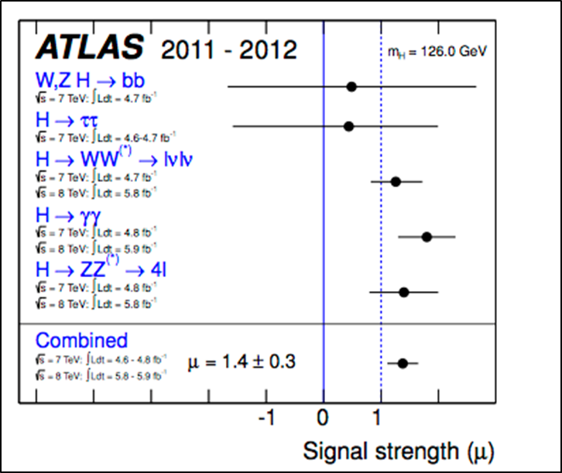
“Higgs” strongly couples to γγ
LHC CMS result
LHC ATLAS result

Slide 40
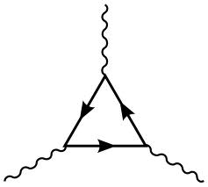
a new type of collider?
γ
s-channel production;
lower energy;
no e⁺ source
t, W, …
H
another advantage:
no beamstrahlung
→ higher energy reach
than e⁺e⁻ colliders
γ
γγ collider Higgs factory

Slide 41
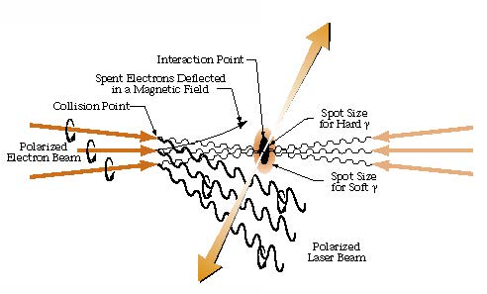
combining photon science & particle physics!
γγ collider
K.-J. Kim, A. Sessler
Beam Line
Spring/Summer 1996
few J pulse
energy with
λ~350 nm

Slide 42
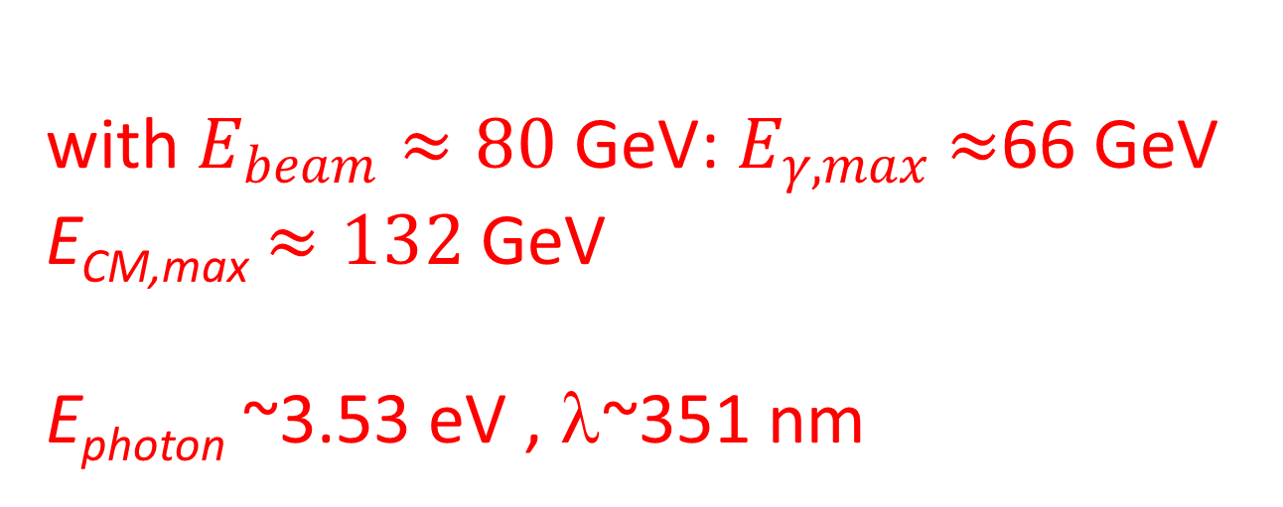
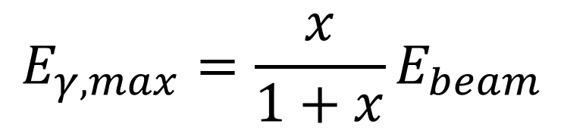
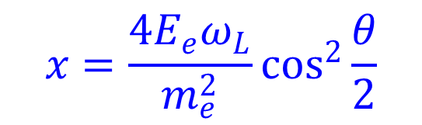
which beam & photon energy / wavelength?
$$E_{γ,max}=\frac{x}{1+x}E_{beam}$$
$$x=\frac{4E_{e}ω_{L}}{m_{e}^{2}}\cos^{2}{\frac{θ}{2}}$$
example x ≈ 4.3
(for x>4.83 coherent pair production occurs)
$\text{w}\text{ith} E_{beam}≈80 \text{GeV}\text{:}{ E}_{γ,max}$ $≈$66 GeV
E_{CM,max} $≈132$ GeV
E_{photon} ~3.53 eV , λ~351 nm

Slide 43
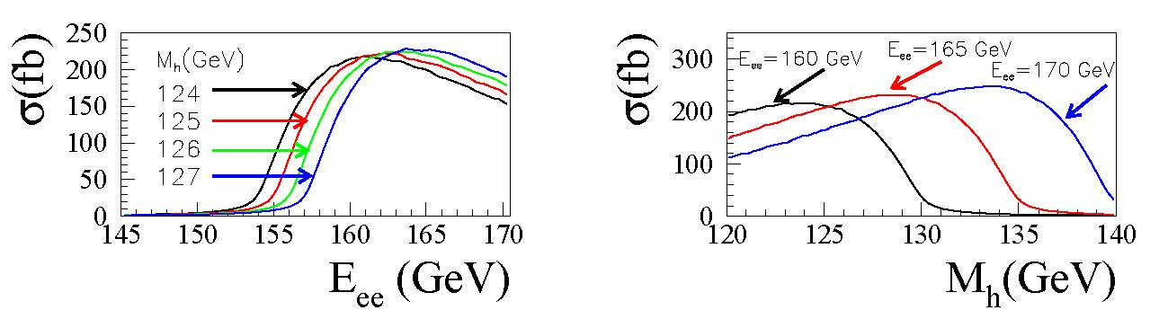
Higgs γγ production cross section
Left: The cross sections for γγ → h for different values of Mh as functions of ECM(e⁻e⁻).
Right: The cross section for γγ→ h as a function of Mh for three different values of ECM(e⁻e⁻).
Assumptions: electrons have 80% longitudinal polarization and lasers are circularly polarized, so that produced photons are highly circularly polarized at their maximum energy.

Slide 44
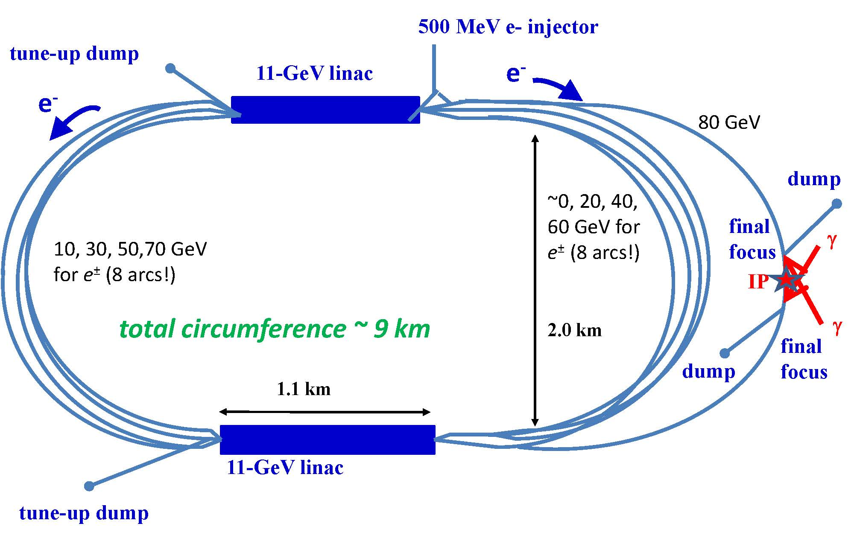
SAPPHiRE: a Small γγ Higgs Factory
scale ~ European XFEL,
about 10k Higgs per year
SAPPHiRE: Small Accelerator for Photon-Photon Higgs production using Recirculating Electrons

Slide 45
SAPPHiRE | symbol | value
total electric power | P | 100 MW
beam energy | E | 80 GeV
beam polarization | P_{e} | 0.80
bunch population | N_{b} | 10¹⁰
repetition rate | f_{rep} | 200 kHz
bunch length | σ_{z} | 30 μm
crossing angle | θ_{c} | ≥20 mrad
normalized horizontal/vert. emittance | γε_{x,y} | 5,0.5 μm
horizontal IP beta function | β_{x}* | 5 mm
vertical IP beta function | β_{y}* | 0.1 mm
horizontal rms IP spot size | σ_{x}* | 400 nm
vertical rms IP spot size | σ_{y}* | 18 nm
horizontal rms CP spot size | σ_{x}^{CP} | 400 nm
vertical rms CP spot size | σ_{y}^{CP} | 180 nm
e⁻e⁻ geometric luminosity | L_{ee} | 2x10³⁴ cm⁻²s⁻¹

Slide 46
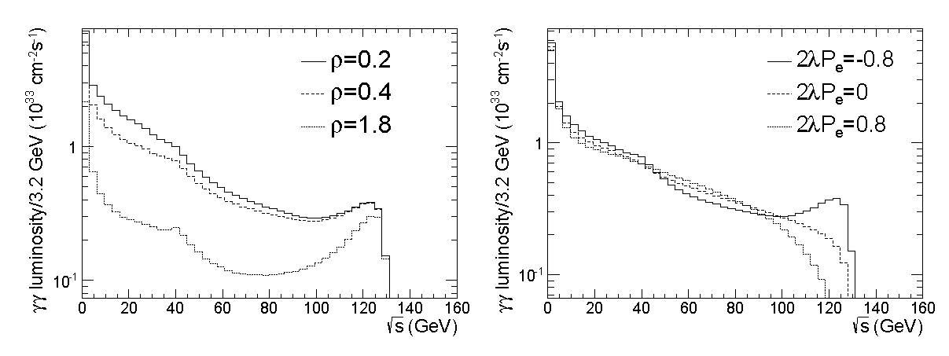
SAPPHiRE γγ luminosity
M. Zanetti
luminosity spectra for SAPPHiRE as functions of E_{CM}(γγ), computed using Guinea-Pig for three possible normalized distances ρ≡l_{CP-IP}/(γσ_{y}*) (left) and different polarizations of in-coming particles (right)

Slide 47
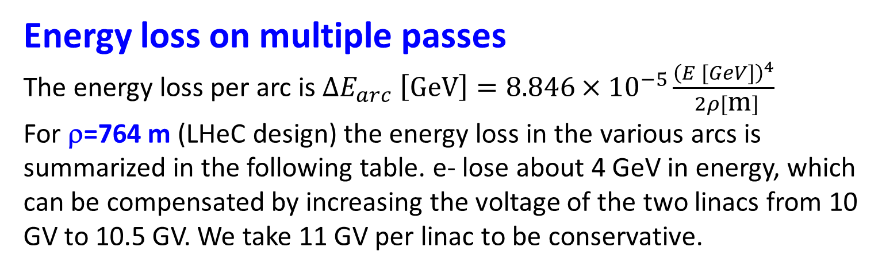
Energy loss on multiple passes
The energy loss per arc is $∆E_{arc} \left[\text{GeV}\right]=8.846×{10}^{−5}\frac{{\left(E [GeV]\right)}^{4}}{ 2ρ[\text{m}]}$
For ρ=764 m (LHeC design) the energy loss in the various arcs is summarized in the following table. e- lose about 4 GeV in energy, which can be compensated by increasing the voltage of the two linacs from 10 GV to 10.5 GV. We take 11 GV per linac to be conservative.
beam energy [ GeV] | ΔE_{arc} [GeV] | Δσ_{E} [MeV]
10 | 0.0006 | 0.038
20 | 0.009 | 0.43
30 | 0.05 | 1.7
40 | 0.15 | 5.0
50 | 0.36 | 10
60 | 0.75 | 20
70 | 1.39 | 35
80 | 1.19 | 27
total | 3.89 | 57 (0.071%)

Slide 48
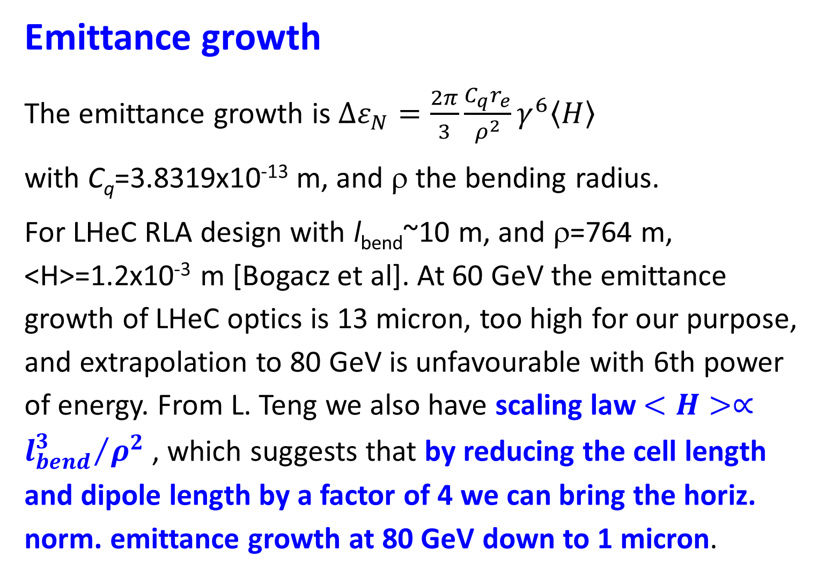
Emittance growth
The emittance growth is $∆ε_{N}=\frac{2π}{3}\frac{C_{q}r_{e}}{ρ^{2}}γ^{6}〈H〉$
with C_{q}=3.8319x10⁻¹³ m, and ρ the bending radius.
For LHeC RLA design with l_{bend}~10 m, and ρ=764 m, <H>=1.2x10⁻³ m [Bogacz et al]. At 60 GeV the emittance growth of LHeC optics is 13 micron, too high for our purpose, and extrapolation to 80 GeV is unfavourable with 6th power of energy. From L. Teng we also have scaling law $<H>∝{l_{bend}^{3}}/{ρ^{2}}$ , which suggests that by reducing the cell length and dipole length by a factor of 4 we can bring the horiz. norm. emittance growth at 80 GeV down to 1 micron.
Valery Telnov thinks this scaling is too optimistic

Slide 49
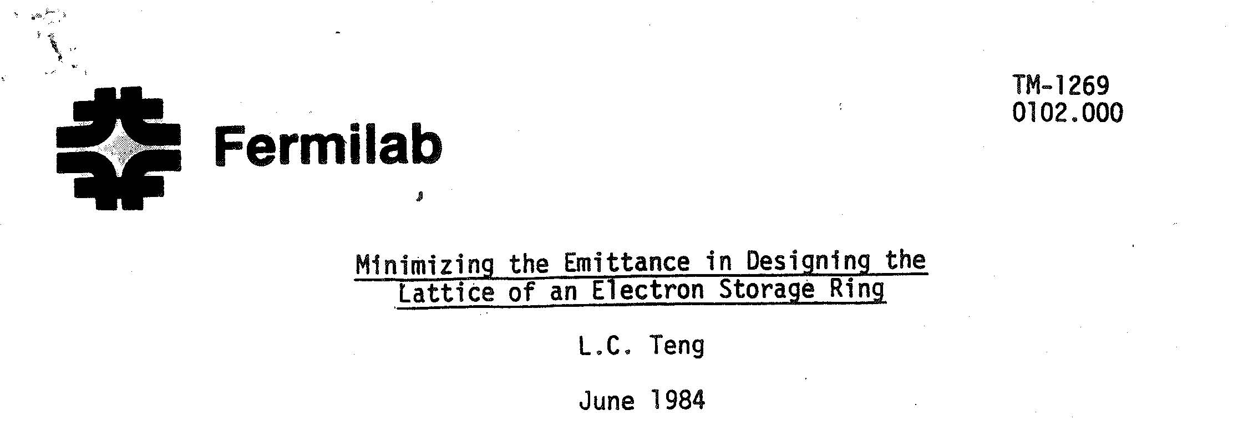
reference

Slide 50
flat polarized electron source
target ε_{x}/ε_{y} ~ 10
flat-beam gun based on flat-beam transformer concept of Derbenev et al.
starting with γε~4-5 μm at 0.5 nC, injector test facility at Fermilab A0 line achieved emittances of 40 μm horizontally and 0.4 μm vertically, with ε_{x}/ε_{y}~100
for SAPPHiRE we only need ε_{x}/ε_{y}~10, but at three times larger bunch charge (1.6 nC) and smaller initial γε~1.5 μm
these parameters are within the present state of the art (e.g. the LCLS photoinjector routinely achieves 1.2 μm emittance at 1 nC charge)
however, we need a polarized beam…
Valery Telnov stressed this difficulty

Slide 51
can we get ~ 1-nC polarized e⁻ bunches
with ~1 μm emittance?
ongoing R&D efforts:
low-emittance DC guns
(MIT-Bates, Cornell, SACLA, JAEA, KEK…)
[E. Tsentalovich, I. Bazarov, et al]
polarized SRF guns (FZD, BNL,…)
[J. Teichert, J. Kewisch, et al]

Slide 52
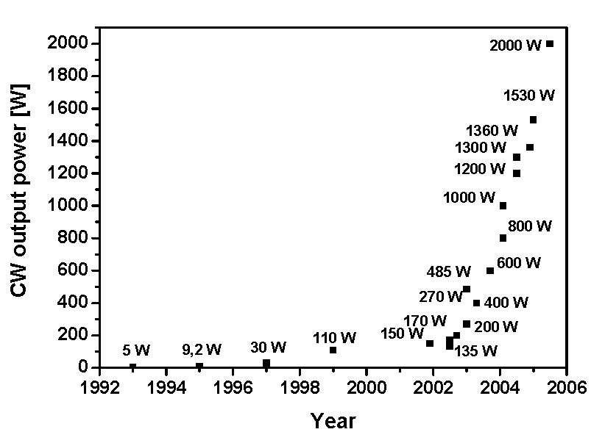
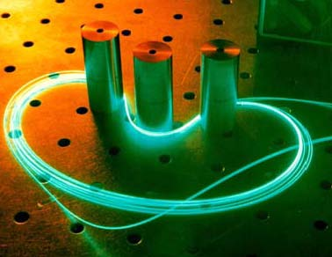
laser progress: example fiber lasers
power evolution of cw double-clad
fiber lasers with diffraction limited
beam quality over one decade:
factor 400 increase!
Source: Fiber Based High Power Laser Systems,
Jens Limpert, Thomas Schreiber, and Andreas Tünnermann

Slide 53
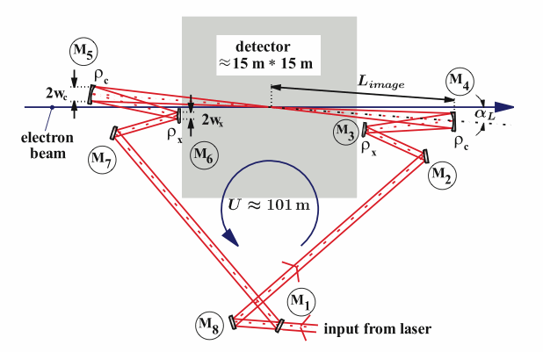

passive optical cavity
→
relaxed
laser
parameters
K. Moenig et al, DESY Zeuthen

Slide 54
self-generated FEL γ beams
(instead of laser)?
e⁻
(80 GeV)
wiggler
converting some
e⁻ energy into
photons (λ≈350 nm)
e⁻
(80 GeV)
e⁻ bend
optical
cavity
mirrors
Compton
conversion
point
e⁻ bend
γγ IP
“intracavity powers at MW levels are perfectly reasonable” – D. Douglas, 23 August 2012
example: λ_{u}=50 cm, B=5 T, L_{u}=50 m, 0.1%P_{beam}≈25 kW
scheme developed
with Z. Huang

Slide 55


LHeC → SAPPHiRE
Schematic sketches of the layout for the LHeC ERL (left) and for a gamma-gamma Higgs factory based on the LHeC (right)

Slide 56


would it fit on SLAC site?

Slide 57
schematic of HERA-γγ
arc magnets -17 passes!
5.6 GeV
15.8
26.0
36.2
46.0
55.3
63.8
71.1
71.1
63.8
55.2
46.0
36.2
26.0
15.8
5.6
beam 1
beam 2
75.8 GeV
laser or auto-driven FEL
ρ=564 m for arc dipoles
(probably pessimistic;
value assumed in the
following)
IP
2x8+1 arcs
20-MV
deflecting
cavity (1.3 GHz)
20-MV
deflecting
cavity
real-estate
linac
Gradient
~ 10 MV/m
total
SC RF =
10.2 GV
3.6 GeV
linac
3.6 GeV
Linac
(1.3 GHz)
2x1.5 GeV
linac
F. Zimmermann, R. Assmann, E. Elsen,
DESY Bschleuniger-Ideenmarkt, 18 Sept. 2012
0.5 GeV injector

Slide 58

γγ Collider at J-Lab
similar ideas elsewhere
By Edward Nissen
Town Hall meeting Dec 19 2011
$$H^{0}$$

Slide 59



Background
Edward Nissen
$$x=\frac{12.3E_{e}(TeV)}{λ_{γ}(μm)}$$
ћ$ω_{γ}=\frac{x}{1+x}E_{e}$
γ
γ
H
arXiv:hep-ex/9802003v2

Slide 60


Possible Configurations at JLAB
Edward Nissen
85 GeV Electron energy
γ c.o.m. 141 GeV
103 GeV Electron energy
γ c.o.m. 170 GeV

Slide 61
SAPPHiRE R&D items
γγ interaction region
large high-finesse optical cavity
high repetition rate laser
FEL in unusual regime
separation scheme for beams
  circulating in opposite directions
  polarized low-emittance e⁻ gun

Slide 62


vertical rms IP spot sizes in nm
in regular
font:
achieved
in italics:
design
values
LEP2 | 3500
KEKB | 940
SLC | 500
LEP3 | 320
TLEP-H | 220
ATF2, FFTB | 150? (35), 65
SuperKEKB | 50
SAPPHiRE | 18
ILC | 5
CLIC | 1
LEP3/TLEP
will learn
a lot from
SuperKEKB
and ATF2!

Slide 63
Conclusions
LEP3, TLEP and SAPPHiRE are exciting and popular projects
LEP3 and SAPPHiRE may be the cheapest possible options to study the Higgs (cost ~1BEuro scale), feasible, “off the shelf”, but, esp. SAPPHiRE, not easy
TLEP is more expensive (~5 BEuro?), but clearly superior in terms of energy & luminosity, and it would be extendable towards VHE-LHC, preparing ≥50 years of exciting e⁺e⁻, pp, ep/A physics at highest energies

Slide 64

LEP3, TLEP, and SAPPHiRE offer interesting energy-frontier physics at moderate cost and/or with long-term perspective, using robust technology;
we should make a wise choice
thank you for listening!

Slide 65
References for LEP3/TLEP:
[1] A. Blondel, F. Zimmermann, ‘A High Luminosity e+e- Collider in the LHC tunnel to study the Higgs Boson,’ V2.1-V2.7, arXiv:1112.2518v1, 24.12.2011
[2] C. Adolphsen et al, ‘LHeC, A Large Hadron Electron Collider at CERN,’ LHeC working group, LHeC-Note-2011-001 GEN.
[3] H. Schopper, The Lord of the Collider Rings at CERN 1980- 2000, Springer-Verlag Berlin Heidelberg 2009
[4] K. Oide, ‘SuperTRISTAN - A possibility of ring collider for Higgs factory,’ KEK Seminar, 13 February 2012
[5] R.W. Assmann, ‘LEP Operation and Performance with Electron-Positron Collisions at 209 GeV,’ presented at 11th Workshop of the LHC, Chamonix, France, 15 - 19 January 2001
[6] A. Butterworth et al, ‘The LEP2 superconducting RF system,’ NIMA Vol. 587, Issues 2-3,
2008, pp. 151
[7] K. Yokoya, P. Chen, CERN US PAS 1990, Lect.Notes Phys. 400 (1992) 415-445
[8] K. Yokoya, Nucl.Instrum.Meth. A251 (1986) 1
[9] K. Yokoya, ‘Scaling of High-Energy e⁺e⁻ Ring Colliders,’ KEK Accelerator Seminar, 15.03.2012
[10] V. Telnov, ‘Restriction on the energy and luminosity of e⁺e⁻ storage rings due to beamstrahlung,’ arXiv:1203.6563v, 29 March 2012
[11] H. Burkhardt, ‘Beam Lifetime and Beam Tails in LEP,’ CERN-SL-99-061-AP (1999)
[12] R. Bossart et al, ‘The LEP Injector Linac,’ CERN-PS-90-56-LP (1990)
[13] P. Collier and G. Roy, `Removal of the LEP Ramp Rate Limitation,’ SL-MD Note 195 (1995).
[14] A. Blondel et al, “LEP3: A High Luminosity e+e- Collider to study the Higgs Boson”, CENR- ATS-Note-2012-062 TECH
[15] P. Azzi et al, “Prospective Studies for LEP3 with the CMS Detector,” arXiv:1208.1662 (2012)

Slide 66
References for SAPPHiRE:
[1] S. A. Bogacz, J. Ellis, L. Lusito, D. Schulte, T. Takahashi, M. Velasco, M. Zanetti, F. Zimmermann, ‘SAPPHiRE: a Small Gamma-Gamma Higgs Factory,’ arXiv:1208.2827
[2] D. Asner et al., ‘Higgs physics with a gamma gamma collider based on CLIC I,’ Eur. Phys.
J. C 28 (2003) 27 [hep-ex/0111056].
[3] J. Abelleira Fernandez et al, ‘A Large Hadron Electron Collider at CERN - Report on the
Physics and Design Concepts for Machine and Detector,’ Journal of Physics G: Nuclear
and Particle Physics 39 Number 7 (2012) arXiv:1206.2913 [physics.acc-ph].

Slide 67
backup slides

Slide 68
rf efficiency (P_{wall}→P_{SR})
compare numbers from LHeC Conceptual Design Report: J L Abelleira Fernandez et al, “A Large Hadron Electron Collider at CERN Report on the Physics and Design Concepts for Machine and Detector,” J. Phys. G: Nucl. Part. Phys. 39 075001 (2012):
conversion efficiency grid to amplifier RF output = 70%
transmission losses = 7%
feedbacks power margin = 15%
→ total efficiency ~55%
50% assumed for LEP3/TLEP at same frequency & gradient

Slide 69
transverse impedance & TMCI
LEP bunch intensity was limited by TMCI: N_{b,thr}~5x10¹¹ at 22 GeV
LEP3 with 700 MHz: at 120 GeV we gain a factor 5.5 in the threshold, which almost cancels a factor (0.7/0.35)³ ~ 8 arising from the change
in wake-field strength due to the different RF frequency
LEP3 Q_{s}~0.2, LEP Q_{s}~0.15: further 25% increase in TMCI threshold?
only ½ of LEP transverse kick factor came from SC RF cavities
LEP3 beta functions at RF cavities might be smaller than in LEP
LEP3 bunch length (2-3 mm) is shorter than at LEP injection (5-9 mm)
M. Lamont, SL-Note-98-026 (OP)

Slide 70
beam-beam with large hourglass effect?
simulations by K. Ohmi presented at 2nd EuCARD LEP3 Day

