Slide 1
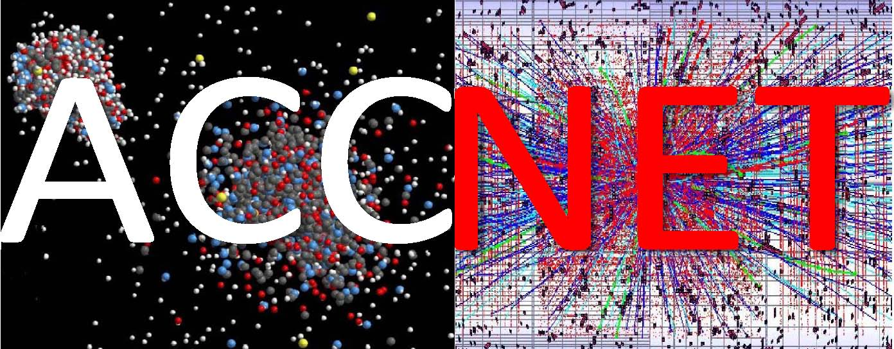
EuCARD WP4 - Accelerator Networks
coordinated by
Ralph Assmann, Jean-Marie De Conto, Mariusz Grecki, Jens Osterhoff, Walter Scandale, Peter Spiller, Ezio Todesco, Arnd Specka, Wolfgang Weingarten (ret.), and Frank Zimmermann
11th EuCARD Steering Committee Meeting
Uppsala & CERN, 6-7 December 2012

Slide 2
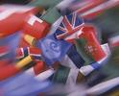
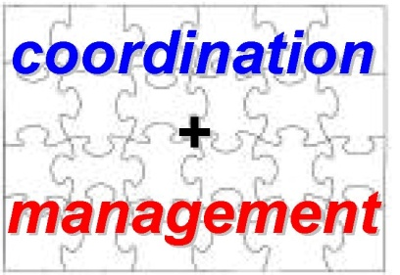
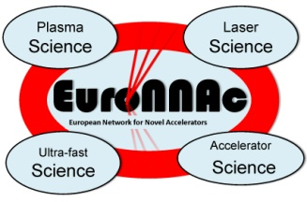
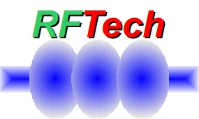
ACCNET Accelerator Science Networks
Coordination & Management
coordinated by Walter Scandale, IN2P3 ; Peter Spiller, GSI ;
Frank Zimmermann, CERN
EURO-
LUMI
RFTECH
EuroNNAc
novel accelerators
coordinated by
Ralph Assmann, CERN
Jens Osterhoff, DESY
Arnd Specka, E.Pol.
accelerators & colliders
performance
coordinated by
Frank Zimmermann &
Ezio Todesco, CERN
sc & nc rf technologies
coordinated by
Jean-Marie de Conto, UJF
Mariusz Grecki, DESY
Wolfgang Weingarten,
CERN

Slide 3
recent changes to AccNet coordinators
Henri Videau (Ecole Polytechnique) has retired
Arnd Specka (Ecole Polytechnique) has joined as new co-coordinator for EuroNNAc

Slide 4
AccNet (co-)sponsored events in 2012
EuroNNAc2012, CERN 24 May 2012
Special RFTech session MixDes2012, Warsaw, 24-26 May
EuCARD/AccNet-CERN/LER-INFN/LNF-INFN-Pisa joint ECLOUD’12 workshop, Elba, 5-9 June
IEEE RT2012, Berkeley, 11-15 June
HOMSC2012 workshop Daresbury, 25-27 June
LLRF collaboration meeting Lodz, 6-8 August
two special EuCARD-WP4 sessions at ICAP’12, Warnemünde, 19-25 August
1st & 2nd EuCARD “LEP3” mini workshops, 18 Jun+23 Oct
HiLumi LHC - LARP Annual Meeting in Frascati continued AccNet workshops on LHC upgrade (crab cavities, HL-LHC design), now as a real project (AccNet role as pioneer!)

Slide 5
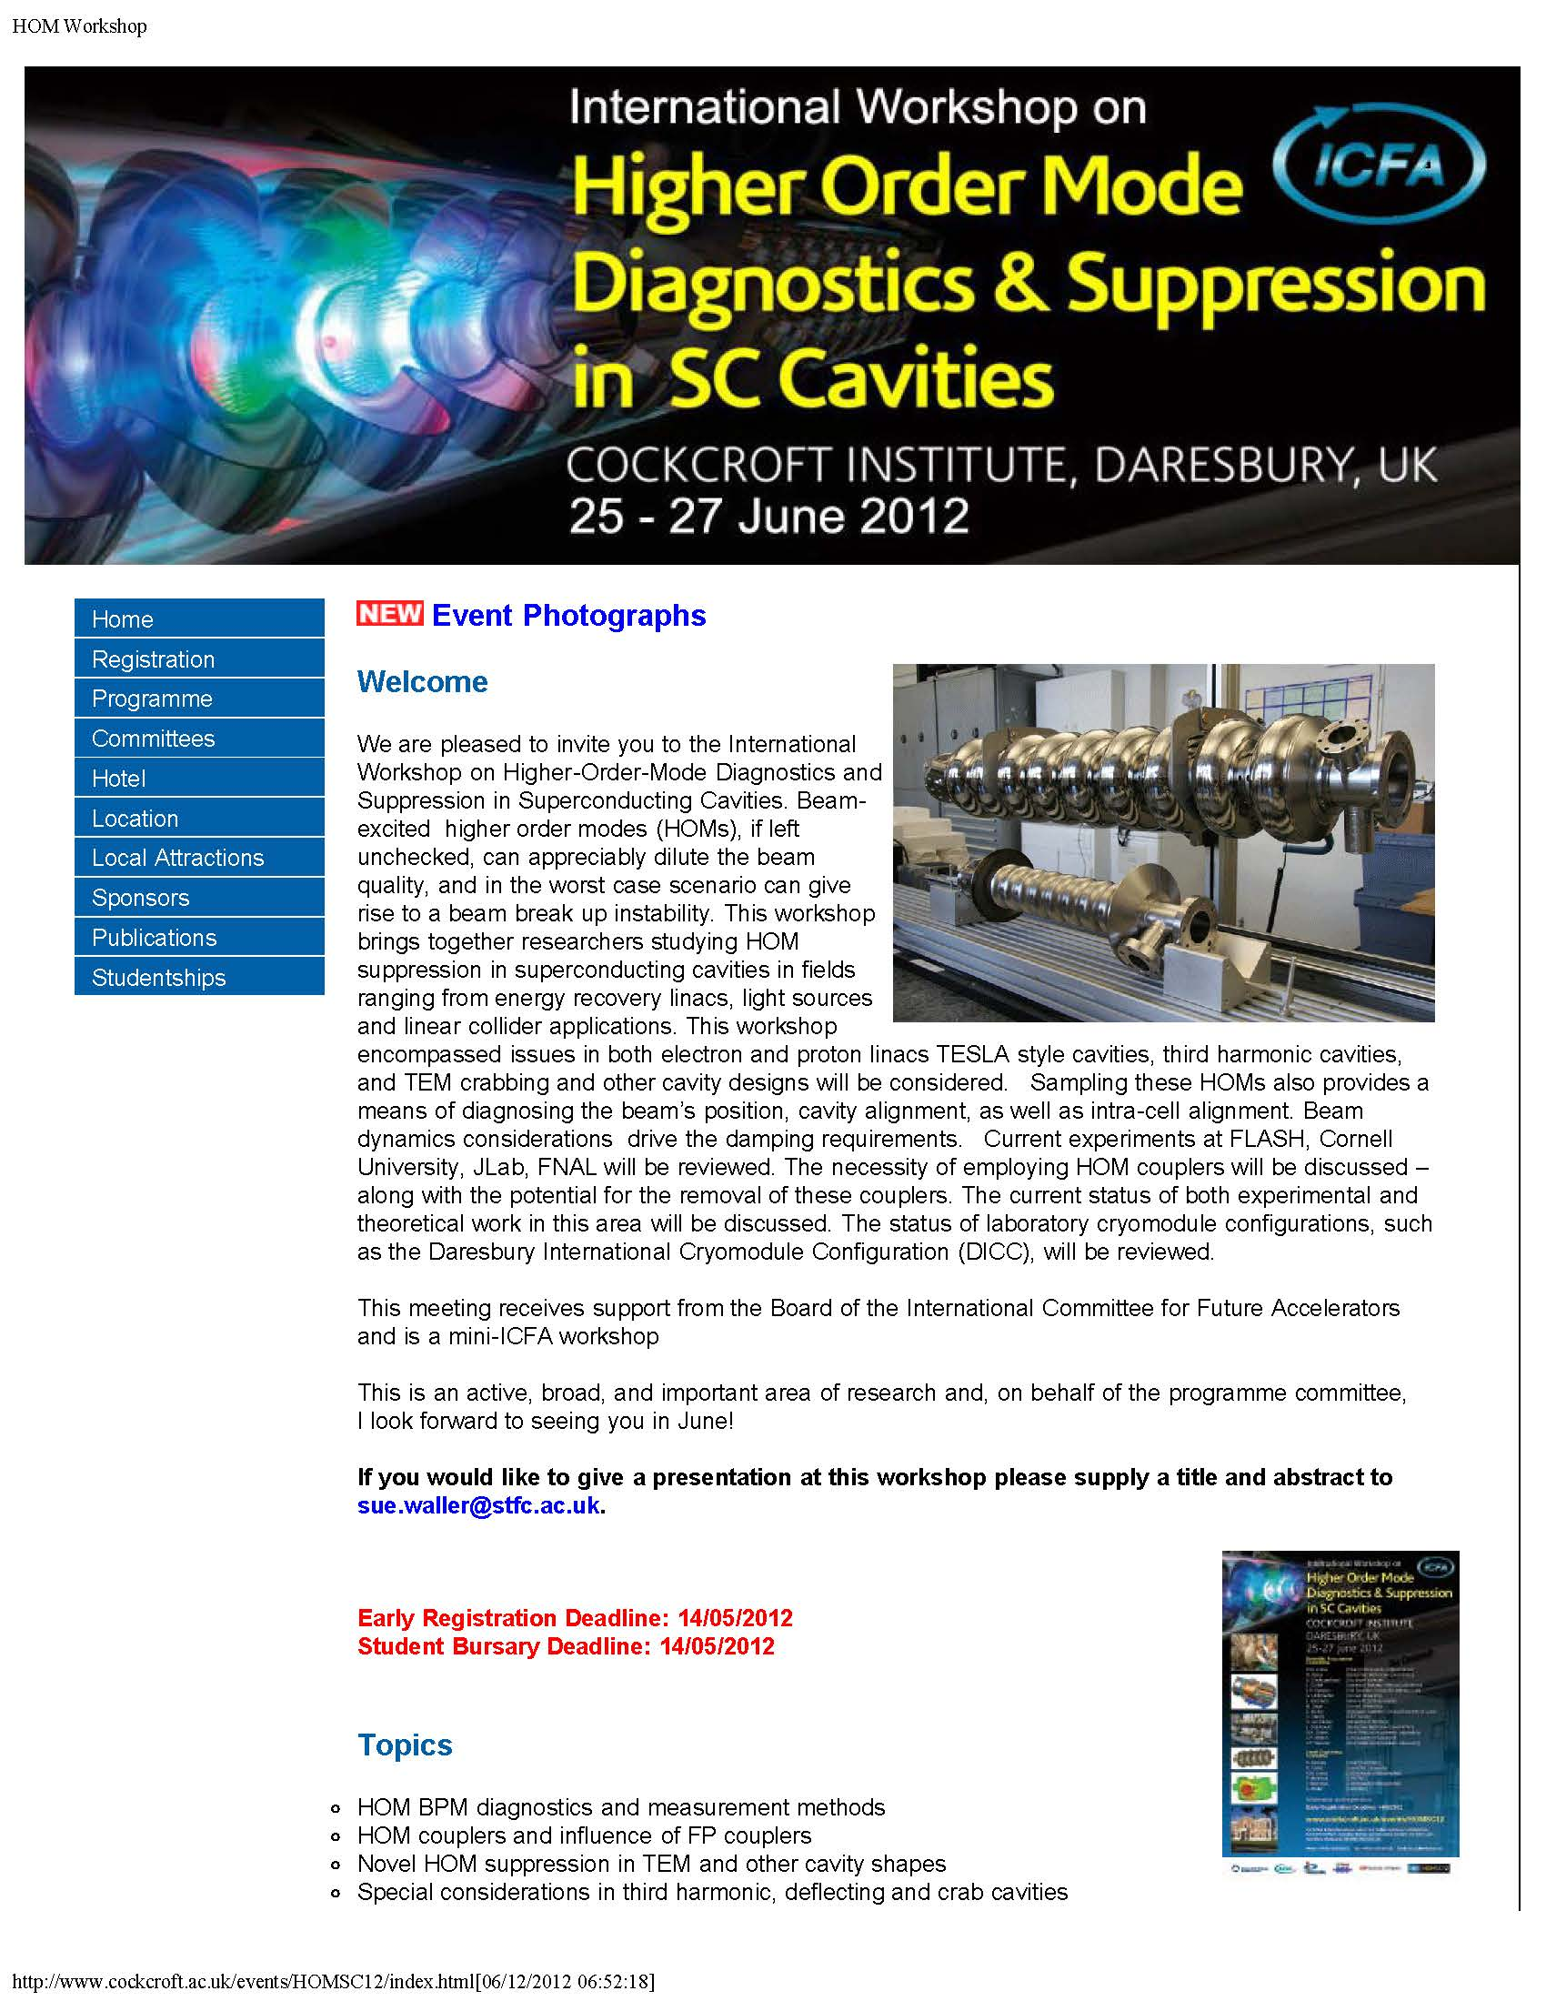
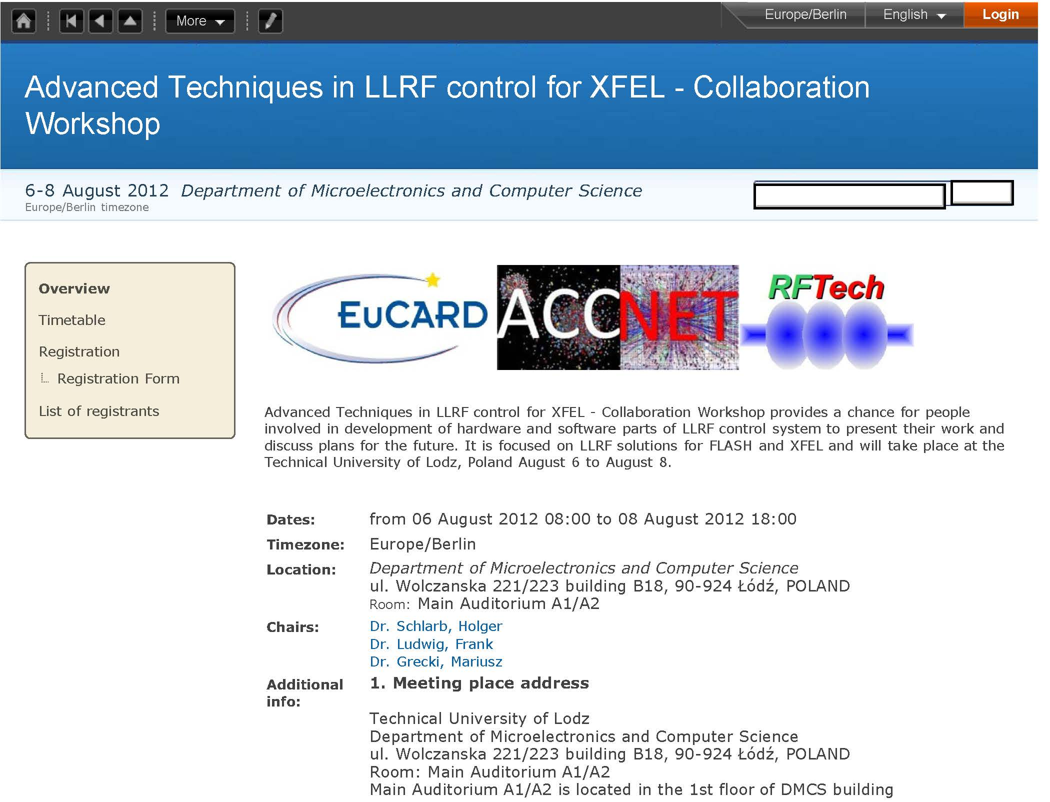
RFTech co-sponsored events

Slide 6
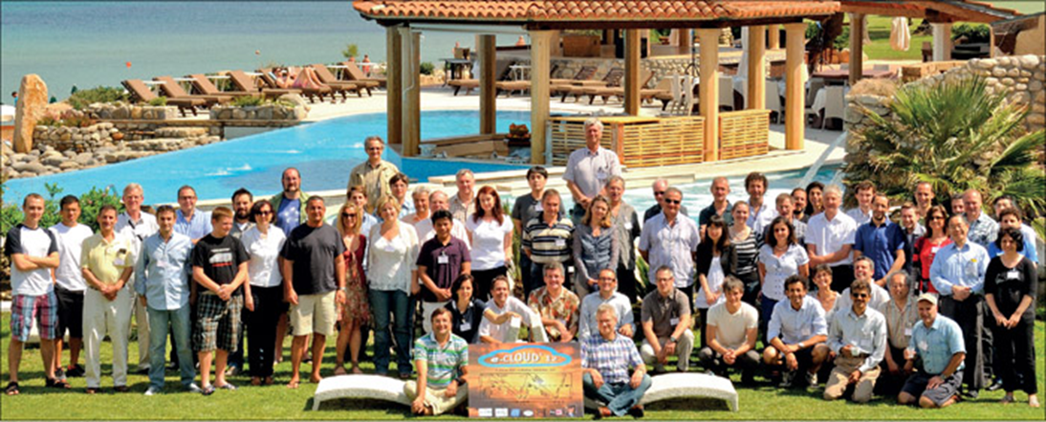
ECLOUD’12, Elba, 5-9 June 2012
reviewed recent e-cloud observations at LHC, DAFNE, PETRA-III, Cesr-TA, J-PARC,.. & e-cloud predictions for SuperKEKB, SuperB, Project-X, ISIS upgrade, RHIC upgrade, HL-LHC, HE-LHC, ILC,…
established & strengthened links with space community (ESA, Val Space consortium, ONERA, ICMM, Princeton SPL, EPFL LEMA, …)
discussed new powerful simulation tools (SYNRAD3D/Cornell, OSMOSEE/ONERA, PyECLOUD/CERN, WARP-POSINST/LBNL, BI-RME-ECLOUD/EPFL, FEST3D/Aurora, …)
62
participants

Slide 7
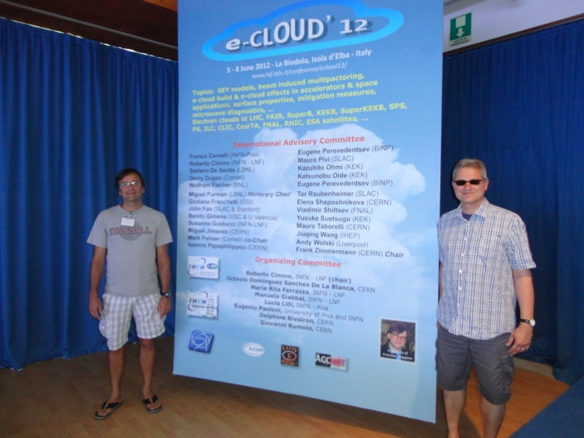
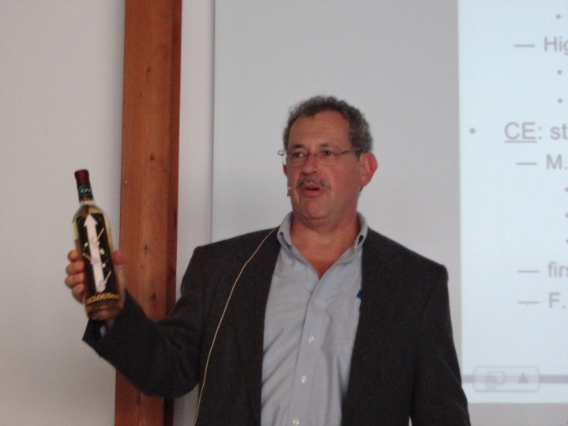
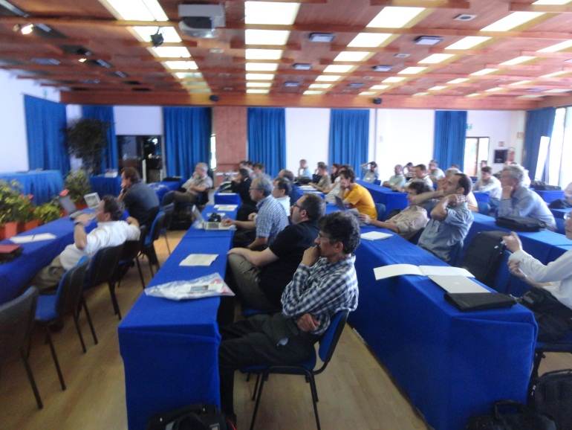
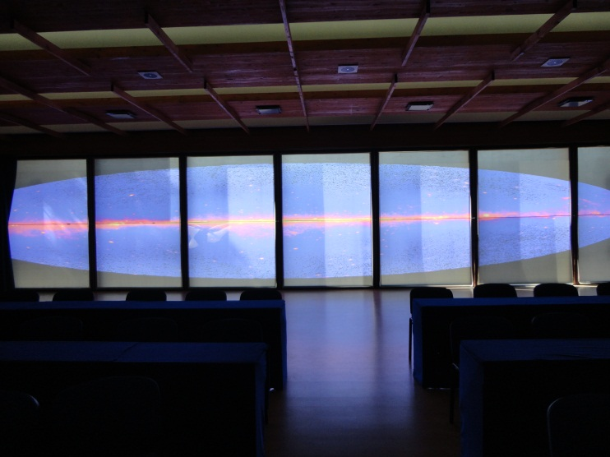
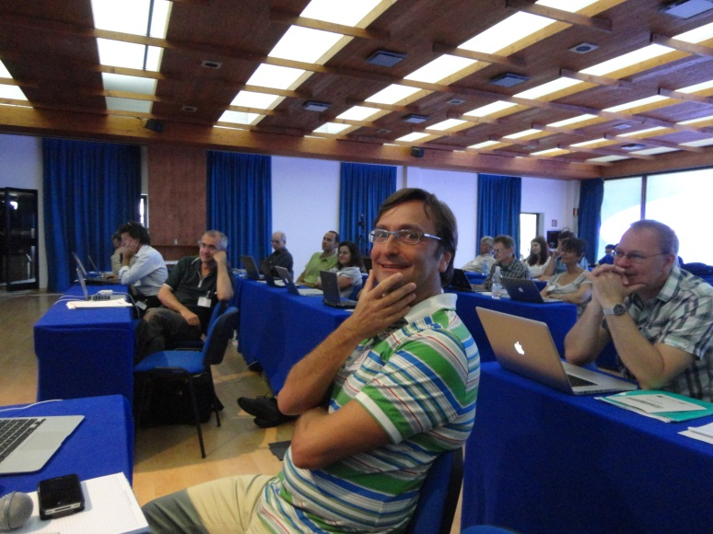
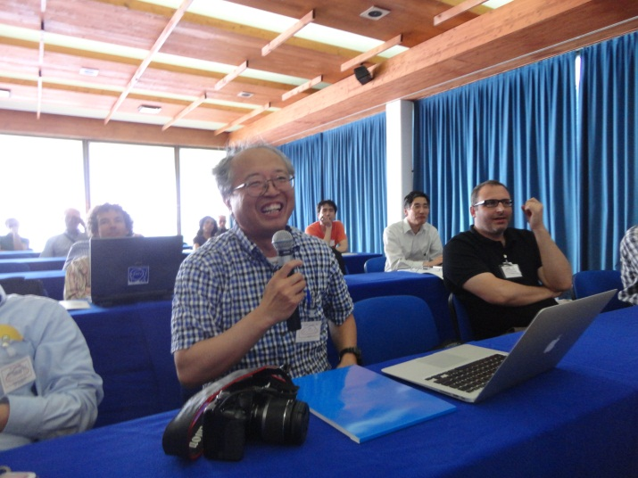
ECLOUD’12 photos
EuCARD workshop proceedings to be published shortly
(eds. R. Cimino, G. Rumolo, F. Zimmermann);
in addition PRST-AB special edition ECLOUD’12

Slide 8
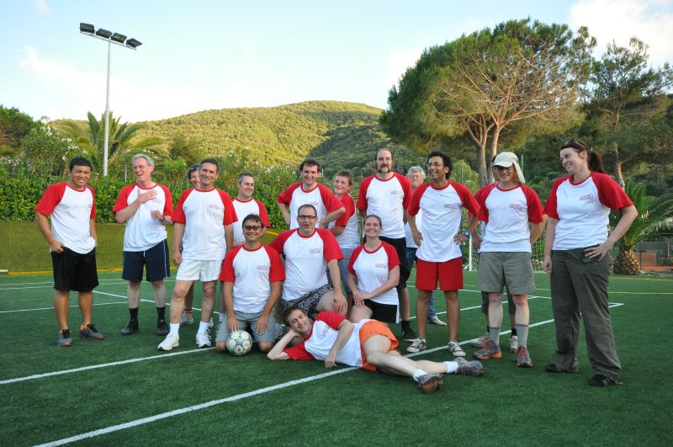
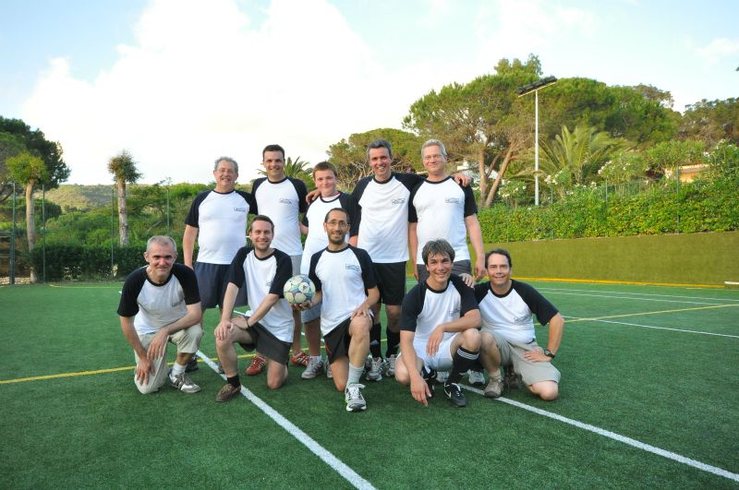
more ECLOUD’12 photos
ECLOUD experiment
first EuCARD soccer match
ECLOUD theory

Slide 9
ICAP’12 AccNet sessions
Wednesday 22 August
LHC & FAIR (EuCARD-AccNet)
Chair Giovanni Rumolo
09:00-09:25 (invited)
Ralph Assmann, CERN, Switzerland: Advanced modeling and measurements of LHC beam halo and collimation
09:25-09:45
Giuliano Franchetti, GSI, Germany: Space charge and electron cloud simulations
09:45-10:05
Tatiana Rijoff, U. Milano: Beam-beam long range compensation studies for the LHC
10:05-10:30
Giovanni Iadarola, Università degli Studi di Napoli Federico II, Italy: Electron cloud simulations with PyECLOUD
RF & Impedance (EuCARD-AccNet)
Chair: Jean-Marie De Conto
14:00-14:25
Carlo Zannini, EPFL, Switzerland: EM simulations in beam coupling impedance studies: some examples of application
14:25-14:50
Uwe Niedermayer, TU Darmstadt, Germany: Kicker modeling
14:50-15:15
Eirini Koukovini-Platia, EPFL, Switzerland: A method of EM characterization of coating materials for beam chambers

Slide 10
EuroNNAc activities in 2012
EuroNNAc2012 meeting at CERN from May 2-5 2012, with written minutes, decisions, action list and EXCEL table for facilities.
Statement submitted to the European Strategy Preparatory Group (editing team included Allen Caldwell (MPI), Massimo Ferrario (INFN), Jens Osterhoff (DESY), Toshi Tajima (LMU), Henri Videau (ecole polytechnique) and Ralph Assmann (CERN/DESY)) https://indico.cern.ch/contributionListDisplay.py?confId=175067. "On the Prospect and Vision of Ultra-High Gradient Plasma Accelerators for High Energy Physics".
Plan to develop visions into more realistic accelerator proposals and funding requests.
Finalized negotiations on EuroNNAc2 as part of EuCARD ; EuCARD2 (European Coordination of Accelerator R&D) project funding now known.

Slide 11
AccNet (co-)sponsored events in 2012
Special RFTech session MixDes2012, Warsaw, 24-26 May
EuCARD/AccNet-CERN/LER-INFN/LNF-INFN-Pisa joint ECLOUD’12 workshop, Elba, 5-9 June
IEEE RT2012, Berkeley, 11-15 June
HOMSC2012 workshop Daresbury, 25-27 June
LLRF collaboration meeting Lodz, 6-8 August
two special EuCARD-WP4 sessions at ICAP’12, Warnemünde, 19-25 August
1st & 2nd EuCARD “LEP3” mini workshops, 18 Jun+23 Oct
HiLumi LHC - LARP Annual Meeting in Frascati continued AccNet workshops on LHC upgrade (crab cavities, HL-LHC design), now as a real project (AccNet role as pioneer!)
→ refocusing on future beyond HL-LHC (LEP3/TLEP, (S)HE-LHC…)

Slide 12
possible long-term strategy
TLEP (80 km,
e⁺e⁻, up to
~350 GeV c.m.)
PSB
PS (0.6 km)
SPS (6.9 km)
LHC (26.7 km)
LEP3
(e⁺e⁻, 240 GeV c.m.)
SHE-LHC
(pp, up to
100 TeV c.m.)
also: e± (200 GeV) – p (7 & 50 TeV) collisions
≥50 years of e⁺e⁻, pp, ep/A physics at highest energies

Slide 13
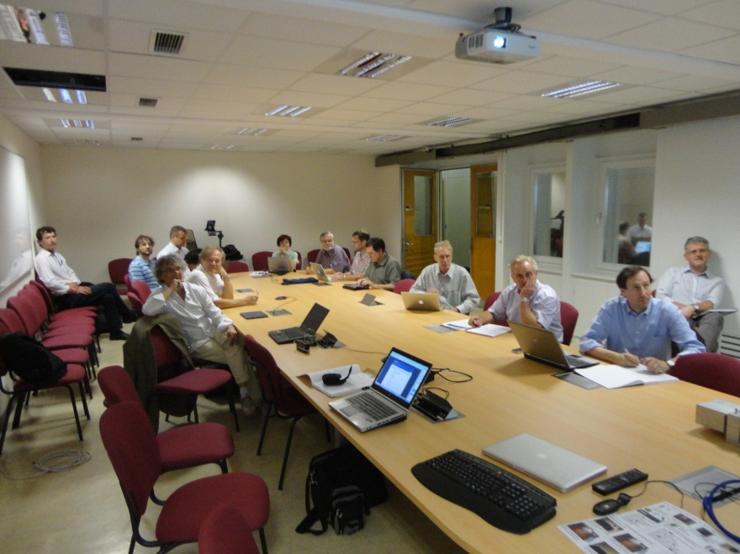
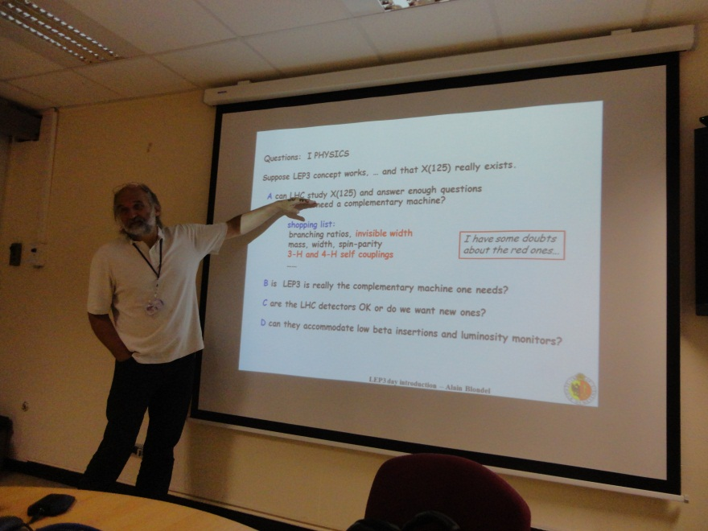
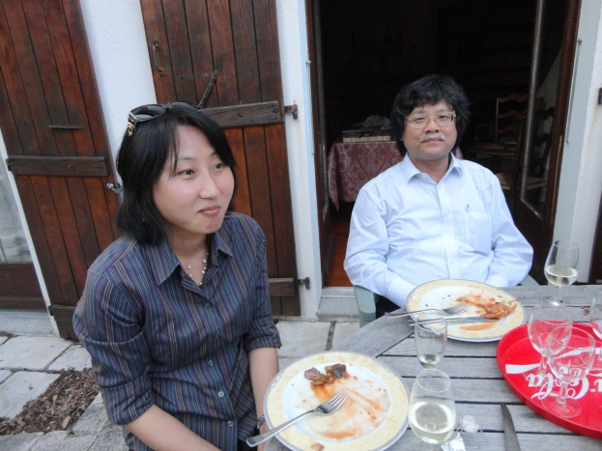
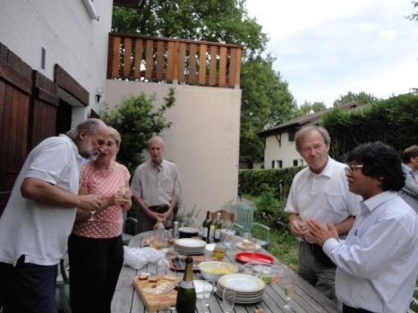
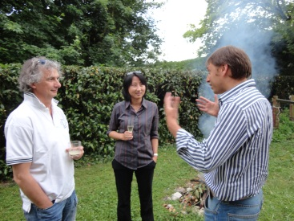
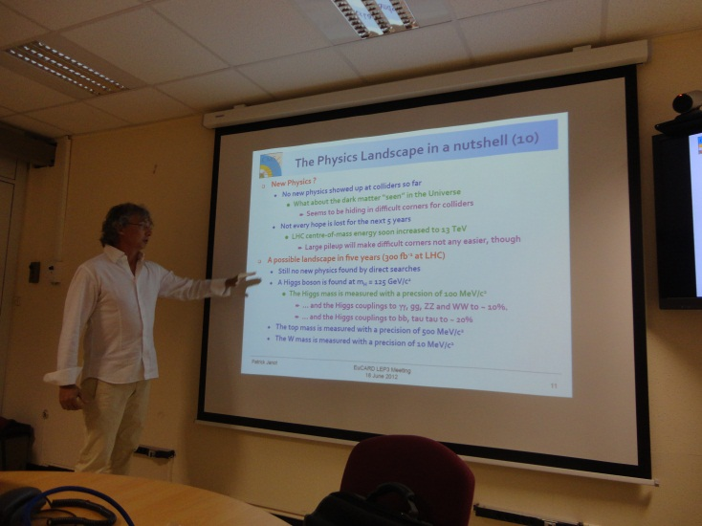
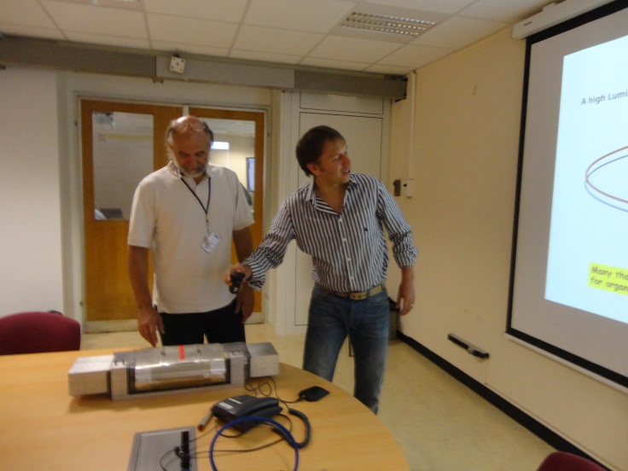
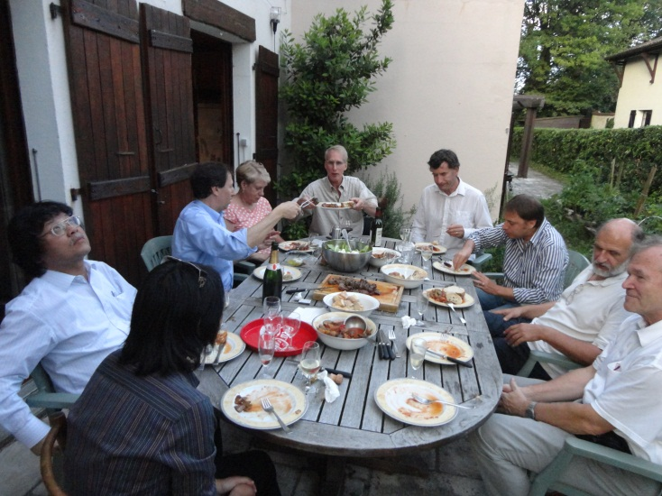
1st EuCARD LEP3 Day
~40 participants
physics case, beam parameters, beam dynamics (beamstrahlung), hardware (RF, vacuum, magnets), tunnel,…

Slide 14
EuroLumi exchanges & joint studies
participation of several students & expert speakers (SLAC, BINP) and administrative support for ECLOUD’12
Valery Telnov (BINP) for 1st LEP3 Day (talk on beamstrahlung effects)
Uli Wienands (SLAC) for 2nd LEP3 Day (2 talks on SLAC/LBNL optics, parameters, & polarization)
several participants (2 speakers + 1 session chair) for special EuCARD session at ICAP’12
Kazuhito Ohmi (KEK) for LHC & LEP3/TLEP beam-beam simulations, Nov 2012
collaboration with CINVESTAV/Mexican universities (3 students at CERN: LHC e-cloud, crab cavities, Linac4 )

Slide 15
RFTech exchanges & joint studies
LLRF Collaboration meeting in Lodz (6-8.08.2012, 43 participants) link
support for 1 scientist from DESY to visit LASA Milan for testing a piezo lifetime in cryo conditions (2 visits, in total 2 weeks)
support of 5 PhD students attending RFTech special session at Mixdes 2012
support for HOMSC12 Workshop Cockcroft I. link
several participants (1 speaker & 1 chair) in ICAP’12
support of participation in RT2012 link, (with several posters advertising RFTech)
support of visits of 3 scientists from Swierk (Poland) to Helmholtz-Zentrum Berlin (2 weeks) for experiments with superconducting cathode.

Slide 16
WP4 AccNet outreach & dissemination
ECLOUD’12 article in CERN Courier, Sept. 2012
Article on EuCARD LEP3 Day in
Accelerating News Magazine, issue 3
presentations and seminars:
TU Darmstadt, SLAC SSI, SLAC50, Oxford,
KEK, CERN colloquium, …
Posters & papers at conferences:
10 contributions to IPAC’12 New Orleans
6 contributions to RT2012, Berkeley
6 contributions to ICAP’12 Warnemünde

Slide 17
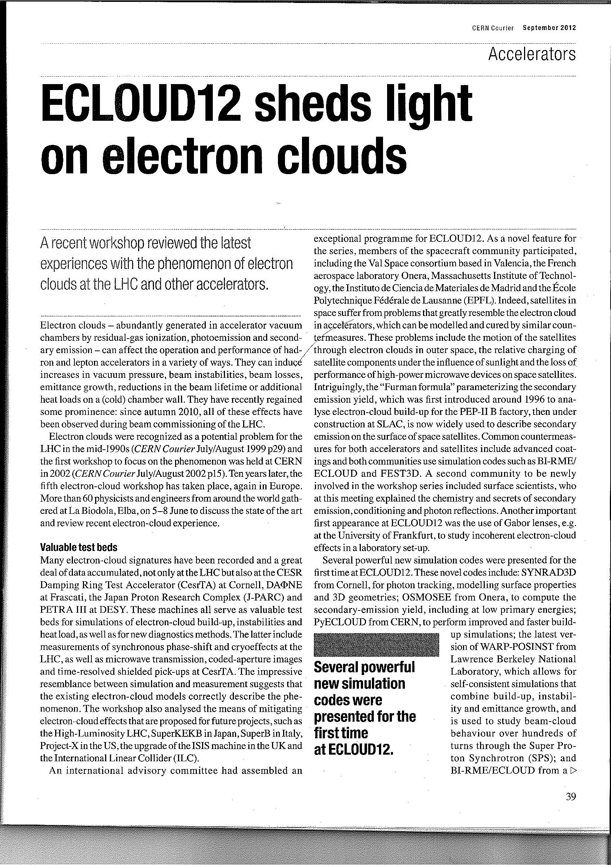
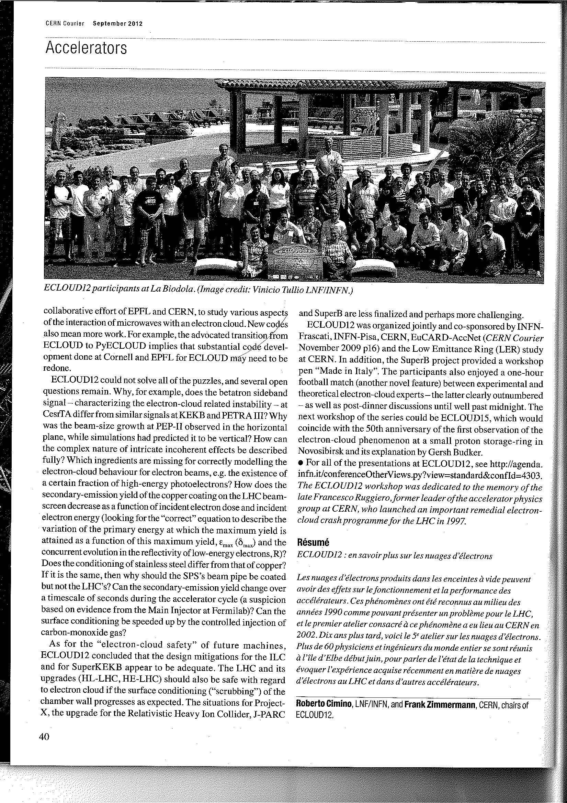
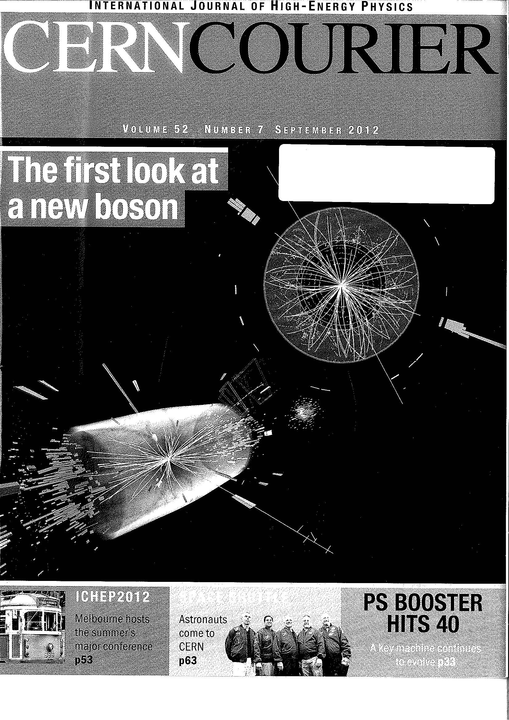
AccNet article in CERN Courier Sept 2012

Slide 18
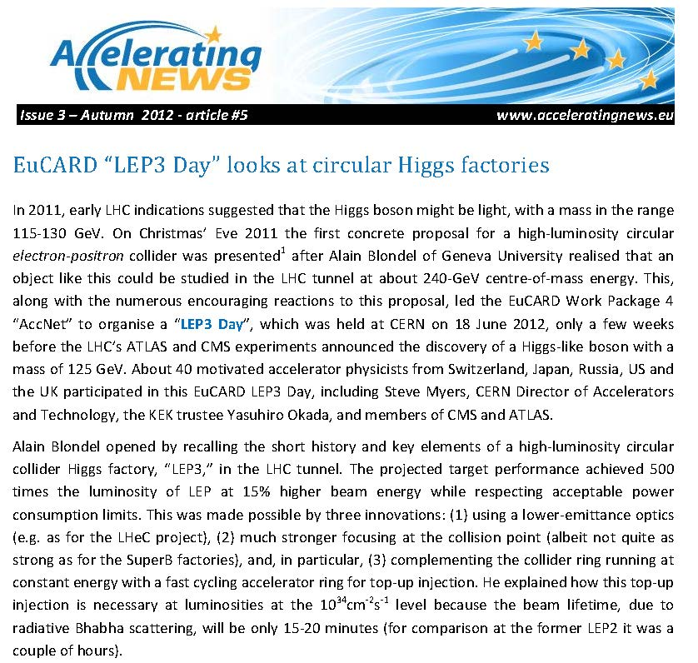
AccNet article in Accelerating NEWS issue 3

Slide 19
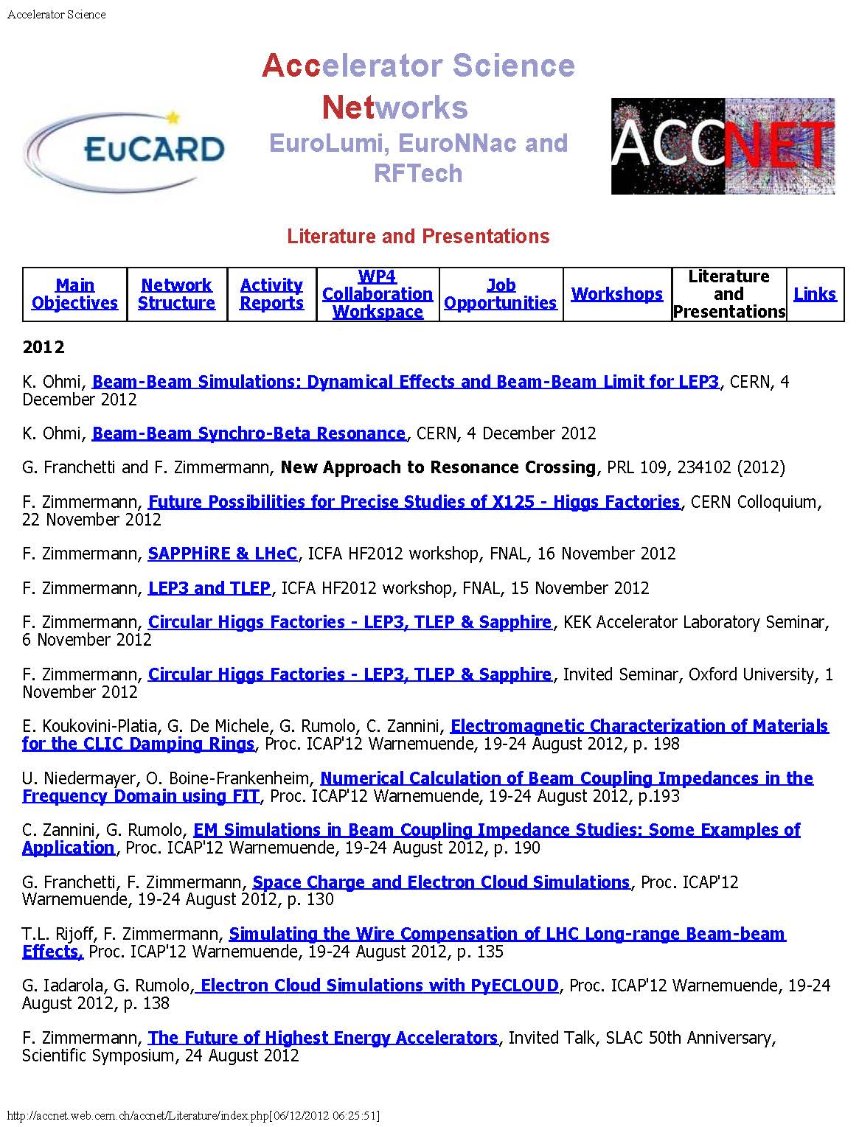
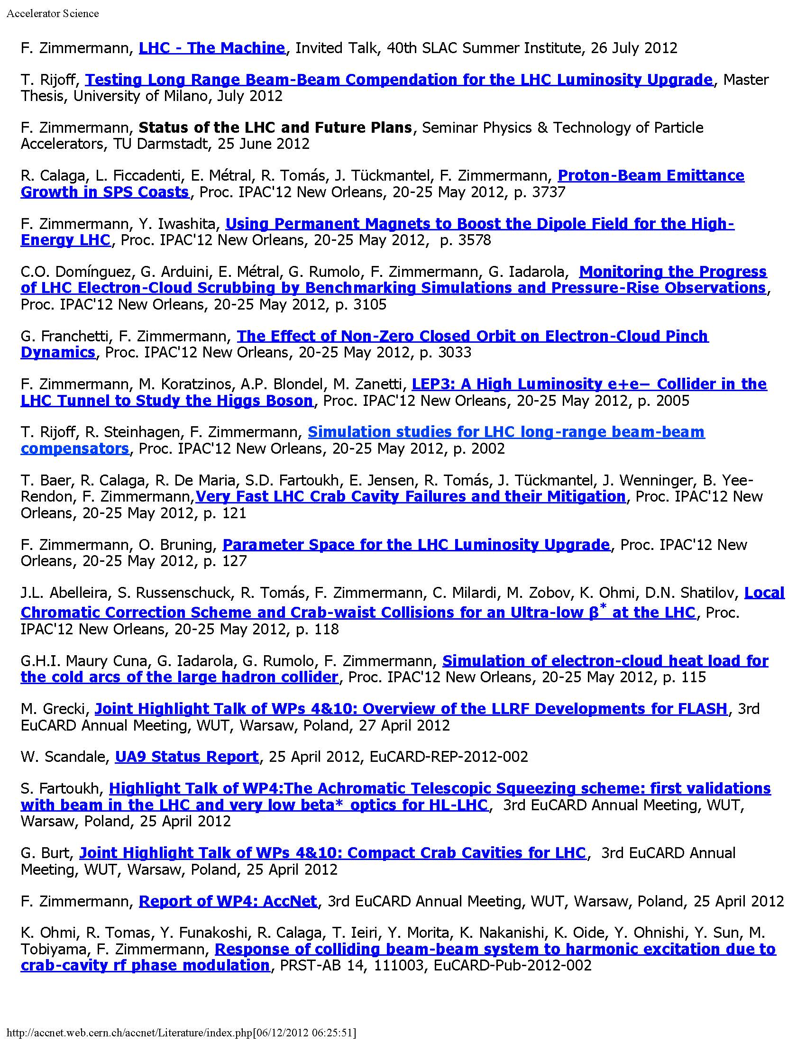
AccNet recent talks & literature

Slide 20
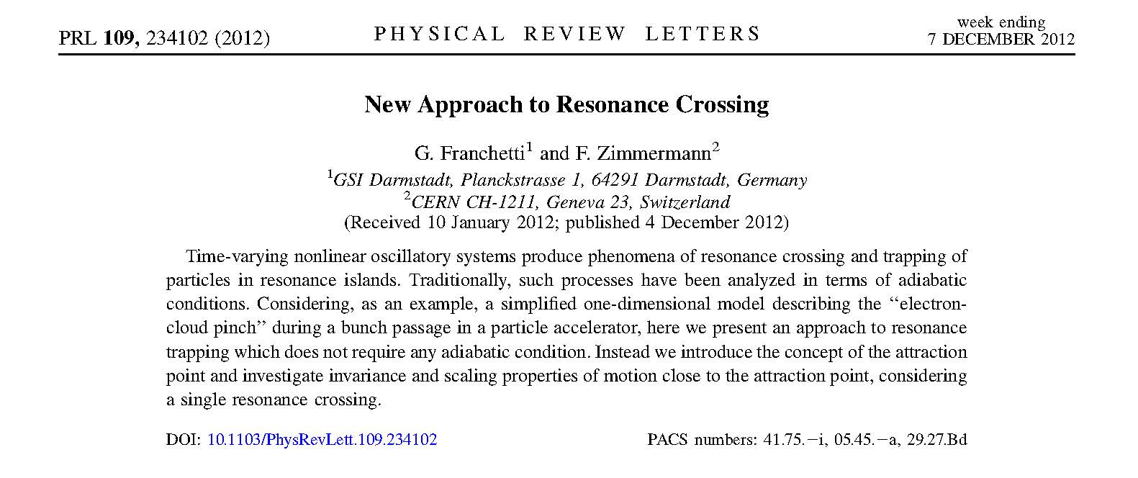
recent publication
continuous CERN-GSI collaboration thanks to CARE and EuCARD
(started at CARE-HHH-2004 workshop)

Slide 21
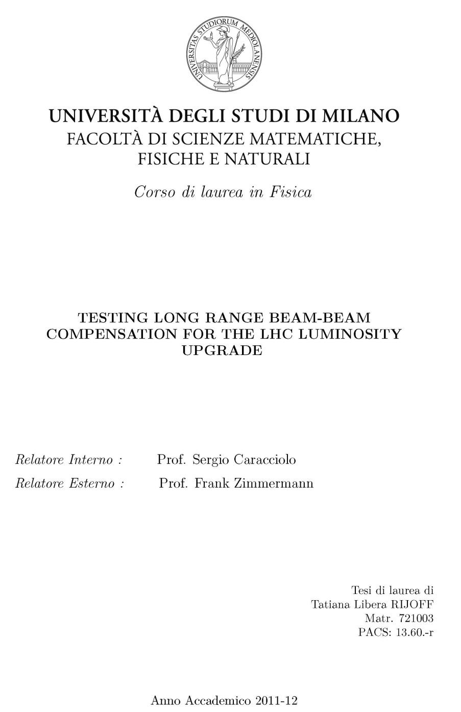
recent Master thesis

Slide 22
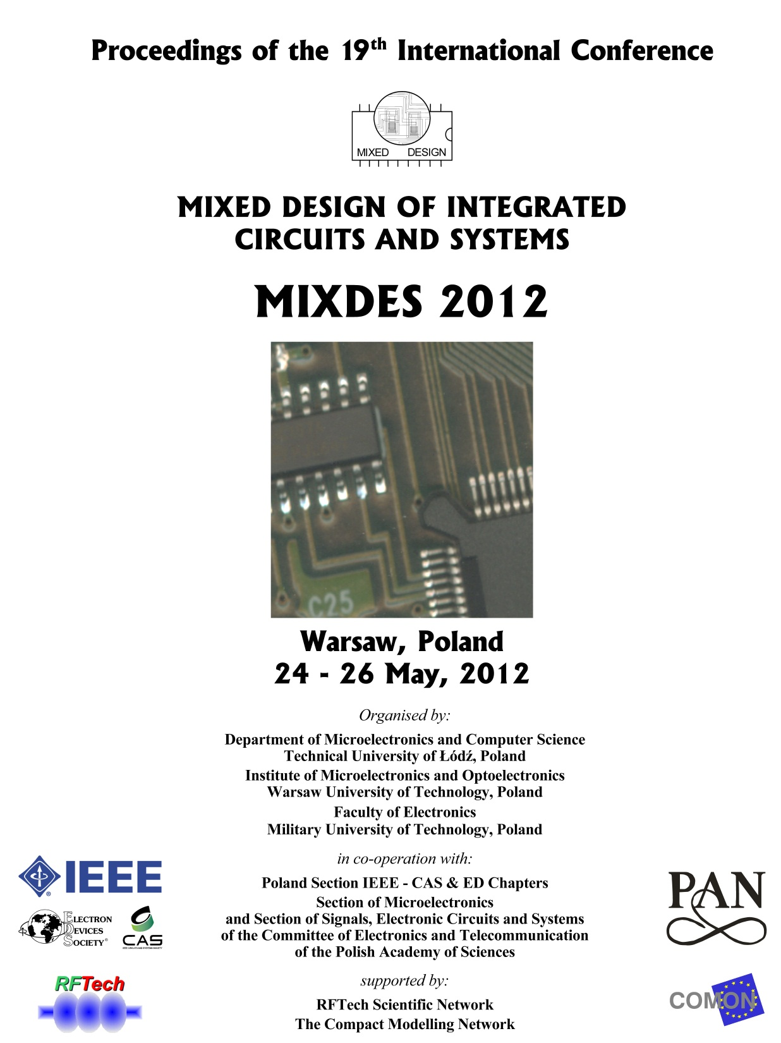
MixDes2012 proceedings

Slide 23
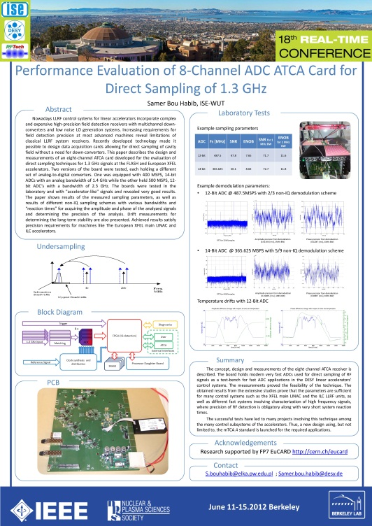
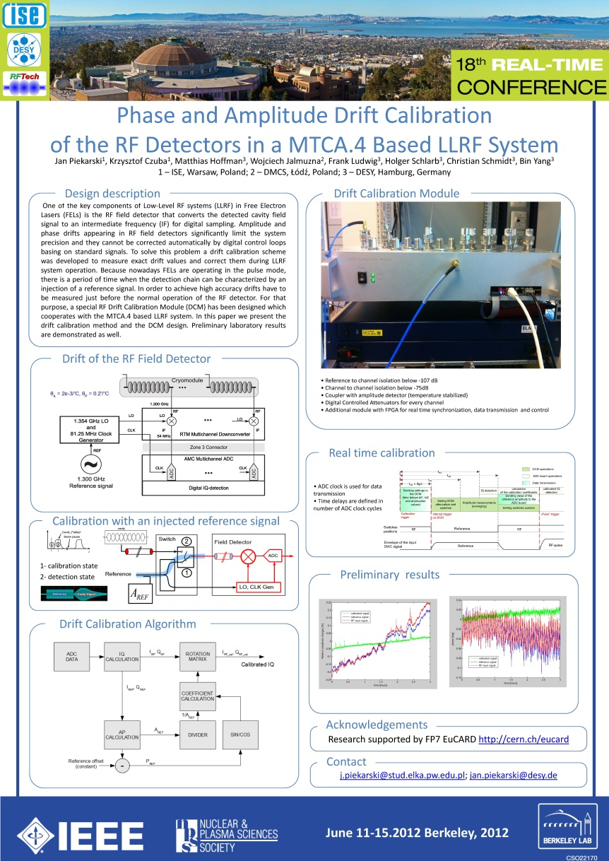
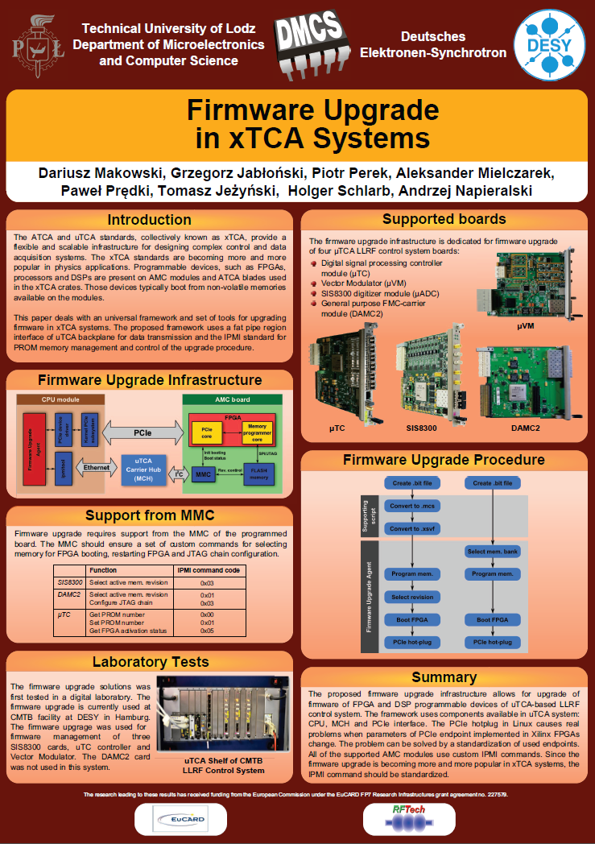
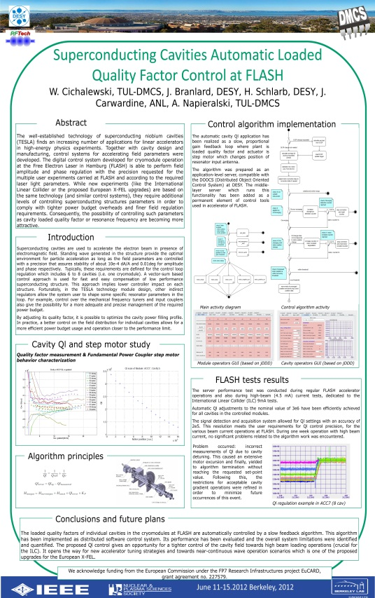
some RT2012 RFTech posters

Slide 24
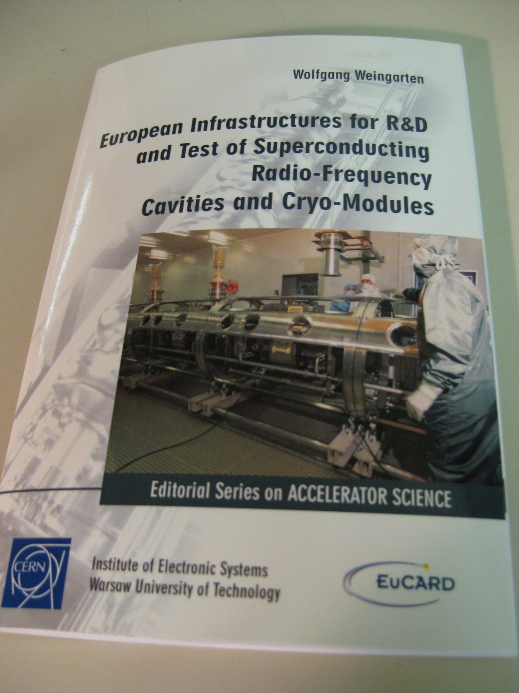
AccNet Deliverable
D4.3.2
– “Strategy/result for SRF test infrastructures” –
published as EuCARD
monograph

Slide 25
AccNet deliverables
Deliverables of tasks | Description/title | Nature | Delivery month | Status
4.1.1 | Continually updated AccNet web site | O | M2 | DONE, OK
4.1.2 | AccNet Strategy for future proton & electron facilities in Europe | R | M48 | on track
4.2.1 | Continually updated EuroLumi web site | O | M2 | DONE, OK
4.2.2 | EuroLumi Strategy and issues for LHC IR, LHC injector and beam-parameter upgrade path(s), with comment on longer-term prospects, and for FAIR | R | M48 | on track
4.3.1 | Continually updated RFTECH web site | O | M2 | DONE, OK
4.3.2 | Strategy/result for SRF test infrastructures | R | M24 | DONE, OK
4.3.3 | RFTECH strategy/result for cavity design, LLRF & HPRF systems and design integration, and costing tools | R | M48 | on track
4.4.1 | Organization of founding workshop gathering the PWA community | O | M27 | DONE, OK
4.4.2 | Preparation of a proposal for a EC co-funded network in the EuCARD2 proposal | R | M33 | DONE, OK

Slide 26
completed AccNet deliverables
D4.1.1 –Continually updated AccNet web site http://cern.ch/accnet/ )
D4.2.1 – A continually updated EuroLumi web site (http://cern.ch/accnet/Tasks/Eurolumi/ )
D4.3.1 – A continually updated RFTech web site (http://cernc.ch/accnet/Tasks/Rftech/ )
D4.3.2 – Strategy/result for SRF test infrastructures: Complete
D4.4.1 – Organization of founding workshop gathering the PWA community: Completed & report submitted
D4.4.2 – Preparation of a proposal for a EC co-funded network in the EuCARD2 proposal: Completed & report submitted
The AccNet web sites are documented in a report https://edms.cern.ch/file/1001866/4/EuCARD-Del-D4.1.1-D4.2.1-D4.3.1-1001866-v3.0.pdf
The completed deliverables are available from the link http://cern.ch/EuCARD/about/results/deliverables/ .

Slide 27
AccNet milestones
M.4.1.4
– 4th general AccNet Steering meeting during the 3rd EuCARD Annual meeting at Warsaw
M4.2.4:
– Instead of a general annual EuroLumi workshop, 3 topical mini-workshops have been organized and supported during the fourth year: ECLOUD12, LEP3 Days 1 & 2
– next/final major EuroLumi workshop SpaceCharge 2013 in April 2013
M4.3.3:
– 4rd annual RFTECH workshop planned in Grenoble for March 2013
M4.4.4
– 2012 EuroNNAc workshop

Slide 28
planned AccNet events in 2013
co-sponsoring of HFM WAMSDO January 2013? (under discussion)
third EuCARD “LEP3 Day” 10 January
RFTech co-sponsored uTCA Workshop
RFTech co-sponsored LLRF Collaboration Workshop in Swierk (Poland) - 25-27.02.2013
AccNet “SHE-LHC Day”, 21 February, jointly with US Snowmass subgroup, CERN
final RFTech annual workshop, March Grenoble
Joint EuCARD/AccNet-ICFA-HICforFAIR “Space Charge 2013” workshop
European Advanced Accelerator Concepts workshop (EAAC2013), 2-8 June 2013, Elba, Italy (EuroNNAc event?); MixDes2013 Gdynia
→input final EuroLumi strategy
→input final RFTech strategy

Slide 29
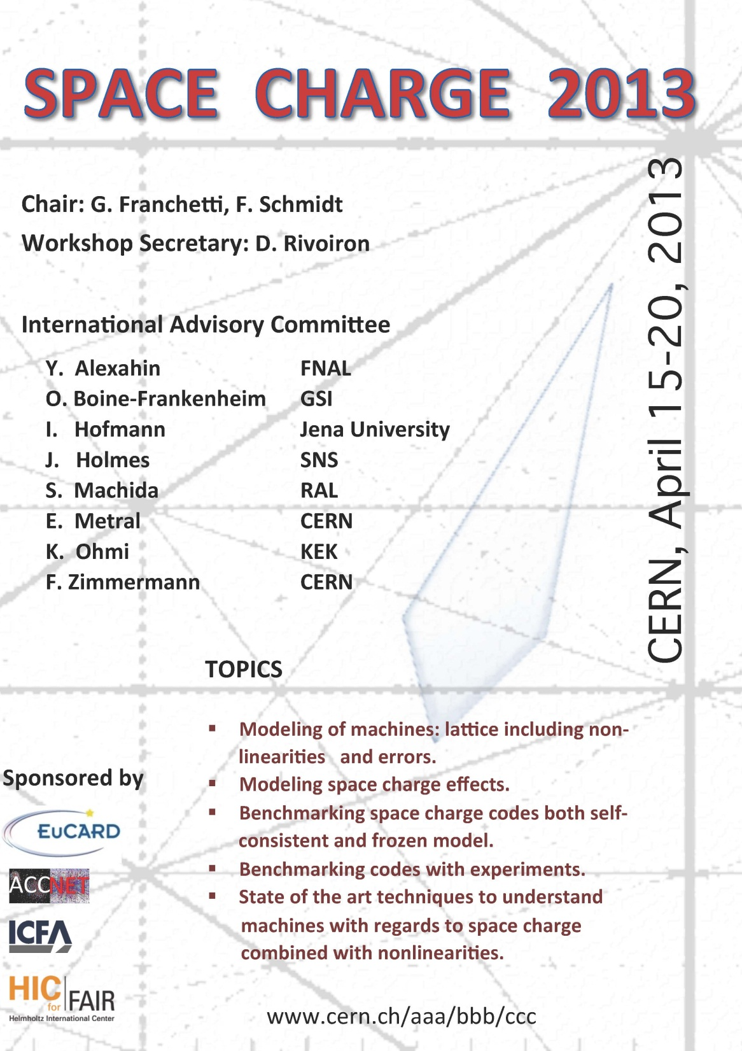
SC 2013
workshop
poster

Slide 30
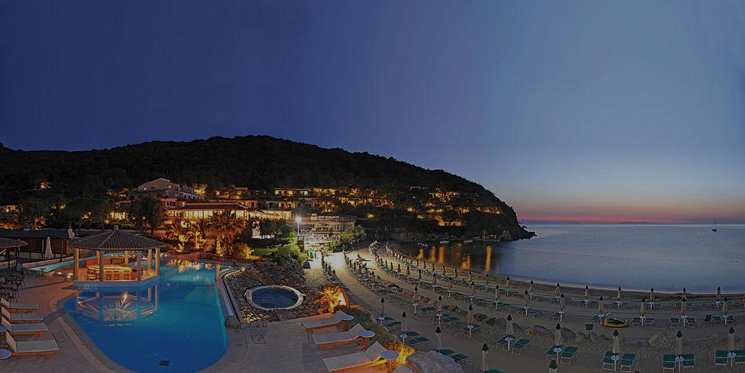
EEAC2013 & EuroNNAc2013
combined European Advanced Accelerator Concepts workshop and 2013 EuroNNAC network meeting ;
EAAC will take place every second year at maximum
INFN and Massimo Ferrario have agreed to host this event in 2013
American colleagues organize the well-established and very successful AAC workshop. EuroNNAc invites Asian partners to collaborate on the additional event and to host it for some future slots
EAAC 2013: Time slot: June 2 - 8, 2013; Location: Elba, Italy ( http://www.elba4star.it/HH/index-Eng.html); Hotel capability: 200 people

Slide 31
proposed AccNet highlights talks
at EuCARD 2013
feasibility study of an 80-km tunnel
John Osborne (CERN)
European HEP-accelerator strategy
Roy Aleksan (CEA)
light-source lessons for Higgs factories
Lenny Rivkin (PSI)

Slide 32
AccNet summary
EuroLumi, RFTech & EuroNNAc extremely active; they help launch & support new initiatives
many activities previously launched or promoted by EuCARD-AccNet have become real projects,
EuroLumi is refocusing effort on (S)HE-LHC & TLEP
strong dissemination efforts
strategy for deliverables to be defined:
1, 2 or 3 booklets (EuroLumi, RFTech, AccNet)?
EuroNNAc?

