Slide 1
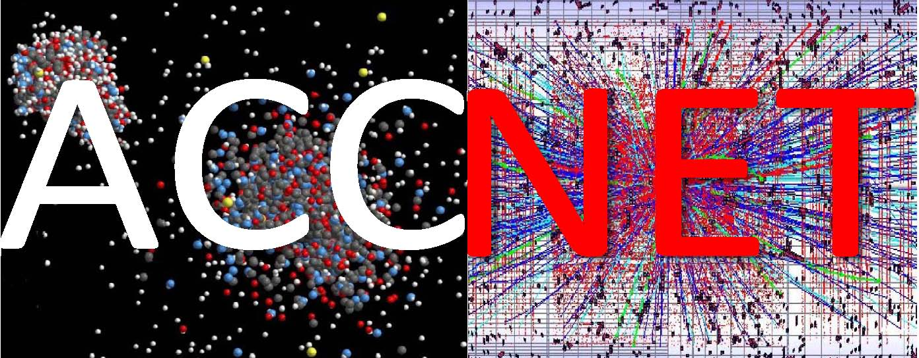
EuCARD WP4 - Accelerator Networks
coordinated by
Ralph Assmann, Jean-Marie De Conto, Mariusz Grecki, Jens Osterhoff, Walter Scandale, Peter Spiller, Ezio Todesco, Henri Videau, Wolfgang Weingarten (ret.), and Frank Zimmermann
EuCARD 3rd Annual Meeting,
Warsaw University of Technology, 25 April 2012

Slide 2
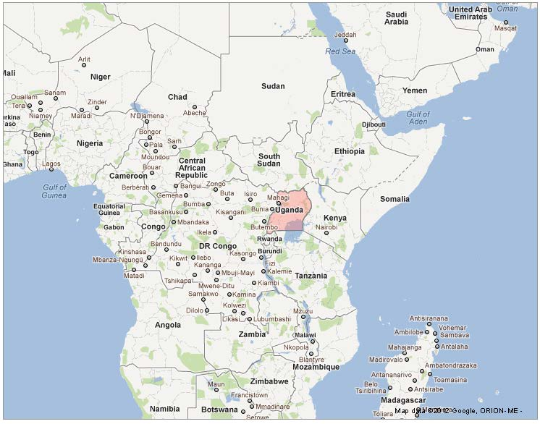
WP4 AccNet getting truly global?
Email 25.03.2012
There is a new registrant in 'EuCARD 3rd ANNUAL MEETING'. See information below:
Event: http://indico.cern.ch/conferenceDisplay.py?confId=166908
Registrant Id: 88
-----------------------------------
Personal Data
-----------------------------------
- Family Name: NKALUBO
- First Name: VICENT
- Institution: RWAD TECHNOLOGICAL INSTITUITE
- Mobile Phone (recommended): 000256711657714
- Phone: 000256711657714
- Email: swatuniversity@yahoo.com
- Address: 71173 clock tower
- City: kampala
- Country: UGANDA
Hello
Yes...I've just deleted their registration after having received an e-mail from our bank saying they've paid with a false credit card....
Thanks for your help
M.

Slide 3
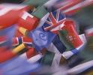
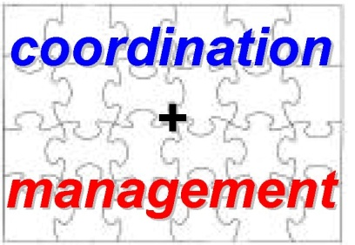
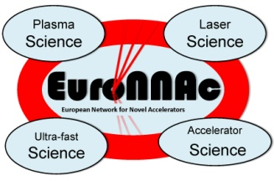
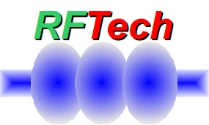
ACCNET Accelerator Science Networks
Coordination & Management
coordinated by Walter Scandale, IN2P3 ; Peter Spiller, GSI ;
Frank Zimmermann, CERN
EURO-
LUMI
RFTECH
EuroNNAc
novel accelerators
coordinated by
Ralph Assmann, CERN
Jens Osterhoff, DESY
Henri Videau, CNRS
accelerators & colliders
performance
coordinated by
Frank Zimmermann &
Ezio Todesco, CERN
sc & nc rf technologies
coordinated by
Jean-Marie de Conto, UJF
Mariusz Grecki, DESY
(Wolfgang Weingarten,
CERN)

Slide 4
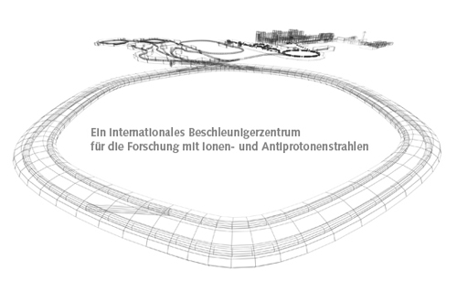
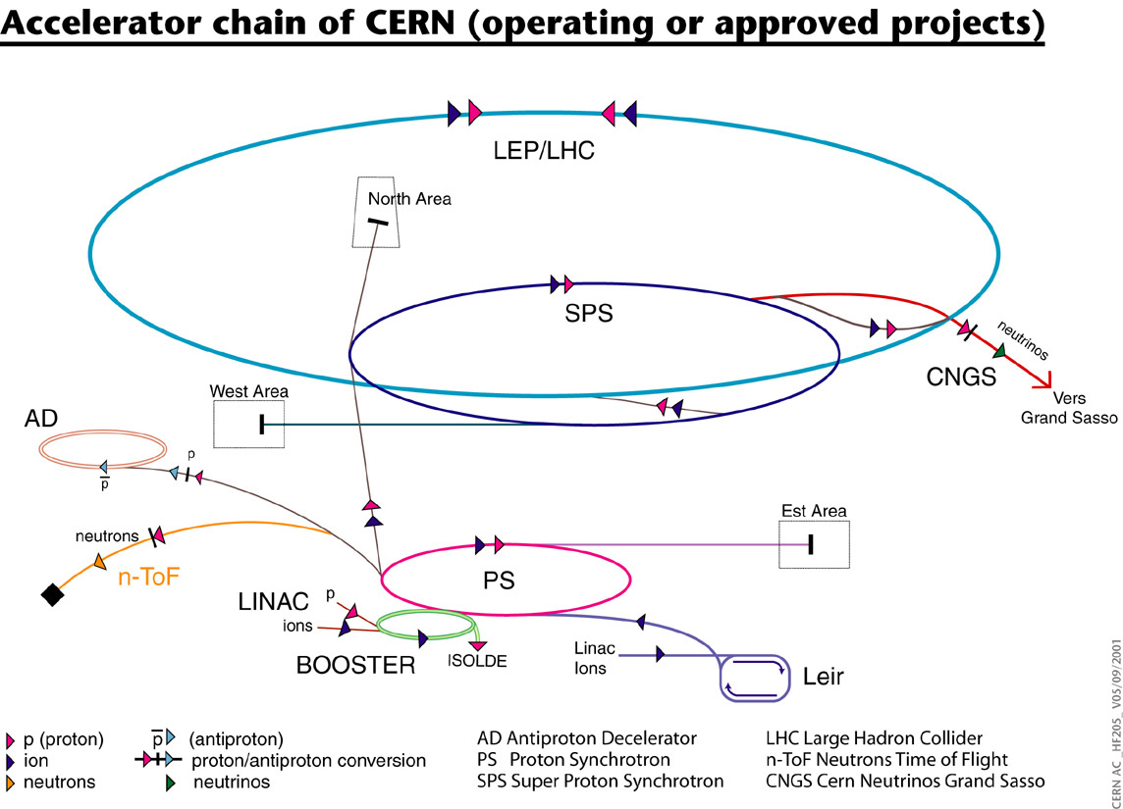
EUROLUMI
brings together experts in beam
dynamics,magnets, collimation, RF, & experiments
FAIR
LHC IR & beam
parameter upgrade
CERN complex upgrade
+
initial initiative on
plasma acceleration
LHC injector upgrade

Slide 5
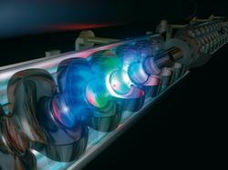
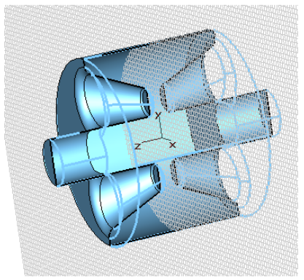
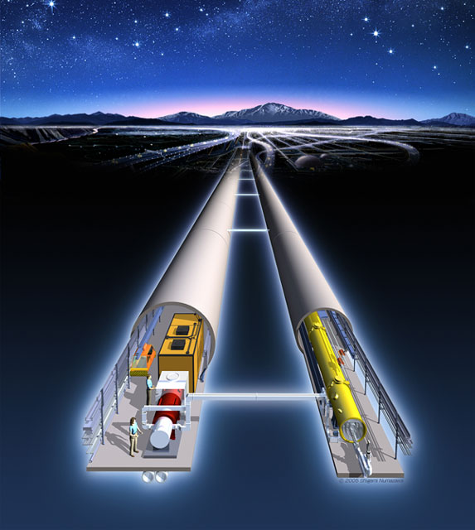
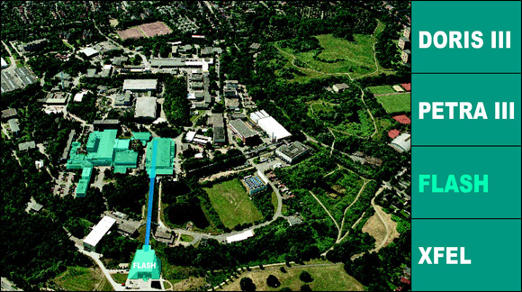
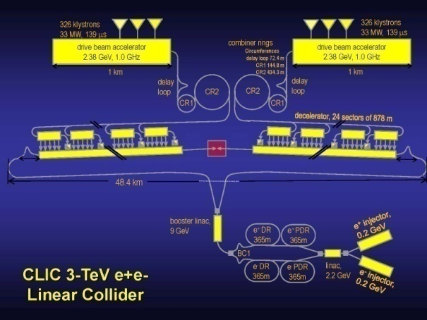
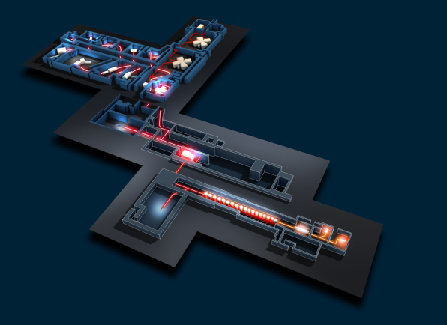
RFTECH
brings together RF experts from different labs, proton & electron accelerators, CLIC and ILC,… ;
encompasses all aspects of RF technology, e.g. klystron development,
RF power distribution system, cavity design, and low-level RF system,
for linear accelerators, storage rings, and associated research infra-
structures, including transversely deflecting (crab) cavities and
financial aspects such as costing tools
SPL
LHC
crab cavity
XFEL
ILC
FLASH
GANIL
SPIRAL2
CLIC

Slide 6
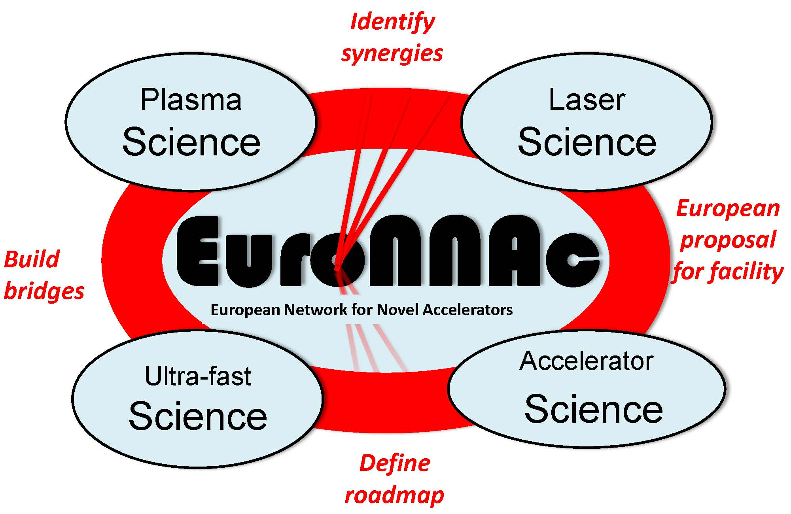
EuroNNAc
will identify possible usage of advanced accelerator techniques in large-scale conventional facilities and to identify a roadmap towards an advanced accelerator facility for big science with applications in applied and fundamental research
R. Assmann

Slide 7
AccNet tools
annual workshops
topical meetings and mini-workshops
capability of inviting or exchanging experts over periods of typically a week to a month
exploratory studies & collaborations
opportunities for students
unique place of discussion with users
→ exchange of ideas and expertise aimed identifying the most promising strategies and technologies

Slide 8
AccNet is a catalyzer
US
programs
+ US labs
other related
EU initiatives:
DS LHC HiLumi
ILC-PP …
LHC
experi-
ments
AccNet
ITER
EuroLumi
RFTech
EuroNNAc
XFEL
ESS, FAIR
users?
other pan-
European research
ventures
European labs &
Universities
Japanese labs
KEK
J-PARC…
Russian labs

Slide 9
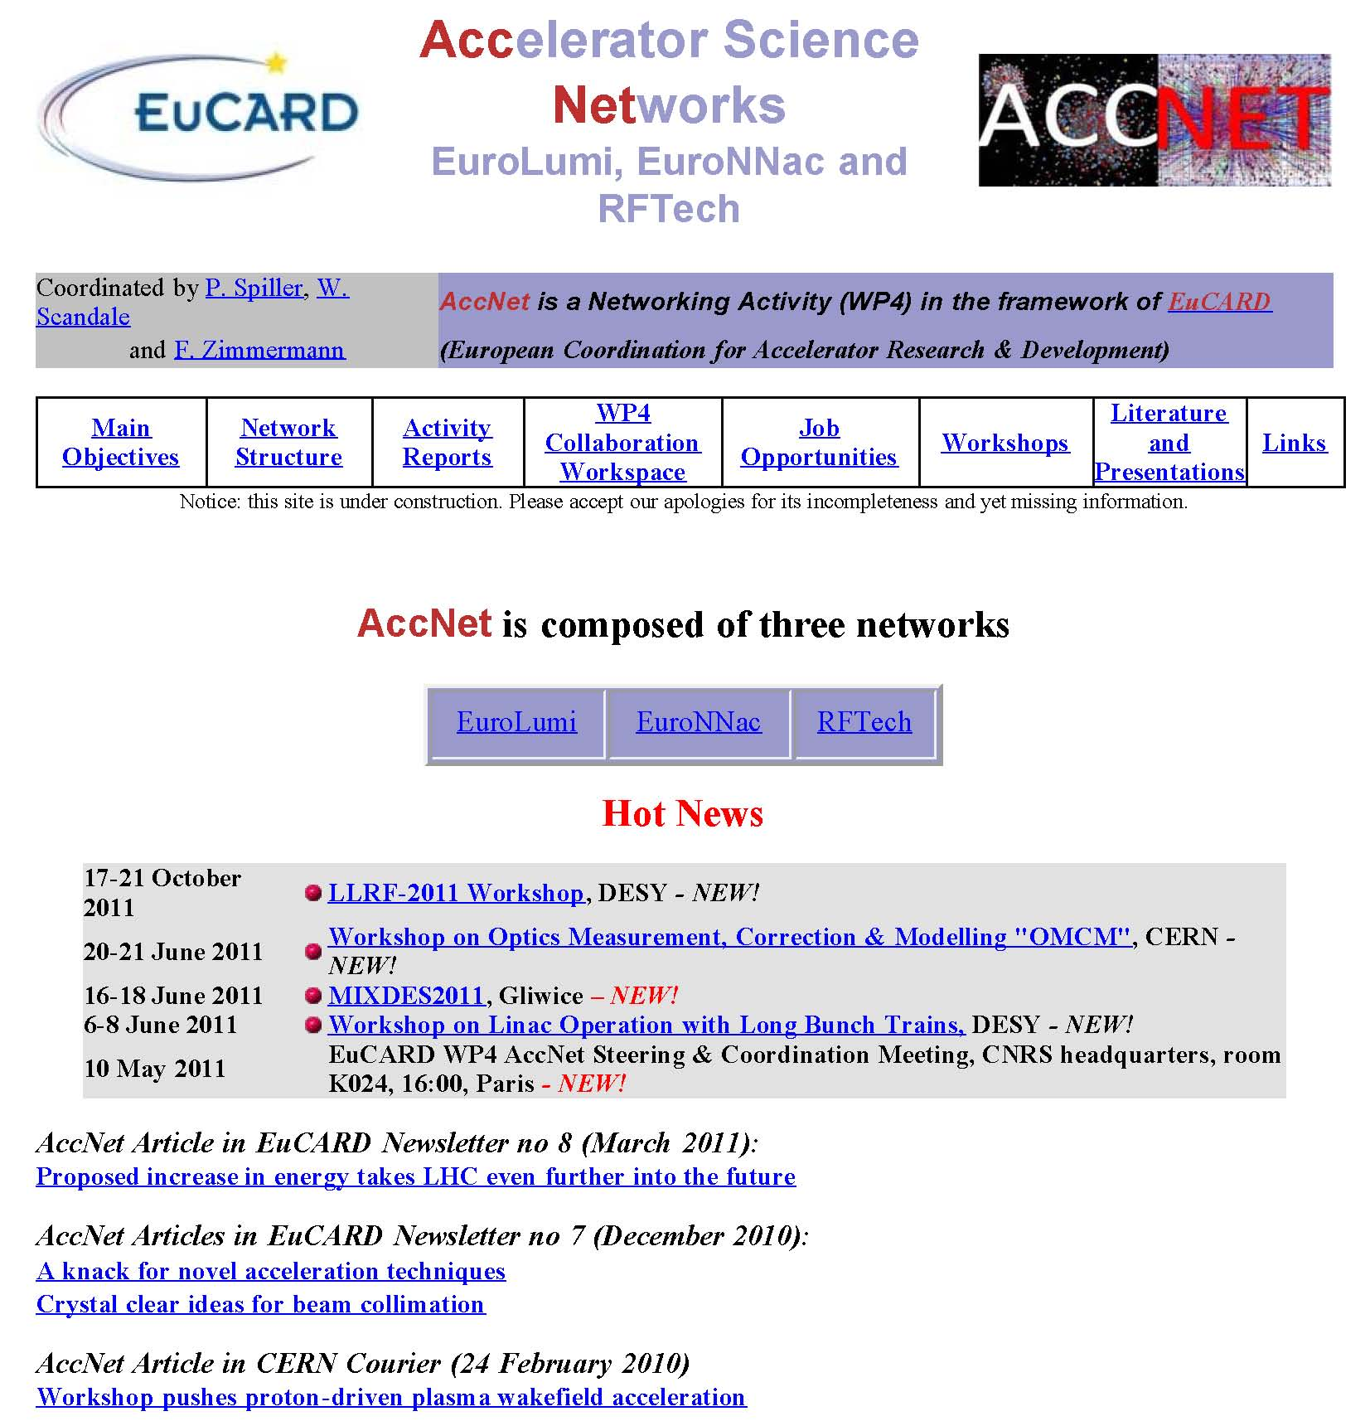
http://cern.ch/accnet/
new address
AccNet web site
maintained & expanded
by Olivier Dadoun (LAL),
and
Frank Zimmermann (CERN)
early in 2011 (after retirement of Bernard Mouton) all AccNet web sites were transferred from LAL to a CERN server for easier access and maintenance

Slide 10
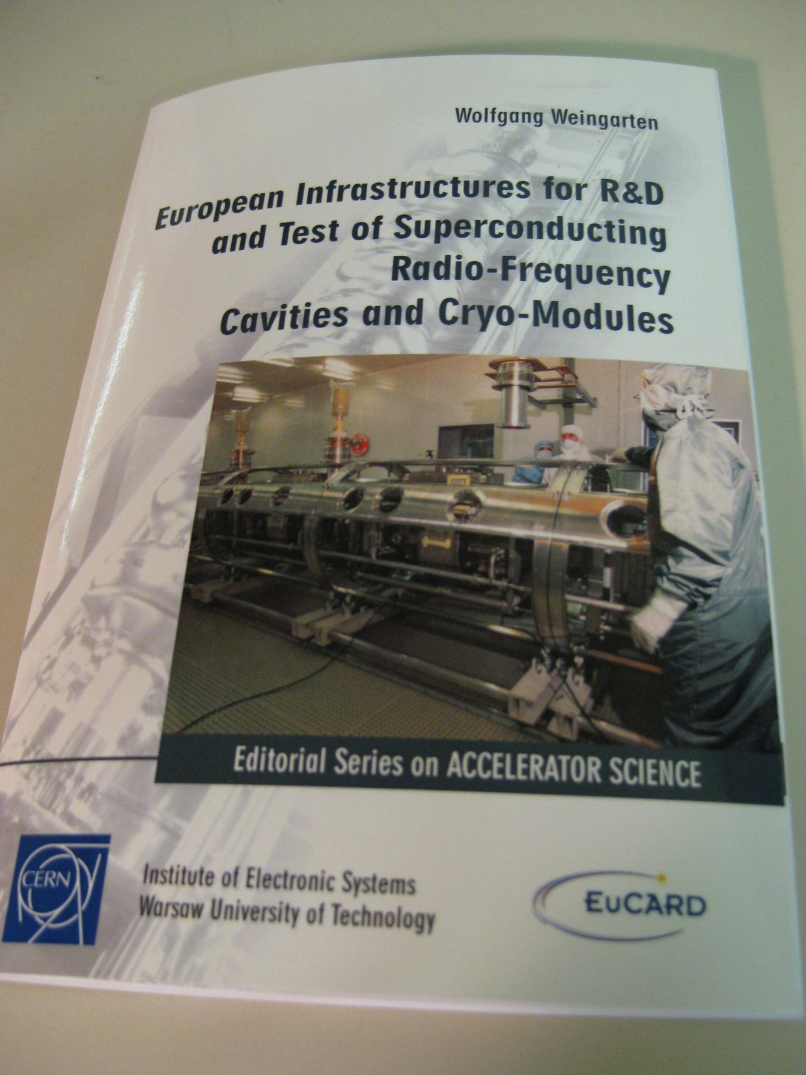
AccNet Deliverable
D4.3.2
– “Strategy/result for SRF test infrastructures” –
has become a EuCARD
monograph!

Slide 11
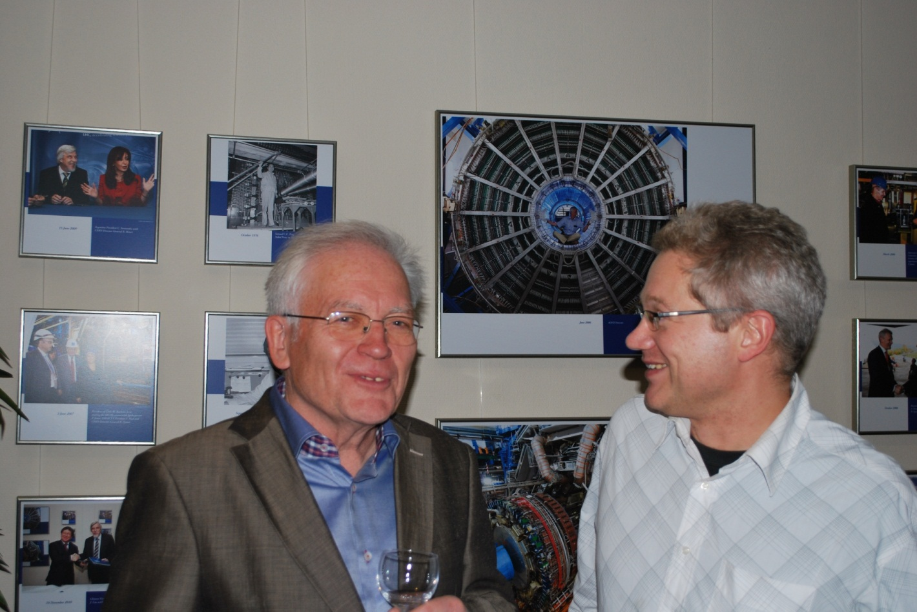
Retirement of RFTech Co-ordinator W. Weingarten
29.11.2011 Many thanks & good luck, Wolfgang!

Slide 12
AccNet achievements since April’11
RFTech co-sponsored workshop on Advanced Techniques in LLRF for XFEL, Cracow 18-20.04.2011
3rd WP4 AccNet Steering & Coordination Meeting, CNRS, 10.05.2011
1st AccNet-EuroNNAc workshop, May 2011
AccNet-RFTech co-sponsored MIXDES2011, Gliwice, 16-18 June 2011
AccNet-RFTech co-sponsored Workshop LLRF-2011, DESY, 17-21.10.‘11
AccNet-EuroLumi Workshop on Optics Measurement, Correction & Modelling "OMCM", CERN, 20-21 June 2011
AccNet co-sponsored MulCoPim'11, Valencia, 21-23 September 2011
AccNet Workshop LHC-CC11 on LHC Crab Cavities, CERN 14-15.11.’11
3rd Annual RFTech meeting, Rostock, 12 December 2011
RFTech co-sponsored LLRF System Integration WS, WUT, 14-16.12.’11
expansion of collaborations with CINVESTAV/Mexico, ESA, ITER, Kyoto U.… MulCoPim’2011; 1st MePAS; 3rd Mexican student at CERN
4th WP4 AccNet Steering & Coordination Meeting, WUT, 24.04.2011

Slide 13
Advanced Techniques in LLRF for XFEL Workshop, Cracow 18-20.04.2011
38 participants from Poland, Germany & US, 35 talks including 2 invited talks
topics:
towards CW operation of XFEL
summary of 9 mA test at FLASH
developement of uTCA based LLRF system (several talks)
RF synchronization system for XFEL (several talks)
LLRF software developement for XFEL
quality management

Slide 14
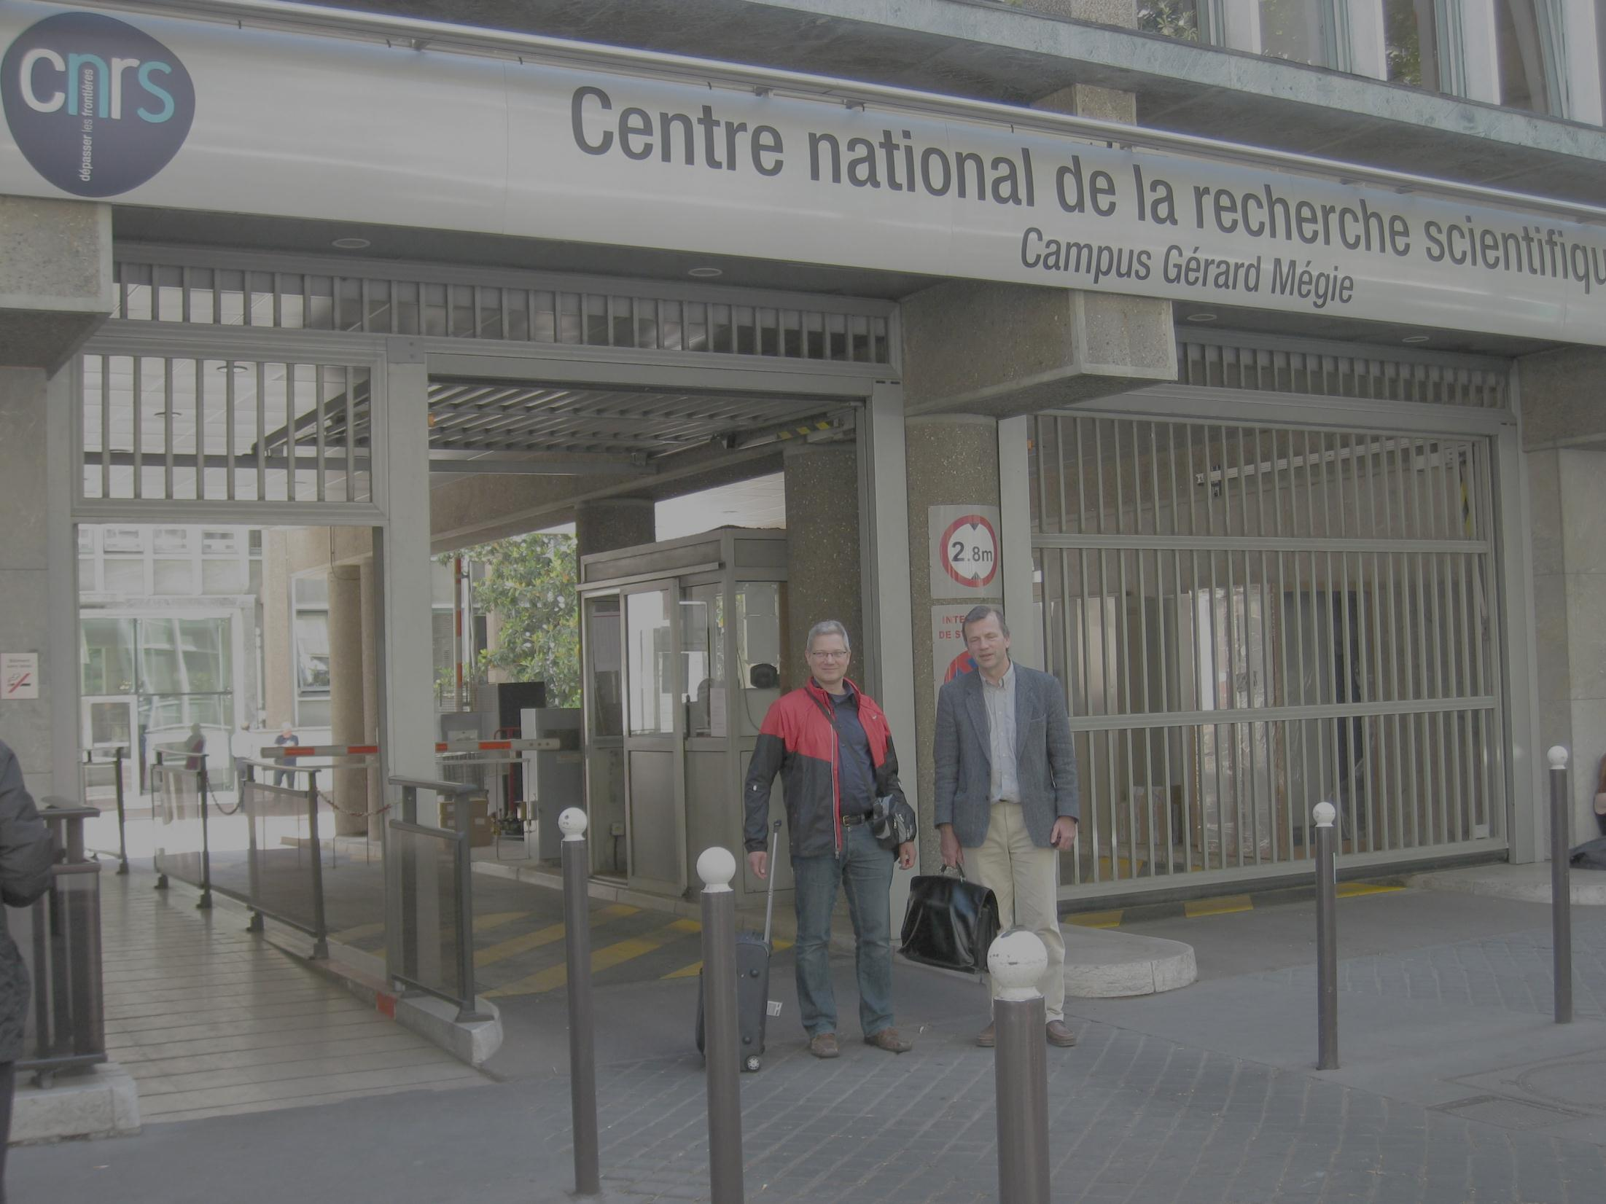
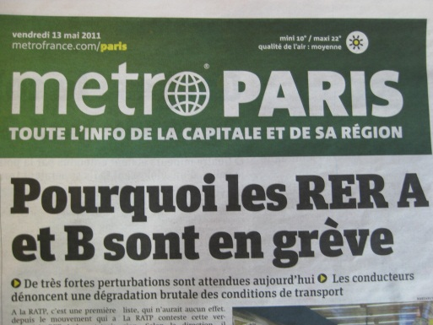
3rd general AccNet Steering meeting, CNRS, May 2011

Slide 15
1st general AccNet EuroNNAc Workshop CERN, 3-6 May 2011
https://indico.cern.ch/internalPage.py?pageId=0&confId=115336
Participants: about 93 persons (from all over the world…)
About 46 presentations & discussions
Goal:
form the network and define the work towards a significant FP8
proposal for novel accelerator facilities in Europe.
Organizer: Ralph Assmann

Slide 16
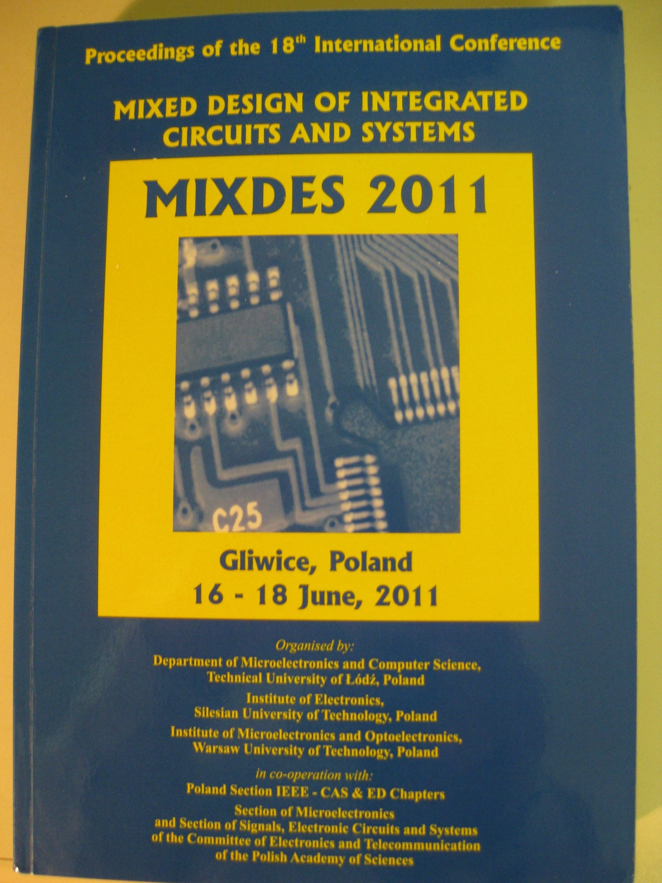
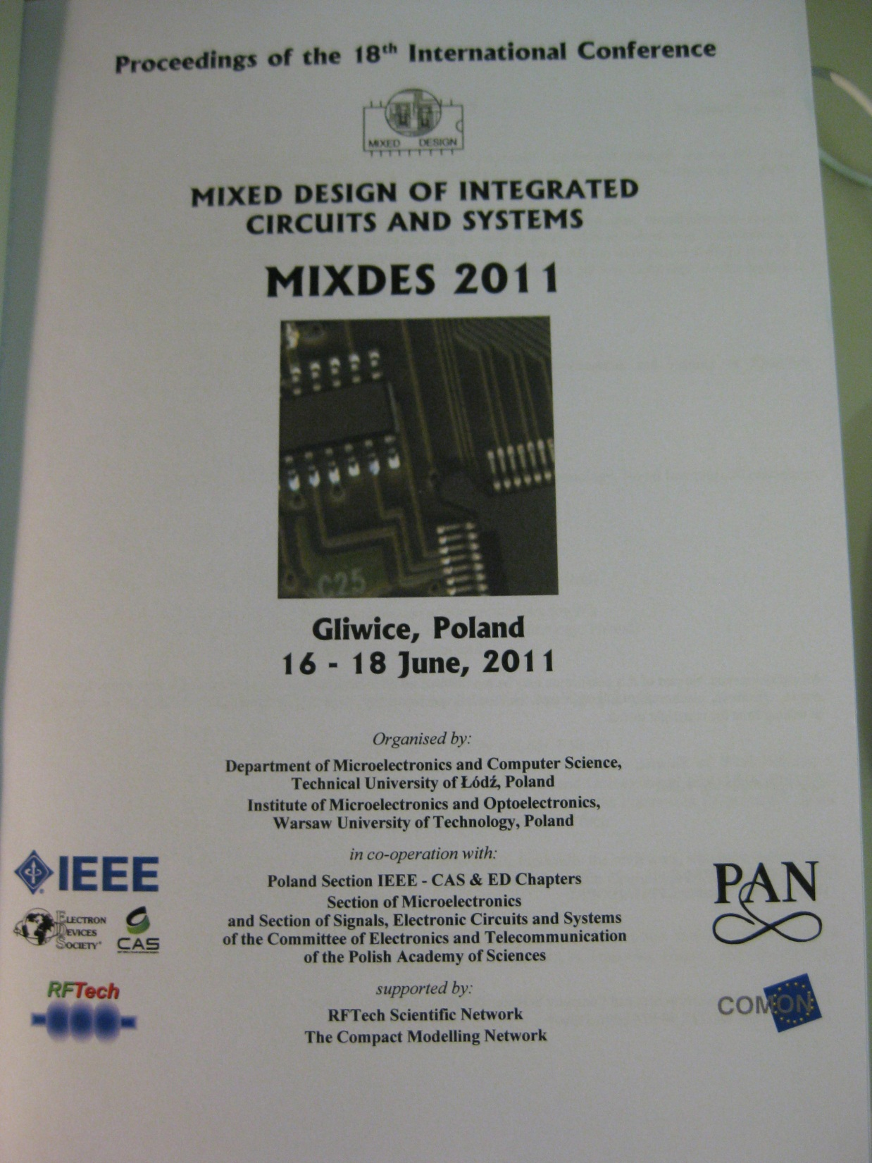
Accnet RFTech co-sponsored MIXDES2011
Proceedings

Slide 17
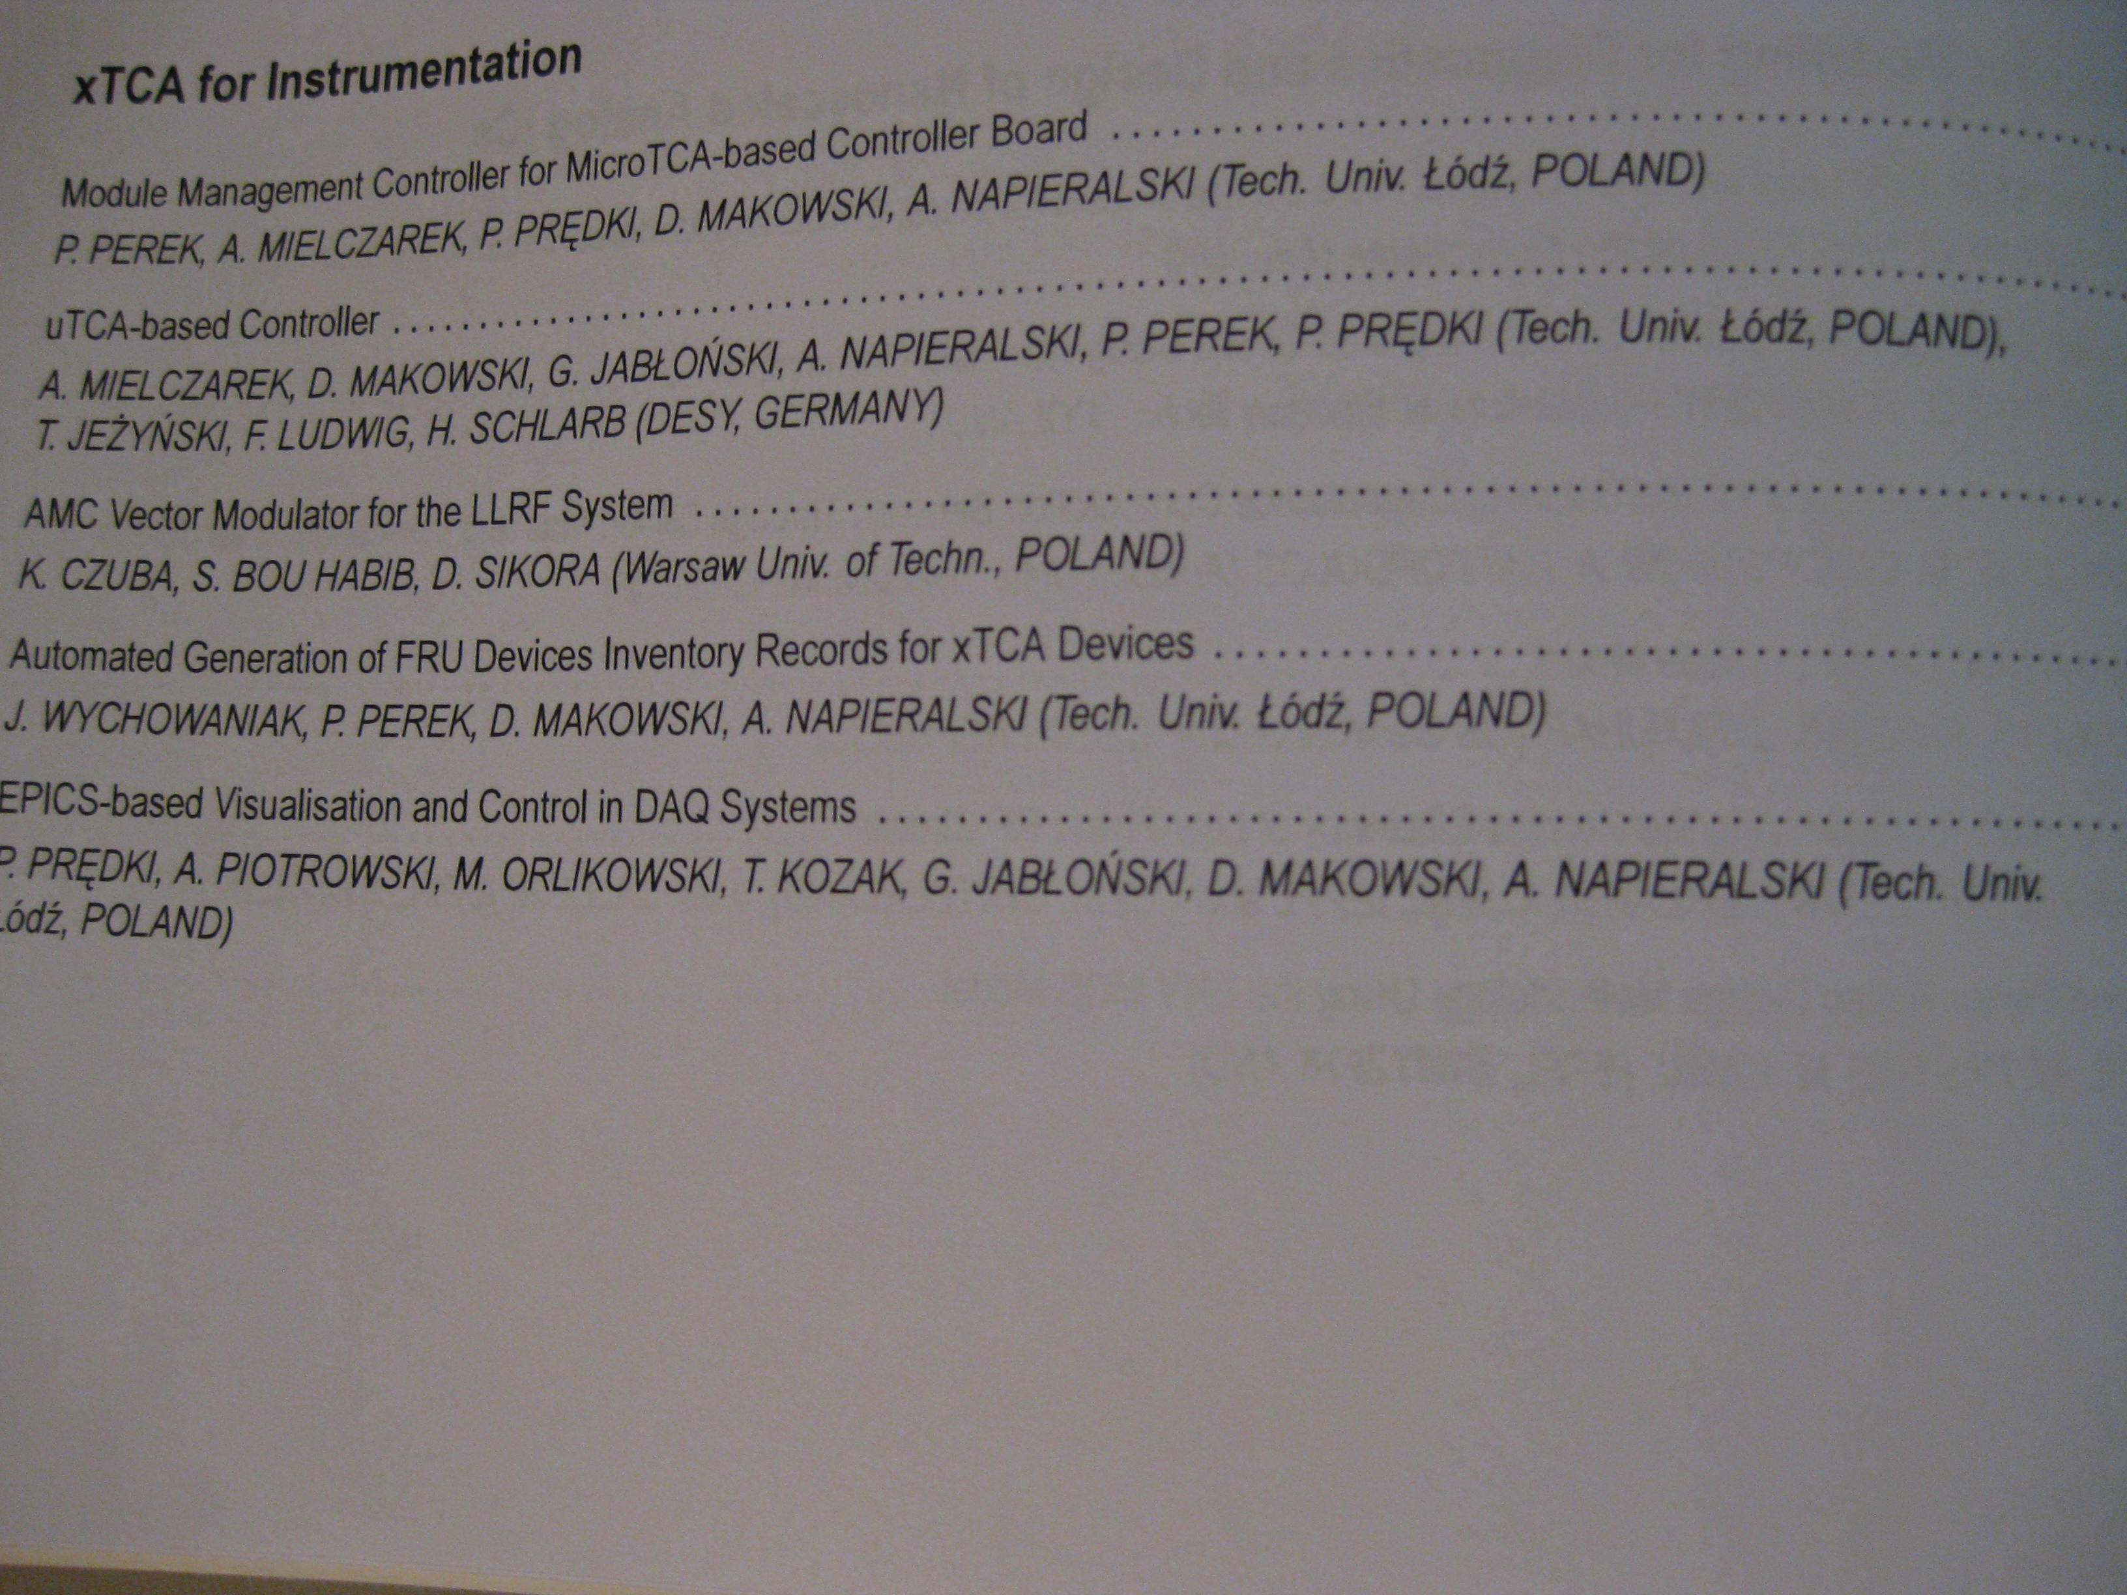
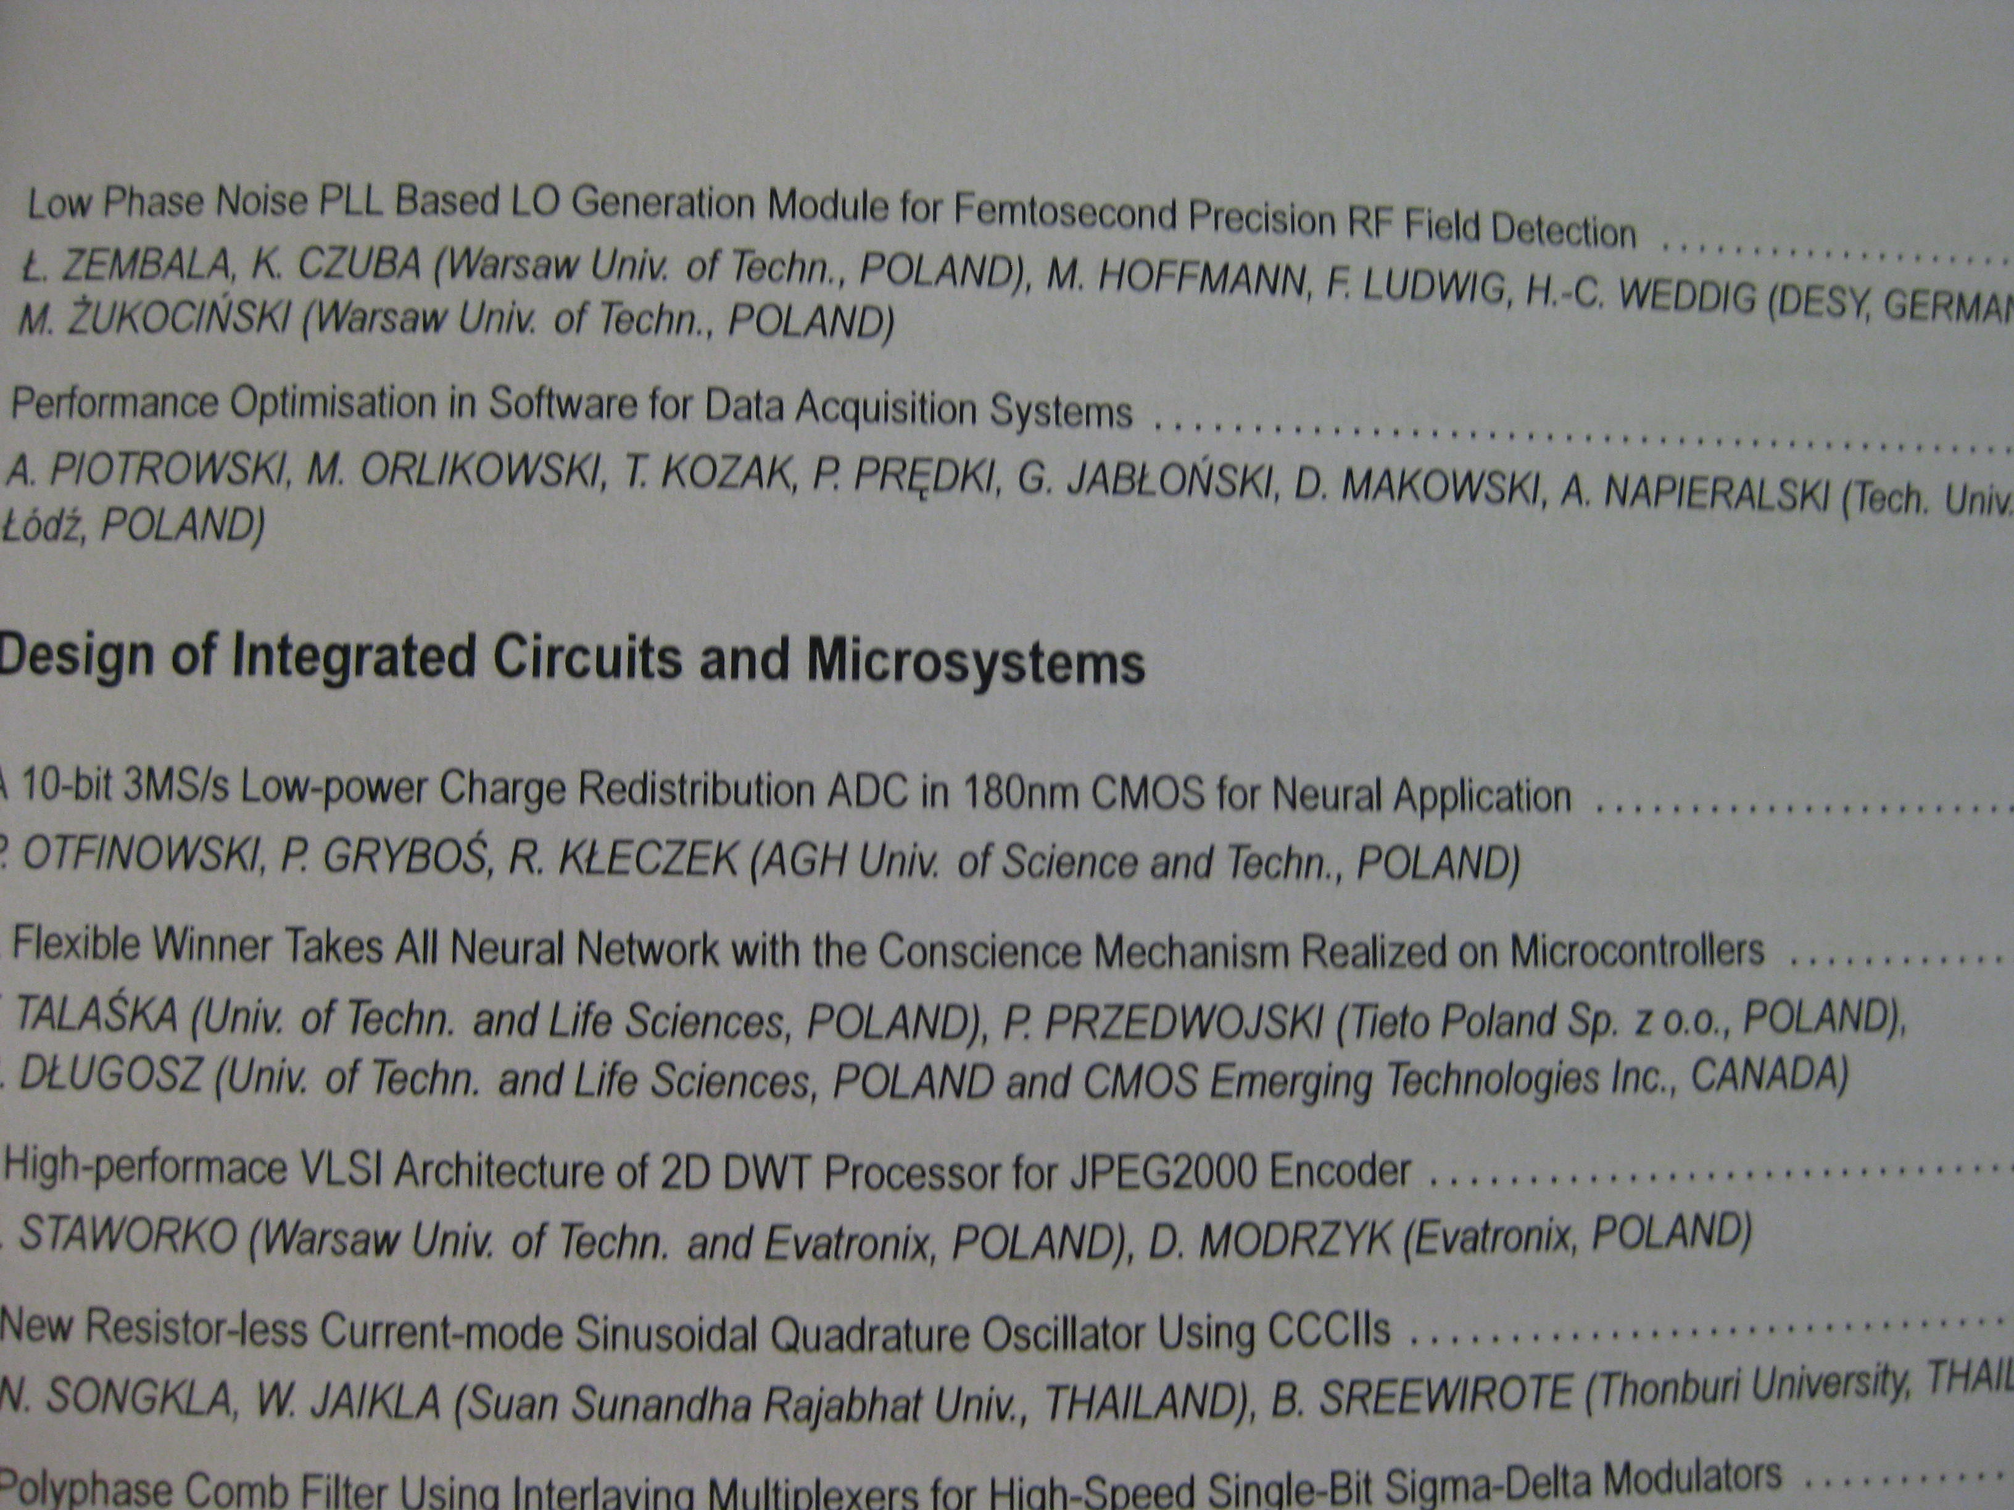
session specific to High Energy Physics and its applications, gathering interesting projects based on xTCA standards, developed for LLRF FLASH and XFEL (DESY) and CODAC (ITER)
seven papers about AMC vector modulator for LLRF System, records for xTCA Devices, Low Phase Noise PLL for femtosecond precision RF Field detection, uTCA-based controllers and optimization of associated software
AccNet-RFTech “xTCA” session @ MIXDES2011
Organizer: Adam Piotrowski

Slide 18
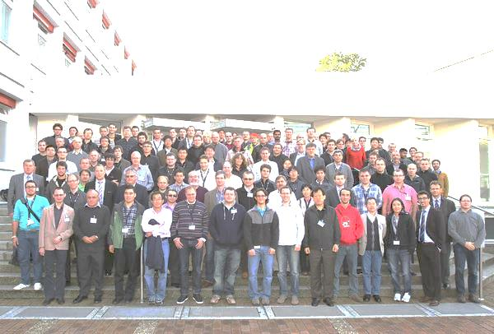
AccNet-EuCARD Low-Level RF Workshop http://llrf2011.desy.de
17-20 October 2011, DESY Hamburg
Topics:
- Reviews of the low-level RF system at various laboratories
- Fast and/or digital low-level RF control for pulsed and CW operation
- Applications of the digital signal processing at accelerator
- Software development
- LLRF systems (requirements, performance reached, modeling)
Highlight: Linear Technology on the ADCs technology edge and their current performance
>118 participants from 16 countries , 9 industrial companies
44 talks including: 10 invited presentations ; 4 tutorials (on Control System Fundamentals, Receiver Fundamentals, FPGA Programming, Embedded system development); 6 lab-talks: CERN, DESY, KEK, FNAL, JLAB, Cornell; 1 industry talk (Linear Technology),;1 welcome talk (Reinhard Brinkmann on DESY accelerator activities); 22 contributed talks (7 hardware, 7 software, 8 systems); 49 posters
Visit of DESY facilities (FLASH and PETRA) - FLASH was overbooked!
9 participants supported by RFTech
Organizer: Mariusz Grecki

Slide 19
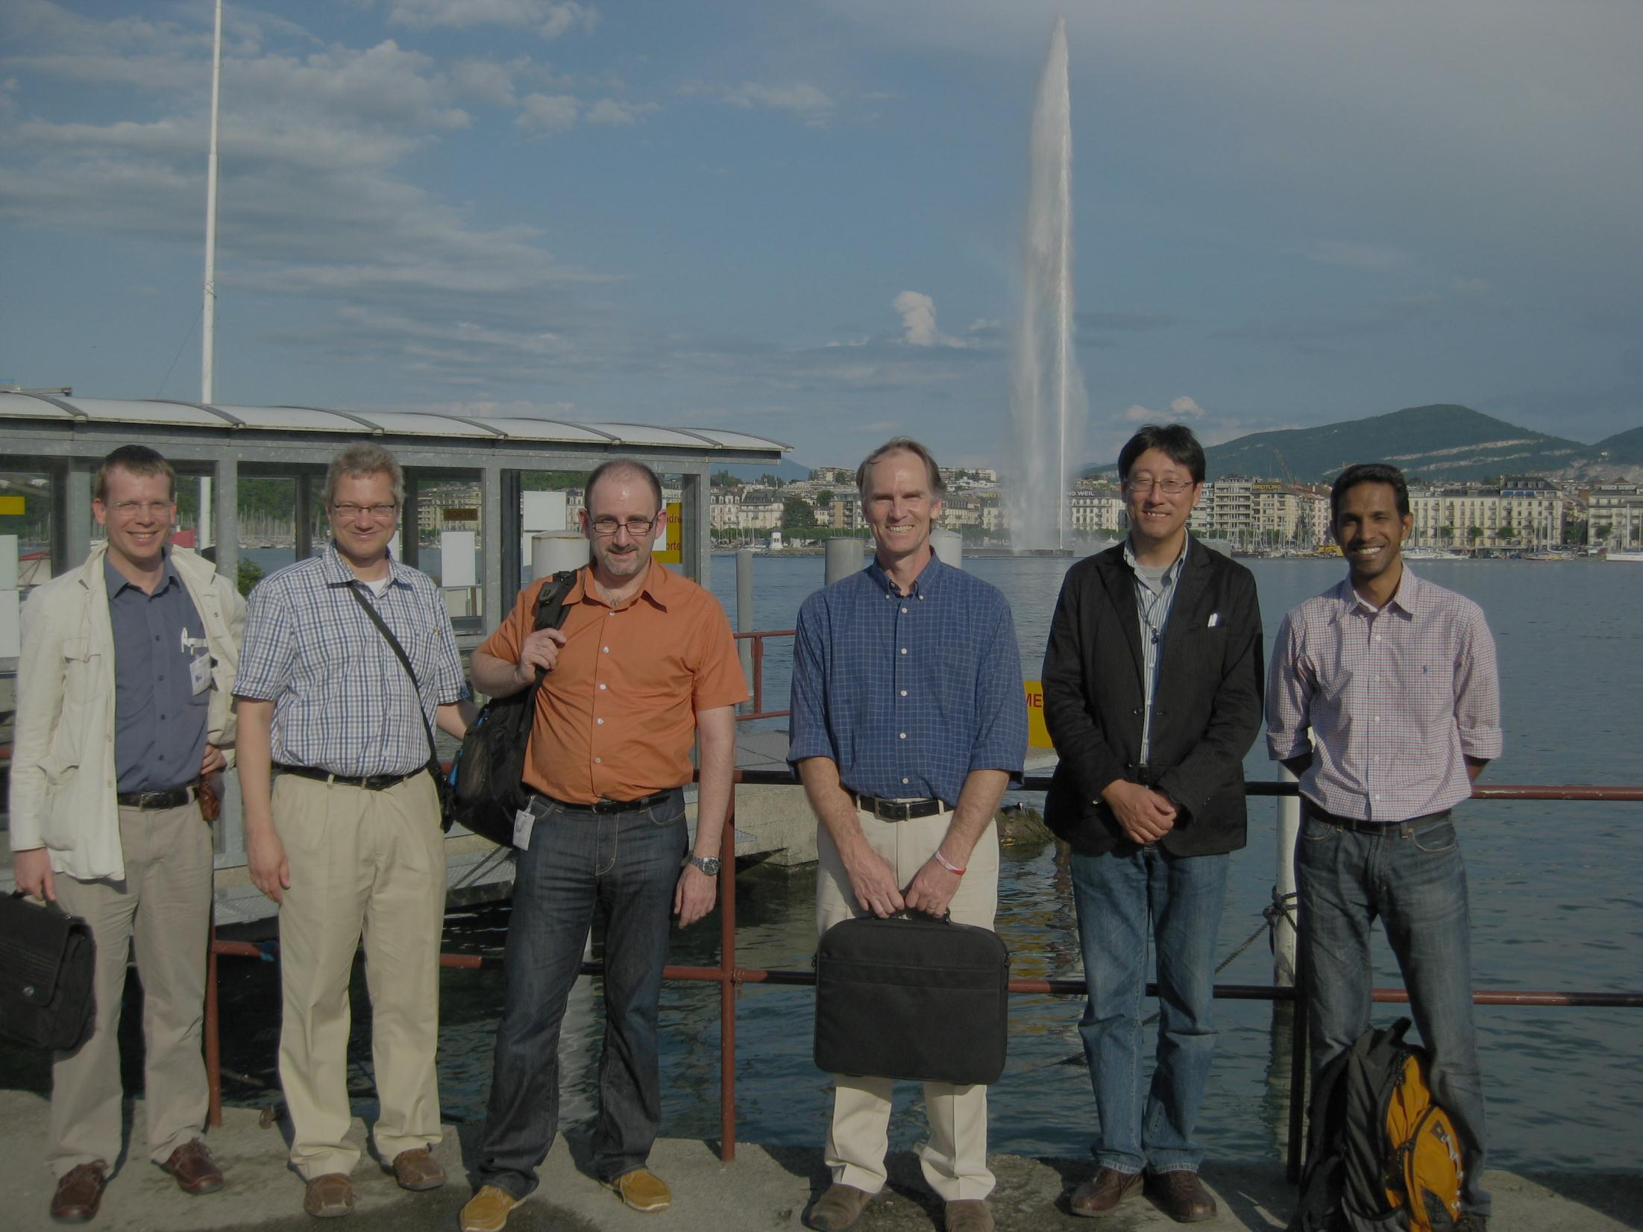
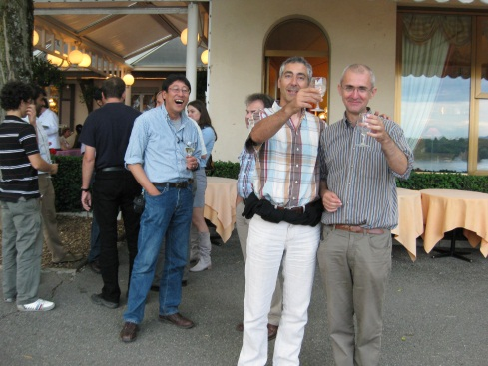
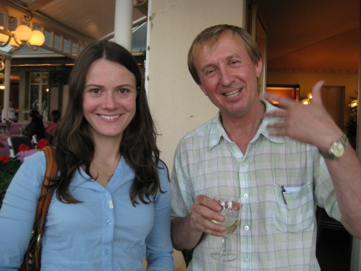
EuCARD-AccNet Workshop Optics Measurements, Corrections and Modeling for High-Performance Storage Rings “OMCM”
20-22 June 2011, CERN
https://indico.cern.ch/conferenceDisplay.py?confId=132526
workshop summary published as EuCARD-CON-2012-004
Participants: about 59 persons (many institutes in Europe, US, and Japan)
46+3 presentations
Sessions: Motivation for HE machines, colliders, HI machines, light sources and damping rings; Experience from colliders, high energy and intensity machines - I + II; Experience from light sources and damping rings ; Techniques review – I & II; Modeling ; Beam diagnostics ; LHC complex present and future plans ; Prospects and future developments
Organizers:
Rama Calaga, Massimo Giovannozzi,
Rogelio Tomas, Frank Zimmermann

Slide 20
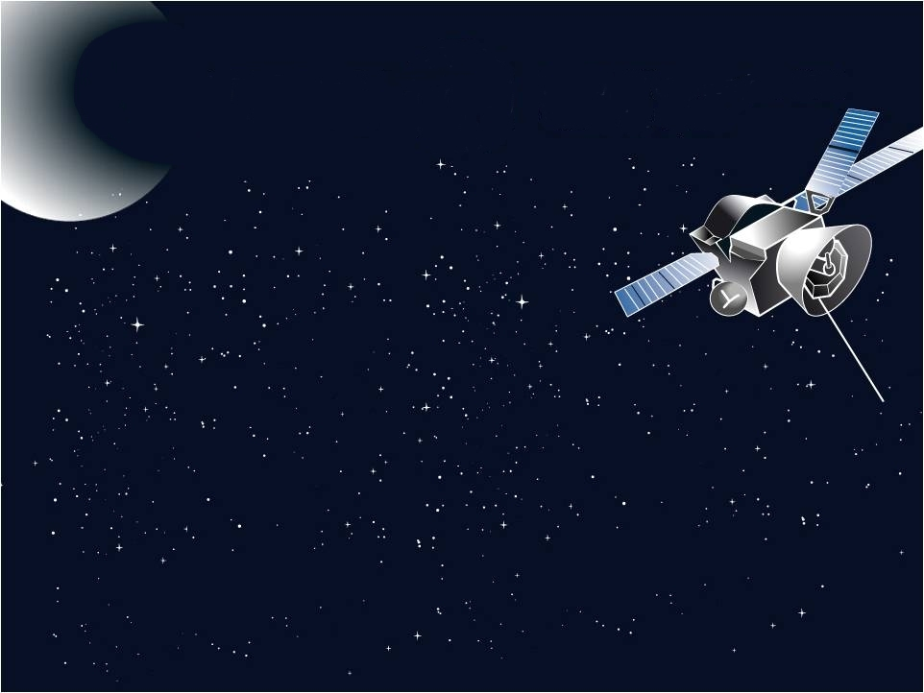
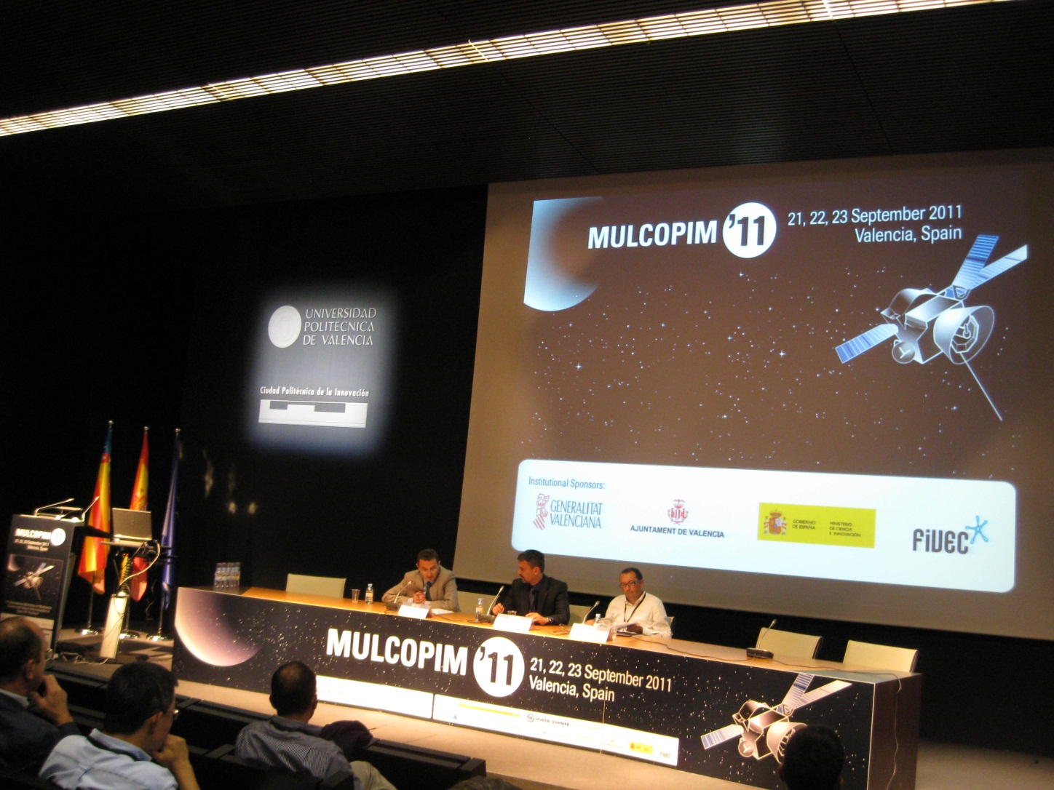
Particle Accelerators
technical sponsors

Slide 21
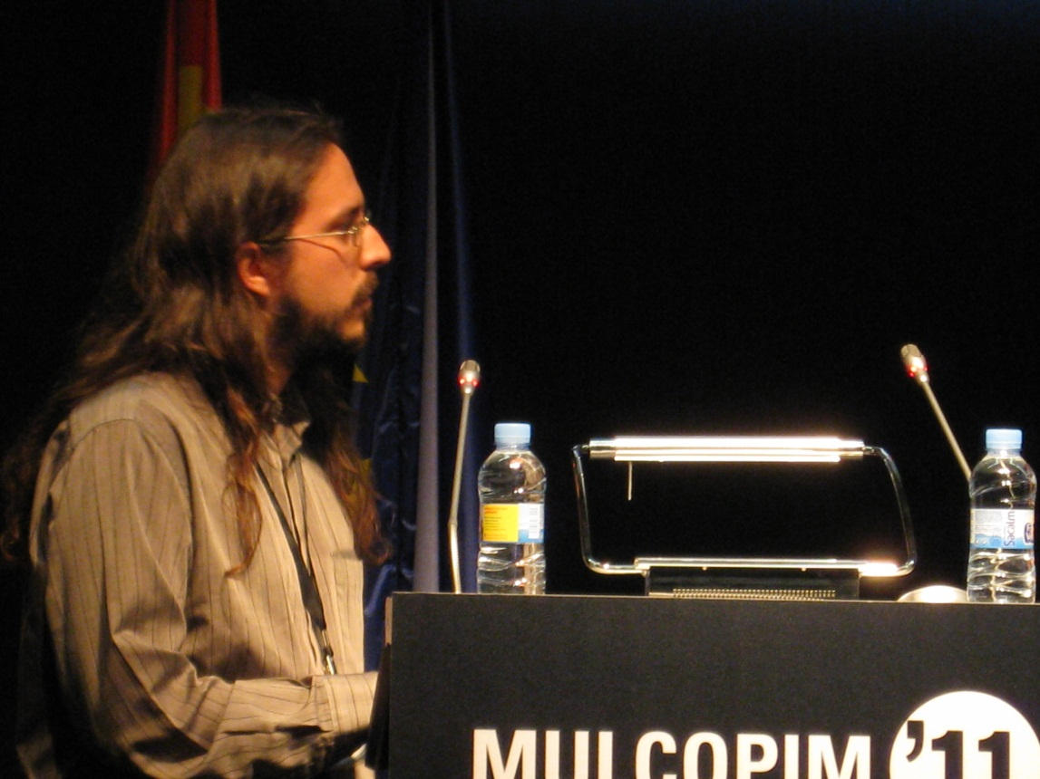
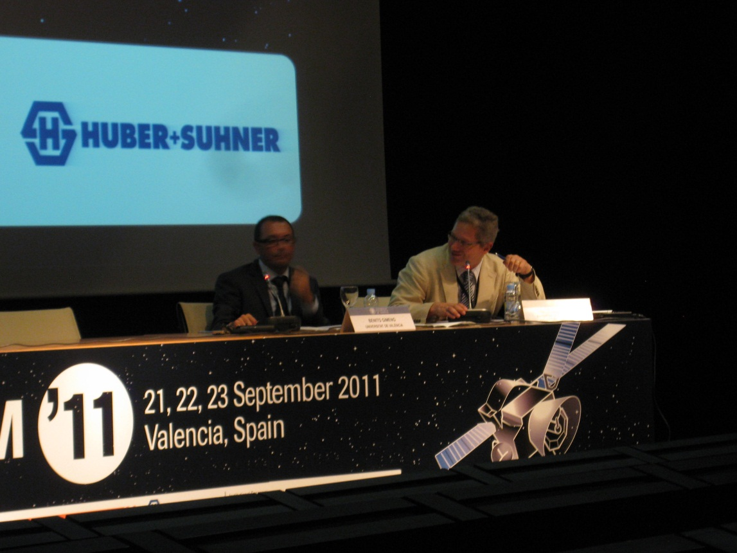
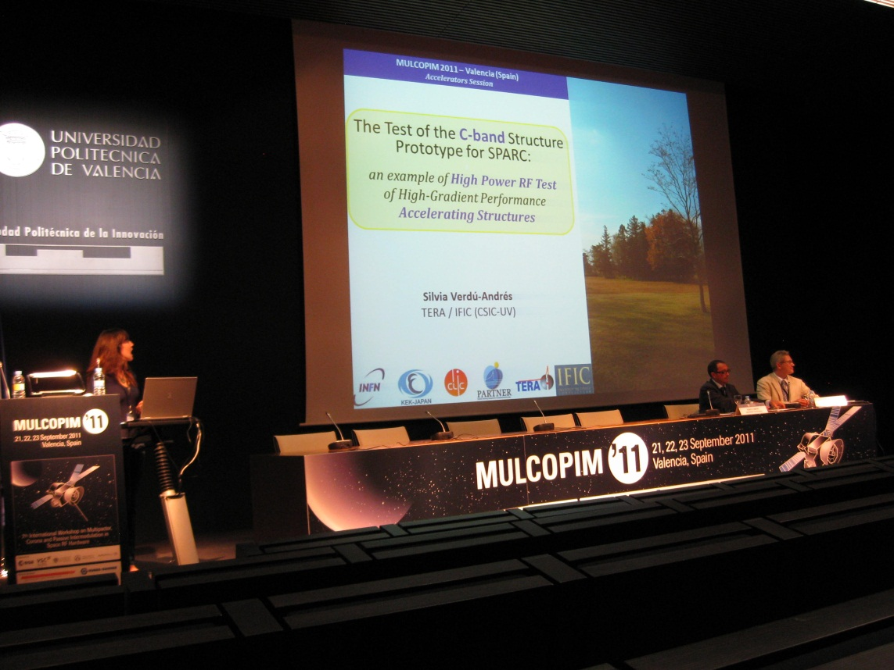
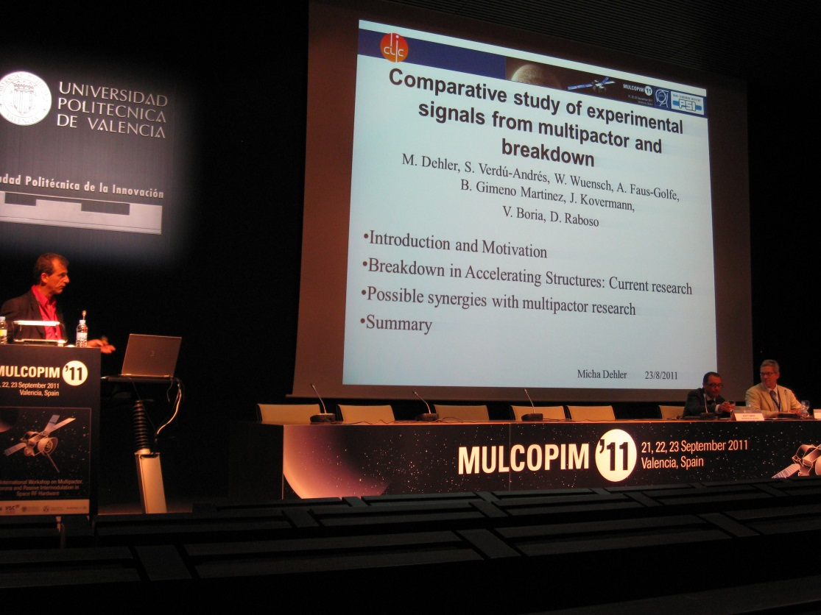
MulCoPim’11
Accelerator Session
MulCoPim topics: multipactor components, multipactor Tx lines, multipactor dielectrics; corona, multipactor experimental, multipactior software, multipactor multicarrie; PIM, SEY, Accelerators

Slide 22
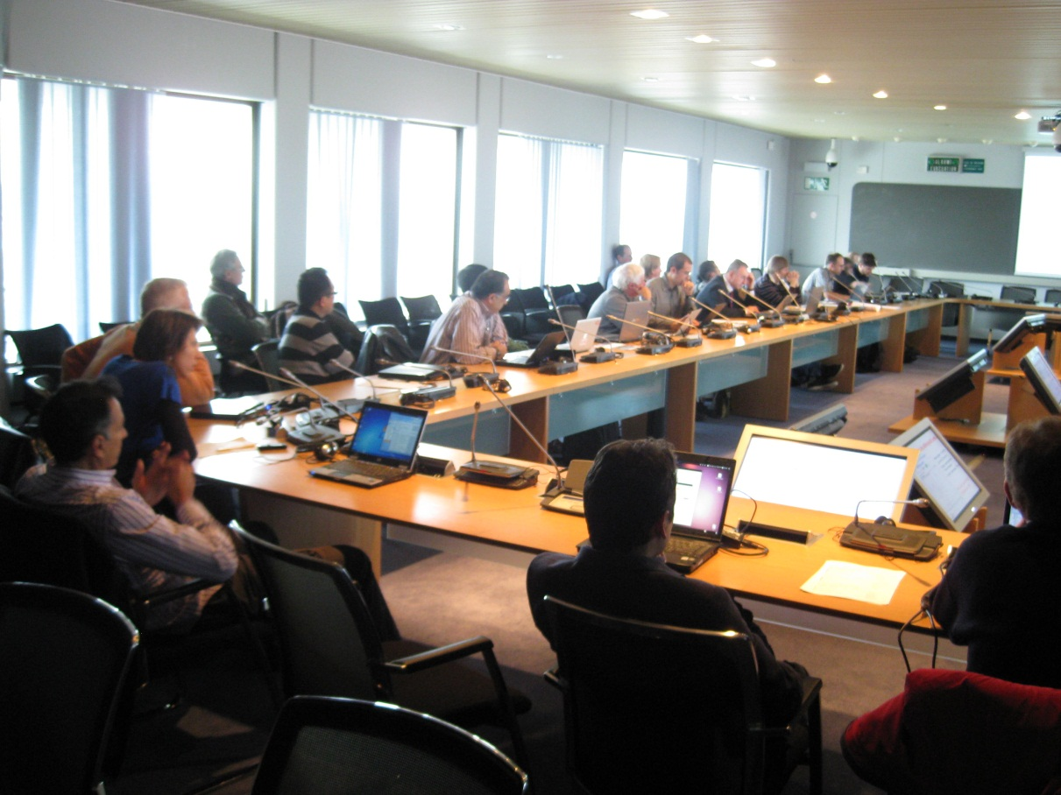
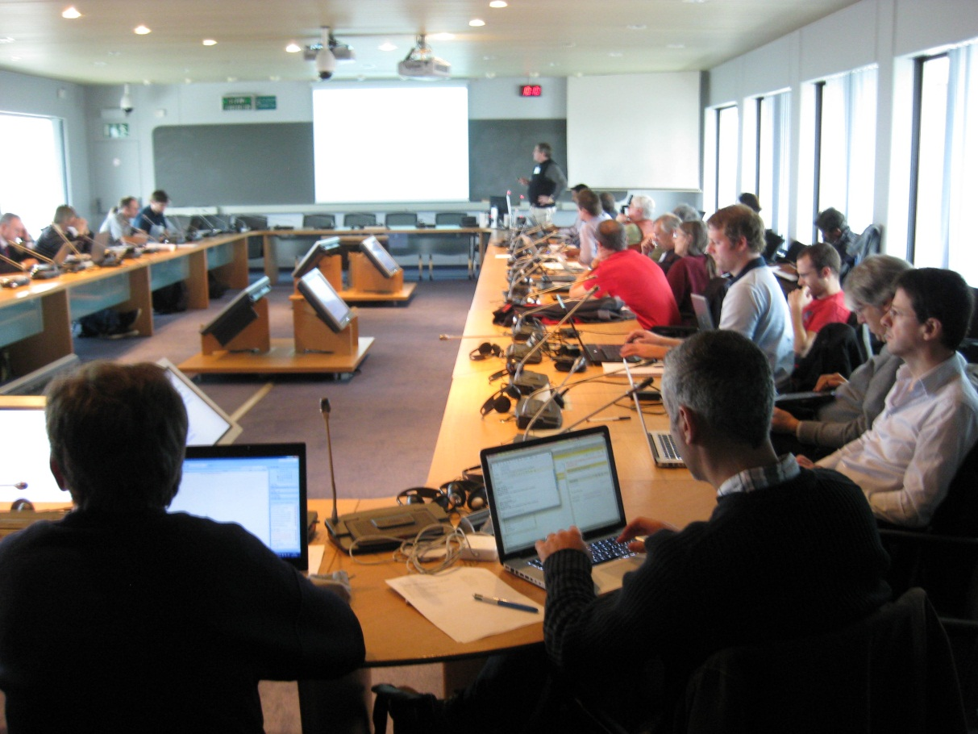
5th Joint EuCARD-AccNet – LARP – KEK – CI/DL workshop on LHC crab cavities
14-15 November 2011, CERN
https://indico.cern.ch/conferenceDisplay.py?confId=149614
workshop summary published as EuCARD-PUB-2012-001
Participants: about 52 persons (many institutes in Europe, US, and Japan)
34 presentations
Main results: convergence to 2 (3) compact crab-cavity designs; first Al prototypes; detailed cavity specifications will be prepared by spring 2012 based on initial set of HL-LHC parameters; beam test of the compact design in the SPS and the LHC are pre-requisites for a final installation in LHC Points 1 and 5.
Organizers:
Rama Calaga, Rogelio Tomas, Frank Zimmermann

Slide 23
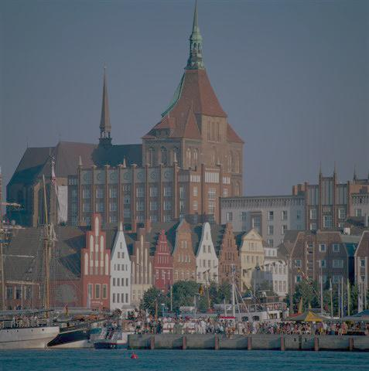
3rd Annual RFTech meeting
12 December 2011, U Rostock
http://lpsc.in2p3.fr/Indico/internalPage.py?pageId=2&confId=646
Participants: 16 RF experts from DESY, CERN, U Rostock, GANIL, LPSC/CNRS, PSI, TU Lodz, TU Darmstadt
Topics:
electromagnetic field computation (finite integration and finite elements methods, pertubative computation)
cavity RF models (coupled multicell cavities with beam, cavity model and experimental validation for gradient flatness procedure).
Low Level RF and regulation.
General topics: RF panorama at CERN, activities at Darmstadt and GANIL –Spiral2)
Specific topics: crab cavities.
Organizers: Ursula van Rienen, Jean-Marie De Conto, Mariusz Grecki

Slide 24
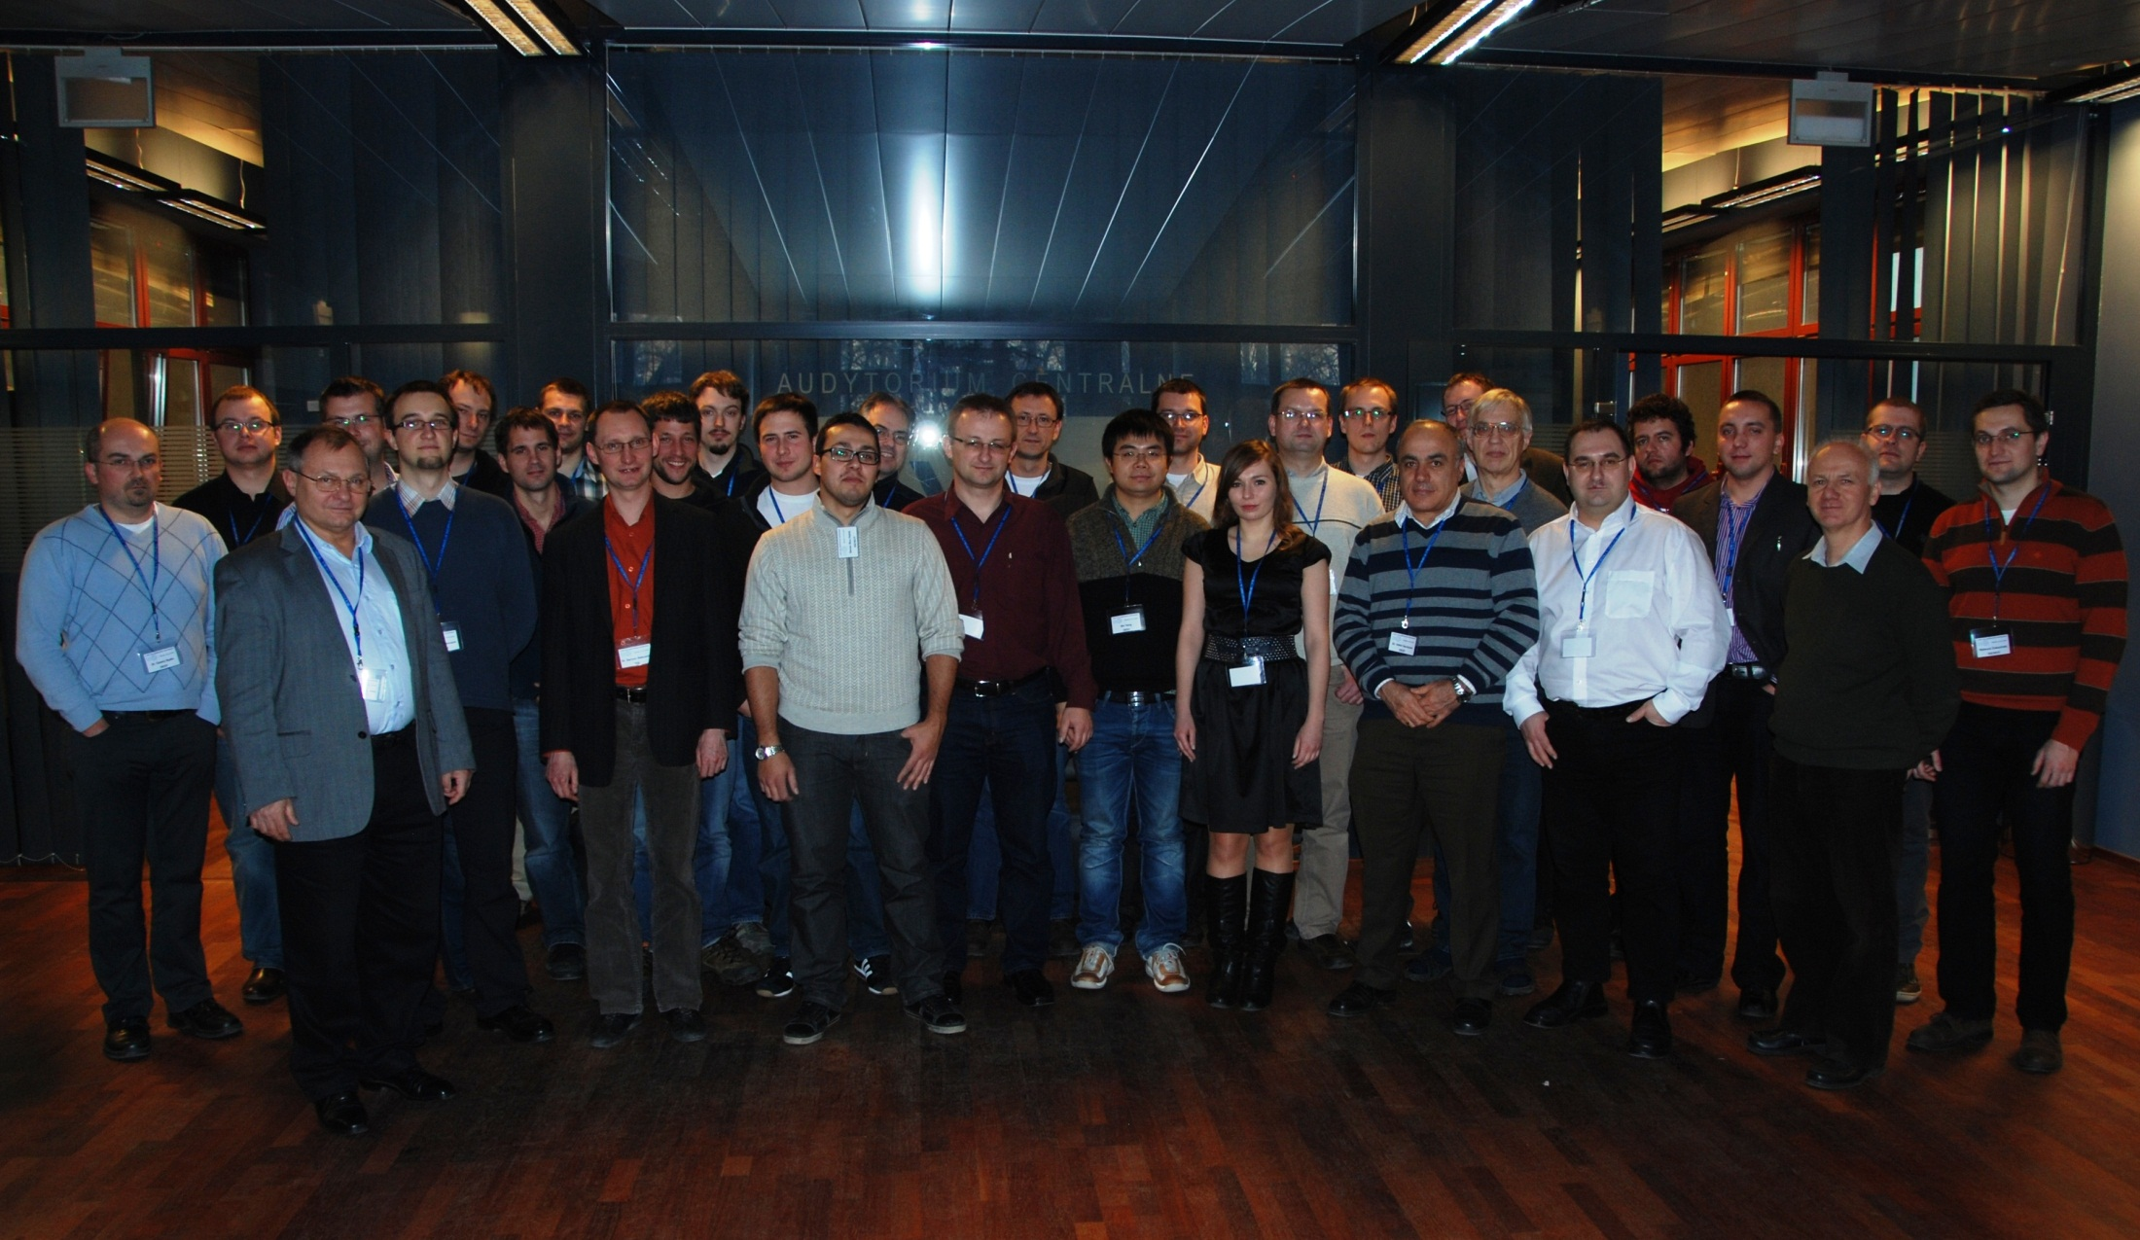
EuCARD-AccNet LLRF Collaboration meeting
14-16 December 2011, Warsaw University of Technology
https://indico.desy.de/conferenceDisplay.py?confId=4991
Participants: 35 LLRF experts (DESY, WUT, TUL,NCBJ,…)
Sessions: system overview and integration, emerging systems 1+2, status of system components, firmware and software developments
RFTech supported all participants of this meeting
About 40 presentations
Main topic: integration of hardware & software
solutions for the LLRF and synchronization
systems at FLASH and XFEL
Organizers:
Holger Schlarb, Frank Ludwig, Mariusz Grecki

Slide 25
AccNet publications
AccNet dissemination in the last year
three outreach talks in Japan (KEK, Hiroshima U., Kyoto U.)
invited presentations at ATLAS and CMS upgrade workshops
invited talk at first Mexican Accelerator school
EuCARD AccNet documents
about 100 in total
- 1 CERN Yellow Report
- 3 journal articles
> 31 conference presentations
- ~10 workshop summaries
- 1 PhD thesis
- 1 master thesis
- 2 EuCARD monographs
not all in the database

Slide 26
AccNet talks & papers from 2011/12
many not yet in the database
R. Bartolini et al, Summary of the AccNet-EuCARD Workshop on Optics Measurements, Corrections and Modelling for High-Performance Storage Rings "OMCM”, EuCARD-CON-2012-004; G. Arduini et al, 5th LHC Crab Cavity Workshop, LHC-CC11 Workshop Summary Report, EuCARD-PUB-2012-001; K. Ohmi et al, Response of colliding beam-beam system to harmonic excitation due to crab-cavity rf phase modulation, PRST-AB 14:111003(2011), EuCARD-PUB-2012-002; F. Zimmermann, Machine Progress Towards Higher Luminosity, CMS Upgrade Meeting, FNAL, Chicago, 7 November 2011; F. Zimmermann, Hadron Colliders, First Mexican Particle Accelerator School "MePAS," Guanajuato, 7 October 2011; R. Cimino, A surface study on the origin of SEY reduction on accelerator walls, CERN, 29 July 2011 ; F. Zimmermann, Large Hadron Collider - Status & Future Plans, Kyoto University, Kyoto, 22 July 2011; F. Zimmermann, Large Hadron Collider - Status & Future Plans, Hiroshima University, East Hiroshima, 19 July 2011; F. Zimmermann, LHC Performance & Future Plans, KEK, 1 July 2011 ; F. Zimmermann, LHC Machine Status & Plans, ATLAS week, CERN, Geneva, 20 June 2011 ; E. Todesco and F. Zimmermann (eds), The Higher-Energy Large Hadron Collider, Proceedings of the EuCARD-AccNet HE-LHC workshop, Malta, 14-16 October 2010, CERN, EuCARD-CON-2011-001 ; D. Shatilov, E. Levichev, E. Simonow, M. Zobov, Application of Frequency Map Analysis to Beam-Beam Effects Study in Crab Waist Collision Scheme, PRST-AB, 14, 014001 (2011) [WPs 4 & 11] ; R. Calaga (BNL), S. Myers (CERN), F. Zimmermann (CERN), Summary of the 4th LHC Crab Cavity Workshop "LHC-CC10", EuCARD-REP-2011-001 (2011) ; F. Zimmermann, HL-LHC: parameter space, constraints and possible options, Proc. Chamonix 2011 workshop on LHC performance, CERN-ATS-2011-005 (2011) ; Rumolo, F. Zimmermann, and O. Boine-Frankenheim, Summary of EuCARD-AccNet CERN-GSI Workshop on Electron Cloud, CERN, Geneva, 7-8 March 2011; U. Iriso, Electron Clouds Thresholds with 75 ns Bunch Spacing (draft), 11 February 2011

Slide 27
AccNet papers from PAC11, IPAC11 and MulCoPim11
many not yet in the database
O. Dominguez, U. Iriso, H. Maury, G. Rumolo, F. Zimmermann, “Benchmarking Electron-Cloud Build-Up and Heat-Load Simulations against Large-Hadron-Collider Observations,” MulCoPim’2011; R. Calaga, T. Baer, J. Barranco, R. Tomas, J. Wenninger, F. Zimmermann, B. Yee-Rendon, “Beam Losses Due to Abrupt Crab Cavity Failures in the LHC,” PAC’11 New York ;
G. Xia, et al, “A Proposed Experimental Test of Proton-Driven Plasma Wakefield Acceleration Based on CERN SPS,’ PAC11 New York ; G. Franchetti, F. Zimmermann, “Electron-cloud Pinch Dynamics in Presence of Lattice Magnet Fields,” IPAC11 San Sebastian ; G.H.I. Maury Cuna, G. Arduini, G. Rumolo, L.J. Tavian, F. Zimmermann, “Simulation of Electron-cloud Build-Up for the Cold Arcs of the LHC and Comparison with Measured Data,” IPAC11 San Sebastian ; T. Baer, R. Calaga, R. Tomás, J. Tückmantel, J. Wenninger, F. Zimmermann, “LHC Machine Protection against Very Fast Crab Cavity Failures ,” IPAC11 San Sebastian, EuCARD-CON-2011-048; C.O. Domínguez, F. Zimmermann, “Luminosity Optimization for a Higher-Energy LHC,” IPAC11 San Sebastian; C.O. Domínguez, G. Arduini, V. Baglin, G. Bregliozzi, J.M. Jimenez, E. Métral, G. Rumolo, D. Schulte, F. Zimmermann, “Electron Cloud Parameterization Studies in the LHC,” IPAC11 San Sebastian ; C.M. Bhat, F. Zimmermann, “LHC Luminosity Upgrade with Large Piwinski Angle Scheme: A Recent Look,” IPAC11 San Sebastian ; S. Hillenbrand, R.W. Assmann, A.-S. Müller, T. Tückmantel, F. Zimmermann, “Energy Spectrometer Studies for Proton-driven Plasma Acceleration,” IPAC11 San Sebastian ; R.W. Assmann, I. Efthymiopoulos, S.D. Fartoukh, G. Geschonke, B. Goddard, C. Heßler, S. Hillenbrand, M. Meddahi, S. Roesler, F. Zimmermann, A. Caldwell, G.X. Xia, P. Muggli, “Accelerator Studies on a Possible Experiment on Proton-driven Plasma Wakefields at CERN,” IPAC11 San Sebastian

Slide 28
EuroLumi exchanges & joint studies
Mexican PhD student Humberto Maury (CINVESTAV)
- e-cloud simulations for LHC & HL-LHC
Mexican master student Bruce Yee (CINVESTAV)
- simulations of LHC crab-cavity failure scenarios
Mexican master student Cristhian Valerio (CINVESTAV)
- H- source
Italo-german expert Giuliano Franchetti (GSI)
- incoherent e-cloud effects & resonance trapping
US-LARP physicist Chandra Bhat (FNAL)
- generation & stability of long flat bunches for LHC
US physicists Glenn Decker (ANL) and Mike Plum (SNS)
- optics diagnostics - modeling for high-intensity proton rings
Japanese expert Kazuhito Ohmi (KEK)
- beam-beam & e-cloud simulation studies for LHC, HE-LHC & HL-LHC
Italian expert Roberto Cimino (INFN-LNF)
- e-cloud surface physics & mitigation, preparation of ECLOUD’12
Russian and European experts S. Dabagov (INFN-LNF) – crystal collimation

Slide 29
planned AccNet workshops
EuroNNAc 2012 meeting, CERN, 3-6 May 2012
AccNet-RFTech co-sponsored MIXDES2012, Warsaw, 24-26 May 2012
AccNetEuroLumi – INFN - LER joint workshop on electron cloud effects & mitigation ECLOUD’12, 5-9 June, Italy
AccNet-RFTech co-sponsored workshop on Higher-Order-Mode Diagnostics and Suppression in Superconducting Cavities, HOMSC12, Daresbury, UK (June 25-27, 2012) http://www.cockcroft.ac.uk/events/HOMSC12/index.html
AccNet-EuroLumi co-sponsored conference ICAP’12, 19-24.08.’12
AccNet-EuroLumi Workshop on dynamic vacuum at/near GSI
AccNet-EuroLumi & CI joint workshop on Extreme Beams?
AccNet-RFTech co-sponsored LLRF meeting, early 08.2012 (in Lodz)
LHC crystal collimation workshop, fall 2012?
4th Annual RFTech meeting, Grenoble?, December 2012
AccNet-EuroLumi Workshop on LHC/FAIR beam instrumentation?
2nd AccNet-EuroLumi workshop on the High-Energy LHC, early 2012

Slide 30
additional proposed AccNet workshops
RFTech topical meeting on energy efficient systems, Grenoble or CERN, during 2012
AccNet-EuroLumi Workshop on short bunch length for LHC, CERN, fall 2012
AccNet Workshop LHC-CC12 on LHC Crab Cavities, combined with HiLumi LHC workshop, Frascati, November 2012
AccNet-EuroLumi CERN-GSI joint workshop on magnet setting generation & application software, fall 2012 or early 2013

Slide 31
EuroNNAc 2012 meeting
CERN, 2-4 May 2012
next week!
Goals:
Organize the three working groups (definition). Select leader and deputy leader per working group. Define sub-task leaders.
Define strategies and detailed plans per working group, aiming at a coherent proposal for one or a few European and international pilot facilities for advanced accelerators.
Prepare a written report on novel acceleration and the EuroNNAc network. A draft based on the EuroNNAc 2011 meeting can be discussed at EuroNNAc 2012 before publication in a journal (state-of-the-art, authorship, conclusions, strategic road map, ...).
Approve plans for a European conference for advanced accelerators, the first to take place in 2013. Define committees, scope, …
Prepare input to European Strategy for Particle Physics

Slide 32
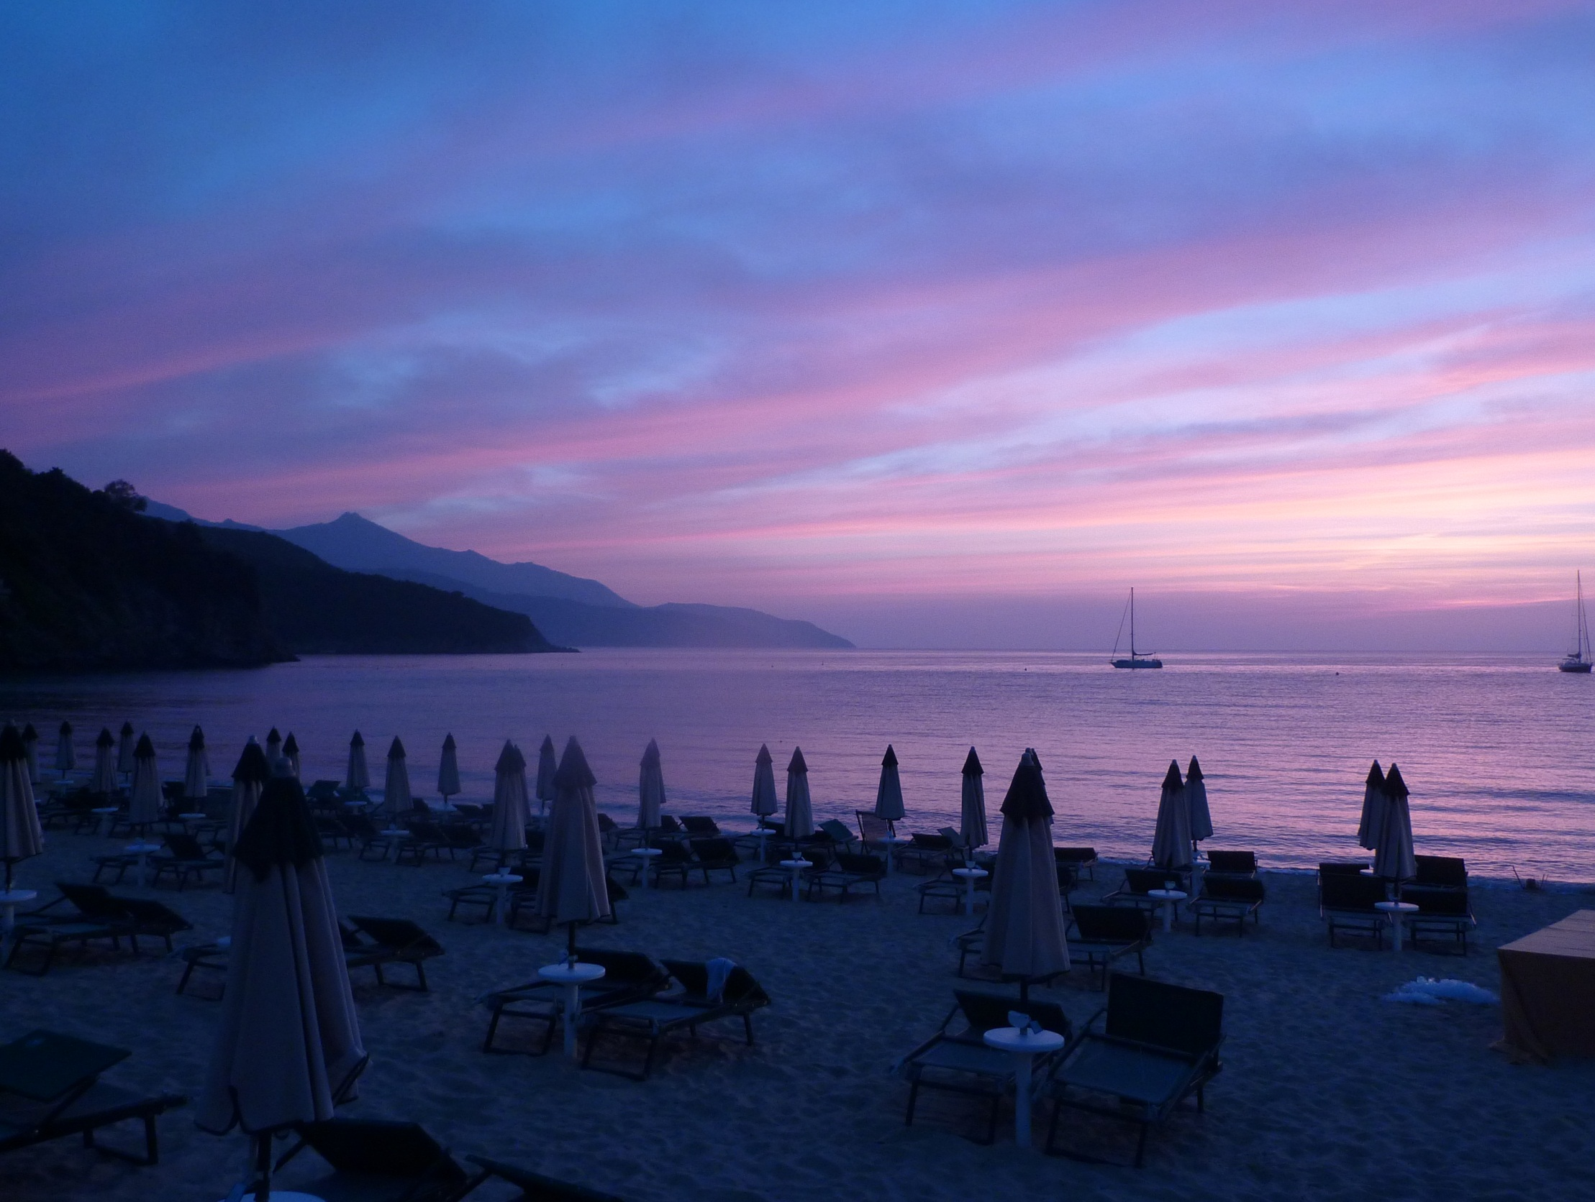
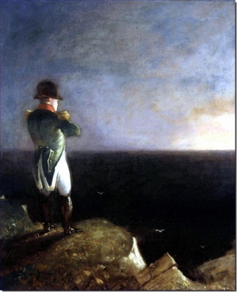
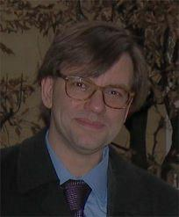
ECLOUD’12
La Biodola, Isola d’Elba, Italy
http://www.hotelhermitage.it/
from 5 to 8 June 2012
Sezione di Pisa
topics: SEY models, e-cloud build & e-cloud effects in accelerators & space applications, beam induced multipactoring, surface properties, mitigation measures, microwave diagnostics, … electron clouds at LHC, FAIR, SuperB, KEKB, SuperKEKB, SPS, PS, ILC, CLIC, Cesr-TA, FNAL, RHIC, ESA satellites, …
AccNet supports invited key speakers from ESA & MIT
more information at:
http://www.infn.lnf.conference/ecloud12
contacts: Roberto Cimino, Frank Zimmermann
in memory of
Francesco Ruggiero

Slide 33
International Computational Accelerator Physics Conference, ICAP’12
19-24.08.’12, Warnemünde
with dedicated EuCARD-AccNet session(s)
conference chair: Ursula van Rienen

Slide 34
AccNet highlights talks
at EuCARD 2012
Compact Crab Cavities for LHC
Graeme Burt (Lancaster U./ CI) [w WP10]
The Achromatic Telescopic Squeezing scheme: first validations with beam in the LHC and very low beta* optics for HL-LHC Stephane Fartoukh (CERN)
Overview of the LLRF Developments for FLASH Mariusz Grecki (DESY) [w WP10]

Slide 35
use of resources
most/all AccNet mini-workshops have
moderate expenses (<10 kCHF)
collaborators cover part of the costs
management with a lot of enthusiasm
devotes extra time

Slide 36
AccNet success indicators
excellent attendance to AccNet workshops
from many European labs, universities, US laboratories, Japan, international organizations
impact:
- on most relevant topics
- initiated crab-cavity program for LHC
- e-cloud modeling & mitigation
- push for high-energy LHC
high cost efficiency ; exchange of ~20 expert visitors ; two theses, >31 conf. papers, 2 journal articles, 2 EuCARD monographs

Slide 37
AccNet conclusions
EuroLumi gives input to LHC upgrade
strategy for LHC crab cavities, HL-LHC parameters,
“LPA” scenario, flat-beam crab-waist scenario (w WP11), e-cloud mitigation, HL-LHC e-cloud,
revisions of LHC upgrade plans, energy upgrade
RFTech organizes RF community
EuroNNAc organizes novel acc. community
AccNet is breaking new grounds
plasma acceleration
crystal collimation
new contacts (ESA, CINVESTAV, VALSPACE, MIT, Kyoto U., Hiroshima U.)

Slide 38
pushes frontiers
for accelerators in Europe
and around the world

Slide 39
Dziekuje!

Slide 40
Appendix AccNet institutes & contacts AccNet expenses & deliverables

Slide 41
AccNet EuroLumi institutes & contacts
Institute | Name
BNL | Calaga Rama
 | Drees Angelika
 | Fischer Wolfram
 | Peggs Steve
CERN | Bottura Luca
 | Todesco Ezio
 | Zimmermann Frank
CI | Chattopadhyay Swapan
CNRS-LAL | Mouton Bernard
 | Scandale Walter
 | Variola Alessandro
CNRS-LPSC | Baylac Maud
CSIC - IFIC | Faus Golfe Angeles
DESY | Mais Helmut
FNAL | Bhat Chandra
 | Sen Tanaji
 | Shiltsev Vladimir
 | Valishev Alexander
Institute | Name
GSI | Boine-Frankenheim Oliver
INFN-LNF | Biagini Marica
 | Palumbo Luigi
 | Spataro Bruno
INFN-NA | Vaccaro Vittorio
KEK | Ohmi Kazuhito
LBNL | Furman Miguel
MPP | Caldwell Allen
 | Xia Guoxing
TEMF Darmstadt | Mueller Wolfgang
 | Weiland Thomas
TUBE | Bruns Warner
 | Henke Heino
UJF | De Conto Jean-Marie
UOM | Sammut Nicholas
UPSA | Ekelof Tord
USAN | Petracca Stefania

Slide 42
AccNet RFTech institutes & contacts
Institute | Name
BESSY Berlin | Knobloch Jens
BNL | Ben-Zvi Ilan
 | Calaga Rama
CEA-DSM | Chel Stéphane
 | Daël Antoine
 | Devanz Guillaume
 | Duperrier Romuald
CERN | Angoletta Maria Elena
 | Brunner Olivier
 | Calatroni Sergio
 | Capatina Ofelia
 | Chiaveri Enrico
 | Garoby Roland
 | Hofle Wolfgand
 | Jensen Erk
 | Junginger Tobias
 | Montesinos Eric
 | Ruber Roger
 | Vretenar Maurizio
 | Vullierme Bruno
 | Weingarten Wolfgang
CI | McIntosh Peter
CNRS-IPNO | Bousson Sébastien
 | Gardès Daniel
 | Gassot Hui Min
 | Olry Guillaume
CNRS-LAL | Mouton Bernard
 | Variola Alessandro
Darmstadt University-IKP | Eichhorn Ralf
Institute | Name
WUT | Czuba Krzysztof
DESY | Elsen Eckhard
 | Grecki Mariusz
 | (Proch Dieter)
 | (Simrock Stefan)
ESRF | Jacob Jorn
FZD | Teichert Jochen
Goettingen University | Quadt Arnulf
GSI | Huelsmann Peter
IFJ PAN | Wierba Wojchiech
INFN-LNF | Ghigo Andrea
INFN-Milano | Pagani Carlo
INFN-Roma | Tazzari Sergio
Institute for Nuclear Studies, Swierk | Nietubyc Robert
 | Szcwinski Jaroslaw
 | Wronka Slawomir
Karlsruhe University? | Ustinov Alexey?
LPNHEP (IN2P3 Jussieu) | Augustin Jean-Eudes
 | Debu Pascal
Rostock University | Glock Hans-Walter
 | van Rienen Ursula
Royal Holloway | Molloy Stephen
TEMF Darmstadt | Mueller Wolfgang
 | Weiland Thomas
TUL | Makowski Dariusz
 | Napieralski Andrzej
 | Smage Bogna
UFJ and LPSC | De Conto Jean-Marie
Wuppertal University | Mueller Guenter

Slide 43
AccNet EuroNNAc institutes & contacts
Europe | Name |  |  | Affiliation
EuCARD, CERN | Dr. | Assmann* | Ralph | EuCARD/CERN
 | Dr. | Geschonke | Gunther | CERN
 | Dr. | Koutchouk | Jean-Pierre | EuCARD/CERN
 | Dr. | Zimmermann | Frank | EuCARD/CERN
France | Dr. | Cros | Brigitte | LPGP -CNRS
 | Prof. Dr. | Malka | Viktor | LOA
 | Dr. | Martin | Philippe | CEA
 | Prof. Dr. | Mourou | Gerard | ILE
 | Dr. | Specka | Arnd | Ecole polytechnique
 | Dr. | Videau* | Henri | Ecole polytechnique
Germany | Prof. Dr. | Caldwell | Allen | MPI-P Muenchen
 | Dr. | Floettmann | Klaus | DESY
 | Prof. Dr. | Gruener | Florian | LMU Muenchen/MPQ
 | Dr. | Osterhoff* | Jens | University Hamburg, DESY
 | Prof. Dr. | Sauerbrey | Roland | FZD Rossendorf
Italy | Dr. | Ferrario | Massimo | LNF
 | Dr. | Ghigo | Andrea | INFN Frascati
 | Prof. Dr. | Guiletti | Danilo | INFN Frascati
 | Dr. | Serafini | Luca | INFN Frascati
Portugal | Prof. Dr. | Mendonca | Jose Tito | Instituto Superior Tecnico
Russia | Dr. | Kostyukov | Igor | Institute of Applied Physics
Sweden | Prof. Dr. | Wahlstroem | Claes-Goran | Lund University
Switzerland | Prof. Dr. | Rivkin | Leonid | EPFL, PSI
United Kingdom | Prof. Dr. | Jaroszynski | Dino | University of Strathclyde
 | Dr. | Najmudin | Zulfikar | Imperial College
 | Prof. Dr. | Neely | David | Rutherford Appleton Lab
 | Prof. Dr. | Seryi | Andrei | John Adams Institute
*Coordinators
Status 11.1.2011
Non-Europe | Name |  |  | Affiliation
China | Prof. Dr. | Sheng | Zhengming | Institute of Physics, CAS
India | Dr. | Naik | Prasad | RRCAT
Japan | Prof. Dr. | Yokoya | Kaoru | KEK
United States | Prof. Dr. | Chou | Weiren | ICFA/Fermilab
 | Prof. Dr. | Joshi | Chan | University of California
 | Prof. Dr. | Katsouleas | Thomas | Duke University
 | Dr. | Leemans | Wim | LBNL
 | Prof. Dr. | Muggli | Patric | USC
 | Prof. Dr. | Raubenheimer | Tor | SLAC
 | Prof. Dr. | Tajima | Toshiki | ICUIL/LMU

Slide 44
AccNet deliverables
Deliverables of tasks | Description/title | Nature | Delivery month | Status
4.1.1 | Continually updated AccNet web site | O | M2 | DONE, OK
4.1.2 | AccNet Strategy for future proton & electron facilities in Europe | R | M48 | on track
4.2.1 | Continually updated EuroLumi web site | O | M2 | DONE, OK
4.2.2 | EuroLumi Strategy and issues for LHC IR, LHC injector and beam-parameter upgrade path(s), with comment on longer-term prospects, and for FAIR | R | M48 | on track
4.3.1 | Continually updated RFTECH web site | O | M2 | DONE, OK
4.3.2 | Strategy/result for SRF test infrastructures | R | M24 | DONE, OK
4.3.3 | RFTECH strategy/result for cavity design, LLRF & HPRF systems and design integration, and costing tools | R | M48 | on track

Slide 45
completed AccNet deliverables
D.4.1.1 –Continually updated AccNet web site http://cern.ch/accnet/ )
D.4.2.1 – A continually updated EuroLumi web site (http://cern.ch/accnet/Tasks/Eurolumi/ )
D.4.3.1 – A continually updated RFTech web site (http://cernc.ch/accnet/Tasks/Rftech/ )
D4.3.2 – Strategy/result for SRF test infrastructures:
Complete
The AccNet web sites are documented in a report https://edms.cern.ch/file/1001866/4/EuCARD-Del-D4.1.1-D4.2.1-D4.3.1-1001866-v3.0.pdf
The completed deliverables are available from the link http://cern.ch/EuCARD/about/results/deliverables/ .

Slide 46
AccNet milestones
M.4.1.3
– 3rd general AccNet Steering meeting during the 2nd EuCARD Annual meeting at CNRS.
M4.2.3:
– Instead of a general annual EuroLumi workshop, 2 topical mini-workshops have been organized and supported during the third year: OMCM, LHC-CC11 (note recent overlap with FP7 HiLumi)
– next major EuroLumi workshop in June 2012
M4.3.3:
– 3rd annual RFTECH workshop was held in Rostock, 12 December 2011

Slide 47
AccNet expenses during last year
travel & per diem for Mexican CINVESTAV visitors
H. Maury (2 years), B. Yee (1 year), C. Valerio (1 year)
support of 5 PhD students for MIXDES2011 special session
travel support for INFN expert R. Cimino to discuss e-cloud mitigation and ECLOUD’12 preparation
travel support of US experts G. Decker (ANL) and M. Plum (SNS) to attend OMCM’11
support of several workshops (MulCoPim’11, Long Bunch Trains, LLRF System Integration, MIXDES2011)
support for AccNet workshops OMCM’11, LHC-CC11 & 3rd RFTech annual meeting
travel costs for SC mtgs and EuCARD annual meetings

