Slide 1
HIGH ENERGY LHC
Paris, 11th May 2011
2nd EuCard meeting
E. Todesco
CERN, Geneva Switzerland
On behalf of the HE-LHC working group
R. Assmann, R. Bailey, O. Bruning, O. Dominguez Sanchez, G. De Rijk, M. Jimenez, S. Myers, L. Rossi, L. Tavian, E. Todesco, F. Zimmermann « First thoughts on a Higher Energy LHC » CERN ATS-2010-177
and of the participants to the Malta workshop

Slide 2
A 16.5+16.5 TeV proton collider in the LHC TUNNEL
The idea
Installing a 16.5+16.5 TeV proton
accelerator in the LEP tunnel
Main ingredient: 20 T operational field dipoles
Proposal in 2005 for an LHC tripler, with 24 T magnets [P. McIntyre, A. Sattarov, “On the feasibility of a tripler upgrade for the LHC”, PAC (2005) 634].
Working group launched at CERN in May 2010
www.cern.ch/he-lhc
Report published in September R. Assmann, R. Bailey, O. Bruning, O. Dominguez Sanchez, G. De Rijk, M. Jimenez, S. Myers, L. Rossi, L. Tavian, E. Todesco, F. Zimmermann « First thoughts on a Higher Energy LHC » CERN ATS-2010-177
Workshop in Malta October 2010
http://indico.cern.ch/internalPage.py?pageId=0&confId=97971
Proceedings: CERN Yellow report 2011-3

Slide 3
THE VIEW FROM THE HIGH ENERGY PHYSICS COMMUNITY
Discovery potential [J. Wells, CERN 2011-3]
The panorama is complex and LHC discoveries will shed more light but …
The energy frontier is always extremely interesting and for many processes cannot be traded with more luminosity at lower energy
Do we need new experiments ? [M. Nessi, CERN 2011-3]
Most of the electronics and inner detectors will be rebuild and upgraded already for the HL-LHC – so it will be for the HE-LHC
Modular and gradual approach is possible
Main questions to be answered ‘soon’ (in a few years)
Can we manage to keep the same magnets and structures, just replacing modules?
If a new detector is needed, will it involve new civil engineering?
The results of the LHC will change everything, one way or another. There will be a new “theory of the day” at each major discovery, and the arguments will sharpen in some ways and become more divergent in other ways. Yet, the need to explore the high energy frontier will remain.

Slide 4
THE INJECTION ENERGY
Injection energy is important
Keeping the same injection would avoid the need of new injectors and transfer lines but would bring the dynamic range from 15.6 to more than 40 – not considered as realistic
Injection at 1.2 TeV (or more) we keep the same dynamic range
Beneficial effect on the aperture
2/3 of LHC aperture used by the beam
Higher injection energy → lower beam size √E → 40 mm aperture possible
Aperture is very valuable asset – keep it as low as possible
Reduction from 56 mm to 40 mm allows 20% reduction of the cost and 30% less stored energy (with a coil of 80 mm thickness)

Slide 5
Peak LUMINOSITY
Luminosity: twice the LHC
A factor 2.4 comes for free (nearly …) from the energy
Proposal of rebalancing: 50% less bunches n_{b} compensated by 15% larger bunch intensity N and 30% smaller β∗
☺ Electron cloud becomes less critical (larger bunch spacing: 50 ns)
☺ Smaller stored energy (not 2.4 the LHC, but only 30% more)
☺ Smaller load due to synchrotron radiation (not 2.4^4=31 LHC, but only 17 LHC)
The smaller β∗ and the larger intensity seem at hand
Luminosity parameters [F. Zimmermann et al. CERN 20111-3]

Slide 6
INTEGRATED LUMINOSITY AND SYNCHROTRON RADIATION
Luminosity: twice the LHC
Synchrotron radiation induces a strong reduction of emittance
Artificial transverse emittance blow-up can be needed to avoid reaching beam-beam limit
Optimal running time of the order of 10 h (still reasonable)
One should get about 0.8 fb⁻¹ per day
Evolution of luminosity during a run [F. Zimmermann et al. CERN 20111-3]

Slide 7
SYNCHROTRON RADIATION AND HEAT LOADS
Synchrotron radiation: scaled with 4th power of the energy
But we have less beam, so SR power is a factor 17 larger
Less than 2.4^4= 31,
but still large
Heat loads
The term coming from synchrotron radiation is dominant – on the beam screen we have 6 times larger loads than in the LHC
Different options of beam screen temperature: 40-60 K is appealing
Cold mass heat load is only 50% larger (related to MB current)
Not yet possible to tell is LHC cryogenics can be reused
It will be 20 years old, but …
Heat loads in the LHC and one option for HE LHC [D. Delikaris, L. Tavian CERN 2011-3]

Slide 8
BEAM SCREEN, INJECTION, DUMP
Magneto resistance of the beam screen: increase of about a factor 2 w.r.t. LHC (due to higher field) [E. Metral, CERN 2011-3]
Impedances scale with √ of magneto resistance → 40% larger impedance should not be an issue for the beam stability
Injection lines (in case of injection at 1.3 TeV) [B. Goddard et al. , CERN 2011-3]
Completely new layout needed – more space needed (60 m between quads) also for injection protection devices
Dump [B. Goddard et al. , CERN 2011-3]
Dump possible with a similar layout as in the LHC – upgrade of dilution or of the dumping block needed

Slide 9
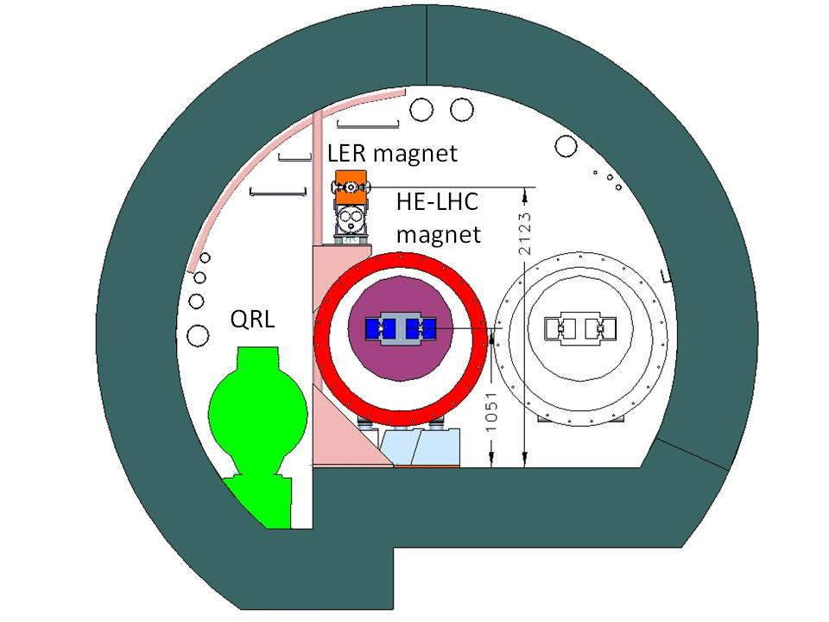
INJECTORS
Option for the injectors [R. Garoby, CERN 2011-3]
Low Energy Ring (LER) in the LHC tunnel:
2 T superferric dipoles
Option1 – bypass of experiments
Option2 – going through experiments
Injection in one go
No additional work for transfer lines
Superconducting SPS (S-SPS): 5-6 T dipoles
Not occupying precious space in the
LHC tunnel
No problem of experiments bypass
Higher cost
Issue: LHC injectors still working in 2025-2040?
LER magnets [H. Piekartz, CERN 2011-3]
HE-LHC and LER in the LEP tunnel
[H. Piekartz, CERN 2011-3]

Slide 10
PROTECTION AND COLLIMATION
Several aspects to be considered
Efficiency: degraded by factor 3-6 w.r.t. LHC – will be addressed by with future upgrades
Robustness: energy density a factor 2.6 larger than acceptable
Either larger emittance, or more robust materials, or review of limits
Larger apertures at 16.5 TeV to avoid too small gaps and large impedance
Stored energy vs beam energy (left) and energy density versus beam energy (right) [R. Assman. CERN 2011-3]

Slide 11
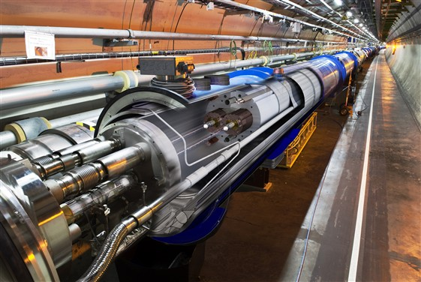
MAGNETS: DIPOLES MAIN CONSTRAINTS
Design is driven by
Transverse space in the tunnel → transverse size of the magnet
570 mm diameter for the cold mass in the LHC
We assume 800 mm diameter for the HE-LHC
Coil must be reasonably compact
Cost: we need Nb₃Sn and HTS
Cost of Nb₃Sn ~4 times Nb-Ti
Cost of HTS ~ 4 times Nb₃Sn
→ grading of material is necessary
Margin
We ask to work with 20% margin
from critical surface, i.e., we have
to design a magnet for 25 T
LHC ‘Energy Upgrade’ proposed in [O. Bruning, et al.,LHC Project Report 626 (2002)]
24 T dipole for LHC tripler proposed in [P. McIntyre, A. Sattarov, PAC 2005, 634]
This proposal: [L. Rossi, E. Todesco, CERN 2011-3]

Slide 12
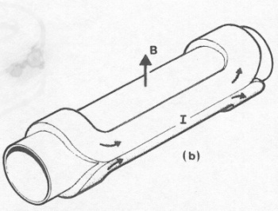
MAGNETS: DIPOLE COIL
First choice: current density – keep the same as the LHC
B [T] ~ 0.0007 × coil width [mm] × current density [A/mm²]
LHC: 8 [T]~ 0.0007 × 30 × 380
Accelerators used current density of the order of 350−400 A/mm²
This provides ~2.5 T for 10 mm thickness
80 mm needed for reaching 20 T
w.r.t. McIntyre design at 800 A/mm²
Stress increases only by 2.4
Coil size is still manageable
Operational field versus coil width in accelerator magnets

Slide 13
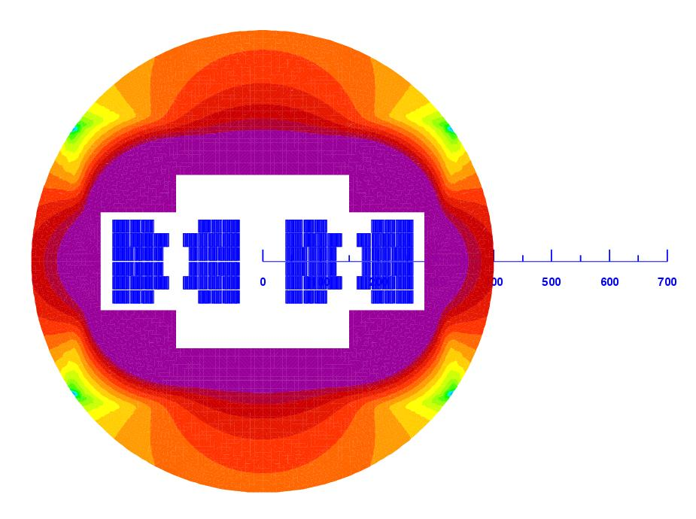
MAGNETS: DIPOLE PARAMTERS
Stored energy is critical
Sketch of the double aperture magnet
with the iron yoke – Coils are in blue
Coil grading (one quarter of coil shown)
Stress in the coil at 20 T operational field [A. Milanese]

Slide 14
COST
Acrobatic estimate (prices for 2025 …)
Nb₃Sn 4 times more expensive than Nb-Ti
HTS 4 times more expensive than Nb₃Sn
3.8 M$ of conductor per LHC-like magnet (15 m, 2-in-1)
4.6 M$ including manufacturing (hypothesis: the same as LHC except coil construction increased by 50%)
1200 dipoles → 5500 M$
About five times the LHC for 2.5 times the field

Slide 15
THE NEW TUNNEL OPTION
Option 1:
3000 LHC magnets at 8.3 T (no HTS no Nb3Sn) in 52 km tunnel
Magnet cost: 3000 M$
Option 2:
1600 magnets with NB-Ti and Nb₃Sn at 15 T (no HTS) in a 33 km tunnel
Magnet cost: 4200 M$
Plus
Tunnel cost
Infrastructures, which can be as costly as the tunnel
Experiments
Permits for sites, …

Slide 16
CONCLUSIONS
From a point of view of beam dynamics, the HE-LHC does not present hard showstoppers
The main challenge is the 20 T magnet
Available technology today is up to 15 T
Cost
Stored energy and protection
Main critical choices
Timeline for R&D on magnets
20 T or 15 T ?
Injector options
Can we use the experiments layouts with upgrade of detectors?

Slide 17
RESERVE SLIDES

Slide 18
GUIDELINES FOR THE COIL
What material can tolerate 380 A/mm² and at what field ?
For Nb-Ti: LHC performances - up to 8 T
For Nb₃Sn: 1500 A/mm² at 15 T, 4.2 K – up to 12 T
With lower current density 190 A/mm²/m we can get to 15 T
Last 5 T made by HTS - we ask for having ~380 A/mm²
Today in Bi-2212 we have half, i.e., ~200 A/mm²
Engineering current density versus field for Nb-Ti and Nb₃Sn (lines)
and operational current (markers)

Slide 19
Main OPEN ISSUES
HTS
Critical current: reach 400 A/mm² operational current in HTS
With 200 A/mm² as today, one would reach ~17.5 T
Manufacturing of dipoles
We start to have experience on solenoids, much less on dipoles
Building an hybrid coil
Different curing for Nb-Ti, Nb₃Sn, HTS
Protection
Very large stored energy
Hybrid coil
Stresses
200 MPa are at the limit of Nb₃Sn

