Slide 1
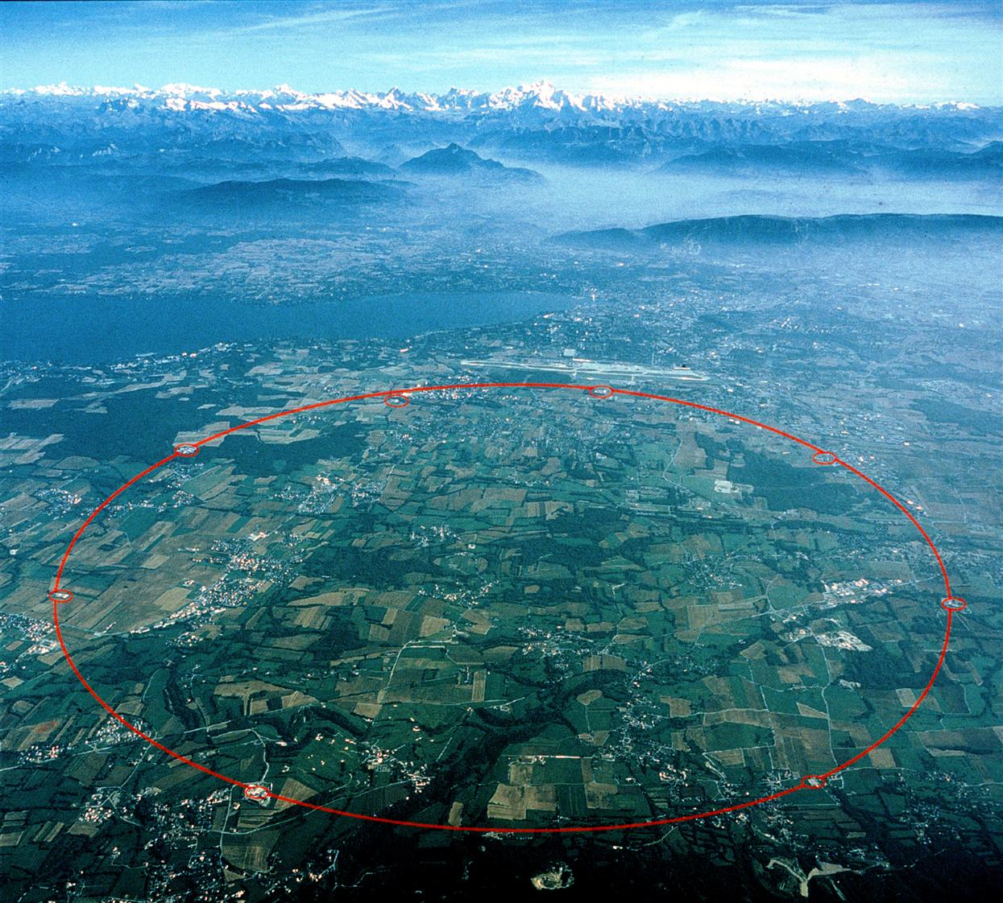




Machine Progress Towards Higher Luminosity
Frank Zimmermann
CMS Upgrade Meeting
FNAL, Chicago, 7 November 2011 (via EVO)
Thanks to Martin Aleksa, Gianluigi Arduini, Ralph Assmann, Hannes Bartosik, Oliver Brüning, Octavio Dominguez, Massimiliano Ferro-Luzzi, Humberto Maury, Jordan Nash, Yannis Papaphilippou, Anders Ryd, Benoit Salvant

Slide 2
topics
luminosity evolution over next few years
in light of 2011 experience
- beam-beam limits
- β* reach (aperture, collimation, optics)
- leveling, pile up
50-ns vs 25-ns running
- electron cloud
- enhanced satellites w 50 ns spacing
before/after Linac4 & other upgrades
how to reach highest luminosity?

Slide 3
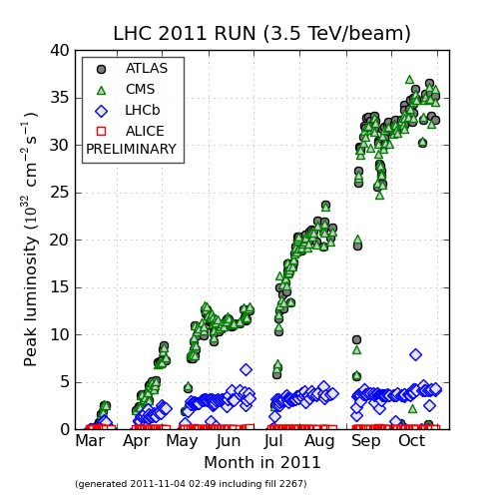
2011 peak luminosity evolution
peak luminosity increased almost linearly over the year (adding more
bunches, increasing bunch intensity, reducing β*) – now near the limit

Slide 4
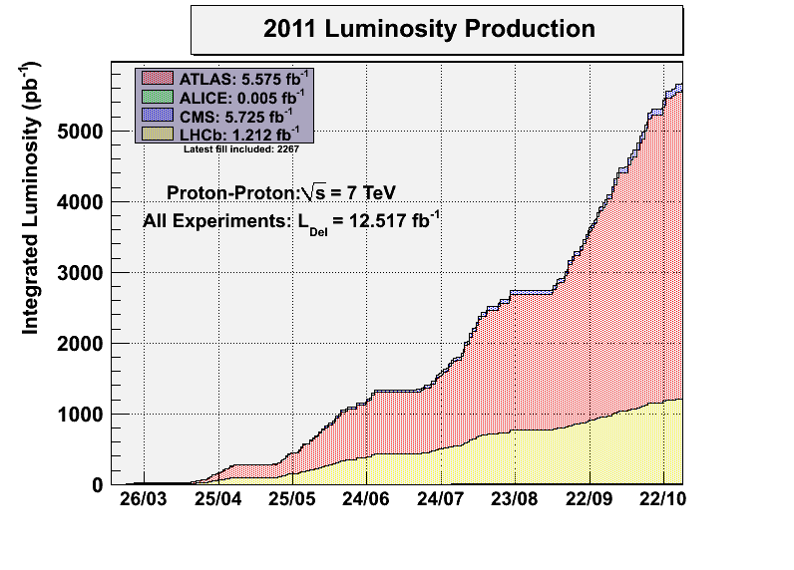
2011 integrated luminosity evolution
~1.5/fb
/month
~1/fb
/month
9 months with ~26 days each & peak luminosity of 3.6x10³³ cm⁻²s⁻¹
(at the end) and 5.5/fb in total gives a “Hübner factor” of ~0.08

Slide 5
2011 LHC records
 | CMS | ATLAS
peak stable luminosity delivered | 3.55x10³³ cm⁻² s⁻¹ | 3.65x10³³ cm⁻² s⁻¹
maximum luminosity in on fill | 123.13 pb⁻¹ | 122.44 pb⁻¹
maximum luminosity in one day | 135.65 pb⁻¹ | 135.45 pb⁻¹
maximum luminosity in 7 days | 537.9 pb⁻¹ | 583.5 pb⁻¹
maximum luminosity in 1 month | 1614.99 pb⁻¹
maximum colliding bunches (w/o satellites) | 1331 | 1331
maximum peak #events /crossing |  | 23.8 (33.96)
maximum (av.) #events / bunch crossing | 19.94 | 17.5 (32.21)
longest time in stable beams for one fill | 26 h | 26 h
longest time in stable beams for one day | 19.9 h (82.9%) | 21.9 h (91.2%)
longest time in stable beams for one week | 107.1 h (63.7%)? | 107.1 h (63.7%)
longest time in stable beams for one month | 232.2 h | 232.2 h?
fastest turnaround to stable beams | 2.1 h | 2.1 h

Slide 6
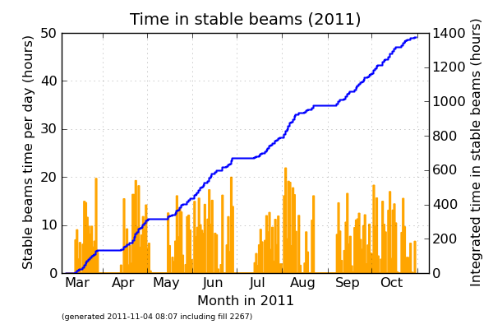
2011 time spent in physics
1400/(31 24 8) ~23.5% of the total,
+ lumi decay + lumi ramp up → consistent with Hübner factor 0.08

Slide 7
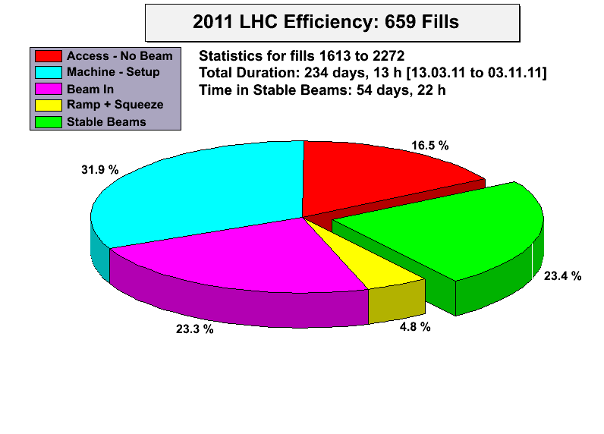
2011 time spent in physics

Slide 8
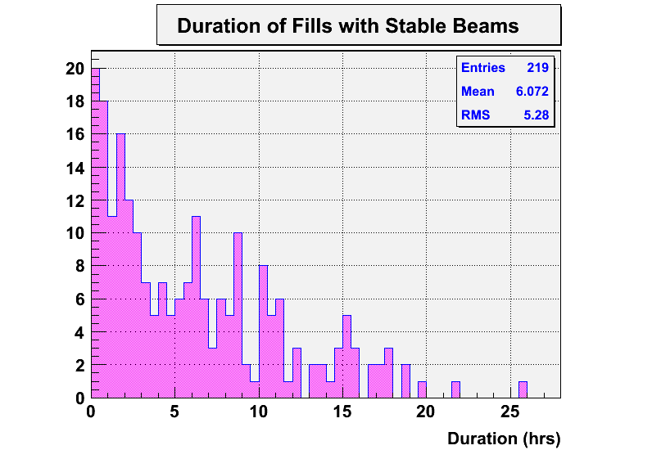
2011 length of physics fills

Slide 9
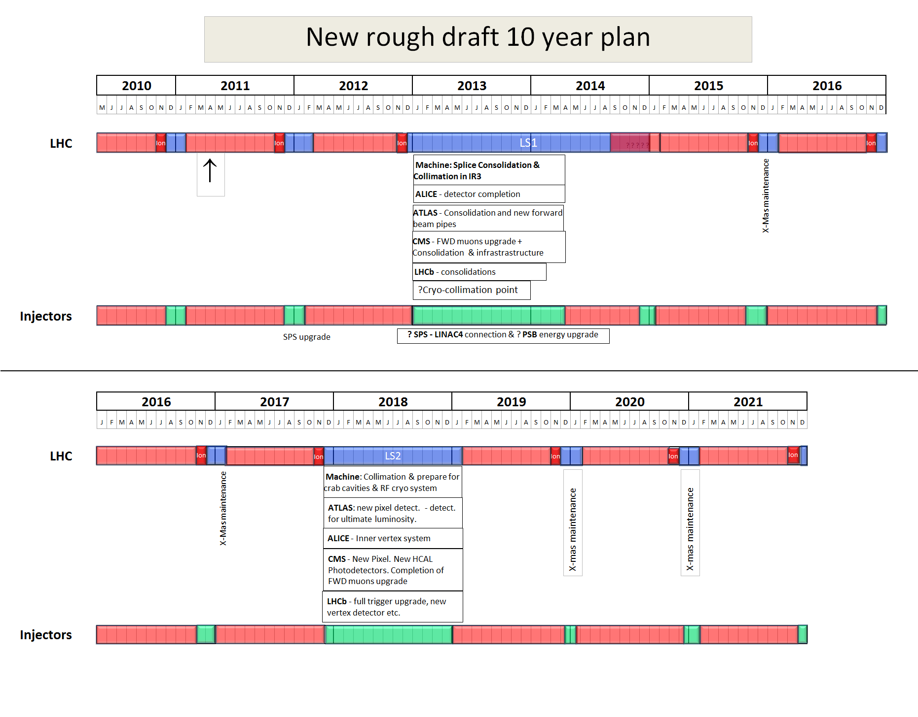
10 year plan 2011-2021
from early 2011
4 TeV?
6.5 TeV?
p-Pb
run
2022
LS3
Installation of the HL-LHC hardware

Slide 10
LHC beam parameters
 | design | October 2011 | end 2012 ? | 2016 ??
Beam energy | 7 TeV | 3.5 TeV | 4 TeV | 6.5 TeV
transv. norm. emittance | 3.75 μm | 2.5 μm | 2.5 μm | 3.5 μm
beta* | 0.55 m | 1.0 m | 0.7 m | 0.5 m
IP beam size | 16.7 μm | 24 μm | 19 μm | 17 μm
bunch intensity | 1.15x10¹¹ | 1.5x10¹¹ | 1.6x10¹¹ | 1.2x10¹¹
# colliding bunches | 2808 | 1331 | 1350 | 2800
bunch spacing | 25 ns | 50 ns | 50 ns | 25 ns
beam current | 0.582 A | 0.335 A | 0.388 A | 0.604 A
rms bunch length | 7.55 cm | 9 cm | 9 cm | 7.6 cm
full crossing angle | 285 μrad | 240 μrad | 240 μrad | 260 μrad
“Piwinski angle” | 0.64 | 0.37 | 0.51 | 0.61
peak luminosity | 10³⁴ cm⁻²s⁻¹ | 3.6x10³³ cm⁻²s⁻¹ | 7.4x10³³ cm⁻²s⁻¹ | 1.3x10³⁴ cm⁻²s⁻¹
average peak pile up* | 25 | 18 | 36 | 30
* with σ~80 mbarn

Slide 11
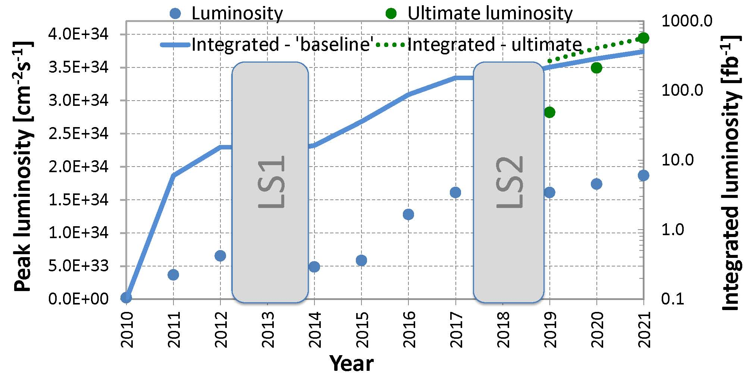
10-year luminosity forecast
total
~400 fb⁻¹
total
17 fb⁻¹
total
156 fb⁻¹
6.5 TeV &
transition
to 25 ns
modified from O. Brüning, M. Lamont, L. Rossi

Slide 12
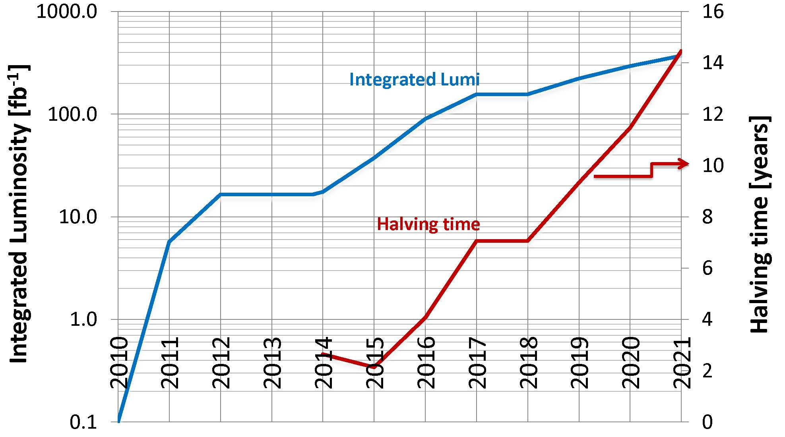
10-year luminosity forecast
HL-LHC
modified from O. Brüning, M. Lamont, L. Rossi

Slide 13
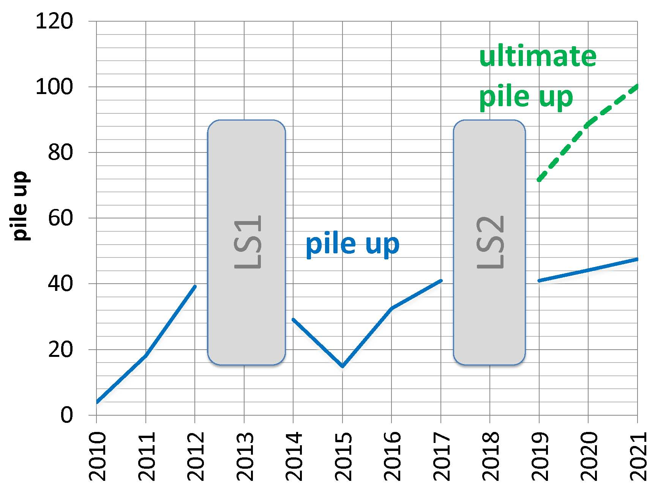
10-year pile-up forecast

Slide 14
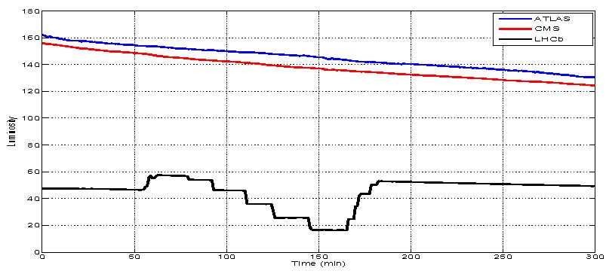
2011: offset leveling test
W. Herr et al,
March 2011
conclusion: the luminosity can be successfully leveled using transverse offsets between 0 and a few σ (here at IP8) without significant effects on the beam or the performance of the other experiments (IP1&5)

Slide 15
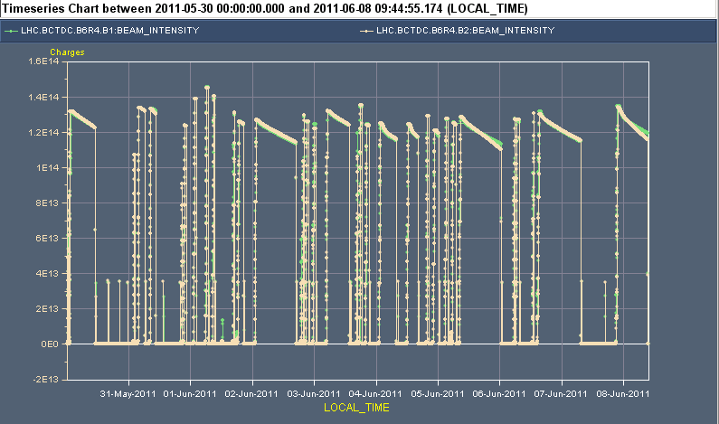
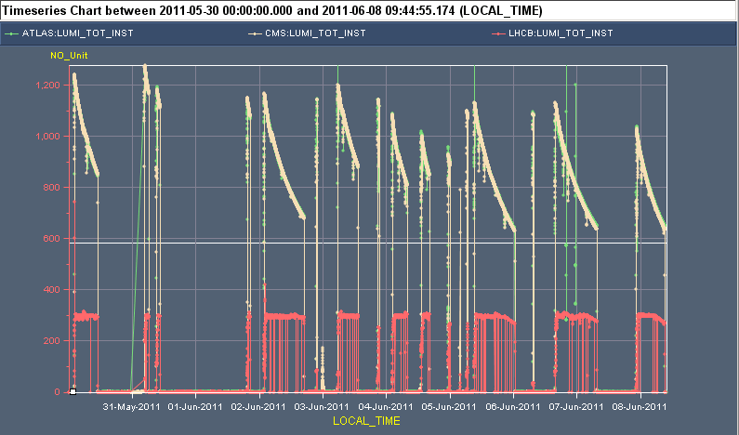
Monday 30/5 to Wednesday 08/06
2011: routine leveling in IP2 & 8
Beam intensities
1.4e11
1.2e33
Luminosities
Blow up
leveling works
3e32
Wk 3

Slide 16
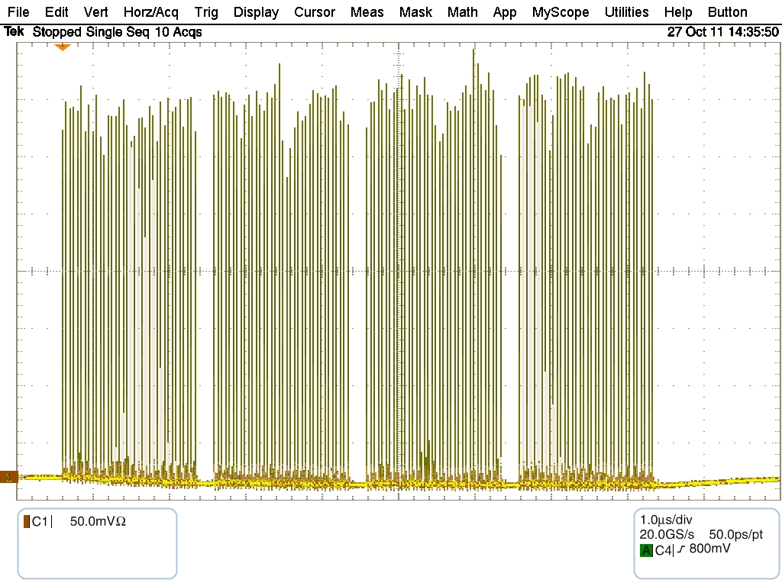
enhanced satellites for ALICE
wall current profile SPS beam
average over sequential 10 turns, 20 ms before extraction
144 bunches with satellites
test in week 43
enhanced
satellites
are produced
by RF
gymnastics
in the PS
(S. Hancock)
Satellites going up to about 8 %, average of few %
T.Bohl, S.Hancock
R. Assmann, LMC

Slide 17
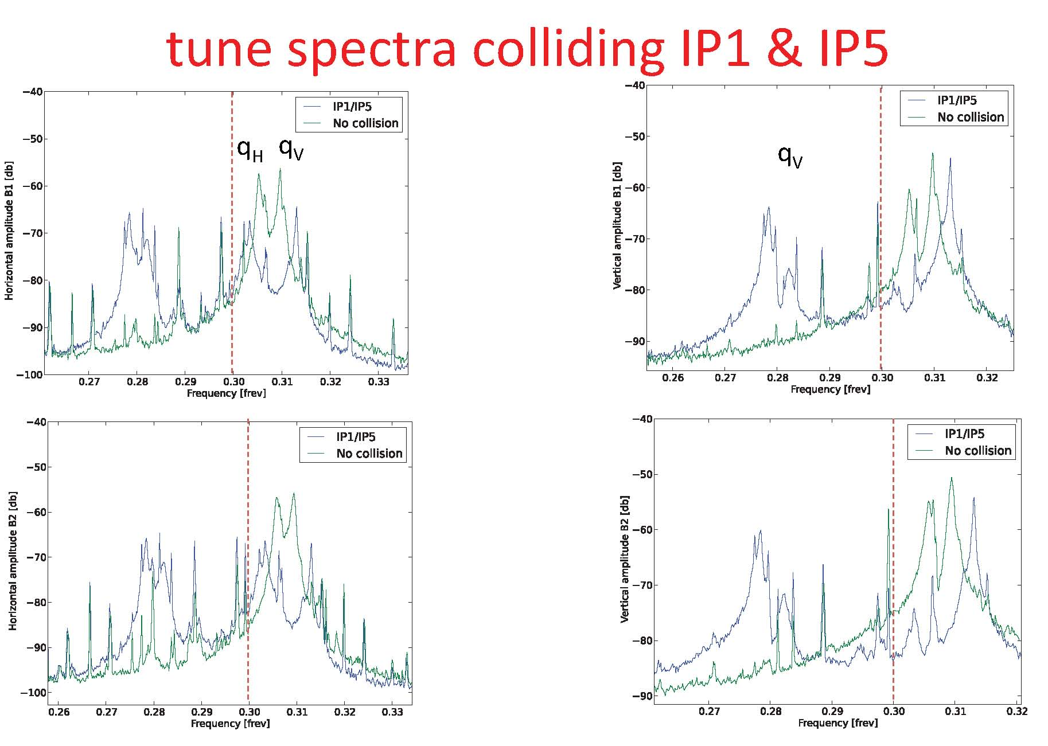
T. Pieloni, W. Herr et al, May 2011
no head-on beam-beam limit found yet
>0.03
beam parameters investigated beyond nominal LHC (N_{b} = 1.8‐1.95x10¹¹, ε =1.2-1.4 μm); no significant beam losses nor emittance effects observed with linear head-on parameter of ξ_{bb}= 0.02 /IP and ξ_{bb}=0.034 (total) – more than 3x above design!

Slide 18
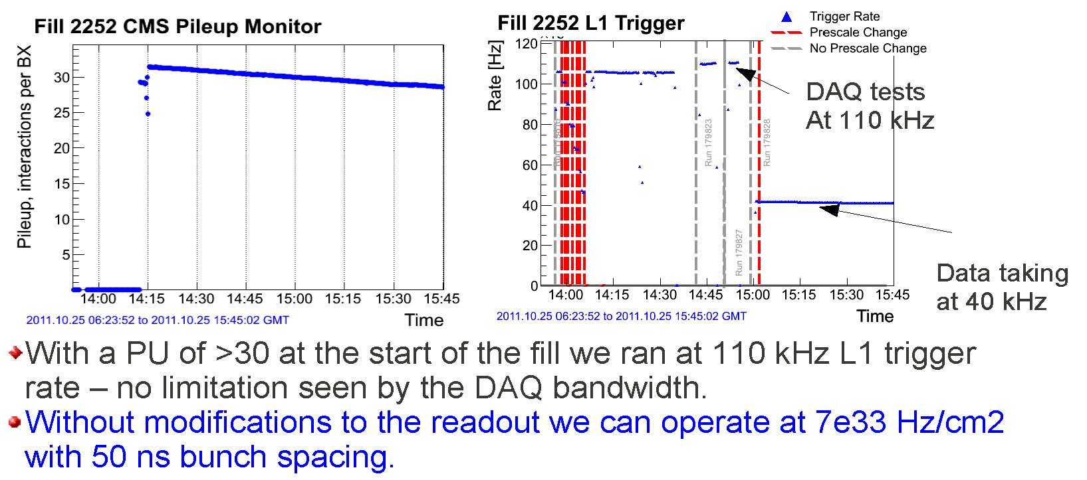
high pile-up test – CMS results
no “pile-up limit” found yet
A. Ryd, LMC112

Slide 19
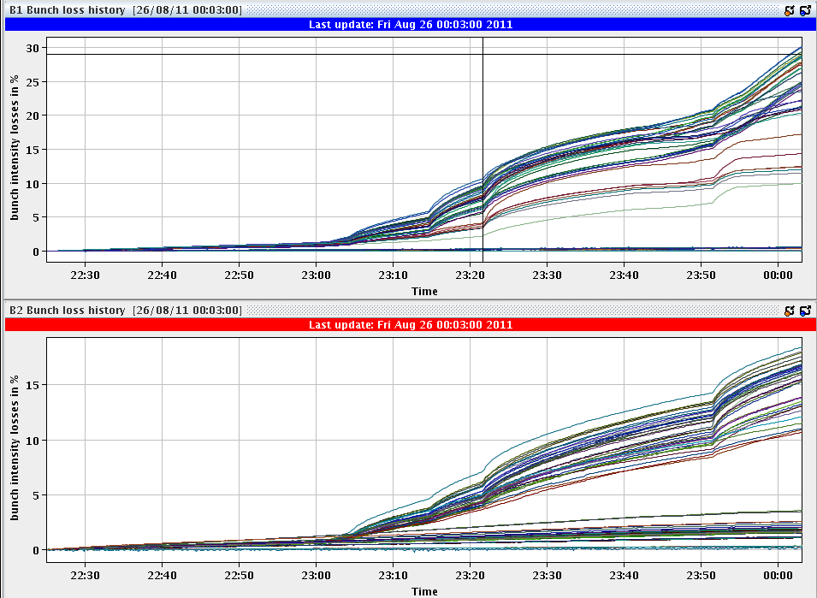
long-range beam-beam effect
W. Herr et al, August 2011
crossing angle
100% = 240 μrad
at β*=1.5 m
50-ns spacing
30%
35%
HD 1-2-5
Strong LR
40%
50%
we cannot reduce the crossing angle
much below 240 μrad at β*=1 m
HD 8
Tiny LR
HD 1-5
Strong LR
HD 2-8
Small LR

Slide 20
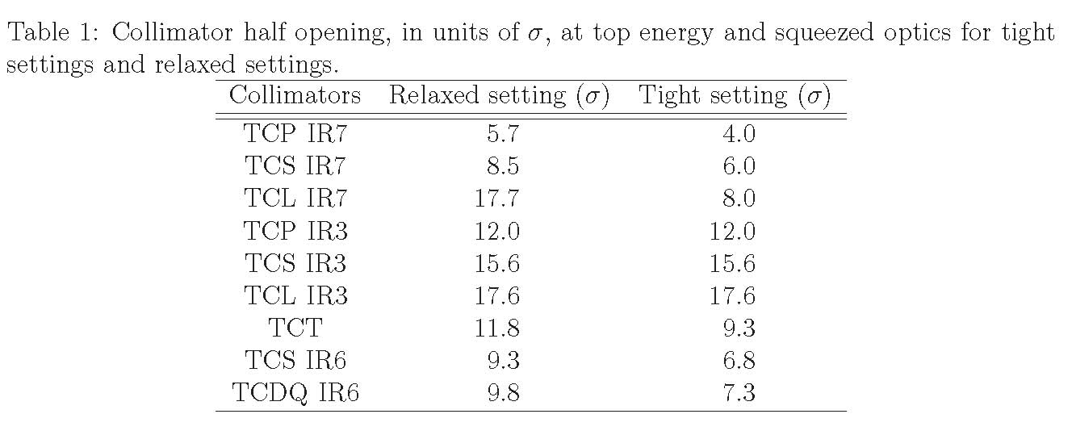
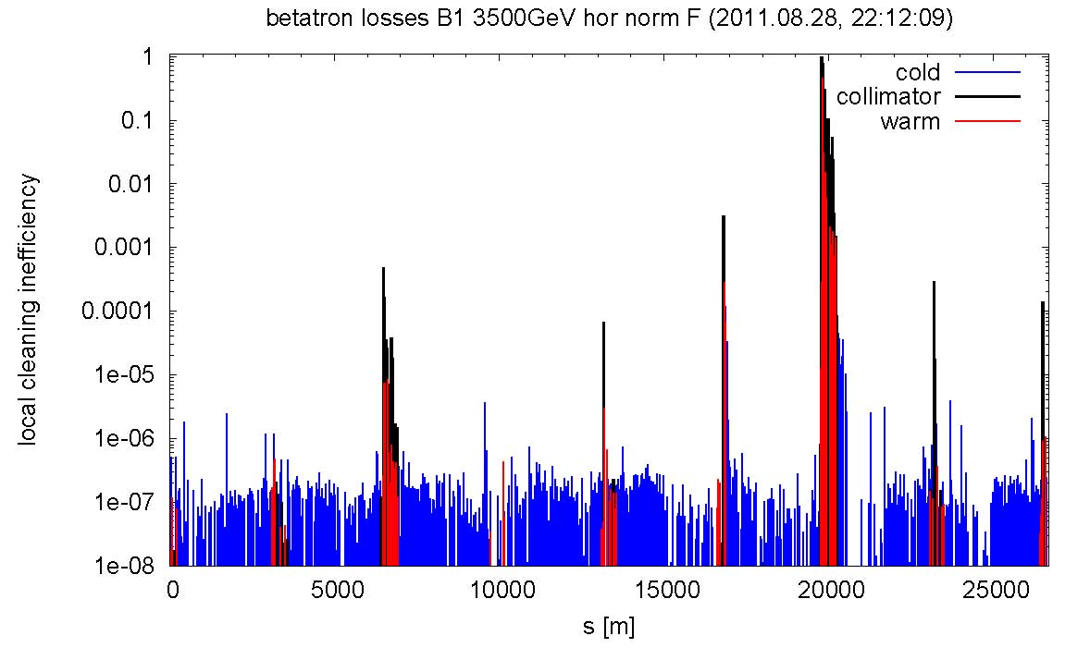
β* reach from 2011 MDs
tight collimator settings tested in MD block2
“We found a good IR aperture in both planes and IPs. So good that we want to take more time to see if we overlooked something. Had to open the TCT aperture to the following values before seeing primary losses at the triplet:”
IR1 - V -> 18.3 - 18.8 σ (at β*=1.5 m)
IR1 - H -> 19.8 - 20.3 σ
IR5 - V -> ≥ 20.3 σ (corrector limit reached)
IR5 - H -> 19.8 - 20.3 σ
S. Redaelli, M. Giovannozzi et al
LHC MD block 3
tight collimator settings
with TCT at 9.3 σ
qualified for physics
operation
at present TCTs at 11.8 σ at β∗=1 m; this could be reduced to 9.3 σ
(β∗<0.7 m)
R. Assmann et al, CERN-ATS-Note-2011-079 MD

Slide 21
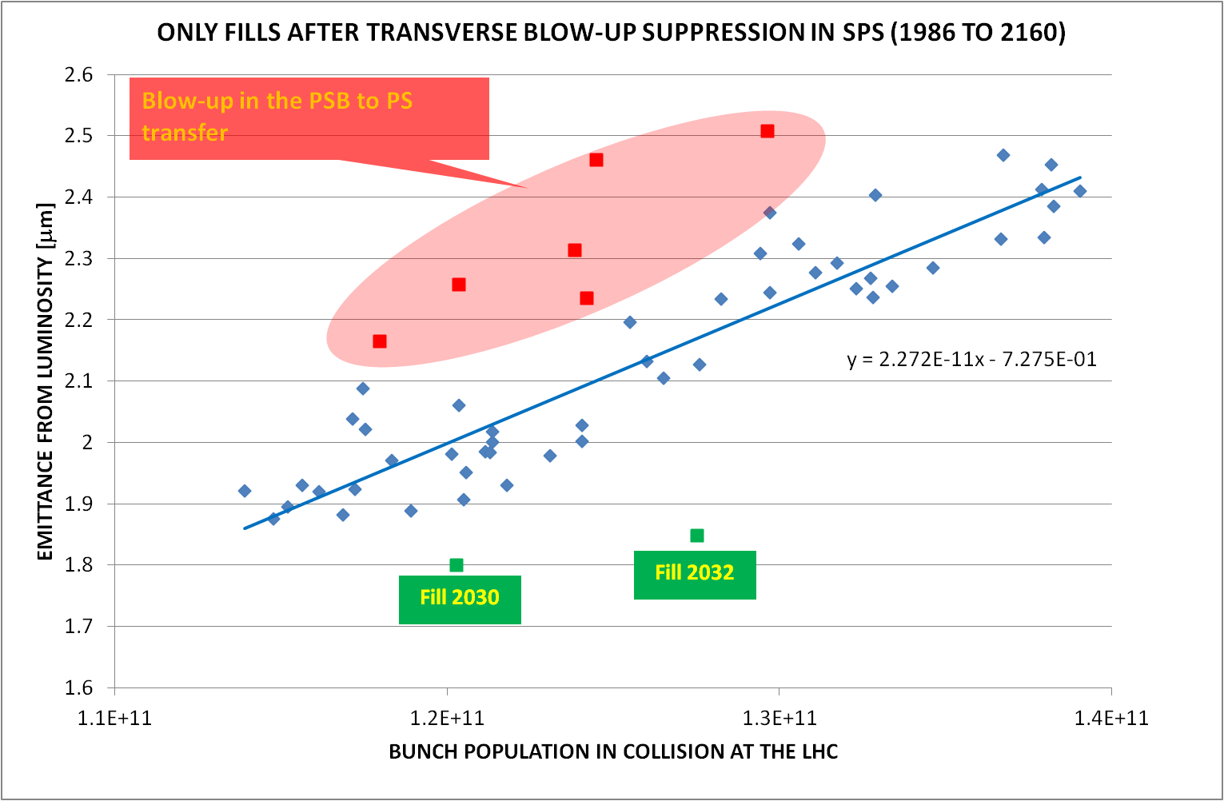
2011: LHC emittance vs bunch intensity with 50 ns spacing
at N_{b}=1.5x10¹¹
emittance is
about
~2.5 μm
G. Arduini, LMC110

Slide 22
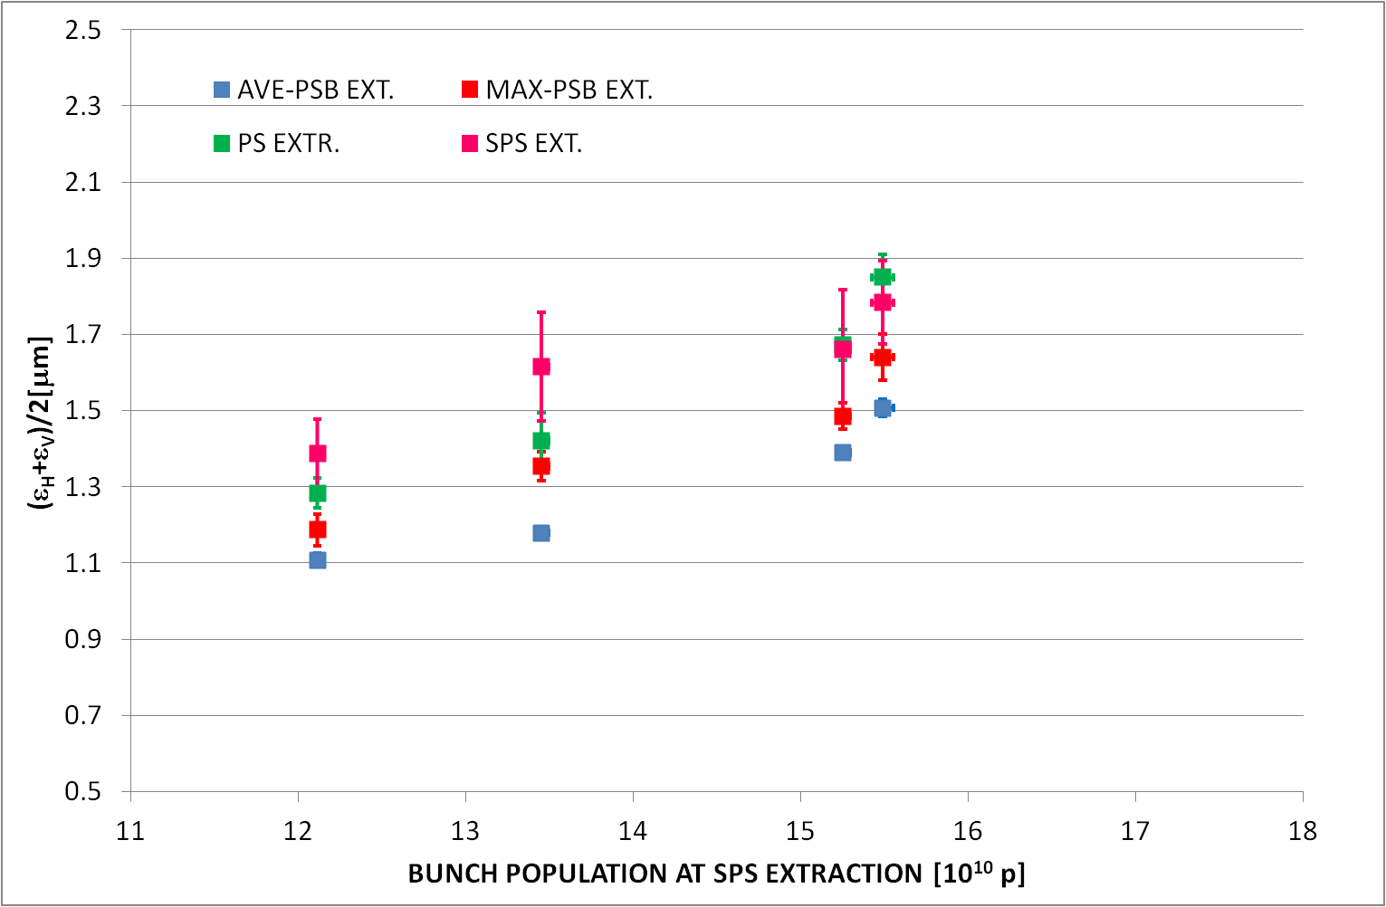
2011: injector emittance vs equivalent LHC bunch intensity (w/o losses)
G. Arduini, LMC110

Slide 23
50 ns vs 25 ns
50-ns beam: smaller emittance from the PS (less splittings in the PS; i.e. less charge in the PSB); ~2 μm vs ~3.5 μm at LHC injection
25-ns beam: emittance growth due to e-cloud in the SPS and LHC (to be improved by scrubbing in the LHC, and a-C coating in the SPS)
25-ns has more long-range collisions
total current limit (by vacuum; RF) → limit # bunches
bunch train current limits in SPS & LHC → limit # bunches
UFO rate seems to greatly increase for 25-ns spacing
ultimately (2014?) we must (try to) transit to 25-ns spacing because of pile up
also there are the possibilities to alternate high-luminosity high-pile-up 50-ns running and lower-luminosity 25-ns running with reduced pile up (?); or to use ALICE enhanced satellites to get both high and low pile up events at the same time – preferences of experiments?

Slide 24
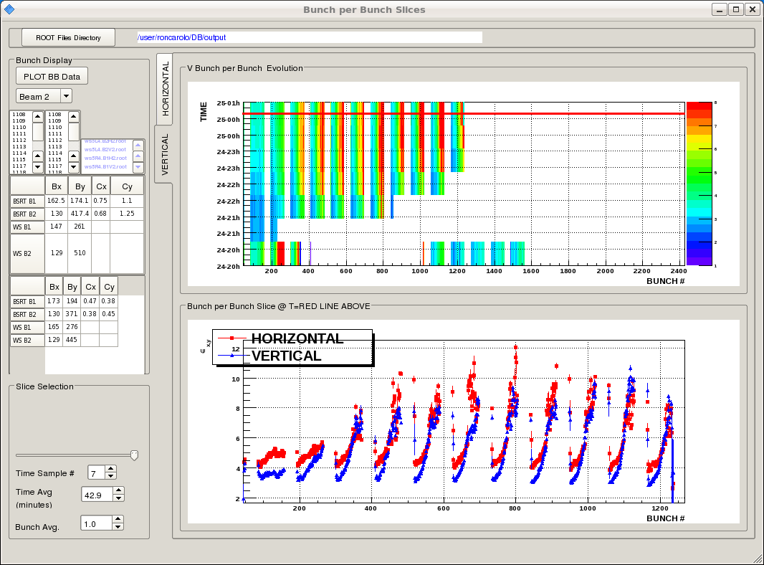
e-cloud emittance blow up with 25 ns
MD October 2011
3.5 μm
2 μm

Slide 25
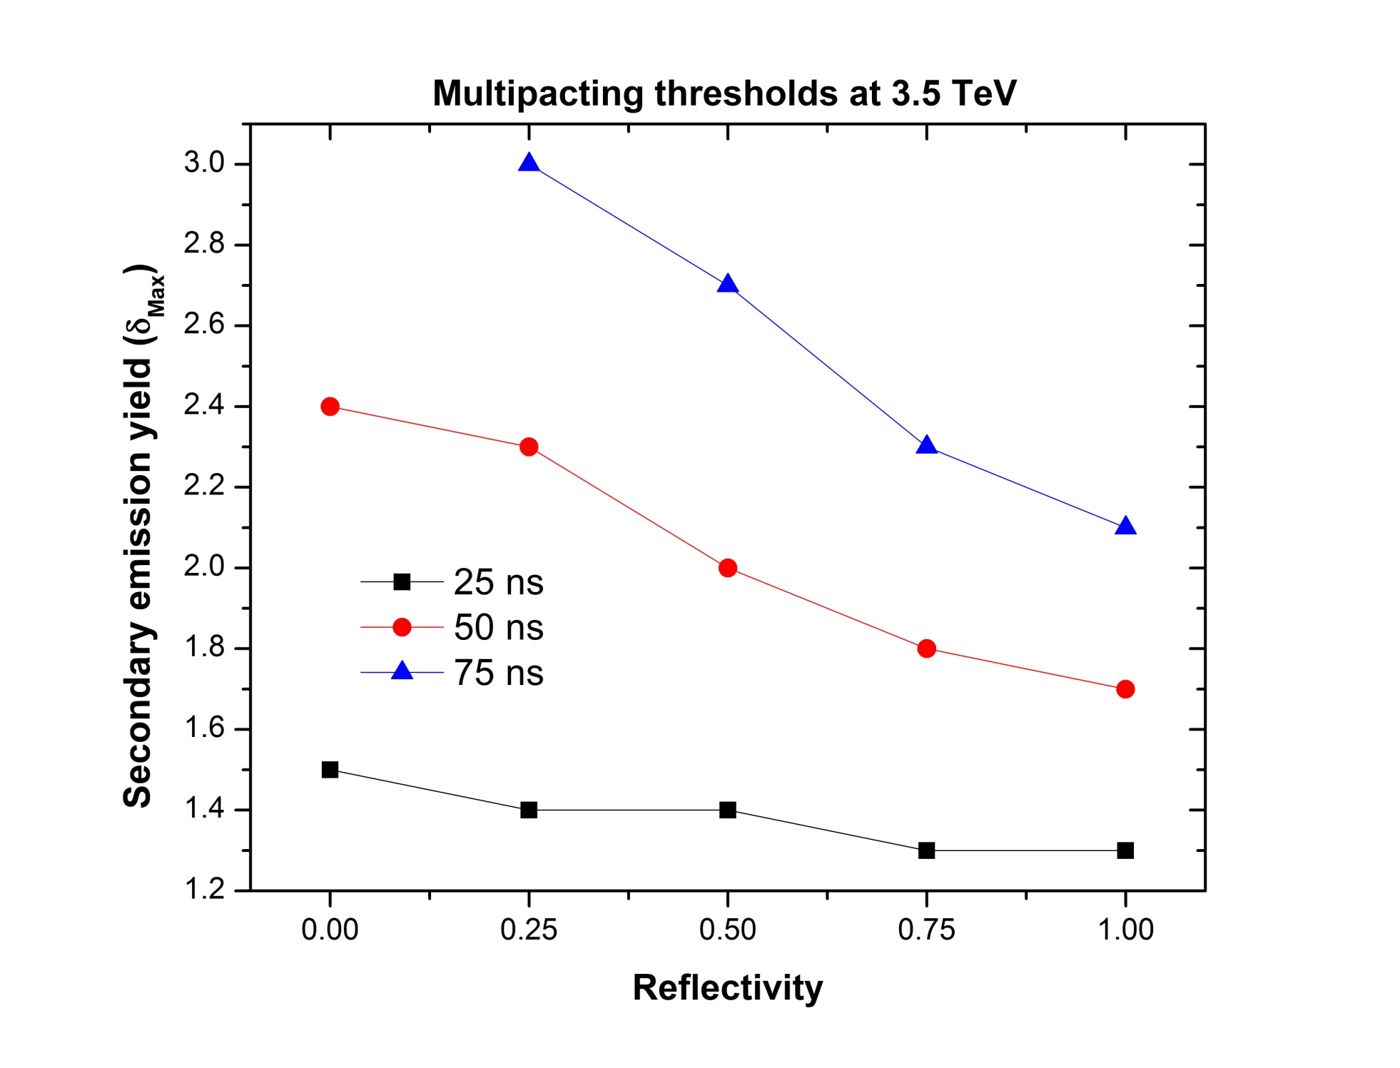
electron cloud scrubbing – LHC arcs
H. Maury
after April
2011 scrubbing run
25-ns tests
October 2011
goal for 25 ns
of low-energy e-

Slide 26
possible concerns for 2014/15
radiation to electronics – SEU’s
UFOs at higher energy & with 25 ns
electron cloud & high energy & at 25 ns
emittance growth in physics
…

Slide 27
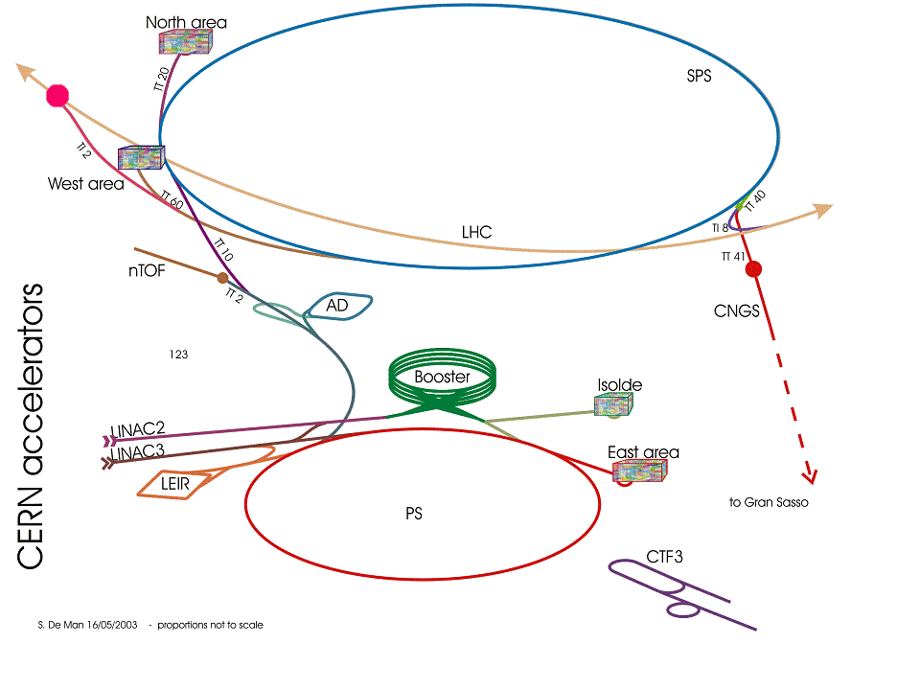
LHC injector complex
Duoplasmatron = Source  90 keV (kinetic energy)
LINAC2 = Linear accelerator  50 MeV
PSBooster = Proton Synchrotron Booster  1.4 GeV
PS = Proton Synchrotron  25 GeV
SPS = Super Proton Synchrotron  450 GeV
LHC = Large Hadron Collider  7 TeV

Slide 28
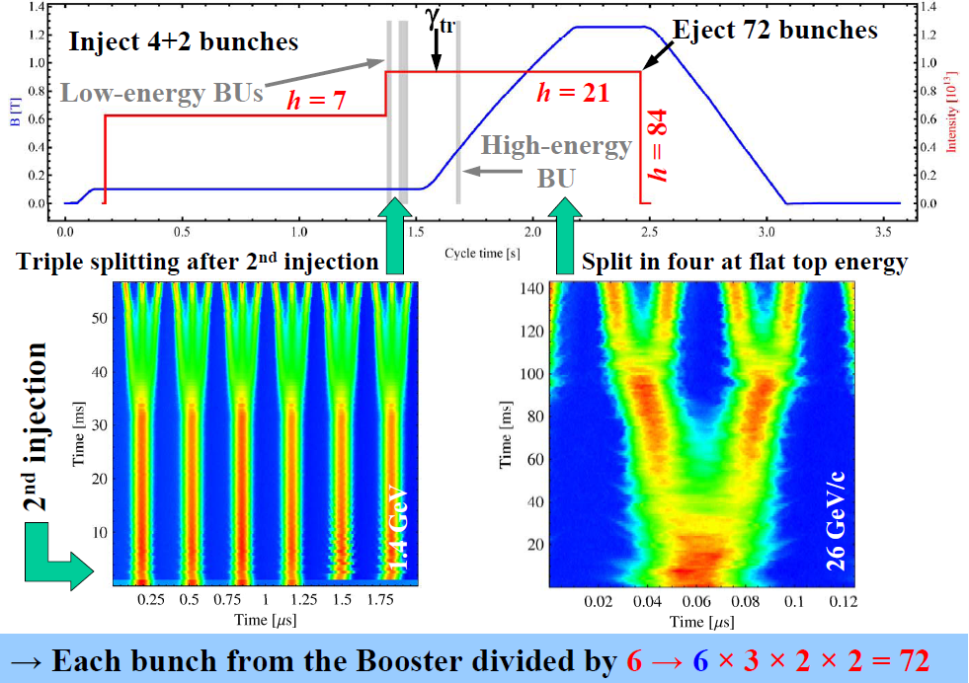
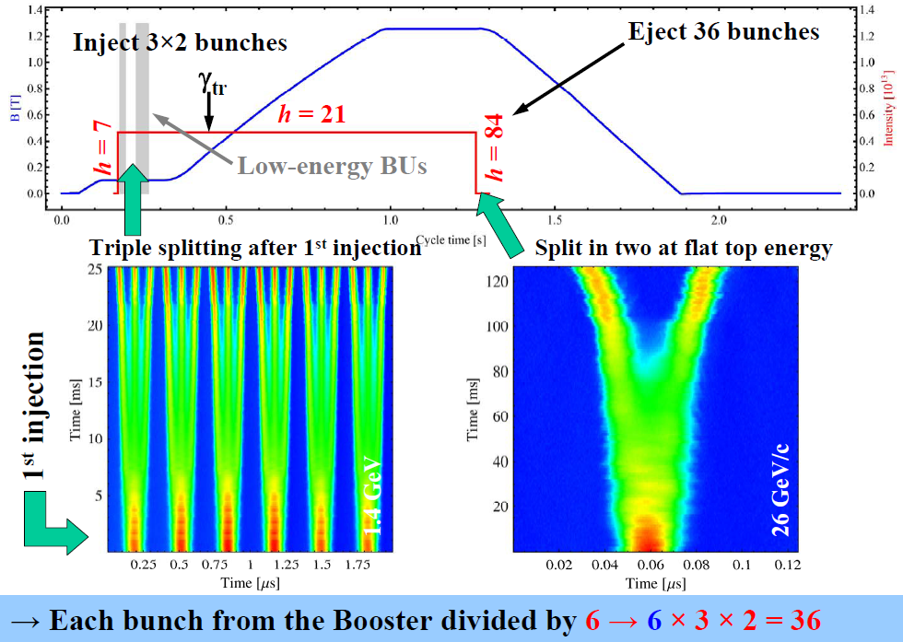
3 LHC p beams from the CERN PS
25 ns beam from the PS
50 ns beam from the PS
Ɛ_{h/v} very low, potential for higher than nominal intensity
 | Possible Characteristics 2011
 | PSB extraction |  |  |  | PS extraction |  |  | SPS extraction
 | Ip / ring | ɛ_{h} and ɛ_{v} | nb | nb | Ip / bunch | ɛ_{h} and ɛ_{v} | nb | Ip / bunch | ɛ_{h} and ɛ_{v} | ɛ_{longit} | nb
 | [x10¹¹] | [mm ∙ mrad] | batches | bunches | [x10¹¹] | [mm ∙ mrad] | bunches | [x10¹¹] | [mm ∙ mrad] | [eVs] | bunches
 |  | 1σ, norm. |  |  |  | 1σ, norm. |  |  | 1σ, norm.
LHC25 (DB) | 16 | 2.5 | 2 | 4 + 2 | 1.3 | 2.5 | 72 | 1.15 | 3.6 | 0.7 | 4 x 72
LHC50 (SB) | 24 | 3.5 | 1 | 3 x 2 | 1.75 | 3.5 | 36 | 1.45 | <3.5 | ≤ 0.8 | 4 x 36
LHC50 (DB) | 8 | 1.2 | 2 | 4 + 2 | 1.3 | 1.3 | 36 | 1.15 (?) | 1.5 (?) | ≤ 0.8 | 4 x 36
Rende
Steerenberg
Chamonix
2011
LHC50 SB (2010) → LHC 50 DB (low emittance, 2011) or LHC25 DB (more bunches)
+ future PS “batch compression” to (further) boost the brightness?

Slide 29
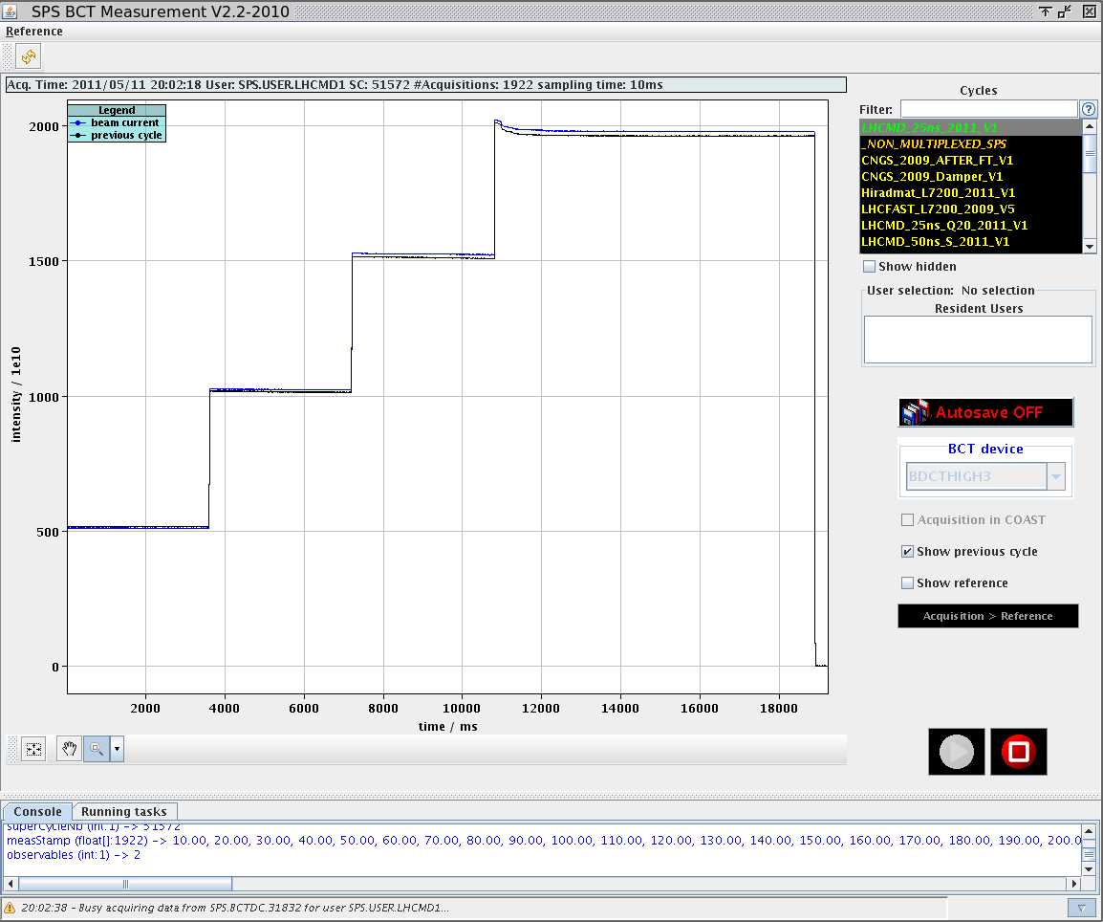
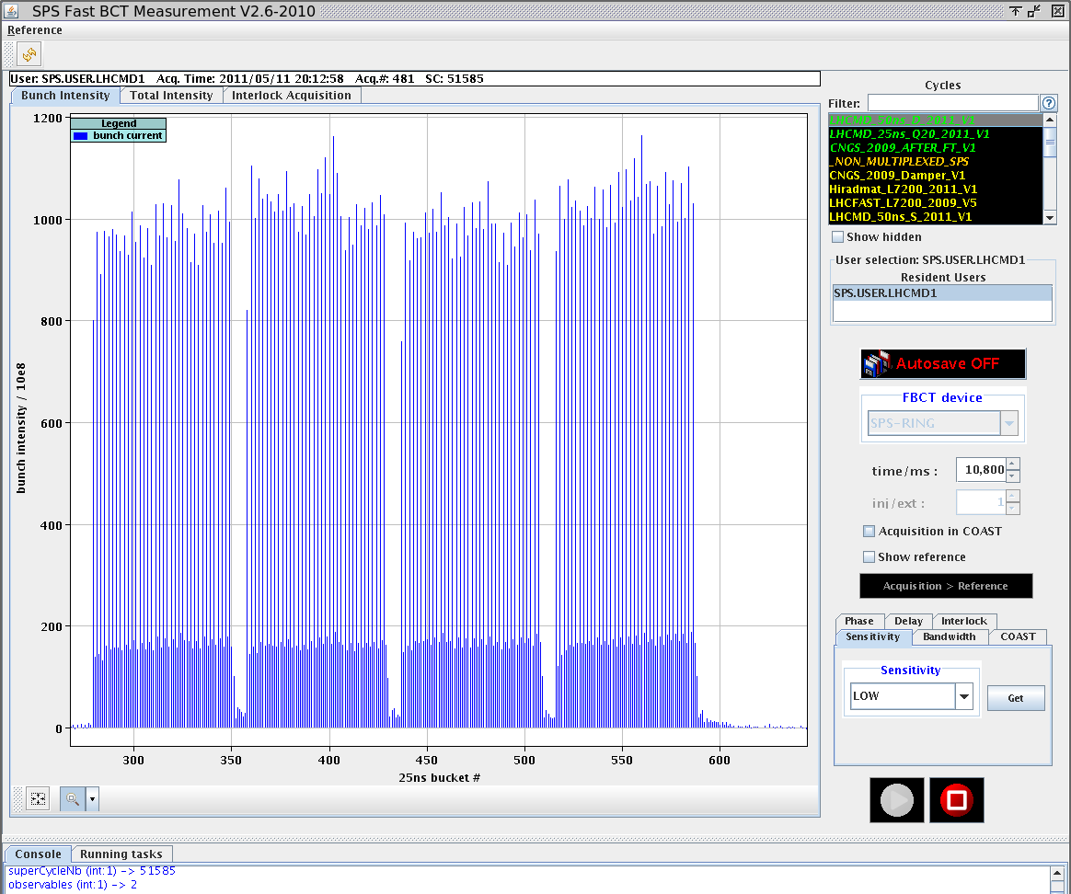
SPS: 50ns bunch train – Double PSB batch
  Intensity 1.65 10¹¹ p/b reached !
    Up to 4 batches injected
    Very low losses along the cycle (reproducible 3%)
    ε_{x}=2.0 μm and ε_{y}=1.9 μm at flat top (sum 3.9)
May 2011
Roland Garoby, LHCC 14/06/2011

Slide 30

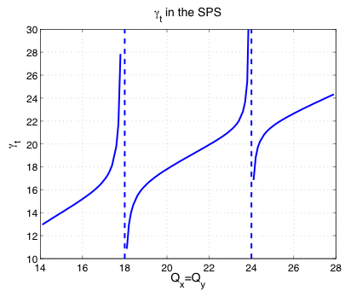
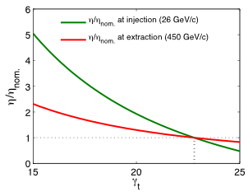

new optics for SPS (low γ_{t} or “Q20”)
not yet fully commissioned for LHC
H. Bartosik, Y. Papaphilippou
N_{th} … Instability threshold
ε … longitudinal emittance
τ … bunch length
η … slippage factor
SPS intensity limitations for LHC p beams in SPS
  TMCI due to transverse impedance, N_{th} ~ η
  Loss of longitudinal Landau damping), N_{th} ~ ε²τη
  Longitudinal coupled bunch instabilities, N_{th} ~ ηε²/τ
  Electron cloud instability
Slippage factor η defined by optics through transition energy (γ_{t}):
Increase in instability thresholds N_{th} for higher slippage factor η due to faster synchrotron motion ( ) and faster damping of instabilities
Slippage factor in SPS relative to nominal optics
1998
2010
Low γ_{t} optics
Nominal optics
1978
nominal
Notes:
TMCI threshold can be increased by increasing chromaticity or longitudinal emittance

Slide 31
SPS single-bunch intensity limits
(units of protons/bunch)
chromaticity Q’/Q | 0.0 | 0.07
old Q26 optics | 1.7x10¹¹ | 2.2 x10¹¹
new Q20 optics | 2.8x10¹¹ | 3.8 x10¹¹
>2 x LHC
ultimate
Benoit Salvant

Slide 32
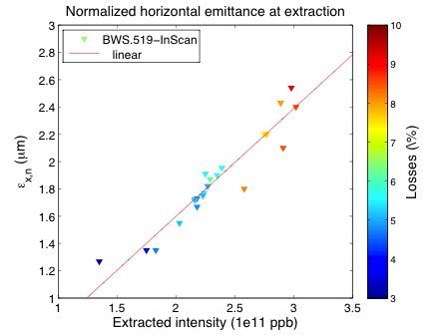
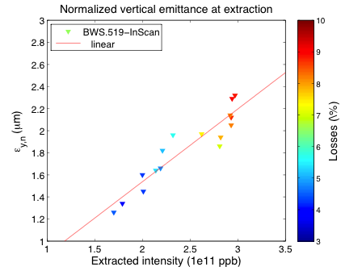
N_{b} & ε with SPS Q20 low-γ_{t} optics (1 bunch)
extracted intensity together with total losses along the cycle
overestimation of horizontal emittance and its slope (dependence of dp/p on intensity)
PSB emittances: ~ 1μm < 1.5e11p / ~ 1.1μm @ 2e11p / ~ 1.3μm @ 3e11p
bunch length slightly increasing with intensity
up to N_{b}~3x10¹¹ (~3x LHC at 450 GeV with γε~2.5 μm (2/3 LHC design!)
emittance
measured!
Hannes Bartosik
11 May 2011
intensity

Slide 33
Overall LHC Injector Upgrade Planning
 | Linac4 | PS injector, PS and SPS | Beam characteristics at LHC injection
2011 - 2012 | Continuation of construction… | Beam studies § simulations Investigation of RCS option Hardware prototyping Design § construction of some equipment TDR | 25 ns, 1.2 10¹¹p/b, ~2.5 mm.mrad 50 ns, 1.7 10¹¹p/b, ∼2.2 mm.mrad 75 ns, 1.2 10¹¹ p/b, ≤ 2 mm.mrad
2013 – 2014 (Long Shutdown 1) | Linac4 beam commissioning Connection to PSB ? | PSB modification (H⁻ injection) ? PSB beam commissioning ? Modifications and installation of prototypes in PS and SPS
2015 - 2017 | Progressive increase of Linac4 beam current | If Linac4 connected: progressive increase of PSB brightness Some improvement of PS beam (Injection still at 1.4 GeV) Equipment design § construction for PS injector, PS and SPS Beam studies | Limited gain at LHC injection (pending PSB (or RCS), PS and SPS hardware upgrades)
2018 (Long Shutdown 2) |  | Extensive installations in PS injector, PS and SPS Beam commissioning
2019 –2021 |  |  | After ~1 year of operation: beam characteristics for HL-LHC…
R. Garoby, 24 June 2011

Slide 34
Linac4 commissioning schedule
Start of beam commissioning (3MeV): May 2013
End of beam commissioning (160 MeV): April 2014
(version November 2010)
5 commissioning stages:
(on intermediate dumps)
3 MeV
10 MeV
50 MeV
100 MeV
160 MeV
Linac4 ready : April 2014
M. Vretenar, CERN MAC, August 2011

Slide 35
Baseline scenario:
LINAC4 connection in LS2
Keep Linac4 commissioning schedule (April 2014)
Schedule connection to the PSB only in LS2 → minimum risk; but need to operate in parallel Linac2 and Linac4 for some years;
In case of problems with Linac2, be ready from 2015 to an “emergency” connection of Linac4, with 2 possible options:
a) with H- & full performance after 7-month shutdown;
b) with protons at 50 MeV after a few days shutdown but with reduced PSB performance.
M. Vretenar, CERN MAC, August 2011

Slide 36
alternative LINAC4 connection scenarios for LS1 (NOT baseline)
A.
“green light” Jan. 2014, Linac4 commissioned only to 100 MeV
+ : Linac4 + PSB available from 2015 (PSB performance + mitigate risk of Linac2 failure)
- : a) Risk of reliability/performance issues appearing in the last phase of commissioning
b) Injectors have to stop in 2014.
B.
“green light” June 2015, Linac4 commissioned + 5 months reliability run
+ : Linac4 + PSB available from 2015 (PSB performance + mitigate risk of Linac2 failure)
- : a) Start LHC only in 2015
b) Injectors have to stop in 2014.
M. Vretenar, CERN MAC, August 2011

Slide 37
would there be any benefit for LHC from Linac4 alone?
For 25 ns spacing it is very difficult to go beyond what is done today without RF & e-cloud improvements in the SPS & PSB energy upgrade (all planned in LS2)
With 50 ns bunch spacing one might gain up to a factor of 2 in intensity at the SPS from LINAC4
R. Garoby, CERN MAC, August 2011

Slide 38
potential 50-ns luminosity reach with LINAC4 (my estimate)
γε ~2.5 μm
N_{b} ~2.5x10¹¹
E= 4 TeV, β*~0.7 m:
L~1.6x10³⁴ cm⁻²s⁻¹, pile up ~74
E = 6.5 TeV, β*~0.45 m :
L~3.7x10³⁴ cm⁻²s⁻¹, pile up ~170

Slide 39
a few conclusions
in 2012 may expect addtitonal 10/fb at 4 TeV with ~36 maximum pile up at 50 ns spacing
from 2014 run with 25 ns spacing at 6.5 TeV
by 2017 may have ~150/fb and by 2021 ~400/fb with maximum pile up <50
early connection of LINAC4 might (only) help for 50-ns operation, but could then give highest luminosity & with high maximum pile up (70-170)
maximum luminosity is determined by acceptable pile up (no head-on beam-beam limit!)
leveling could also be applied for CMS to limit the pile up
enhanced satellites would give low & high pile up events
LHC will exceed design luminosity; 2021: time for HL-LHC

Slide 40
thank you for your attention

