Slide 1
EuroLumi2 and/or “AccNet2” in EuCARD2
Frank Zimmermann
ESGARD Meeting, Paris, 10 May 2011
Thanks to:
Rob Appleby, Kurt Aulenbacher, Maud Baylac, Marica Biagini, Oliver Boine-Frankenheim, Oliver Brüning, Jean-Marie De Conto, Ralf Eichhorn, Jean-Pierre Koutchouk, Anke-Susanne Müller, Chris Prior, Mike Seidel, Peter Spiller,…

Slide 2
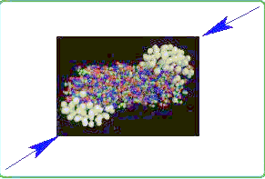
building on success
CARE-HHH 2004-2008:
WP1: Advancements in Accelerator Magnet Technologies AMT
WP2: Novel Methods for Accelerator Beam Instrumentation ABI
WP3: Accelerator Physics and synchrotron Design APD
LHC upgrade, upgrade of LHC injector complex, FAIR, magnets, instrumentation
39 primary HHH workshops, 156 HHH documents,
numerous exchanges of scientists
EuCARD-AccNet 2009-2012:
WP1: Coordination and communication
WP2: EuroLumi network (accelerator performance)
WP3: RFTech network (RF technologies)
WP4: EuroNNAc (advanced accelerator techniques)
13 primary AccNet workshops, 68 AccNet documents,
numerous exchanges of scientists – and counting
impact: High-Luminosity LHC,
luminosity leveling, LHC IR upgrade, large Piwinski angle scheme, injector upgrade, anti e-cloud coatings, ESA, crystal collimation, CERN-GSI studies,…
impact: HL-LHC crab cavities, High-Energy LHC, joint e-cloud efforts, roadmap for SRF test facilities, community organizer for RF technologies & plasma acceleration,…

Slide 3
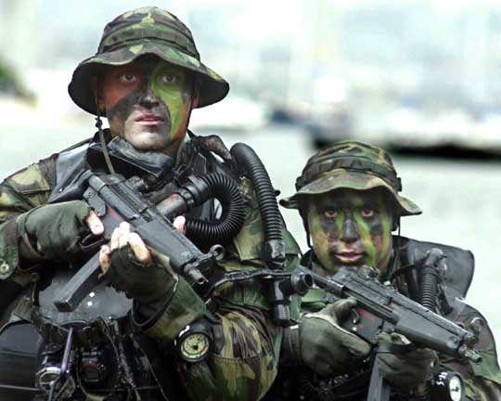
“the only easy day was yesterday”
US Navy SEAL slogan

Slide 4
pushing the frontiers
luminosity frontier
LHC, HL-LHC, SuperB, SuperKEKB, MESA
energy frontier
LHC, HE-LHC, LHeC, RHIC, PDPWA
intensity / beam-power frontier
FAIR, SIS-18 upgrade, ISIS upgrades, PSI HIPA, ESS, SNS, J-PARC, HP-SPL, FFAGs, Project-X, GANIL/Spiral-2?
emittance / beam-temperature frontier
LHC, FAIR, SuperB, SuperKEKB
polarization & e+ frontier
LHeC, MESA, SuperB, RHIC
efficiency frontier
LHeC, MESA, PDPWA
in blue proposed
scope of EuroLumi2

Slide 5
luminosity records & targets
LHC: 7x10³² cm⁻²s⁻¹ at 3.5 TeV (achieved)
10³⁴ cm⁻²s⁻¹ at 7 TeV (design)
KEKB: 2.2x10³⁴ cm⁻²s⁻¹ at 3.6/8 GeV
(achieved, >2 x design)
↓ factor 10-100
HL-LHC: ≥10³⁵ cm⁻²s⁻¹ (“virtual peak luminosity”)
SuperKEKB: 8x10³⁵ cm⁻²s⁻¹ at 4/7 GeV
SuperB: 10³⁶ cm⁻²s⁻¹ at 4.2/6.7 GeV
MESA: 10³⁵ -10³⁹cm⁻²s⁻¹ at 0.137-0.104 GeV
(fixed target)

Slide 6
beam power records & targets
ISIS: 0.2 MW at 800 MeV (achieved)
PSI HIPA: 1.3 MW at 590 MeV (achieved)
SNS: 1 MW (achieved) 1.4 MW at 1 GeV (design)
J-PARC: 0.2 MW at 3 GeV (achieved) 1 MW (design)
↓ factor ~5
PSI HIPA upgrade: 1.8 MW at 590 MeV
ISIS upgrade: 5 MW at 3.2 GeV
ESS: 5 MW at 2.5 GeV ; IFMIF 10 MW
HP-SPL: 3-8 MW at 5 GeV; ILC 22 MW at 0.5 TeV c.m.
Project-X: 2 + 2 MW (at 3 GeV and 60-120 GeV)
CLIC 28 MW at 3 TeV c.m. [2 beams]

Slide 7
e± polarization records & targets
LEP: 57% at 46 GeV (achieved)
MAMI: 75% at1.56 GeV (achieved)
CEBAF: 86% at 6 GeV (achieved)
SLC: 73% at 46 GeV (achieved)
↓ factor ~ 1 - ∞
LHeC: >80% for e- at 60 GeV, some e+ polarization
MESA: >50% for e+ at >0.1 GeV
measurement accuracy: 0.5% (SLC) → 0.1% (LHeC)
factor 5

Slide 8
EuroLumi2 partners in Europe
CERN LHC, HL-LHC, HE-LHC, LHeC, PDPWA
GSI FAIR, SIS-18 upgrade
INFN-LNF SuperB
PSI HIPA
RAL/ASTeC ISIS upgrade, FFAGs, high-intensity proton beams
U Mainz MESA
U Manchester LHC, HL-LHC, HP-SPL
KIT Karlsruhe LHeC, ERLs
U Liverpool LHeC ; LPSC Grenoble HL-LHC, LHeC, SuperB. …
Cockcroft Institute HL-LHC, LHeC
U Darmstadt ERLs, S-DALINAC, MPI Munich PDPWA
U Valencia LHC, HL-LHC, GANIL? …
in addition many strong links to overseas
Institutes (US-LARP, KEK,…)

Slide 9
proposal: a network of networks
AccNet2:
EuroLumi2 – colliders & intensity limits
PWA
Low emittance machines
Applications
Energy efficient systems
SuperB,
SuperKEKB, LHeC
SPS
LHC
FFAGs
plasmas
low emittance
high intensity
LHeC
MESA
possible coordination via AccNet2:
web site, coordinated calendars, common pot, perhaps coordination with other entities (ECFA?, ICFA?, LC’s?,…)

Slide 10
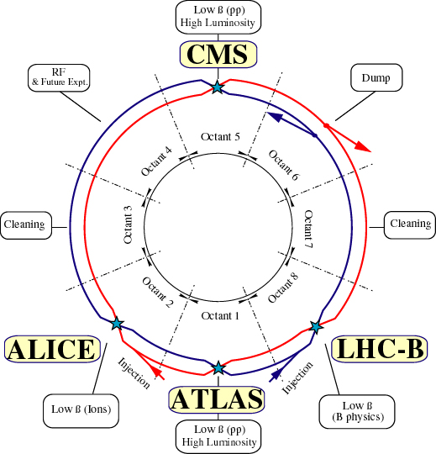
Large Hadron Collider (LHC)
pp and AA collider
c.m. energy 14 TeV
(7x Tevatron)
design luminosity
10³⁴ cm⁻²s⁻¹
(~30x Tevatron)
beam commissioning
started in 2008
EuroLumi2: LHC operation with mixed beam types (p-Pb), e.g. beam-beam with asymmetric beams, BFPP asymmetry, RF synchronisation, etc. Application of stochastic cooling for LHC ion programme. Long-range beam-beam compensation.

Slide 11
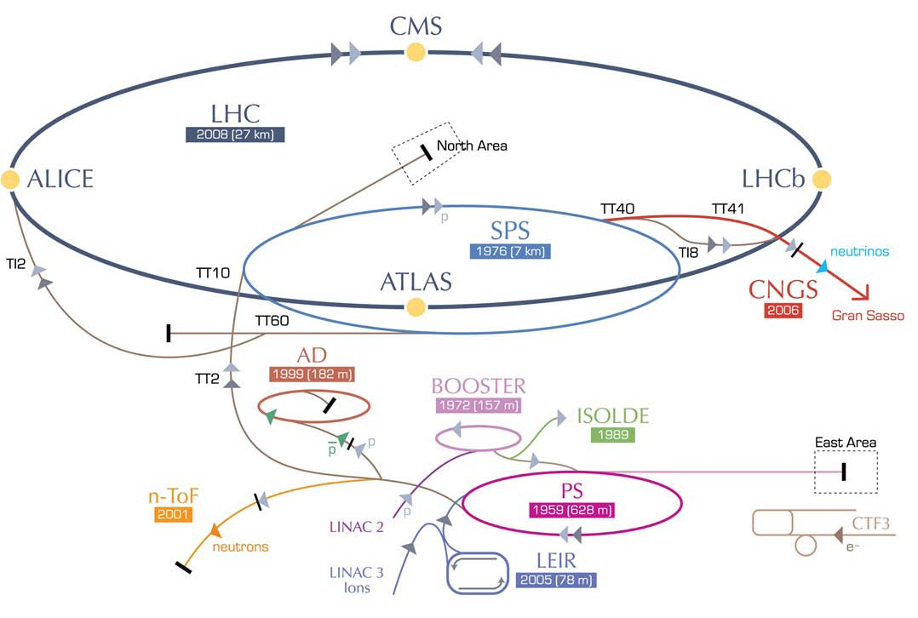
High-Luminosity LHC
IR upgrade
(detectors,
low-β quad’s,
crab cavities, etc)
~2021
SPS enhancements
(anti e-cloud coating,RF,
impedance), 2012-2021
Booster energy upgrade?
1.4 → 2 GeV, ~2018
Linac4,
~2014
EuroLumi2: crab cavities, e-cloud mitigation, chromatic errors (collimation design & off-momentum beta-beating etc.), large Piwinski angle, crab waist, coherent electron cooling

Slide 12
High-Energy LHC
HE-LHC
2030-33
SPS+,
1.3 TeV, 2030-33
2-GeV Booster
Linac4
EuroLumi2: collimation (impact studies for different materials, momentum cleaning & abort gap cleaning with strong damping), vacuum und e-cloud with strong SR

Slide 13
Large Hadron electron Collider
RR LHeC:
2020-21,
new ring
in LHC tunnel,
with bypasses
around
experiments
LR LHeC:
2020-21,
recirculating
linac with
energy
recovery
RR LHeC
e-/e+ injector
2020-21,
10 GeV,
10 min. filling time
EuroLumi2: beam break up & ion effects; positron production, IR design, polarization, …

Slide 14
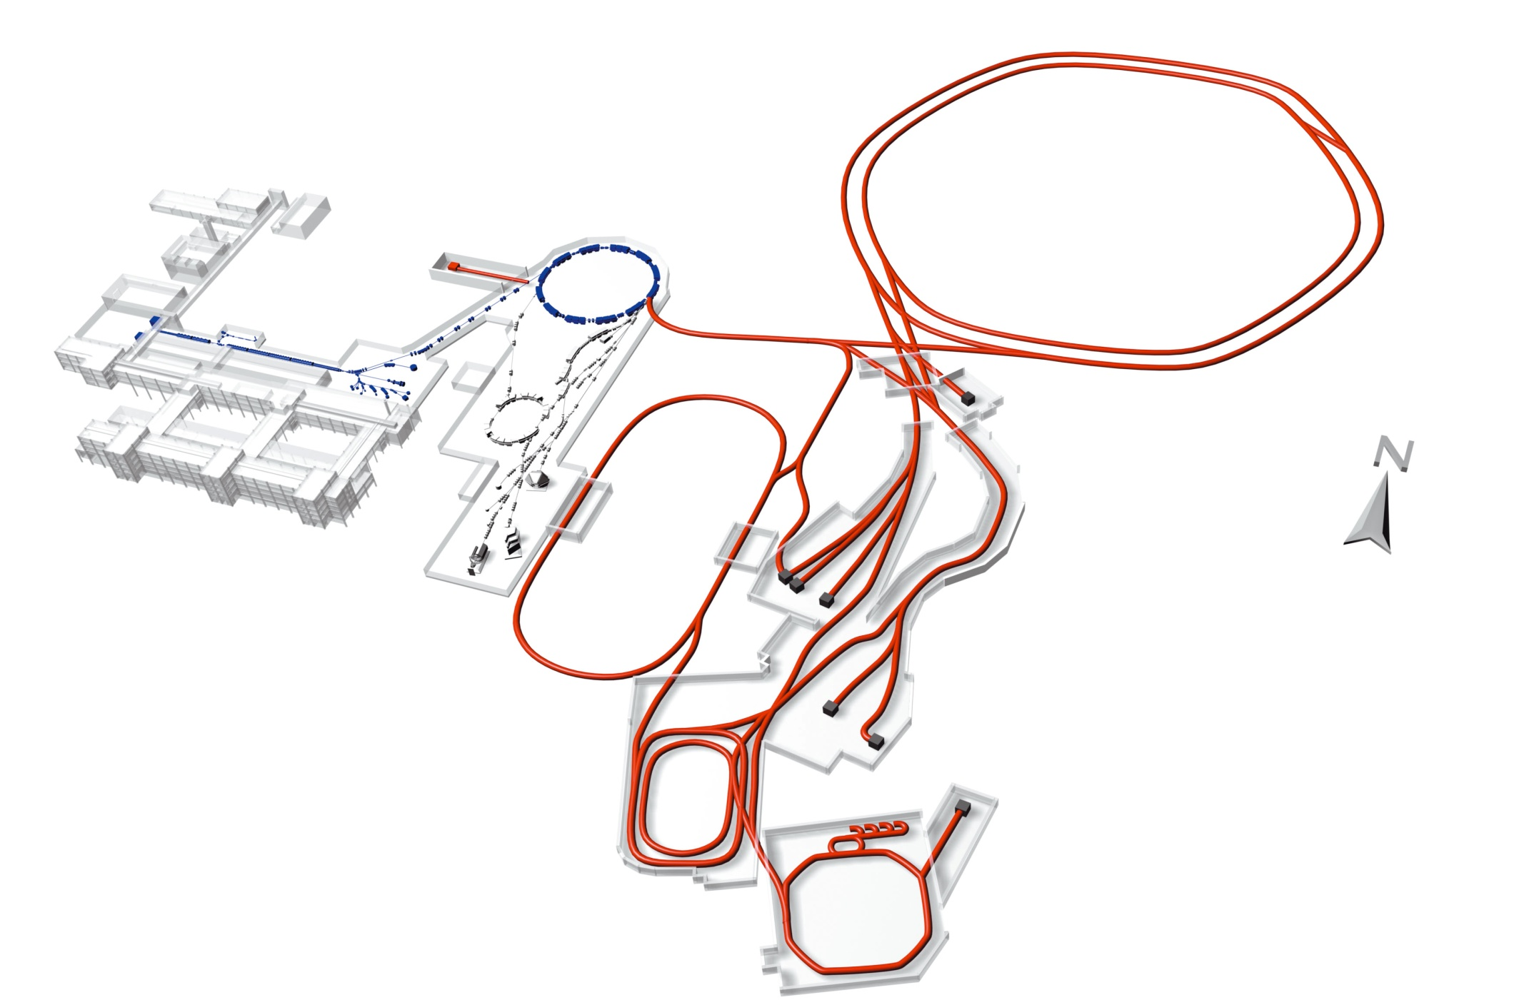
SIS-18 upgrade & FAIR
P. Spiller,
O. Kester,
O. Boine-F.
L=1080 m
100 m
SIS-100/300
p-linac
L=216 m
SIS-18
UNILAC
Radioactive Ion Production Target
Existing facility UNILAC/SIS-18 GSI facility:
provides ion-beam source and injector for FAIR
HESR
Super
FRS
Accelerator Components & Key Characteristics
Ring/Device Beam Energy Intensity
SIS-100 Tm protons 30 GeV 4x10¹³
²³⁸U²⁸⁺ 2.7 GeV/u 5x10¹¹ (intensity factor 100 over present, short single bunch)
SIS-300 Tm ²³⁸U⁹²⁺ 34 GeV/u 2x10¹⁰
CR/RESR/NESR ion and antiproton storage rings
HESR antiprotons 14 GeV 10¹¹
Super-FRS rare isotope beams 1 GeV/u <10⁹
Anti-Proton Production Target
CR
FLAIR
RESR
NESR
EuroLumi2:
dynamic vacuum

Slide 15
SIS-18 upgrade & FAIR
P. Spiller,
O. Kester,
O. Boine-F.
Beam intensity:
Increase in primary beam intensity: x 100 – x 1000
Increase in intensity of secondary particles: x 10.000
Beam energy: x 30
Beams:
Anti protons
Protons to uranium, RIBs
Beam quality:
Cooled anti proton beams
Cooled, intense RIBs
Beam pulse structure: extreme short pulses to quasi continuous
Pulse to pulse variation of beam:
To provide beams to several (max.4) experiments

Slide 16
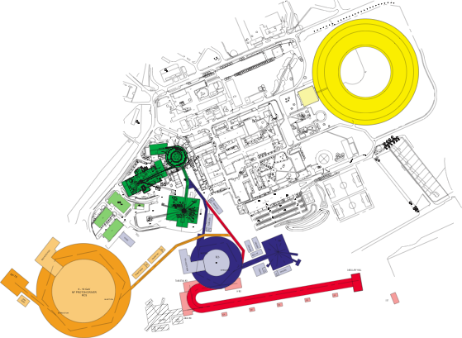
ASTeC and ISIS Upgrades
C. Prior
Replacement linac with increase in injection energy to ~180 MeV
Add new 3.2 GeV synchrotron
Bucket-bucket transfer (2 bunches) from ISIS
Simple energy increase gives ~0.75 MW to new neutron production target (40 Hz)
New 800 MeV H⁻ linac (decommission old ISIS?)
Charge exchange injection, phase space painting
2 MW at 30 Hz, ~5 MW at 50 Hz
All bunches for neutron production
or transfer some bunches to new ring for neutrino factory driver
Diamond
ISIS
TS1
TS2
3.2 GeV RCS
TS3
800 MeV Linac
6-8 GeV RCS for NF
EuroLumi2: space charge
Notes:
Present ISIS in green: 70-800 MeV RCS, 50 Hz, 200 µA, 160 kW (up to 200 kW on a good day). Space charge limited.Option 1: replace old (~50 years) 70 MeV injector linac with new ~180 MeV H- linac. At higher energy, space charge levels are more than halved so more beam could be injected. Maybe go to 350-400 kW. Note that charge-exchange injection system needs to be upgraded.Main upgrade:Phase 1: add new 3.2 GeV RCS to ISIS, to take existing two bunches to higher energy, giving 4 times beam power 0.75-1 MW total. Would require a new target. Upgrade ring designed for straightforward bucket-bucket injection and also for H- charge exchange in Phase 2.Phase 2: add a new 800 MeV H- linac. At 30 Hz would give ~ 2MW, upgraded later to 50 Hz and ~5 MW. The old ISIS would then be decommissioned.

Slide 17
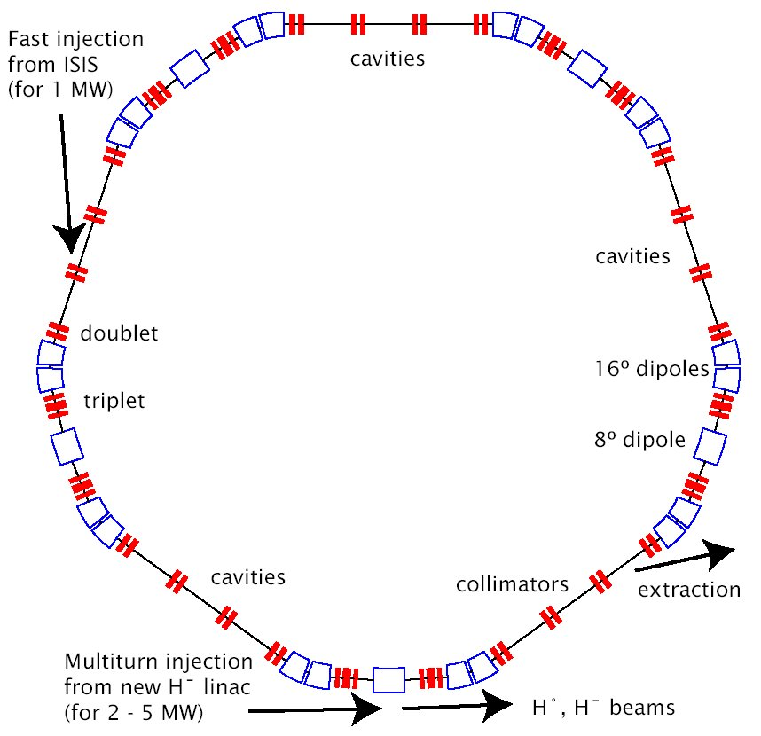
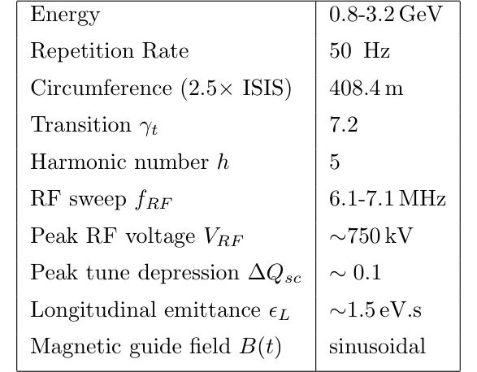
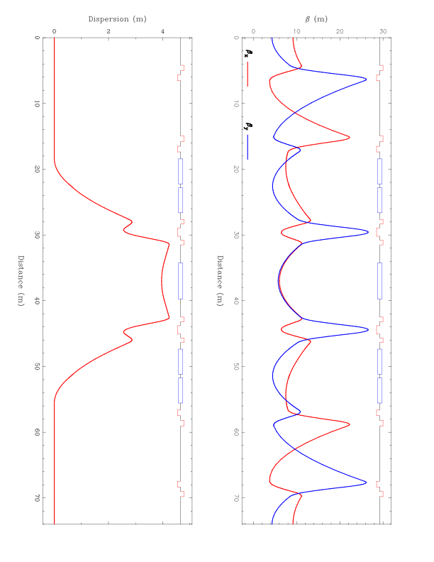
Rapid Cycling Synchrotron Upgrade Ring
C. Prior

Slide 18
800 MeV H⁻ ISIS Upgrade Linac
C. Prior
Based on J-PARC frequency, 324 MHz
Intermediate energy beam transport section to remove longitudinal halo
Superconducting from 75 MeV
RFQ and MEBT chopper based on FETS

Slide 19
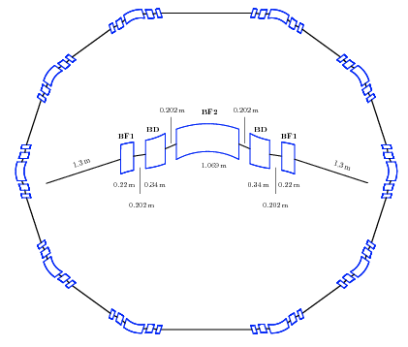
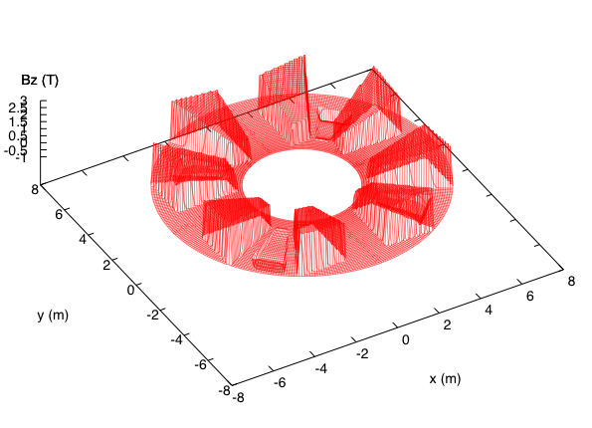
ASTeC: FFAG Projects
C. Prior
Design and commissioning of EMMA (test model for non-scaling FFAG)
Basic designs for PAMELA (medical FFAG-based accelerators at John Adams Institute)
Other designs of FFAGs for muon and proton acceleration
new ideas of “pumplet” structure and vertical orbit excursion FFAG
new ideas for beam transport using FFAG-type magnets
High power accelerators for accelerator-driven sub-critical reactors (ADSR)
Novel Pumplet structure for proton FFAG
Fully isochronous proton FFAG for ADSR
EuroLumi2: optics design
Notes:
EMMA=world’s first non-scaling FFAG, “Electron Model with Many Applications”. Will tell us about FFAG optics, benchmark codes etc before moving on to next stage.
PAMELA= proton/carbon FFAG medical facility, designed from ideas by ASTeC staff at RAL and developed in collaboration with JAI in Oxford
Pumplet=new 5-magnet structure for FFAGs, allows incorporation of straight sections for H- injection, painting, extraction.
High power proton FFAG for ADSR (basic model from Carol Johnstone at Fermilab), under study at RAL; FFAG code needs to be developed for proton optics with heavy space-charge. Isochronous enables cw operation across energy range. (40-350 MeV?)

Slide 20
SuperB
M. Biagini
2-ring, asymmetric energy (e⁻ @ 4.18, e⁺ @ 6.7 GeV) collider with:
large Piwinski angle and “crab waist” (LPA & CW) collision scheme
ultra low emittance lattice
longitudinally polarized electron beam
target luminosity of 10³⁶ cm⁻² s⁻¹
possibility to run at τ/charm threshold with L = 10³⁵ cm⁻² s⁻¹
several design criteria:
minimum construction costs
minimum operating rcosts
minimize wall-plug power and water consumption
maximum reuse of the PEP-II B-Factory (SLAC) hardware
SuperB can also be a good “light source”: there will be some Synchrotron Radiation beamlines, in collaboration with Italian Institute of Technology (IIT)
EuroLumi2: large Piwinski angle, crab waist, polarization, low emittance

Slide 21
SuperB – cont’d
M. Biagini
state-of-the-art technology for emittance and coupling minimization, vibrations and misalignment control, e⁻cloud suppression, IR design, polarised e⁻ beam, etc...
many similarities with the Damping Rings of ILC and CLIC, and with latest generation SL sources, and can profit from the collaboration among these communities → Network is ideal way to exchange experiences and solve problems !
new Conceptual Design Report (Dec. 2010):
http://arxiv.org/abs/1009.6178

Slide 22
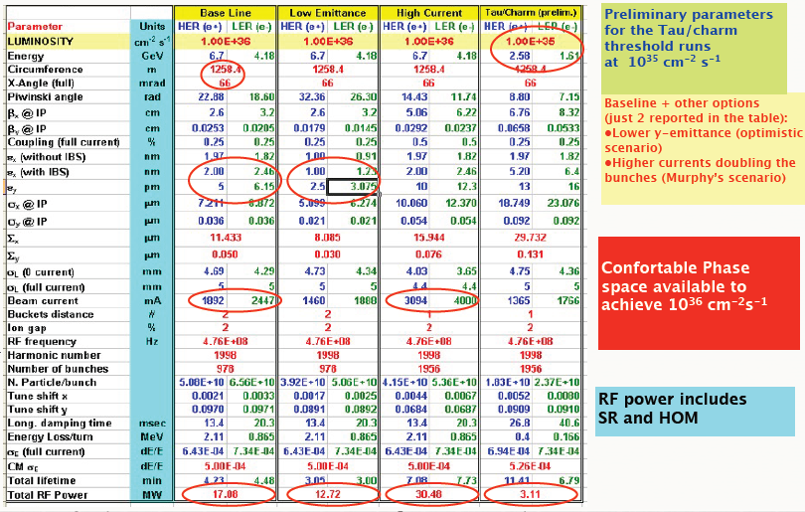
SuperB – cont’d
M. Biagini

Slide 23
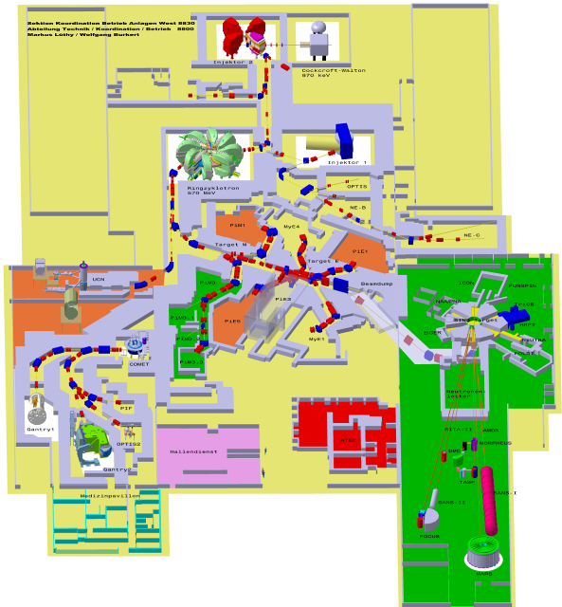
M. Seidel
PSI High Intensity Proton Accelerator
Ring Cyclotron 590 MeV
2.2mA / 1.3MW
SINQ
spallation source
meson production targets
dimensions:
120 x 220m²
proton therapy center [250MeV sc. cyclotron]

Slide 24
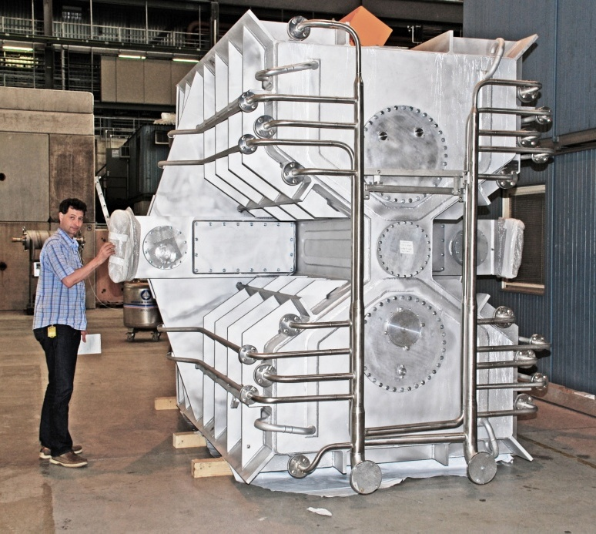
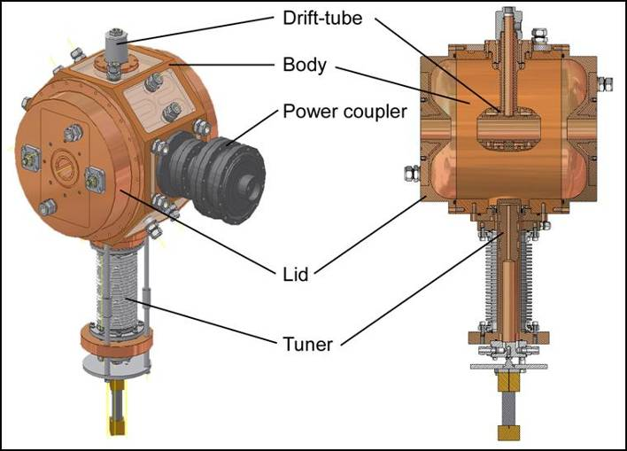
M. Seidel
HIPA Upgrade Program:
raise reliability, and intensity to 1.8MW
new resonators and amplifier chains (Inj.)
reduce longitudinal beam blowup with 10th harmonic buncher
500 MHz buncher
EuroLumi2: beam dynamics with higher harmonic RF system, space charge

Slide 25
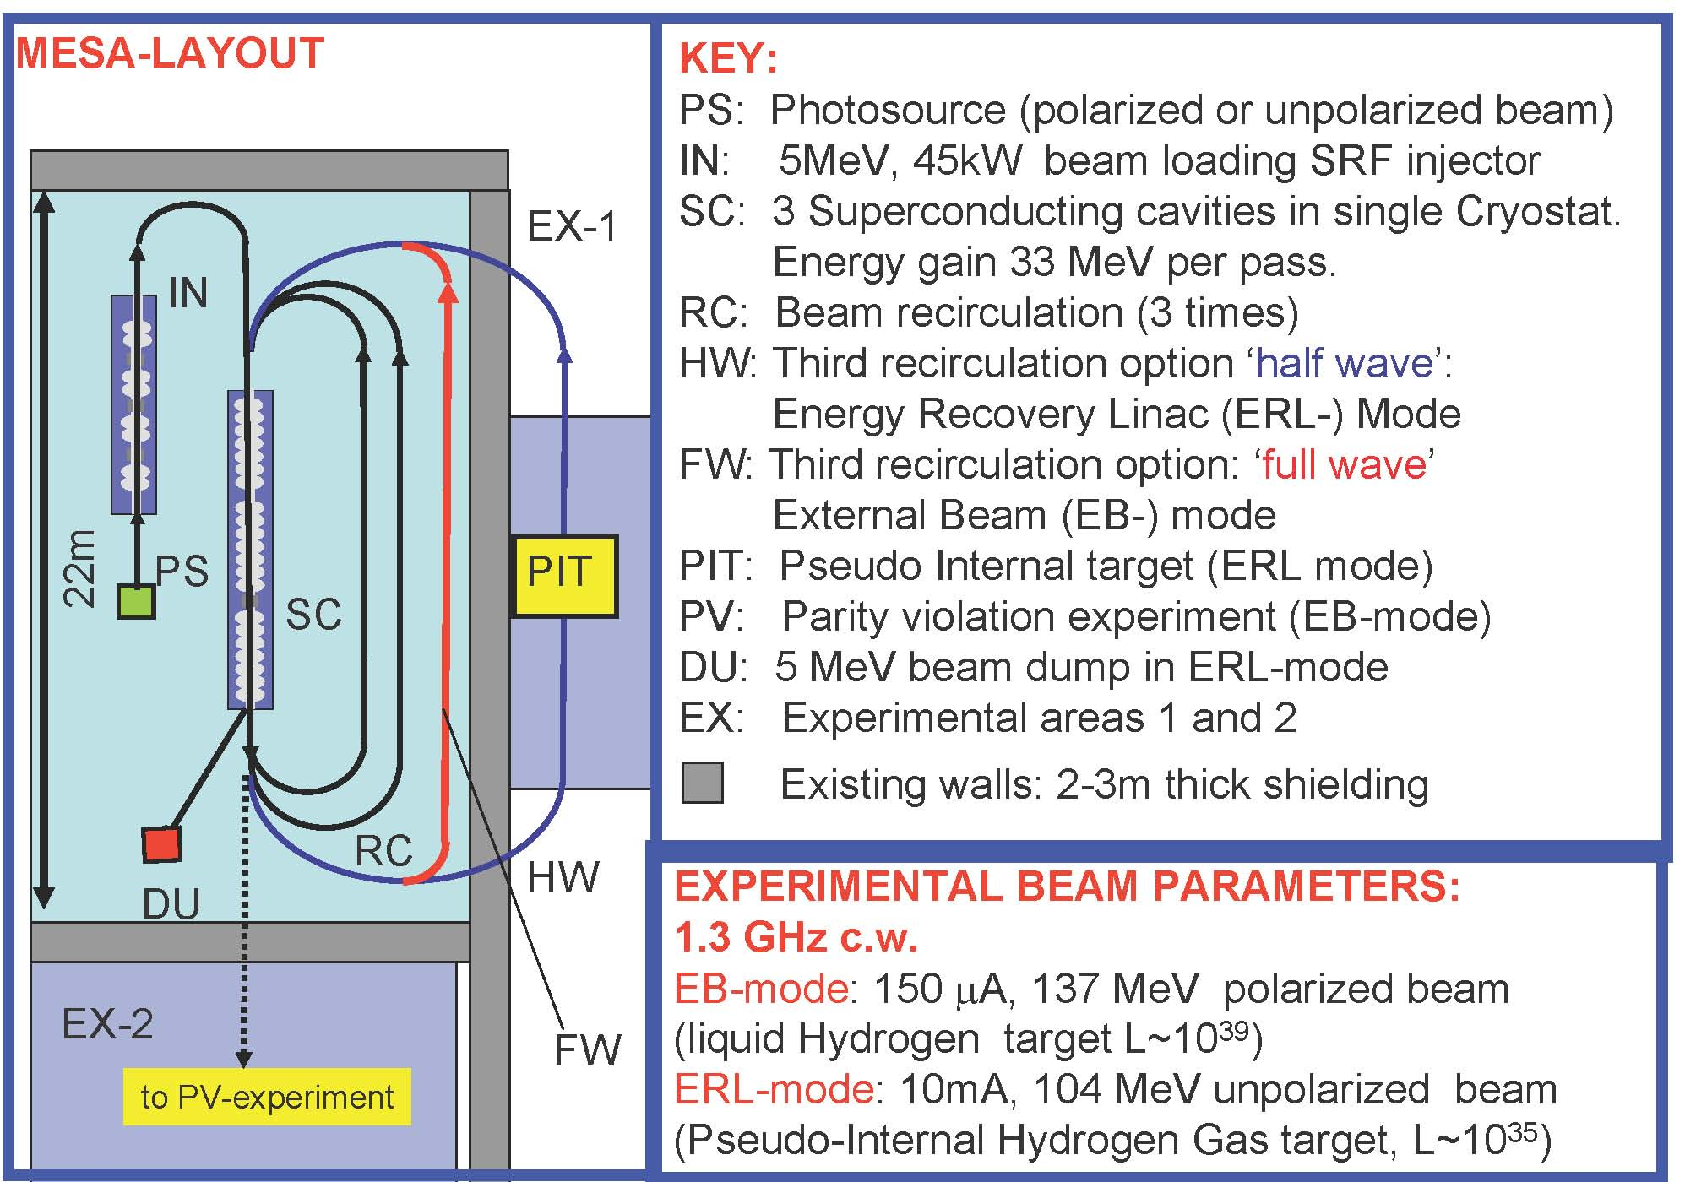
MESA
K. Aulenbacher
EuroLumi2: multi-turn beam dynamics, ion effects, polarization

Slide 26
LHC, HL-LHC, HE-LHC, LHeC – Contacts Oliver Brüning, Ezio Todesco, Frank Zimmermann FAIR - Contacts Peter Spiller, Oliver Boine-Frankenheim SuperB Contact: Marica Biagini MESA (Mainz) Contact: Kurt Aulenbacher PSI HIPA Contact Mike Seidel ISIS upgrade Contact: Chris Prior KIT Contact: Anke Müller U Manchester Contact: Rob Appleby LPSC Grenoble (CNRS &UJF) Contacts: Jean-Marie De Conto, Maud Baylac S-DALINAC Darmstadt Contact: Ralf Eichhorn
growing scope EuroLumi→ EuroLumi2

Slide 27
EuroLumi2
total cost: 400 KEuro?
coordinators: F. Zimmermann? (CERN),
P. Spiller? (GSI), S. Peggs? (ESS)
possible EuroLumi2 work package leaders:
colliders: F. Zimmermann (CERN), M. Zobov (INFN)
intensity: C. Prior (ASTeC), S. Peggs (ESS),
P. Spiller (GSI)
polarization & e+: K. Aulenbacher (Mainz),
F. Zomer (LAL), M. Baylac (LPSC)
all names are ideas/suggestions without
any confirmation

Slide 28
Summary
Proposal for AccNet2:
Network of Networks
comprising EuroLumi2, PWA, low emittance rings, applications, energy efficient systems
Proposal for EuroLumi:
focus on pushing frontiers in luminosity, energy,
beam intensity & power, polarization & e+ production; driven by / driving
LHC, HL-LHC, HE-LHC, LHeC, FAIR, SIS upgrade, ISIS upgrade, HIPA upgrade, SuperB, MESA,…

Slide 29
EuroLumi2 themes:
LHC operation with mixed beam types (p-Pb), [beam-beam with asymmetric beams, BFPP asymmetry, RF synchronisation], application of stochastic cooling for LHC ion programme, long-range beam-beam compensation, crab cavities, e-cloud mitigation, chromatic errors & collimation, large Piwinski angle, crab waist, coherent electron cooling, collimation at higher energy [impact studies for different materials, momentum cleaning & abort gap cleaning with strong SR], vacuum und e-cloud with strong SR, dynamic vacuum, beam break up & ion effects, positron production, IR design, polarization, low emittance, beam dynamics with higher harmonic RF system, space charge, optics design, multi-turn beam dynamics, laser-acceleration of ions (?)…

