Slide 1
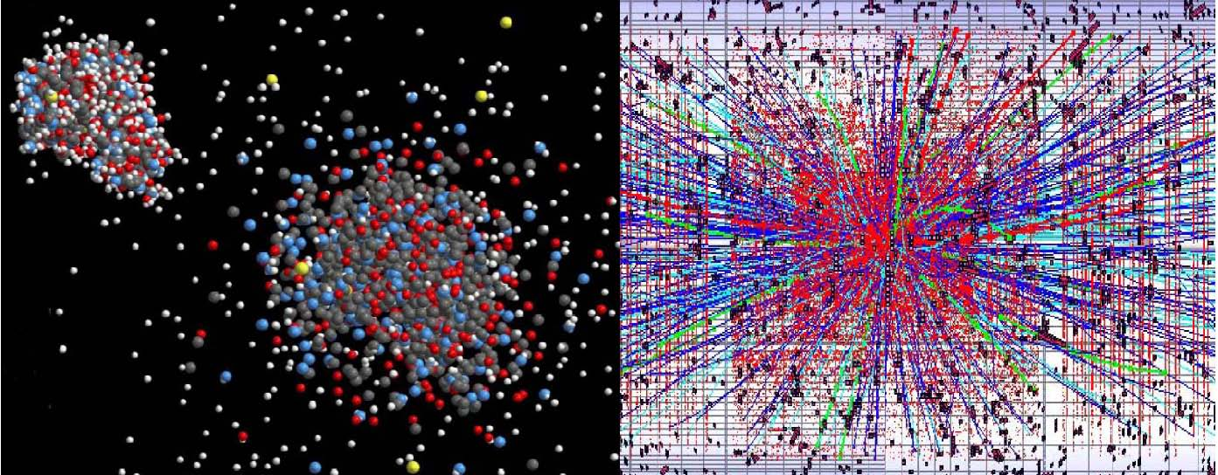
ACC
NET
Frank Zimmermann
for the WP4 coordinators
R. Assmann, J.-M. De Conto, M. Grecki, J. Osterhoff, W. Scandale, P. Spiller, E. Todesco, H. Videau, W. Weingarten, F. Zimmermann
EuCARD 2nd Annual Meeting, CNRS, 11 May 2011

Slide 2

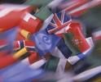

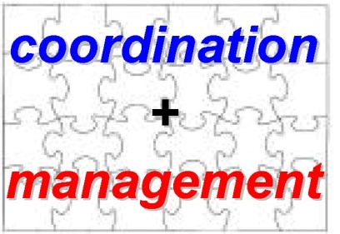
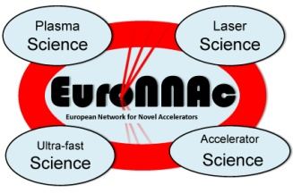

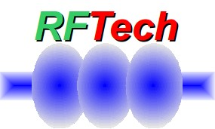
ACCNET
Accelerator Science Networks
Coordination & Management
coordinated by Walter Scandale, IN2P3 ; Peter Spiller, GSI ;
Frank Zimmermann, CERN
EURO-
LUMI
RFTECH
EuroNNAc
sc & nc rf technologies
coordinated by
Jean-Marie de Conto, UJF
Mariusz Grecki, DESY
Wolfgang Weingarten,
CERN
novel accelerators
coordinated by
Ralph Assmann,CERN
Jens Osterhoff, DESY
Henri Videau, CNRS
accelerators & colliders
performance
coordinated by
Frank Zimmermann &
Ezio Todesco, CERN

Slide 3
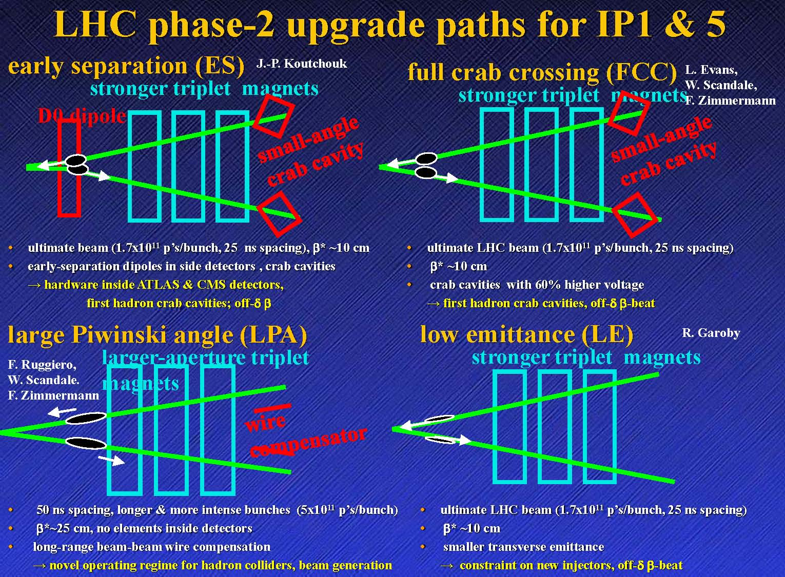
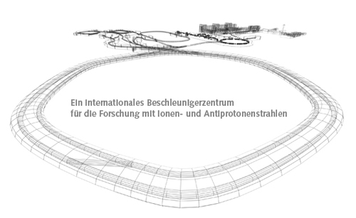
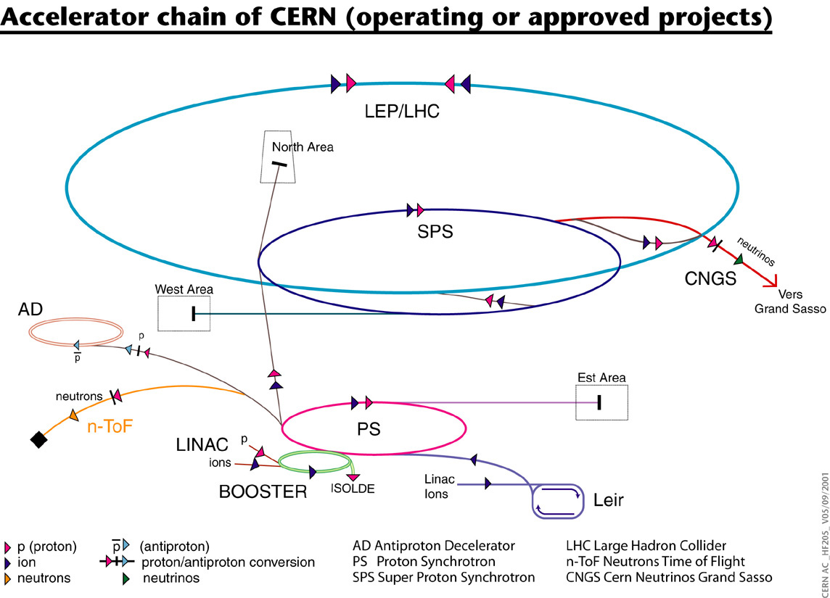
EUROLUMI
brings together experts in beam
dynamics,magnets, collimation & RF
FAIR
LHC IR & beam
parameter upgrade
CERN complex upgrade
+
medical accelerators?
+
initial initiative on
plasma acceleration
LHC injector upgrade

Slide 4
EUROLUMI themes
LHC IR upgrade: IR magnet technology; heat deposition & shielding; magnet lifetime; performance reach; …
LHC beam parameter upgrade: beam generation, beam stability; beam-beam performance & compensation; crab cavities; luminosity leveling; machine protection; collimation upgrade; crab waists; intensity limits …
FAIR: beam losses; space-charge effects; vacuum; aperture; ramping issues; …
CERN complex upgrade: SPS electron-cloud mitigation; impedance effects; intensity limits; beam manipulation; PS booster upgrade ; SPL ; …
LHC energy upgrade: beam dynamics,magnets,…
Applications for society: medical accelerators
Advanced techniques: plasma acceleration, crystal tools

Slide 5
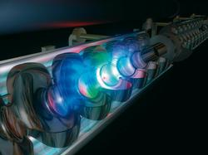
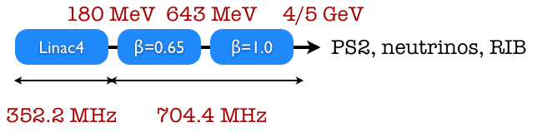
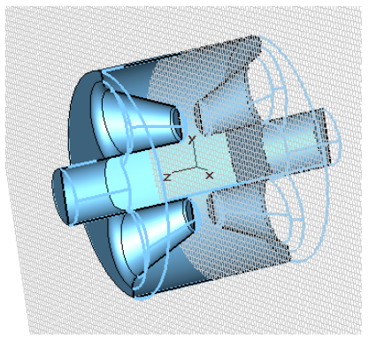
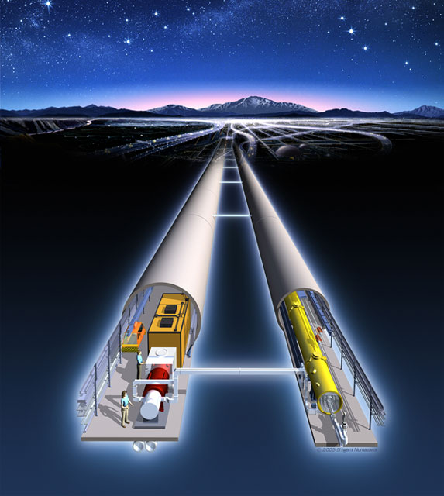
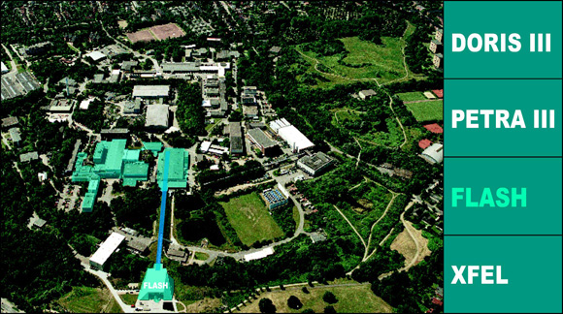
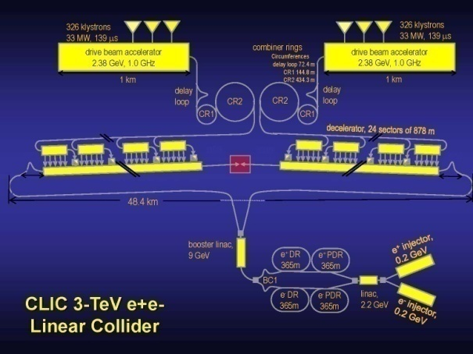
RFTECH
brings together RF experts from different labs, proton & electron accelerators, CLIC and ILC,… ;
encompasses all aspects of RF technology, e.g. klystron development,
RF power distribution system, cavity design, and low-level RF system,
for linear accelerators, storage rings, and associated research infra-
structures, including transversely deflecting (crab) cavities and
financial aspects such as costing tools
SPL
LHC
crab cavity
XFEL
FLASH
ILC
CLIC

Slide 6
RFTECH themes
low level RF: maintain RF phase (0.03 dg) & amplitude (0.03%); minimize power; built-in diagnostics; reliability; operability; reproducibility; maintainability; good understanding; development of LLRF costing tools based on SysML model; …
cavity design: maximize gradient; minimize breakdown; optimize efficiency; minimize cost; minimize impedance; accelerating cavities; coupler design; PETS; compact crab cavities; ….
high power RF: power distribution system; design integration; costing tools; …
SRF test infrastructures: establish multi-purpose state-of-the art network of equipment for R&D and test of SRF cavities and cryo-modules within 2 years; future projects – required equipment – project descriptions

Slide 7
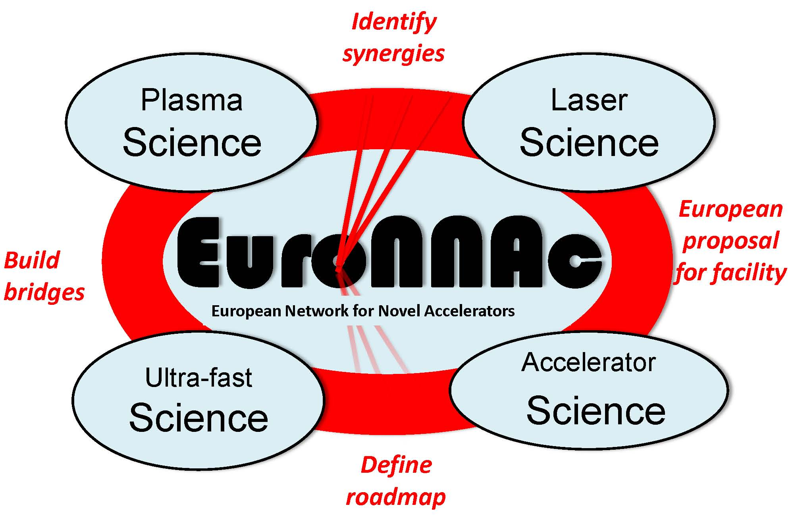
EuroNNAc
The goal of this new European network is to identify possible usage of advanced accelerator techniques in large-scale conventional facilities and to identify a roadmap towards an advanced accelerator facility for big science with applications in applied and fundamental research.
R. Assmann

Slide 8
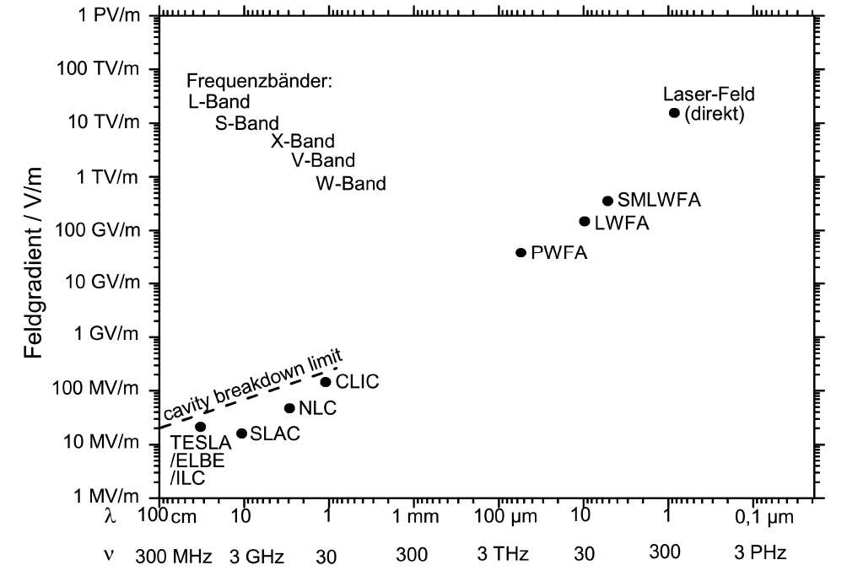
EuroNNAc themes: LWFA, PWFA for e-
no ion or p acceleration!?
Plasma walls cannot be destroyed!
*
Conventional metallic RF structures are fundamentally limited!
R. Assmann
* at present; RFTech co-triggered activity could increase cavity breakdown limits

Slide 9

ACCNET tools
annual workshops
topical meetings and mini-workshops
capability of inviting or exchanging experts over periods of typically a week to a month
exploratory studies & collaborations
opportunities for students
unique place of discussion with users
→ exchange of ideas and expertise aimed identifying the most promising strategies and technologies

Slide 10






ACCNET is a catalyzer!
US
programs
+ US labs
other related
EU initiatives:
DS LHC HiLumi
ILC-PP …
LHC
experi-
ments
ACCNET
ITER
EUROLUMI
RFTECH
EuroNNAc
XFEL
ESS, FAIR
users?
other pan-
European research
ventures
European labs &
Universities
Japanese labs
KEK
J-PARC…
Russian labs

Slide 11
The participation is open inside and outside the consortium. A large number of institutes participate in ACCNET activities.

Slide 12
work organization
several EuroLumi workshops per year
1 major workshop for RFTECH & EuroNNAc per year
possibility of additional topical mini-workshops
possibility of joint EUROLUMI+RFTECH mini-workshops on topics of common interest (either by machine [SPL, LHC+injector RF upgrade, LHC crab cavities, GSI rf systems]; or by topic [RF phase and amplitude jitter, timing stabilization, beam loading compensation, flat bunches, controlled noise injection,…]
1 ACCNET steering meeting / year (ACCNET+EUROLUMI+RFTECH coordinators)

Slide 13
some AccNet 2nd-year achievements
AccNet-RFTech supported WS on Advanced LLRF Control, April 2010
AccNet-RFTech session on xTCA at MIXDES2010 conference, June ‘10
AccNet-EuroLumi workshop on Higher-Energy LHC, HE-LHC, Oct. 2010
(invited) talk at German KET Strategy Workshop
AccNet-EuroLumi workshop on Crystal Collimation, Oct. 2010
AccNet-RFTech 2nd Annual Workshop, December 2010
AccNet workshop on LHC crab cavities, LHC-CC10, December 2010
AccNet web site moved from LAL to CERN server
launch of new network on novel accelerators AccNet-EuroNNAc
several EuCARD Newsletter articles
AccNet-EuroLumi bilateral CERN-GSI workshop on e-cloud, March’11
1st AccNet-EuroNNAc workshop, May 2011
expansion of collaborations with CINVESTAV/Mexico, ESA, ITER,…

Slide 14
AccNet publications
AccNet dissemination
three articles in 7th and 8th EuCARD newsletters (on crystal collimation + novel acceleration techniques & HE-LHC)
one outreach talk at KET Strategy Workshop Germany
presentations at Chamonix’2011 LHC Performance Workshop
EuCARD AccNet documents
about 68 in total, including 16 in 4th semester
- 1 CERN Yellow Report
- 2 journal articles
- 20 conference presentations
- 1 PhD thesis
- 1 master thesis

Slide 15
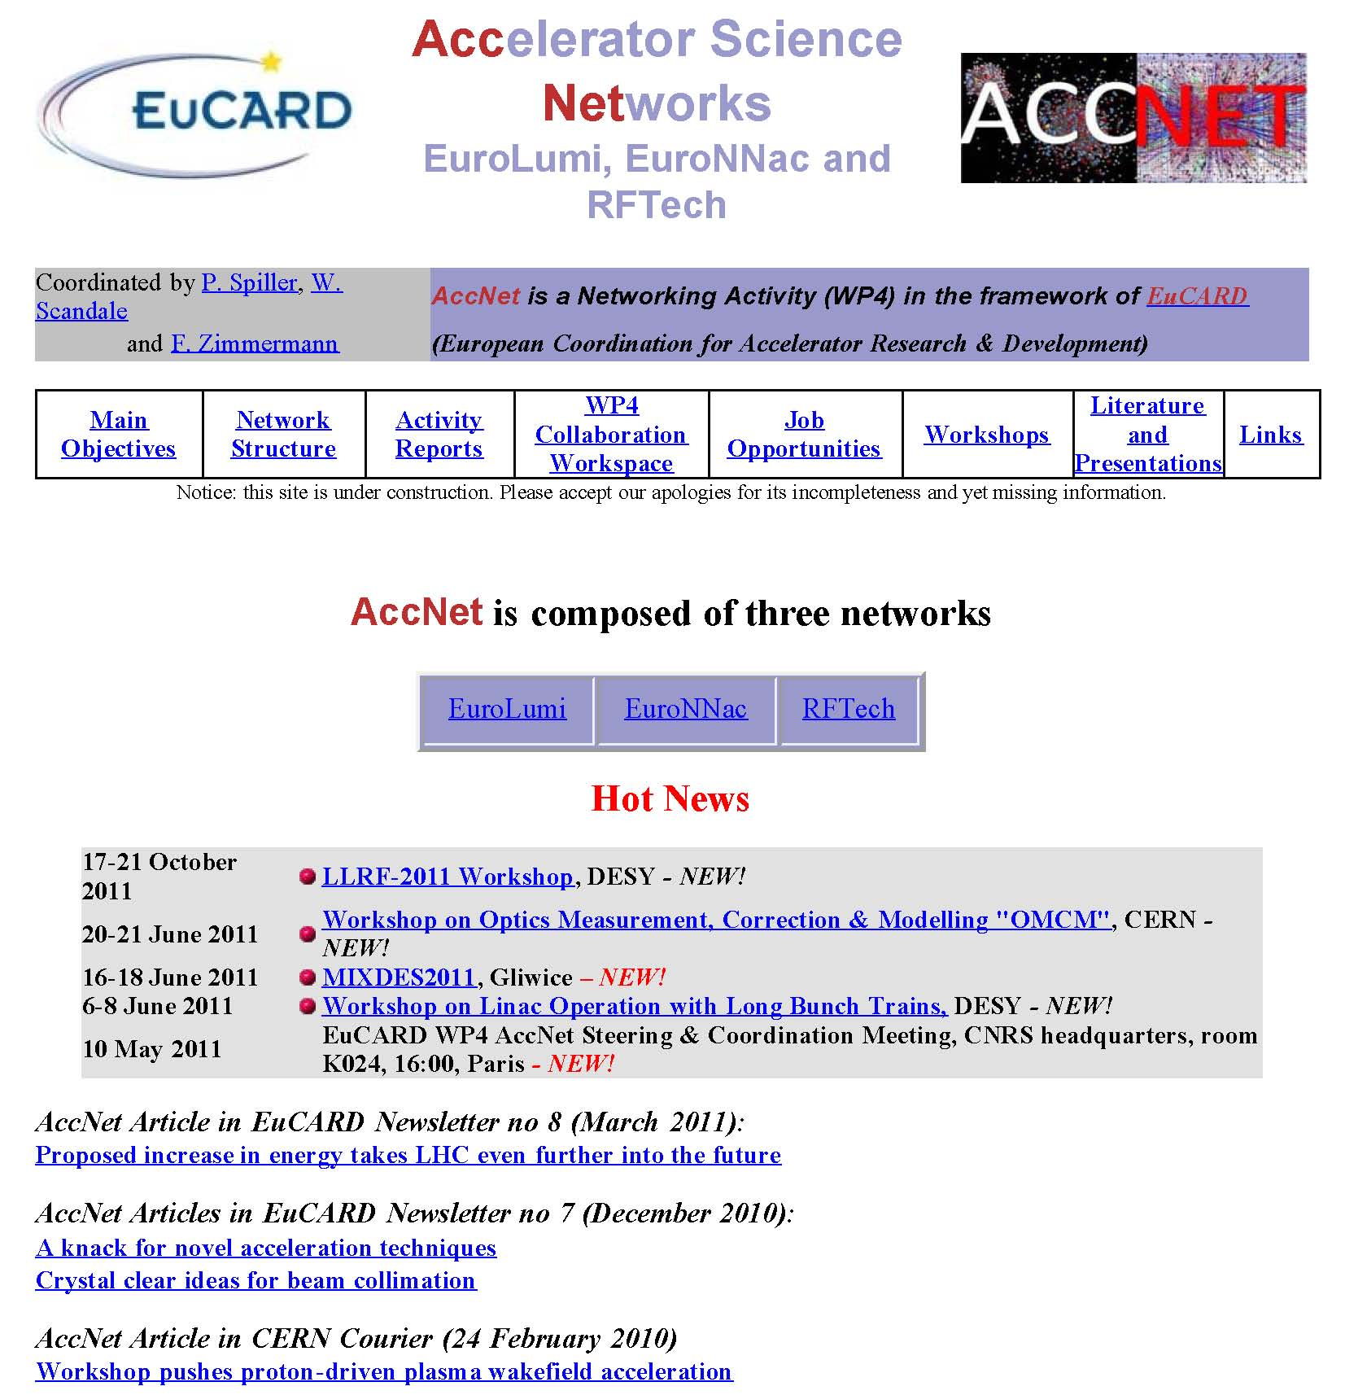
http://cern.ch/accnet/
new address!
AccNet web site
maintained & expanded
by Olivier Dadoun (LAL),
and
Frank Zimmermann (CERN)
early in 2011 (after retirement of Bernard Mouton) all AccNet web sites were transferred from LAL to a CERN server for easier access and maintenance

Slide 16
AccNet EuroLumi institutes & contacts
Institute | Name
BNL | Calaga Rama
 | Drees Angelika
 | Fischer Wolfram
 | Peggs Steve
CERN | Bottura Luca
 | Todesco Ezio
 | Zimmermann Frank
CI | Chattopadhyay Swapan
CNRS-LAL | Mouton Bernard
 | Scandale Walter
 | Variola Alessandro
CNRS-LPSC | Baylac Maud
CSIC - IFIC | Faus Golfe Angeles
DESY | Mais Helmut
FNAL | Bhat Chandra
 | Sen Tanaji
 | Shiltsev Vladimir
 | Valishev Alexander
Institute | Name
GSI | Boine-Frankenheim Oliver
INFN-LNF | Biagini Marica
 | Palumbo Luigi
 | Spataro Bruno
INFN-NA | Vaccaro Vittorio
KEK | Ohmi Kazuhito
LBNL | Furman Miguel
MPP | Caldwell Allen
 | Xia Guoxing
TEMF Darmstadt | Mueller Wolfgang
 | Weiland Thomas
TUBE | Bruns Warner
 | Henke Heino
UJF | De Conto Jean-Marie
UOM | Sammut Nicholas
UPSA | Ekelof Tord
USAN | Petracca Stefania

Slide 17
AccNet RFTech institutes & contacts
Institute | Name
BESSY Berlin | Knobloch Jens
BNL | Ben-Zvi Ilan
 | Calaga Rama
CEA-DSM | Chel Stéphane
 | Daël Antoine
 | Devanz Guillaume
 | Duperrier Romuald
CERN | Angoletta Maria Elena
 | Brunner Olivier
 | Calatroni Sergio
 | Capatina Ofelia
 | Chiaveri Enrico
 | Garoby Roland
 | Hofle Wolfgand
 | Jensen Erk
 | Junginger Tobias
 | Montesinos Eric
 | Ruber Roger
 | Vretenar Maurizio
 | Vullierme Bruno
 | Weingarten Wolfgang
CI | McIntosh Peter
CNRS-IPNO | Bousson Sébastien
 | Gardès Daniel
 | Gassot Hui Min
 | Olry Guillaume
CNRS-LAL | Mouton Bernard
 | Variola Alessandro
Darmstadt University-IKP | Eichhorn Ralf
Institute | Name
WUT | Czuba Krzysztof
DESY | Elsen Eckhard
 | Grecki Mariusz
 | (Proch Dieter)
 | (Simrock Stefan)
ESRF | Jacob Jorn
FZD | Teichert Jochen
Goettingen University | Quadt Arnulf
GSI | Huelsmann Peter
IFJ PAN | Wierba Wojchiech
INFN-LNF | Ghigo Andrea
INFN-Milano | Pagani Carlo
INFN-Roma | Tazzari Sergio
Institute for Nuclear Studies, Swierk | Nietubyc Robert
 | Szcwinski Jaroslaw
 | Wronka Slawomir
Karlsruhe University? | Ustinov Alexey?
LPNHEP (IN2P3 Jussieu) | Augustin Jean-Eudes
 | Debu Pascal
Rostock University | Glock Hans-Walter
 | van Rienen Ursula
Royal Holloway | Molloy Stephen
TEMF Darmstadt | Mueller Wolfgang
 | Weiland Thomas
TUL | Makowski Dariusz
 | Napieralski Andrzej
 | Smage Bogna
UFJ and LPSC | De Conto Jean-Marie
Wuppertal University | Mueller Guenter

Slide 18
AccNet EuroNNAc institutes & contacts
Europe | Name |  |  | Affiliation
EuCARD, CERN | Dr. | Assmann* | Ralph | EuCARD/CERN
 | Dr. | Geschonke | Gunther | CERN
 | Dr. | Koutchouk | Jean-Pierre | EuCARD/CERN
 | Dr. | Zimmermann | Frank | EuCARD/CERN
France | Dr. | Cros | Brigitte | LPGP -CNRS
 | Prof. Dr. | Malka | Viktor | LOA
 | Dr. | Martin | Philippe | CEA
 | Prof. Dr. | Mourou | Gerard | ILE
 | Dr. | Specka | Arnd | Ecole polytechnique
 | Dr. | Videau* | Henri | Ecole polytechnique
Germany | Prof. Dr. | Caldwell | Allen | MPI-P Muenchen
 | Dr. | Floettmann | Klaus | DESY
 | Prof. Dr. | Gruener | Florian | LMU Muenchen/MPQ
 | Dr. | Osterhoff* | Jens | University Hamburg, DESY
 | Prof. Dr. | Sauerbrey | Roland | FZD Rossendorf
Italy | Dr. | Ferrario | Massimo | LNF
 | Dr. | Ghigo | Andrea | INFN Frascati
 | Prof. Dr. | Guiletti | Danilo | INFN Frascati
 | Dr. | Serafini | Luca | INFN Frascati
Portugal | Prof. Dr. | Mendonca | Jose Tito | Instituto Superior Tecnico
Russia | Dr. | Kostyukov | Igor | Institute of Applied Physics
Sweden | Prof. Dr. | Wahlstroem | Claes-Goran | Lund University
Switzerland | Prof. Dr. | Rivkin | Leonid | EPFL, PSI
United Kingdom | Prof. Dr. | Jaroszynski | Dino | University of Strathclyde
 | Dr. | Najmudin | Zulfikar | Imperial College
 | Prof. Dr. | Neely | David | Rutherford Appleton Lab
 | Prof. Dr. | Seryi | Andrei | John Adams Institute
*Coordinators
Status 11.1.2011
Non-Europe | Name |  |  | Affiliation
China | Prof. Dr. | Sheng | Zhengming | Institute of Physics, CAS
India | Dr. | Naik | Prasad | RRCAT
Japan | Prof. Dr. | Yokoya | Kaoru | KEK
United States | Prof. Dr. | Chou | Weiren | ICFA/Fermilab
 | Prof. Dr. | Joshi | Chan | University of California
 | Prof. Dr. | Katsouleas | Thomas | Duke University
 | Dr. | Leemans | Wim | LBNL
 | Prof. Dr. | Muggli | Patric | USC
 | Prof. Dr. | Raubenheimer | Tor | SLAC
 | Prof. Dr. | Tajima | Toshiki | ICUIL/LMU

Slide 19
EuroLumi exchanges & joint studies
Mexican PhD student Humberto Maury (CINVESTAV)
- e-cloud simulations for LHC & HL-LHC
Mexican master student Bruce Yee (CINVESTAV)
- simulations of LHC crab-cavity failure scenarios
Spanish expert Ubaldo Iriso (CELLS/ALBA)
- simulations of LHC e-cloud build up
Italo-german expert Giuliano Franchetti (GSI)
- incoherent e-cloud effects & resonance trapping
US-LARP physicist Chandra Bhat (FNAL)
- generation & stability of long flat bunches for LHC
LARP physicist Rama Calaga (BNL), LARP physicist Uli Wienands (SLAC)
- LHC crab cavities - lessons from SSC and VLHC for HE-LHC
Japanese expert Kazuhito Ohmi (KEK)
- beam-beam & e-cloud simulation studies for LHC, HE-LHC & HL-LHC
Italian expert Roberto Cimino (INFN-LNF)
- e-cloud surface physics & mitigation
Russian and European experts S. Dabagov (INFN-LNF) – crystal collimation
→ WP4 highlight talk by Giuliano Franchetti

Slide 20
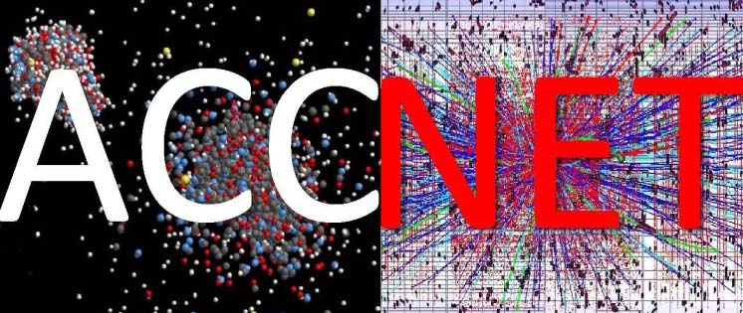
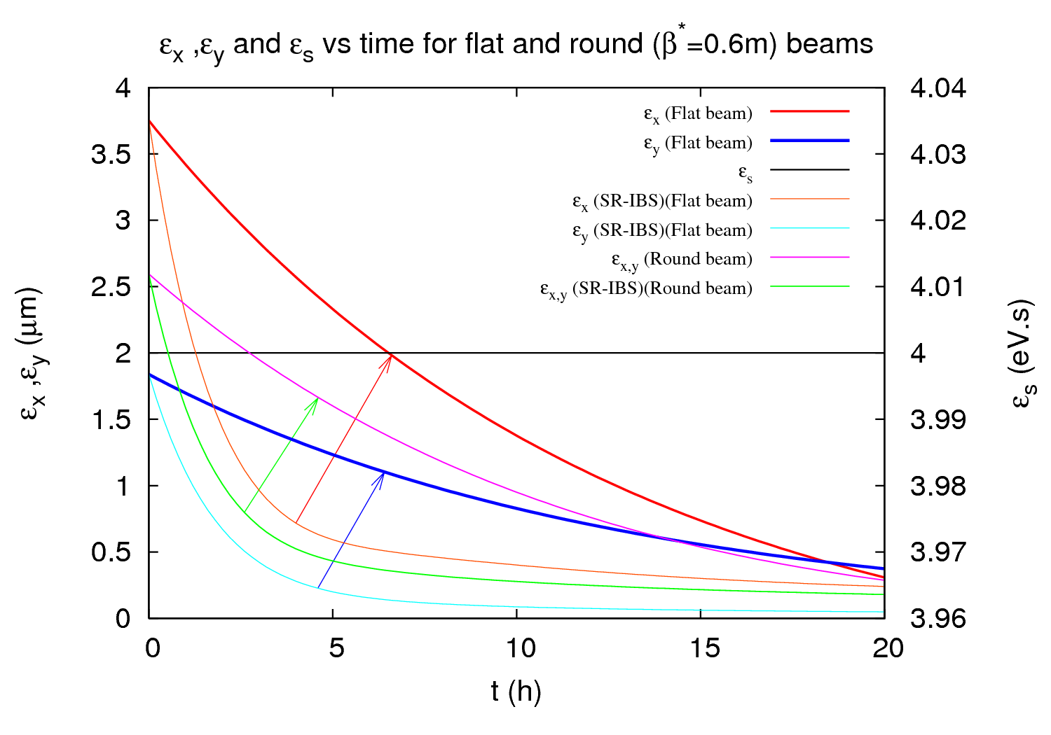
Higher-Energy LHC workshop
http://indico.cern.ch/conferenceDisplay.py?confId=62873
Malta, 14-16 October 2010; 56 participants (13 US, 26 CERN); 1st workshop on 33-TeV pp collider in LHC tunnel
proceedings : E. Todesco and F. Zimmermann (eds), The Higher-Energy Large Hadron Collider, Proceedings of the EuCARD-AccNet HE-LHC workshop, Malta, 14-16 October 2010, CERN, EuCARD-CON-2011-001; published as CERN Yellow Report
key topics
beam energy 16.5 TeV; 20-T magnets; cryogenics: synchrotron-radiation heat load; radiation damping & emittance control; vacuum system: synchrotron radiation
new injector: energy > 1 TeV; parameters
→ WP4 highlight talk by Ezio Todesco
 | LHC | HE-LHC
beam energy [TeV] | 7 | 16.5
dipole field [T] | 8.33 | 20
dipole coil aperture [mm] | 56 | 40
#bunches | 2808 | 1404
IP beta function [m] | 0.55 | 1 (x), 0.43 (y)
number of IPs | 3 | 2
beam current [A] | 0.584 | 0.328
SR power per ring [kW] | 3.6 | 65.7
arc SR heat load dW/ds [W/m/ap] | 0.21 | 2.8
peak luminosity [10³⁴ cm⁻²s⁻¹] | 1.0 | 2.0
events per crossing | 19 | 76

Slide 21
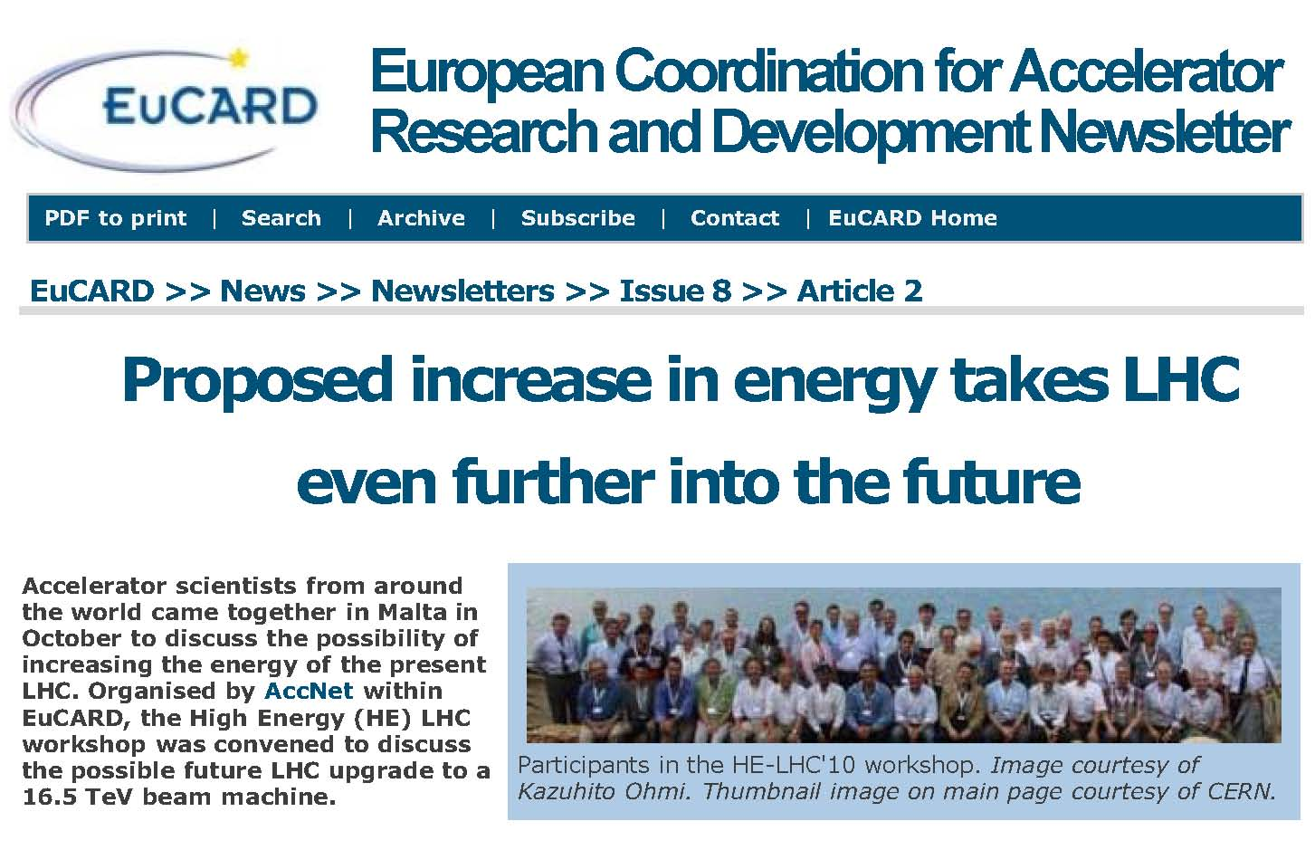
EuCARD Newsletter article

Slide 22
AccNet mini-workshop on
crystal collimation
CERN, 25-27 October’10, ~32 participants, about 1/3from CERN, and others from Italy (INFN Ferrara, Legnaro, Napoli, Roma), Russia (JINR Dubna, IHEP Moscow, St. Petersburg), Germany (GSI Darmstadt), UK (Imperial College), USA (SLAC), and Switzerland (EPFL Lausanne).
http://indico.cern.ch/conferenceDisplay.py?confId=109124
topics:
collimation procedures assisted by bent crystals for HL- LHC and future large colliders
critical review of results from H8 line,
results of collimation experiments in “low energy” storage rings, such as the SPS,
possible use of bent crystals for LHC collimation
other applications of crystals and alternative advanced methods of collimation in other laboratories

Slide 23
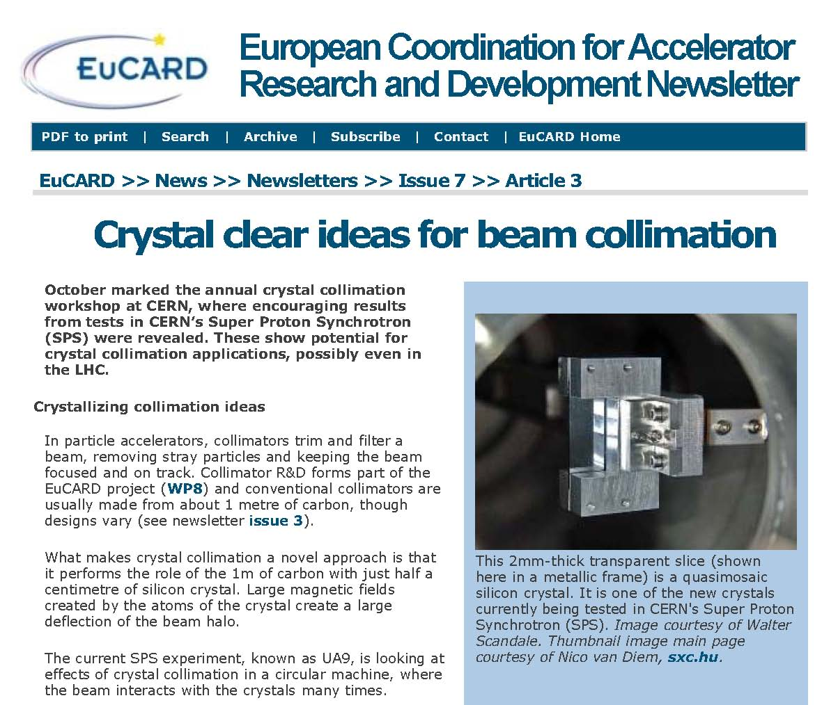
EuCARD Newsletter article

Slide 24

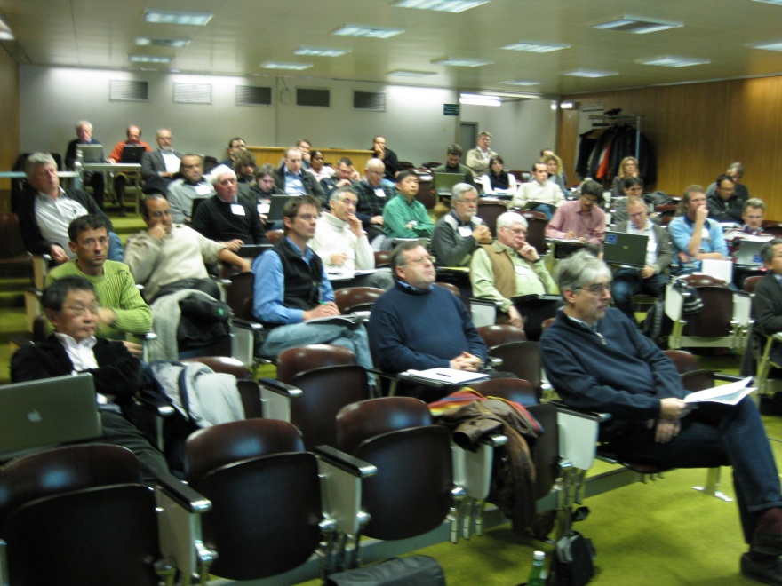
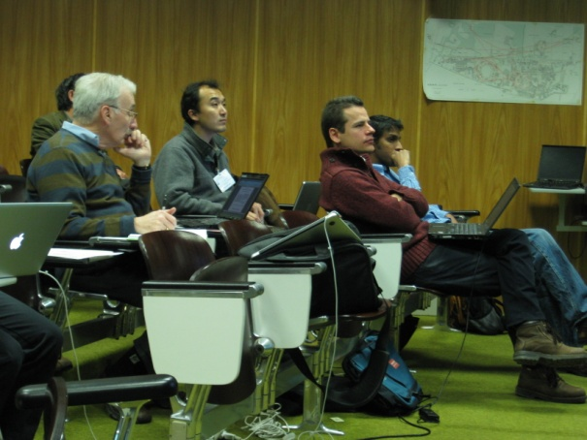
LHC-CC10 workshop
LHC Crab Cavity Workshop, jointly organized by CERN, EuCARD-ACCNET, US-LARP, KEK, & Daresbury Lab/Cockcroft Institute, CERN, 15-17 December 2010
http://indico.cern.ch/conferenceDisplay.py?confId=100672
~50 participants
local crab crossing with compact 400 MHz deflecting SRF cavities has become HL-LHC baseline scheme for geometric luminosity-loss compensation and luminosity leveling
further studies on machine protection and beam-dynamics or technology limits
recommendation to test future LHC prototype cavities with & without beam out- &inside LHC
refined roadmap by summer 2011
workshop summary: R. Calaga (BNL), S. Myers (CERN), F. Zimmermann (CERN), Summary of the 4th LHC Crab Cavity Workshop "LHC-CC10", EuCARD-REP-2011-001 (2011)

Slide 25
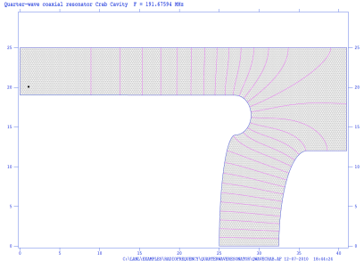
LHC Crab Cavities – for High Luminosity-LHC
endorsed after LHC-CC09 workshop, September 2009
progress at LHC-CC10 workshop, December 2010
key points from LHC-CC10
local scheme with compact crab cavities at 400 MHz;
no SPS test with KEKB crab cavity;
several compact cavity candidates to be prototyped;
machine protection issues need detailed investigation;
SPS & LHC beam test program with consistent time line;
4-5 promising compact cavity designs
R. Calaga,
P. Collier,
S. Myers,
R. Tomas,
F. Zimmermann, et al, et al
Parallel bar elliptical TEM cavity (JLAB)
Half wave spoke resonator (SLAC)
Four rod compact crab cavity (Cockcroft)
Rotated pill-box cavity (KEK)
Quarter-wave resonator (BNL)

Slide 26
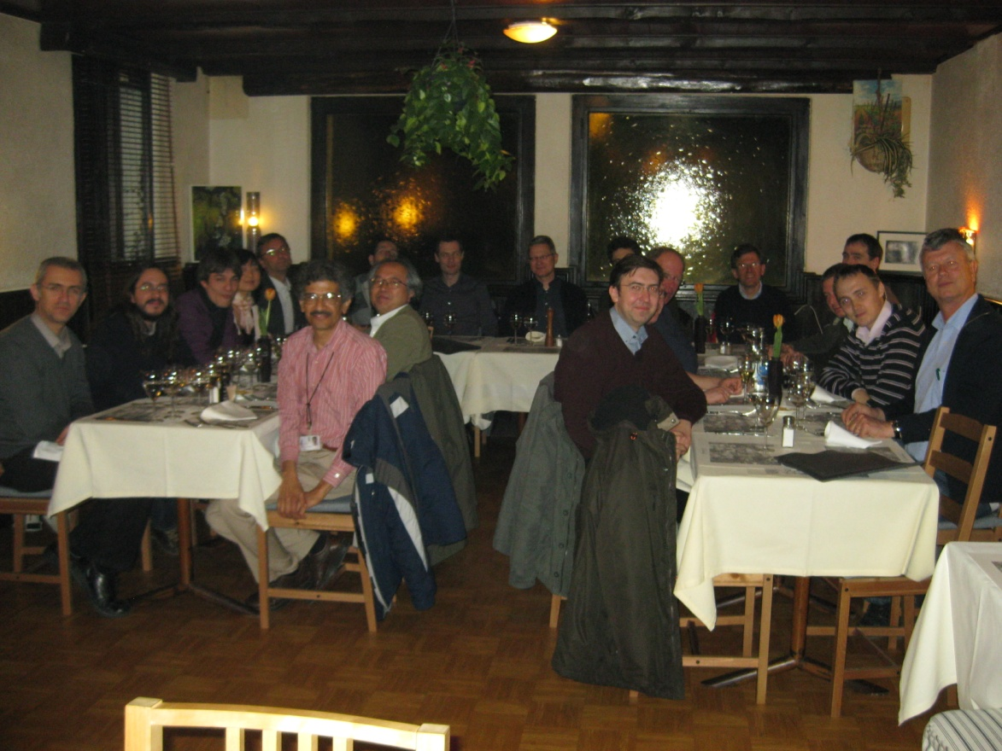
AccNet bilateral CERN-GSI workshop on electron cloud
CERN, 7-8 March ’11, 30 participants, from CERN, GSI, INFN-LNF, KEK, CELLS, CINVESTAV, and several other institutes.
Goals:
review the status of CERN and GSI electron-cloud studies
find synergies between the two laboratories
define a common strategy for future developments in terms of simulation tools, diagnostics and mitigation techniques for the LHC, SPS and FAIR
http://indico.cern.ch/conferenceDisplay.py?confId=125315
workshop summary: G. Rumolo, F. Zimmermann, O. Boine-Frankenheim, Summary of EuCARD-AccNet CERN-GSI Workshop on Electron Cloud, CERN, 7-8 March 2011

Slide 27
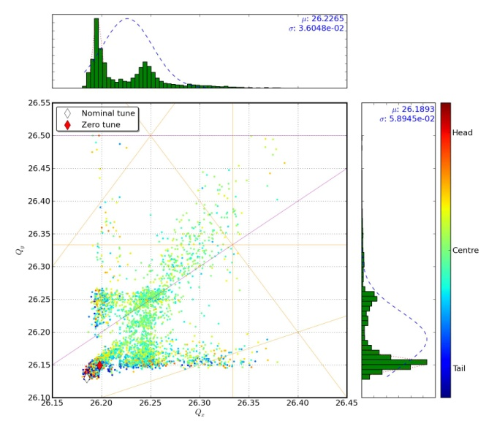
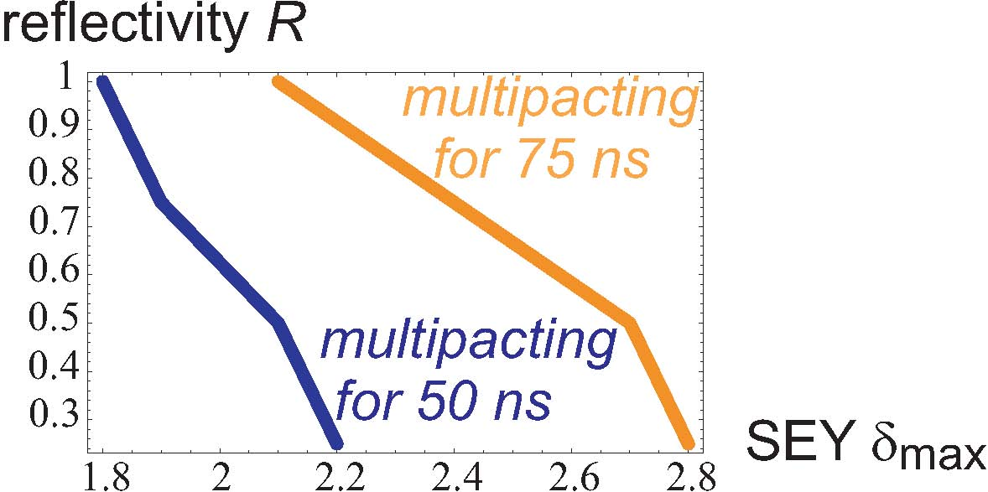
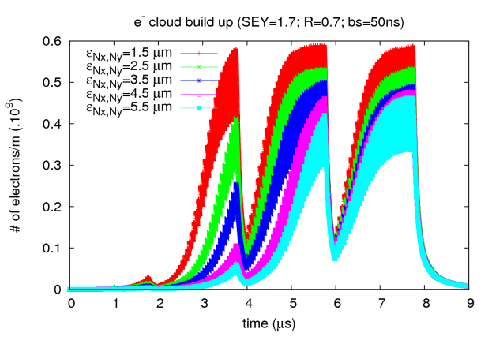
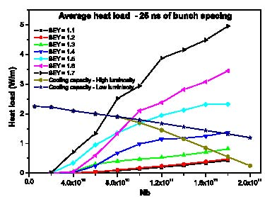
AccNet progress on LHC e-cloud studies
objectives:
surface properties from benchmarking simulations with observations;
scrubbing and running scenario for 2011; longer-term operation modes & upgrade path ; beam stability & emittance growth
O. Dominguez, G. Franchetti, U. Iriso, K. Li, H. Maury, G. Rumolo, F. Zimmermann
multipacting threshold in the LHC arcs
tune footprint with
electron cloud
K. Li
H. Maury
effect of emittance
on e⁻ build up
e-cloud arc heat load for 25-ns spacing,
vs. bunch intensity
O. Dominguez
H. Maury

Slide 28
RFTech activities
Workshop on "Advanced Techniques in LLRF control for XFEL", Cracow, PAS, 18-20 April 2010
RFTech organized with ITER, “xTCA” session of MIXDES2010, Wroclaw, 24-26 June 2010; devoted to development of HEP instrumentation, with high reliability, availability and serviceability; several standards (MTCA, ATCA or AMC) profiting from high-speed serial interfaces; objective: simplify the application of MTCA and ATCA hardware in HEP; RFTech supported 7 diploma and doctoral students
participation in workshop on X-Band RF technology, XB-10, on X-band RF structures, beam dynamics & sources, at CI (UK), 30.11-3.12. 2010
2nd RFTech Annual Meeting 2-3 December, PSI
joint organization of LHC-CC10 together with EuroLumi
R&D for SPL (high-power Superconducting Proton Linac), RFTech established contacts to European and worldwide experts on SRF, & created international working group on SRF cavities and accessories (members: CERN, CNRS-IPN-Orsay, CEA-Saclay (France), BNL (USA), TRIUMF (Canada), and the Universities of Rostock, Darmstadt (Germany), and Royal Holloway London (UK)), which participated in several SPL collaboration meetings
developing strategy for SRF test infrastructures in Europe;
recommendation to push new materials & approaches: Nb film, high-Tc SC,…

Slide 29
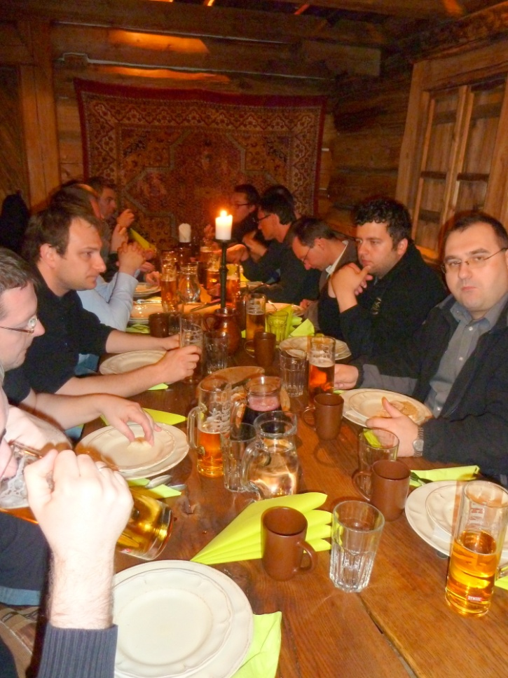
Advanced Techniques in LLRF for XFEL Workshop, Cracow 18-20.04.2011
36 participants from Poland, Germany & US, 35 talks including 2 invited talks
topics:
  towards CW operation of XFEL,
  summary of 9 mA test at FLASH,
  developement of uTCA based LLRF system (several talks)
  RF synchronization system for XFEL (several talks)
  LLRF software developement for XFEL
  quality management

Slide 30
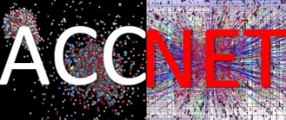
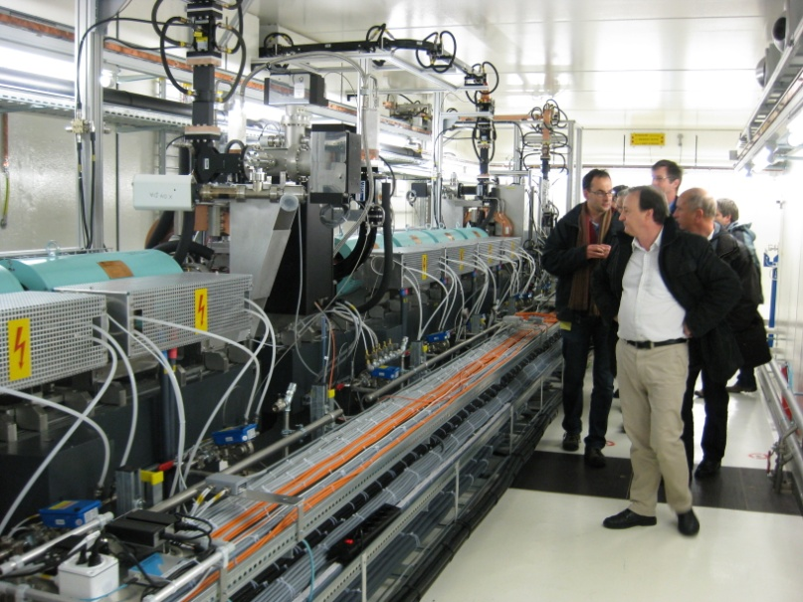
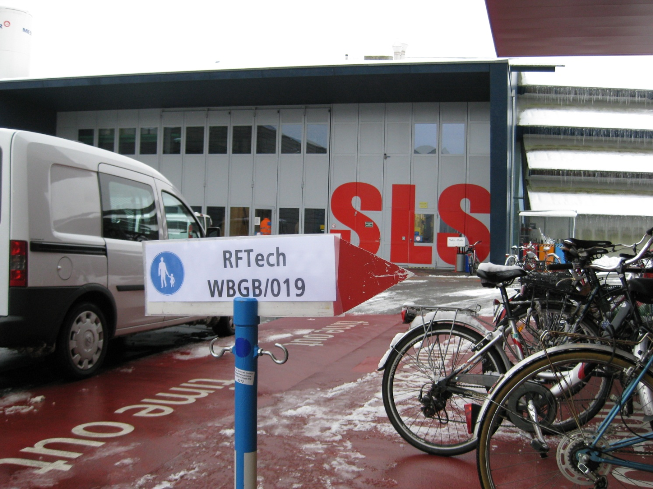
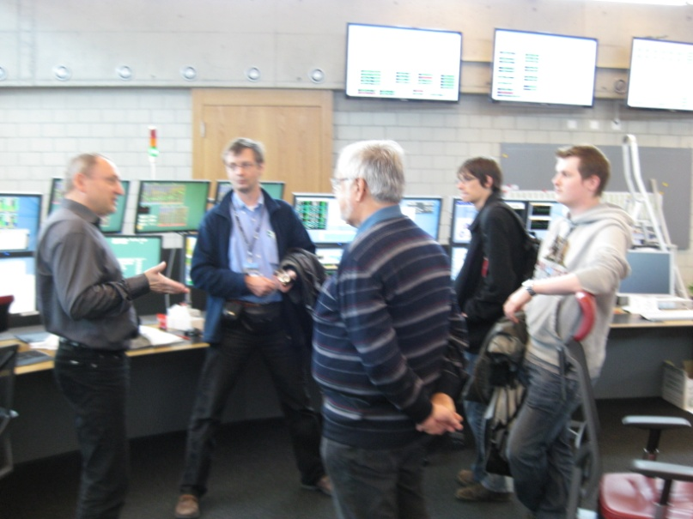
Second Annual RFTech Meeting
PSI, 2-3 December ‘10

Slide 31
Second Annual RFTech Meeting
PSI, 2-3 December ‘10
https://indico.desy.de/conferenceDisplay.py?confId=2831
30 participants, ~2x 1st meeting! (BNL, DESY, CERN, CNRS, CEA, ESRF, IPJS, LU, LPSC, PSI, RHUL, SBT, SOLEIL, UJF, TUD, TUL, WU, …) organized by T.Garvey, M.Grecki, J.-M.DeConto, W.Weingarten & PSI ; sharing experience among several fields of RF technology!
Low Level RF: CERN's PS complex LLRF renovation, SuperB project, FLASH system, as well as use of specific components like uTCA for XFEL machines
Solid State Amplifiers, both in general and particular techniques as well as some specific developments, like at PSI, ESRF and SOLEIL
RF technology for FELs: normal- and superconducting RF aspects (X Band structures, the Swiss FEL project, cryomodule technology) , summary of XFEL RF synchronization workshop
RF limitations related to LHC ultimate beam
Cavity optimization: crab-cavity design for the LHC, HOM free copper cavities
Superconducting RF, e.g. cryomodule assembly in Saclay, SRF infrastructures in Saclay/Orsay, SBT in Grenoble, with analysis and round-table discussion on the need of a European SRF test infrastructure for R&D and test of cavities & cryomodules. Presenting work of young scientists, about cavity design & modelling

Slide 32
EuroNNAc activities
regular phone meetings
PDPWA workshop organized at University College London, 10-11 February 2011
visit of Guoxing Xia (MPI) to CERN in March 2011
preparation of LOI for PDPWA experiment using SPS beam to be submitted to CERN SPSC Committee later in 2011
preparatory meeting of the EuroNNAc organisation committee at Paris Ecole Polytechnique on 8 April 2011
first major EuroNNAc workshop 3-6 May at CERN, firmly established new network and defined path towards novel accelerator facilities in Europe; about 100 expert participants
→ highlight talk by Ralph Assmann

Slide 33
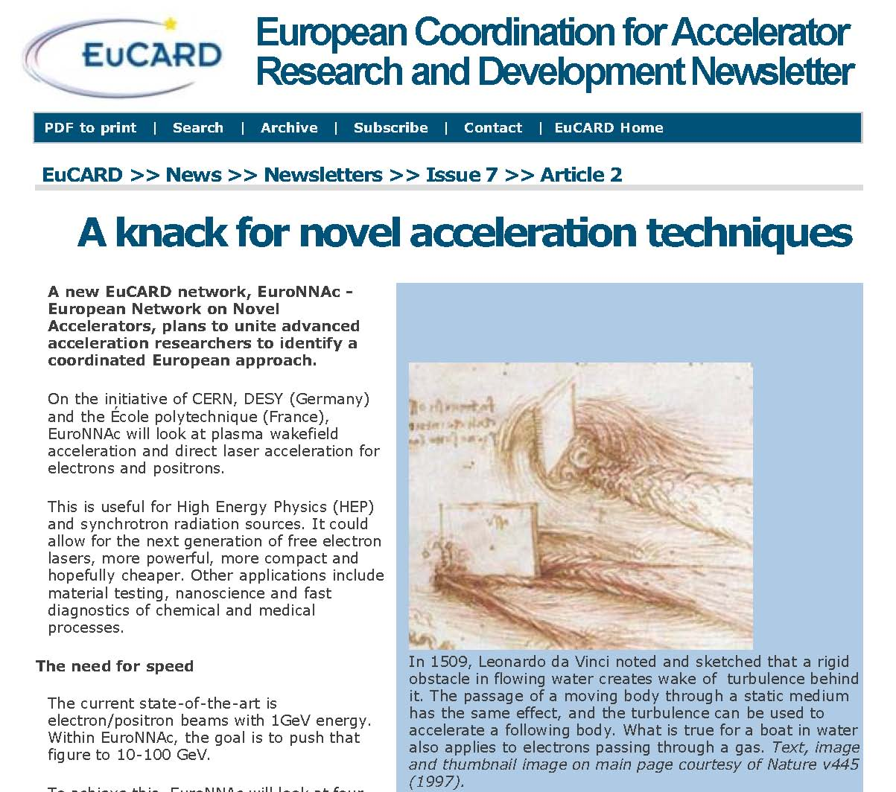
EuCARD Newsletter article

Slide 34
RFTech exchanges & joint studies
participation in XB-10
HP-SPL R&D
strategy on SRF infrastructures & cryomodule
organizing & co-sponsoring several workshops / year
EuroNNAc exchanges & joint studies
German PhD student Steffen Hillenbrand (KIT) -proton-driven plasma acceleration
German experts Allen Caldwell, Guoxing Xia (MPI Munich)
- proton-driven plasma acceleration
Participation in German KET Strategy meeting, Dortmund 2010

Slide 35
EuCARD-AccNet highlights
so far 13 primary AccNet workshops, 68 AccNet documents, numerous exchanges of scientists
significant impact:
crab cavities established as HL-LHC baseline,
pushing HL-LHC large-Piwinski-angle scheme
Higher-Energy LHC – 1st ever workshop!
joint e-cloud effort CERN-GSI-CELLS-KEK-TUD, anti-e coatings
roadmap for SRF test facilities
advancing crystal collimation
community organizer for RF technologies (RFTech)
community organizer for novel acceleration scheme (EuroNNAc)
addt’l financial support from CINVESTAV Mexico, inspired by initial EuCARD investment, for three visitors to continue AccNet activities, such as electron-cloud studies and LHC crab-cavity failure modes

Slide 36
AccNet plans for next 6-12 months
future AccNet workshops
mini-workshop on optics measurements, corrections and modelling for high-performance storage rings 20-22 June 2011
3rd annual RFTech workshop
RFTech co-sponsored MIXDES2011 conference, Gliwice, June 2011
co-organization of “long bunch-trains” workshop at DESY , June ’11
acceleration session at ESA workshop MULCOPIM’2011, Sept.’11
RFTech co-sponsored workshop on LLRF at DESY in October 2011
“EuroLumi 2011” (tentative) November or December 2011
LHC limitations, LHC luminosity upgrade, LHC energy upgrade,
SPS limitations, FAIR challenges
mini workshop on LHC crab cavities, end of 2011 or early 2012
2nd plasma acceleration workshop in 2012
Crystal collimation mini-workshop, fall 2011
brainstorming meeting(s) on medical accelerators

Slide 37
AccNet plans for next 6-12 months – cont’d
  further development of LHC upgrade scenarios
  HL-LHC beam parameters (e.g. Piwinski angle scheme;
    experiments at PS, SPS, LHC; simulations)
  e-cloud benchmarking & mitigation (e.g. scrubbing scheme,
    coating, clearing electrodes)
  injector upgrade path (e.g. SPS limitations)
  energy upgrade (flat beam, crab waist, SR issues)
  intensity & luminosity limitations

Slide 38
AccNet highlights talks
at EuCARD 2011
Higher-Energy LHC
Ezio Todesco (CERN & EuCARD)
multiple resonance crossing with space charge and electron cloud
Giuliano Franchetti (GSI)
the new laser and plasma acceleration network
Ralph Assmann (CERN & EuCARD)

Slide 39
AccNet success indicators
excellent attendance to AccNet workshops
from many European labs, universities, US laboratories, Japan, international organizations
attendance of 2nd RFTech meeting doubled!
impact:
- on most relevant topics
- higher-energy LHC
- established crab-cavity scheme for LHC
- novel anti e-cloud coating techniques
high cost efficiency
- return on investment! (CINVESTAV)

Slide 40
AccNet conclusions
AccNet had an excellent 2nd year
EuroLumi gives input to LHC upgrades
compact crab-cavity baseline, “LPA” scenario
e-cloud mitigation, modeling & predictions
revisions of LHC upgrade plans
higher-energy LHC
link to DS LHC HiLumi, US-LARP, KEK, etc.
RFTech assumed cruising speed
input to XFEL, LHC, GANIL etc. RF systems
AccNet is breaking new grounds
plasma acceleration, crystal collimation
Rich workshop programme in 2010-11

Slide 41

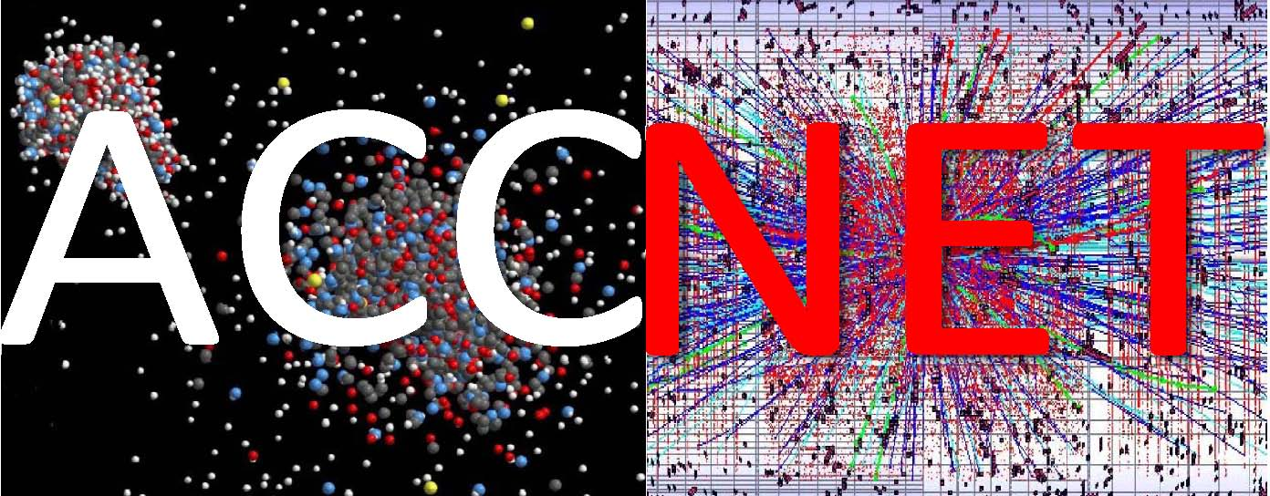

pushes frontiers
for accelerators in Europe
and around the world

Slide 42
Appendix
AccNet expenses & deliverables

Slide 43
AccNet deliverables
D.4.1.1 –Continually updated AccNet web site http://cern.ch/accnet/ )
D.4.2.1 – A continually updated EuroLumi web site (http://cern.ch/accnet/Tasks/Eurolumi/ )
D.4.3.1 – A continually updated RFTech web site (http://cernc.ch/accnet/Tasks/Rftech/ )
D4.3.2 – Strategy/result for SRF test infrastructures: a final strategy report is in preparation, at the moment comprising 30 pages. Final checks with other institutes are planned during the EuCARD Annual Meeting 10-13 May 2011.
The AccNet web sites are documented in a report https://edms.cern.ch/file/1001866/4/EuCARD-Del-D4.1.1-D4.2.1-D4.3.1-1001866-v3.0.pdf
The completed deliverables are available from the link http://cern.ch/EuCARD/about/results/deliverables/ .

Slide 44
AccNet milestones
M.4.1.2
– 3rd general AccNet Steering meeting during the 2nd EuCARD Annual meeting at CNRS at Frascati.
M4.2.2:
– Instead of a general annual EuroLumi workshop, 4 topical mini-workshops have been organized and supported during the second year (high efficiency of topical workshops; minimum interference with LHC consolidation and re-commissioning):HE-LHC’10, LHC-CC10, CrystalCollimation’10, CERN-GSI e-cloud
– next major EuroLumi workshop in fall 2011
M4.3.2:
– 2nd annual RFTECH workshop was held 2-3 December 2010

Slide 45
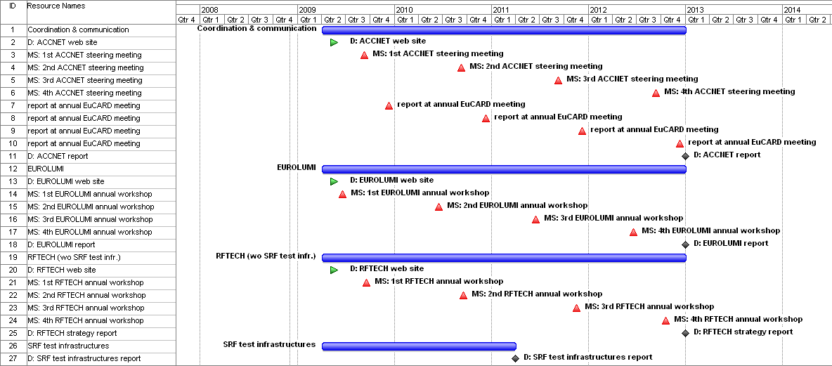
implementation

Slide 46
AccNet expenses
travel & per diem for Mexican CINVESTAV visitors
H. Maury (1 year) and B. Yee (2 months)
travel support & per diem for KEK expert K. Ohmi
travel support for 3 experts R. Cimino, U. Iriso, and G. Franchetti to attend CERN-GSI e-cloud workshop
travel support of expert U. Wienands for HE-LHC’10
support of several workshops (participation in HE-LHC’10, 2nd RFTech workshop, XB-10, LLRF Control for XFEL, MIXDES2011)
travel support for crystal expert (S. Dabagov)
moderate support for LHC-CC10, Crystal-Collimation 2010 and CERN-GSI workshops
travel costs for SC mtgs and EuCARD annual meetings

